Slide 1





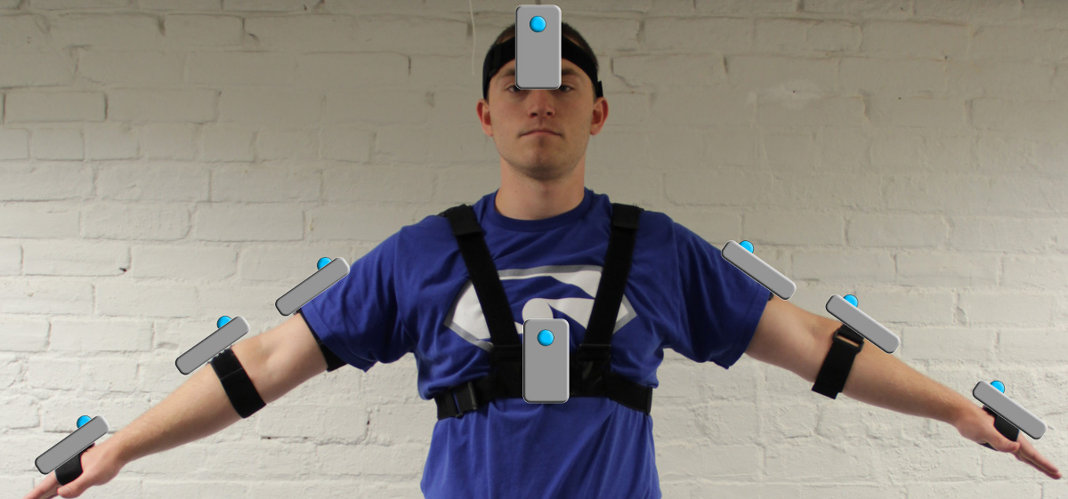
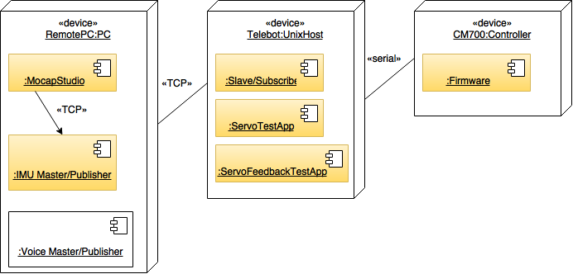
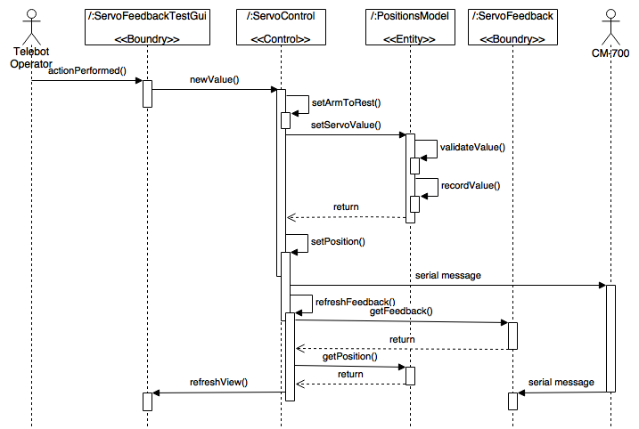
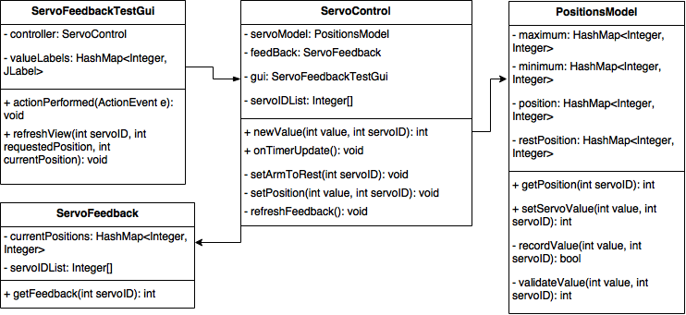
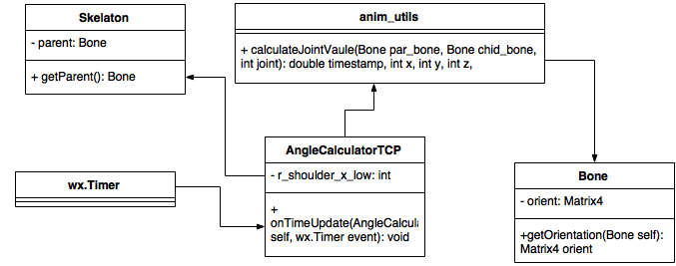
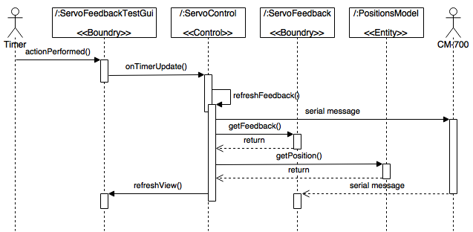
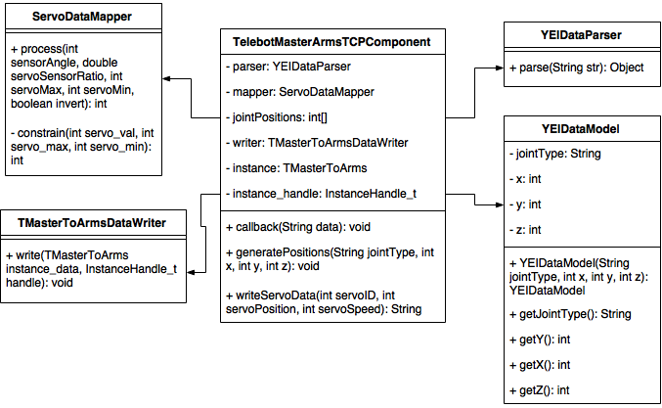
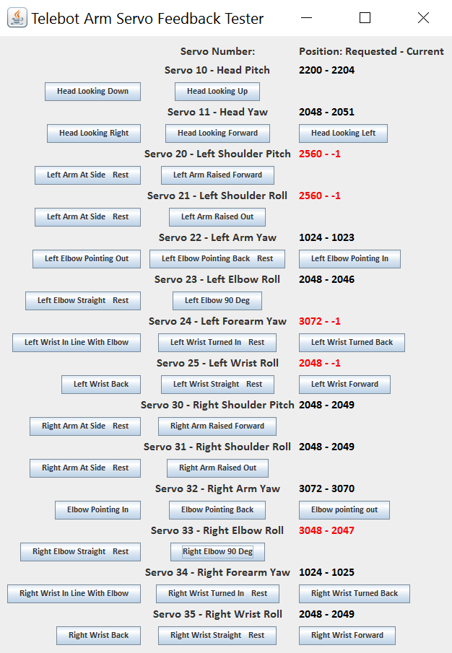
School of Computing & Information Sciences
Senior Project - 2016 - Spring
Robotic Arm
Student: Curtis Cox, Florida International University
Mentor: Nagarajan Prabakar, Florida International University
Instructor: Masoud Sadjadi, Florida International University
Problem
Current System
Requirements
Telebot is a telepresence robot designed to allow disabled law enforcement officers to continue to work with the community, by interacting with them through the body of the robot. The disabled officer would send control commands and speech to the robot from a central location and the robot would send back to the audio and video captured at the scene.
The Telebot project was started by the FIU Discovery Lab in August of 2012 and has been an evolving project for the students in Discovery Lab since. In January of 2016 Shadeh Ferris-Francis and I were tasked with improving the reliability of the systems that allow the Telebot Operator to control the arms and head of Telebot. Dr. Prabakar suggested that we explore the use of quaternion calculations in the motion capture program to improve the fluidity of the resulting movement of the arms. We were further asked to implement a voice control system that would allow the operator to speak simple commands that would result in specific arm configurations.
In order to improve the current system we first had to study and understand the current system. We spent the first few weeks of the project studying Telebot and the software systems that were in place.
The Current Motion Capture System is based on YEI 3-Space Mocap Studio from Yost Labs. This software works in conjunction with YEI 3-Space Sensors which are worn by the operator as shown below:
The new system should:
Utilize the existing YEI 3-Space Sensors. – Done (no change)
Utilize RTI DDS communication to communicate between the remote computer and Telebot. – Done (no change)
Automatically update the sensor angle minimum and maximum values used to calculate angle to servo position value ratios. – Done (I moved the sensor max/min calibration from the IMU Master-Publisher program to Mocap Studio, where the information originates to keep the information current without increasing the communication demands of the system)
Reproduce the movements of the Telebot Operator’s head and arms so that to the casual observer, Telebot’s movements match the Telebot Operator’s movements. – Done (I replaced the sensor x, y, and z rotation angle calculations with XYX, XZX, or YZY fixed-body Euler angle calculations as appropriate for each joint, thus removing the data lost in the unused third axis)
Eliminate the oscillation between two servo positions that would occur when the servo did not receive a change position command. – Done (I tuned the PID feedback settings in the CM-700 Servo Controller’s firmware)
When the Discovery Lab version the program is running, the sensors periodically send a quaternion value representing the 3D rotation that the sensor currently has with respect to it’s calibration orientation. These quaternions are then converted into three vectors. The vectors of two adjacent sensors are compared to determine the rotational difference between the sensors in angles around the x, y and z axis of the sensors (body-fixed coordinates). Two of these three angles are used to calculate the angles that should be adopted by servos on Telebot to reproduce the arm configuration, the third represented data that was lost in the process.
System Design
Object Design
Implementation
Operation of Telebot by motion capture requires four programs spread across three devices. These four programs form a pipe and filter architectural pattern. In the case of the sensor max/min calibration, I took advantage of this fact by moving a filter (sensor calibration) from the IMU Master-Publisher program to Mocap Studio. This allowed us to gain the advantage of the minimum and maximum values staying updated without incurring the additional communication overhead that would have been required to constantly transmit the current values.
The Servo Feedback Test App uses Model-View-Controller architecture
Verification
Screenshots
Summary
Test Case ID: Task798-004 ServoControl newValue method - value too high
Purpose: Test that the ServoControl class newValue method will update the model to reflect the maximum value for the selected servo when a value higher than the valid range for that servo is selected.
Pre-condition:
All servos except servo 25 are at their resting position.
Servo 25 is at 2500.
Input:
servoID: 25
value: 5000
Expected Output:
“<25 3072 0>”
Passed 2/12/2016
Passed 2/26/2016 - (test parameters modified to match new servo min/max values)
Working with the Discovery Lab and Telebot this semester has been a very enjoyable experience. But it was also challenging. At the beginning of this project Telebot’s arms would not operate. My approach to troubleshooting called for a way to test the servos independent of the control program. This led to the creation of the servo test suite and the realization that the CM-700 Servo Controller did not have proper firmware. Rewriting this firmware gave me the opportunity to add feedback functionality to the servo controller. This functionality was used to implement the visual feedback to the operator in the Telebot Arm Servo Feedback App. It also left the door open to implement other programs such as one that will monitor the performance of each servo and predict when one will need to be replaced before it fails.
Dr. Prabakar’s suggestion to look into quaternion calculations led me to the algorithm improvements that I designed for Mocap Studio. Calculating with quaternions rather than vectors has reduced multiplications per joint calculation by more than half, from ~75 to ~32.
By moving the sensor calibration out of the IMU Master/Publisher program and into Mocap Studio, we were able to keep the sensor minimum and maximum values current without incurring additional communication expense.
If you have any additional questions, please feel free to contact me.
Curtis Cox
ccox016@fiu.edu
702-592-7221 cell
public class testServoControl extends TestCase {
private ServoControl controller;
private PositionsModel model;
protected void setUp() throws Exception {
super.setUp();
controller = ServoControl.getSingleton();
model = PositionsModel.getSingleton();
}
protected void tearDown() throws Exception {
super.tearDown();
controller = null;
model = null;
}
public void testNewValue(){
controller.newValue(2500, 25);
assertEquals(2500, model.getPosition(25));
controller.newValue(5000, 25);
assertEquals(MasterArmsConfig.WRIST_ROLL_LEFT_MAX, model.getPosition(25));
controller.newValue(0, 25);
assertEquals(MasterArmsConfig.WRIST_ROLL_LEFT_MIN, model.getPosition(25));
}
}
The Telebot Arm Servo Feedback Tester App Allows the us to control the servos in Telebot’s neck and arms with minimal subsystems. This way we can track down the source of failures. For example, if at least one servo is operational, we know the signal path from the system logic to the servo controller is good, and can eliminate that signal path as the source of error. If a servo moves to one requested position but not it’s counterpart, there may be a disparity between the limits set in the servo and those recorded in the MasterArmsConfig.java file.
Acknowledgement
The material presented in this poster is based upon the work supported by The FIU Discovery Lab. I am thankful to the help that I received from my group member Shadeh Ferris-Francis and the Discovery Lab Telebot Team, Manuel Garcia and Hunter Michko.
Notes:
1

