Slide 1



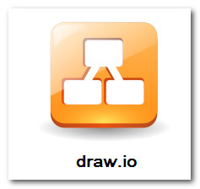



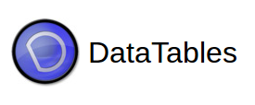

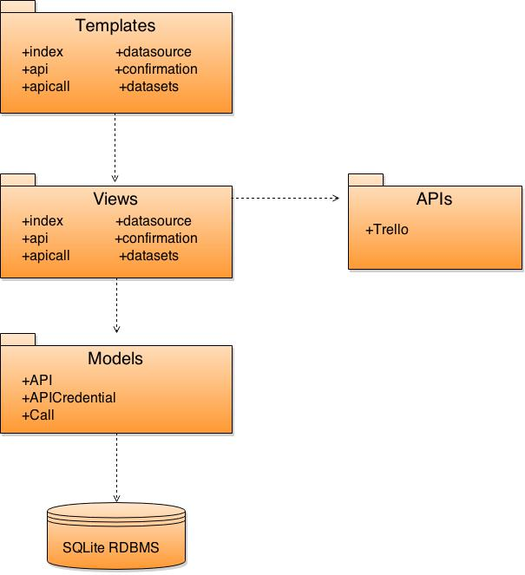
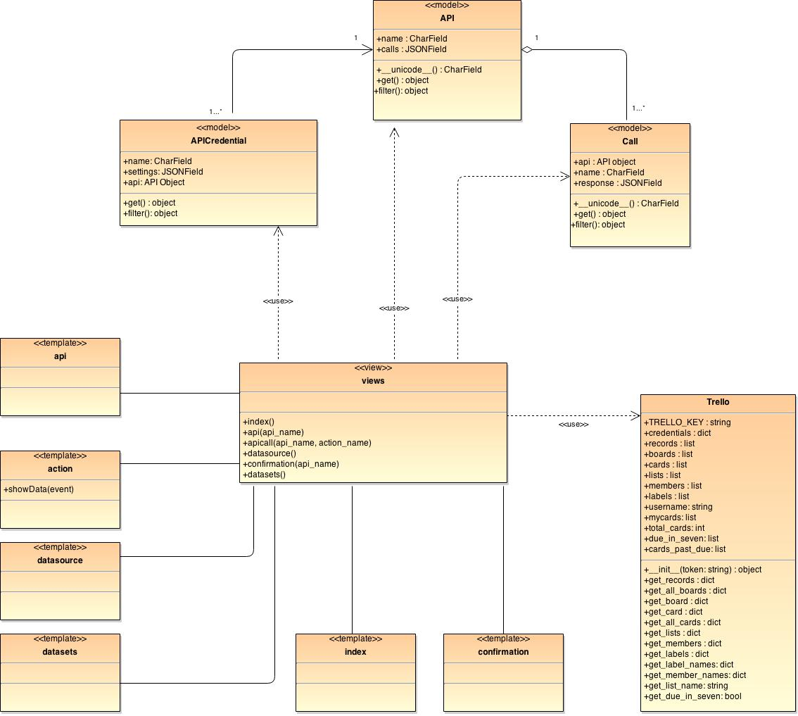
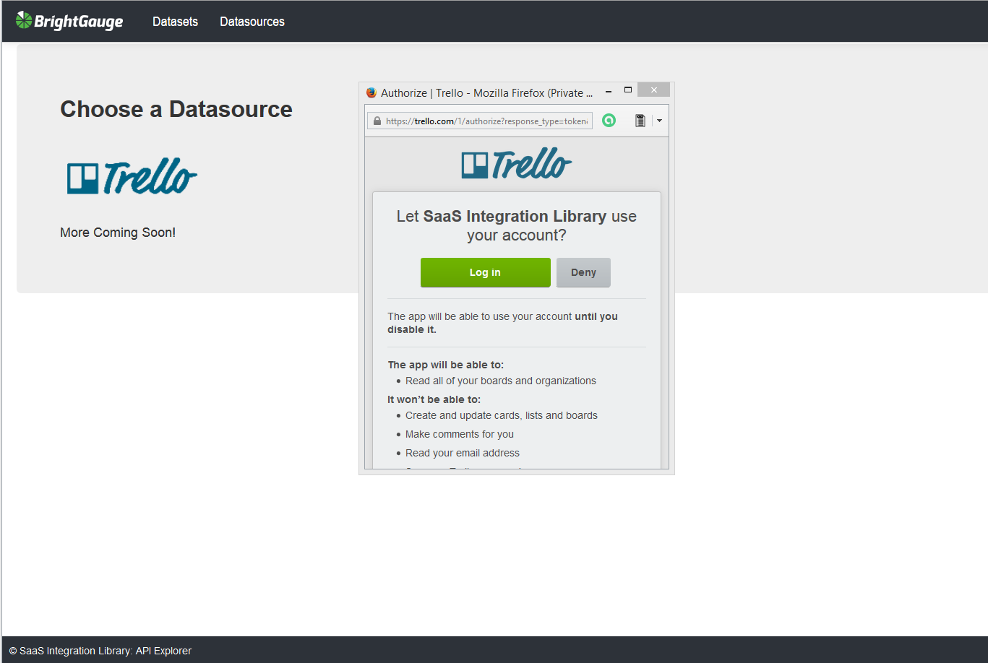
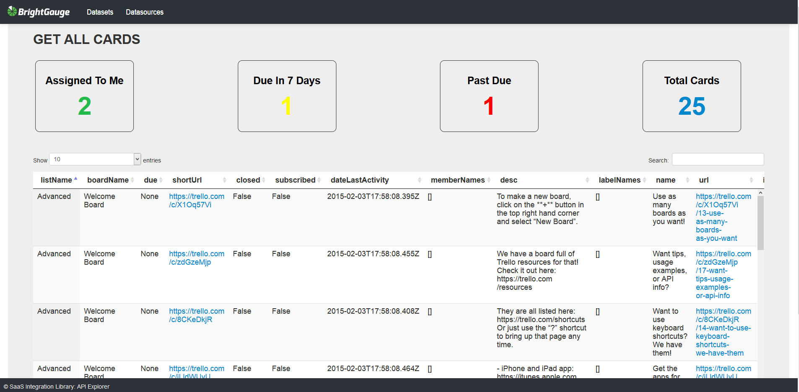
School of Computing & Information Sciences
Senior Project, 2015, Spring
SaaS Integration Library
Student: Adam Merille, Florida International University
Mentor: Brian Dosal, BrightGauge
Instructor: Masoud Sadjadi, Florida International University
Problem
Current System
Requirements
BrightGauge brings business intelligence and data-driven decision making to the IT Service Provider and Managed Service Provider market. A key aspect is being able to integrate with datasources that their clients use and value.
The BrightGauge team would like to be able to pull data from various third-party APIs in order to see if the data would have value to their clients. Their primary target was the Trello project management tool this semester.
BrightGauge does not currently have a datasource testing ground. This application is intended to allow for the exploration of possible new datasources before creating a fully integrated feature into BrightGauge’s main product.
Since the data coming back is not well documented or unknown to the team the data should be retrieved as raw as possible before decisions are made about what aspects should be kept or thrown out.
The system shall enable a user to add a datasource, namely via Trello.
The system shall allow the user to add multiple accounts from the same resource.
The system shall make a calls to get labels, get cards, get lists, get boards, and get members from Trello.
The system shall clean the data before displaying the results in a table format.
The system shall allow for specific filtering with the get cards request into getting the users cards, cards due in 7 days, and cards past due.
System Design
Object Design
Implementation
The web application is built on the Django framework. The Django framework uses a model-view-template design pattern, a variation of model-view-controller where the controller is the framework. Django comes preloaded with SQLite behind the scenes, which was used to store the data.
Using the API provided by Trello, calls are made to retrieve certain data. The retrieved JSON data is then cleaned up and presented in a table format using the DataTables JavaScript library.
Most of the frontend CSS is handled by the Bootstrap CSS framework. Modifications were made where needed.
Verification
Screenshots
Summary
Below is an example of a sunny day test case:
The SaaS Integration Library is a user friendly means to explore data retrieved from API calls. The end focus is geared toward a Trello dashboard as a means to analyze business usage for BrightGauge. The cleanly formatted data is displayed in a table format that is easily readable.
As this is the first version there are some things that would be nice to have in later releases. The integration of Redis for syncing and caching would be a great feature. Also, the system currently has no login nor logout feature. That ability would be useful if the application is used outside the company.
Test Case ID: | SIL_Test1_Sunny_Day
Purpose: | To validate that the addition of a new account from Trello redirects the user to the proper page and adds the required information to the database.
Preconditions: | The user is on the Datasource page of the application.
Inputs: | Select Trello datasource button. Select Login Username: siluser Password: 123456 Select Allow
Expected Output: | The system redirects the user to a confirmation page, lets the user know that the account has been added, displays the username “siluser”, and contains a link to the datasets. The credential information for this account has been added to the database.
Actual Output: | Same as expected.
Acknowledgement
The material presented in this poster is based upon the work supported by Brian Dosal. I am thankful to the help that I received from
Orlando Garcia, Steven Restrepo, and David Small.

