Slide 1



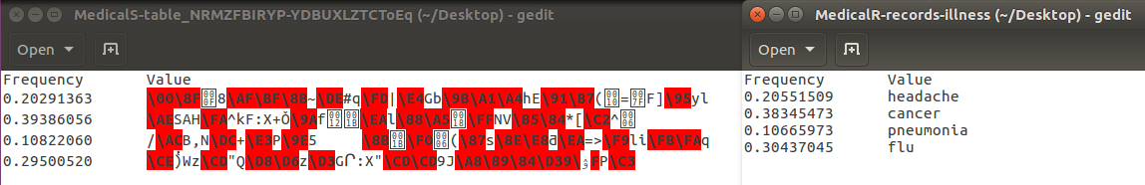
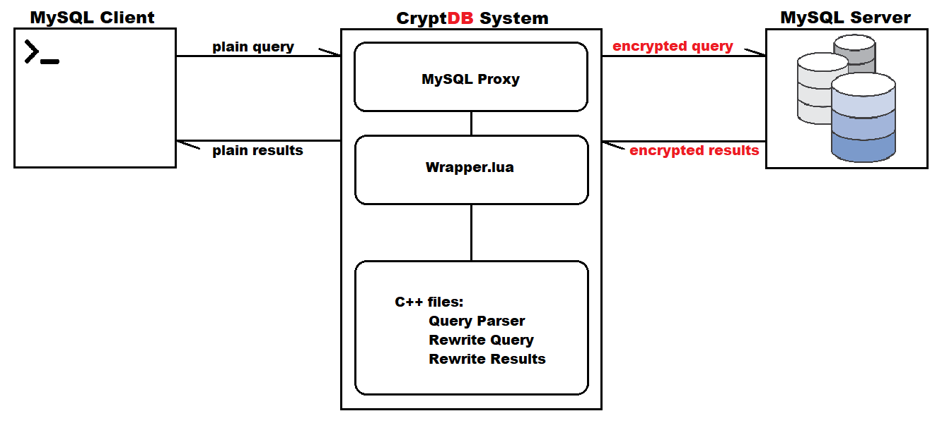
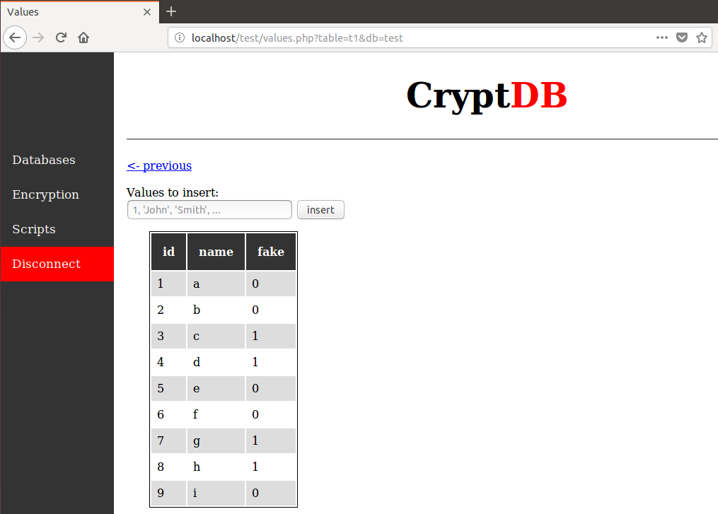
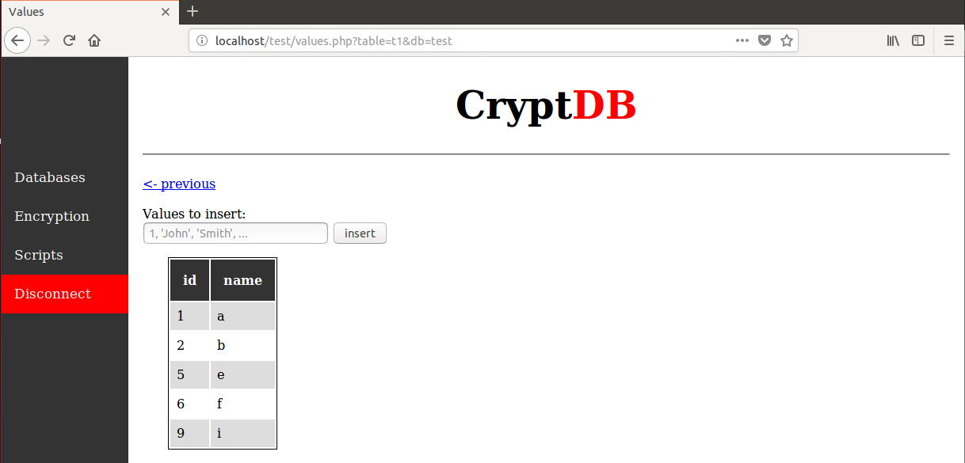
School of Computing & Information Sciences
Senior Project, 2018, Spring
Security Evaluation of Encrypted Databases (SEEDv1.0)
Student: Steven Caceres, Florida International University
Mentor: Mark Finlayson, Florida International University
Professor: Masoud Sadjadi, Florida International University
Problem
As everything continues to shift online, we see an increasing amount of vital information being stored in the cloud, that if compromised, can majorly impact people’s lives. If recent events have shown us anything, it’s that this information needs to be kept more securely.
Solution
Encrypted databases are being designed to allow for encrypted data to be stored in the database, and only decrypt it before reaching the user. Improvements can always be made, and by finding a flaw in the system, we can implement a countermeasure to help increase it’s security.
Current System
Developed at MIT, CryptDB is a proxy database system that leaves current server/client applications unmodified.
It utilizes different layers and methods of encryption to improve security, while also keeping a wide range of queries available to the user.
Requirements
Setup CryptDB according to the guidelines provided
Attempt to attack the system and extract any information that may leak
Attack must be passive, where the database is not altered in any way
Design a countermeasure for the attack without extensively altering the system
The Attack
By analyzing columns that are using deterministic encryption, we are able to calculate the frequency distribution of it’s data
After connecting to the database, all values of a column are queried, and a binary tree is built to keep track of the data, and their frequencies in the column
Knowing the type of database being attacked, an auxiliary set of the same type of data is used to compare and infer the values
Simplified System Design
Countermeasure Design
To counter frequency analysis attacks, fake data can be inserted and removed to keep the frequency distribution uniform
A fake column is inserted on table creation, and allows us to keep track of which data is real or fake
By filtering the result set in the proxy, the encryption layer for the fake column is always kept randomized, and the fake column does not need to be displayed to the user
Implementation
Implementation is done within wrapper.lua since it has access to the plaintext query, and the result set
Before a query is sent to the database by the proxy, the query is parsed, frequencies of data are updated, and the query is altered if it is creating a table
After the database returns the result set to the proxy, it is altered to remove any fake rows, and the fake column
Once the result set has been scrubbed of any fake data, it is passed to the client application to display
Verification
Table values with the fake data and column included in the result set
Summary
Using frequency analysis on deterministically encrypted columns, the frequency distribution of data was obtained, and plaintext values were inferred
System now smooths data frequency by inserting and removing fake data to the tables
Fake data is filtered and omitted from result set before being sent back to the user
Web app created for easier use of the CryptDB system
Table values with fake data and column omitted from the result set
Acknowledgement
The material presented in this poster is based upon the work by Steven Caceres. I am thankful to the help that I received from my group member, Joannier Pinales.
Notes:
1

