Slide 1












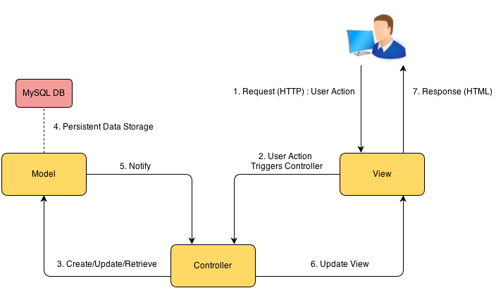
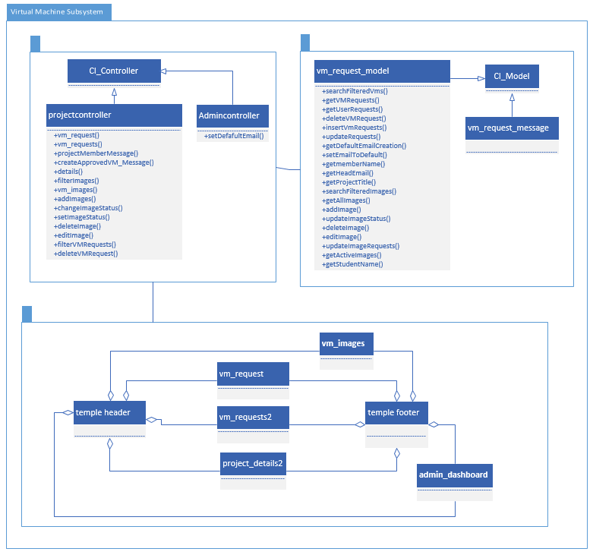
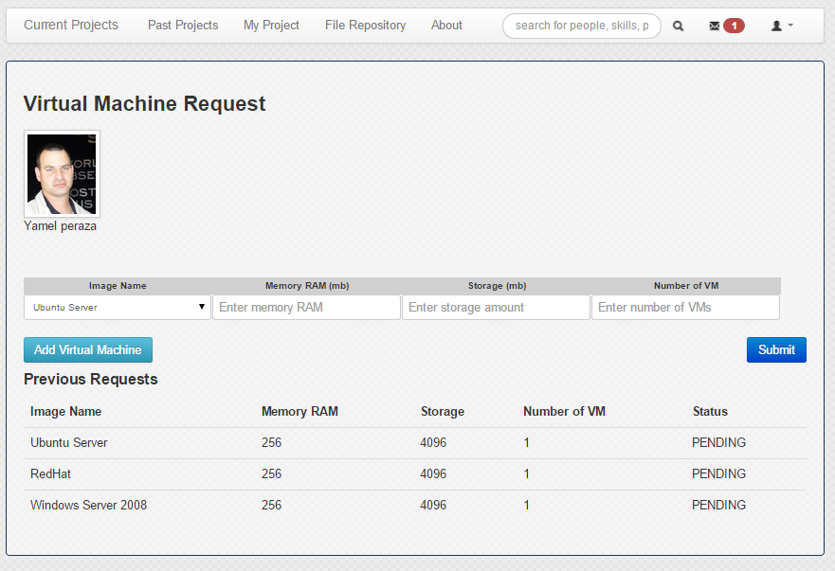
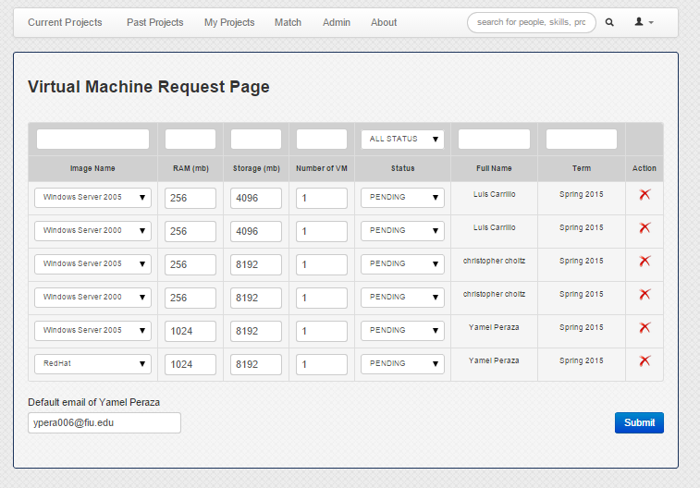
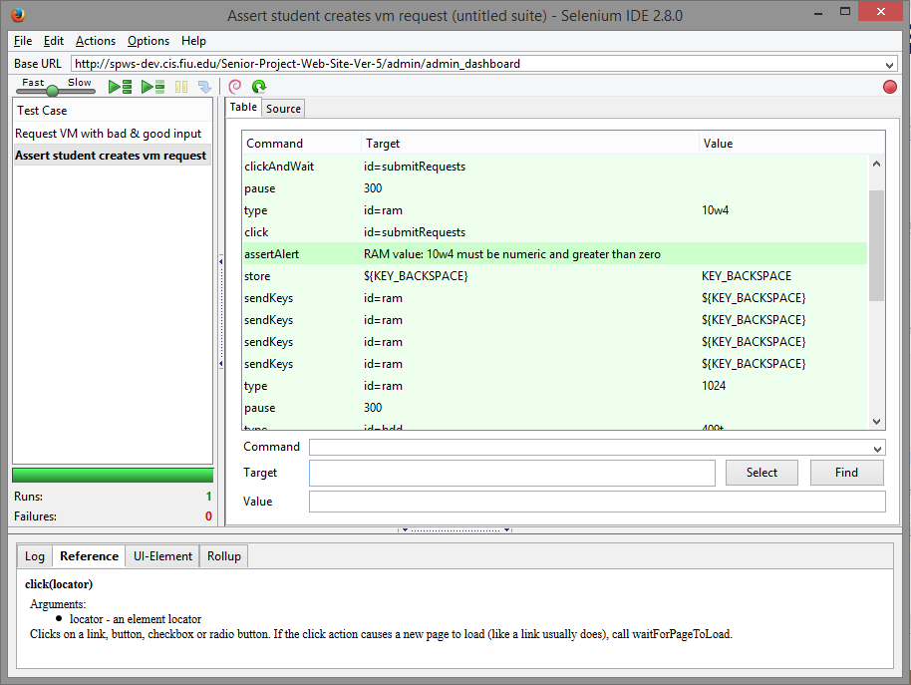
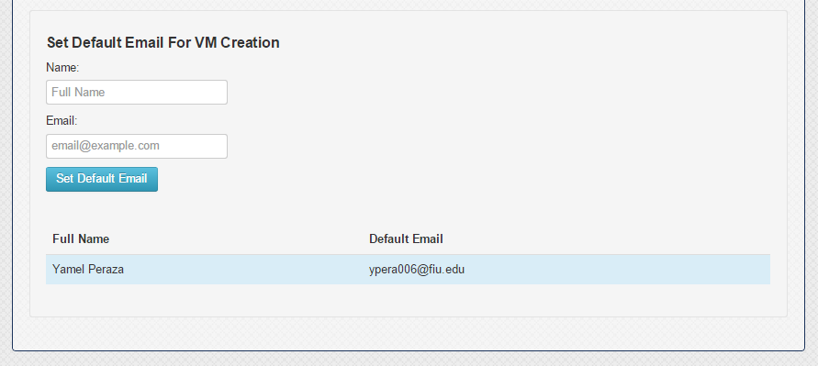
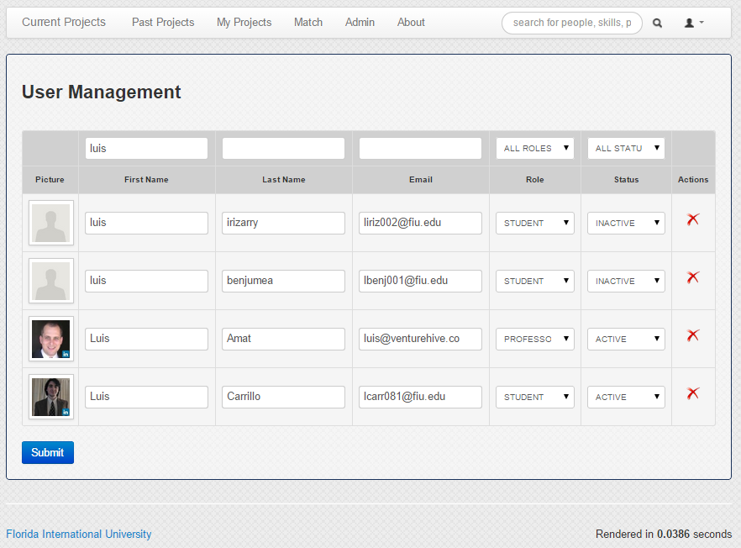
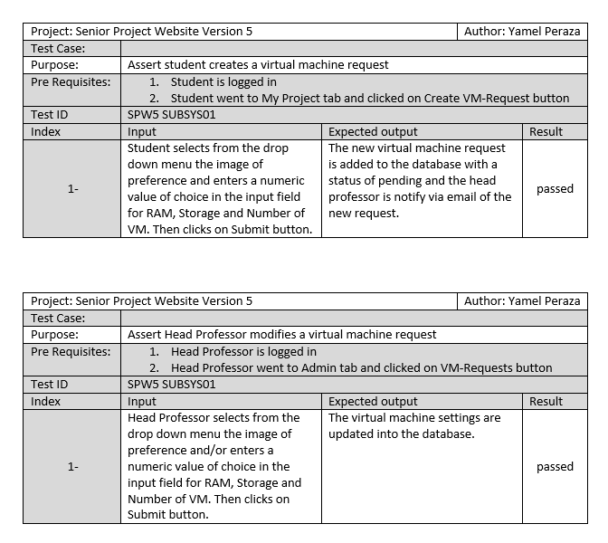
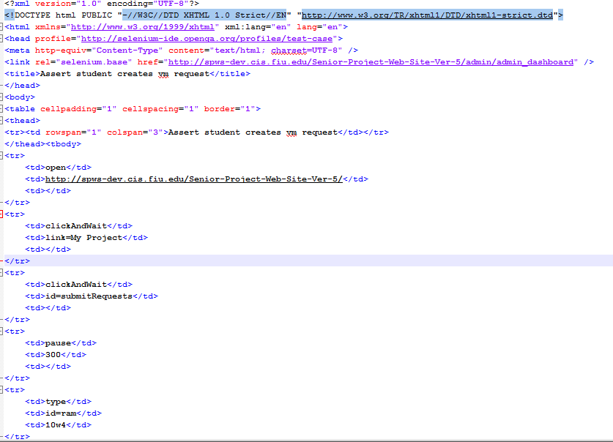
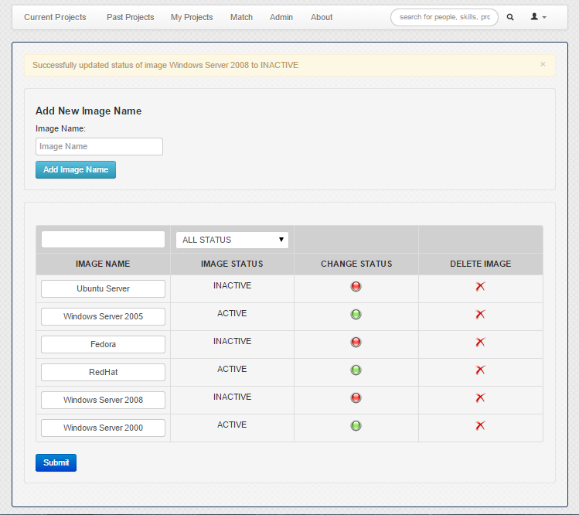
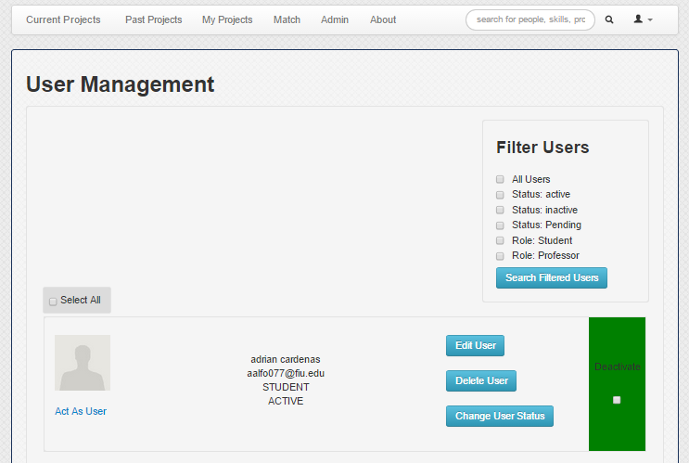
School of Computing & Information Sciences
Senior Project, 2015, Spring
Senior Project Website –Version 5
Student: Yamel Peraza, Florida International University
Mentor: Masoud Sadjadi, Florida International University
Instructor: Masoud Sadjadi, Florida International University
Problem
Current System
Requirements
In Senior Project class students are required to use virtual machines to develop and deploy their applications. The process of requesting virtual environments currently is done manually, given that Senior Project Website does not have the functionality of processing or managing virtual machine requests for its users.
The impractical approach of manually finding each student’s email requesting virtual machines is time-consuming, lacks efficiency and is error prone.
The head professor would like to extend the usability of the system by allowing students to request and customize their virtual machine settings, while letting him manage the students’ requests.
The Senior Project Website does not offer the functionality of requesting virtual machines, nor the means of managing them. A brief description of how this task is currently performed is discussed in this section.
After the projects have been finally assigned to students, the head professor sends an email to all active students in the class requesting their virtual machines’ preferences for the completion of their project. Then each student replies to the head professor’s email with all their needs regarding virtual environments.
Finally, the head professor tracks each individual’s email, gathers all the information, and sends it to the school system admin, who will create the virtual machines for the students.
The system shall allow students to create a virtual machine request.
The system shall allow the head professor to delete a virtual machine request.
The system shall allow the head professor to modify the settings of a virtual machine request.
The system shall allow the head professor to filter the virtual machine requests.
The system shall allow the head professor to notify the school’s system admin about virtual machine creation.
The system shall allow the head professor to add an image name.
The system shall allow the head professor to edit an image.
The system shall allow the head professor to delete an image.
The system shall allow the head professor to filter existing images.
The system shall allow the head professor to change the image status.
System Design
Object Design
Implementation
Widely stable technologies are used on the system.
Senior Project Website is developed based on the MVC architectural pattern using Code Igniter framework, which is very common for the development of web-based applications.
The User Interface layout, tables, buttons, filters, etc were created around Bootstrap, JavaScript and JQuery that allow for a rapid and intuitive development process.
MySQL database is used for persistent data storage. The database was manipulated using phpMyAdmin and MySQL Workbench.
The system was developed using the three-tier and MVC architectural pattern
Verification
Screenshots
Summary
The system was tested using Selenium, which is primarily used for testing purposes in automating web applications. The Selenium IDE was installed into the web browser Mozilla Firefox and test scripts were created to simulate user’s input.
The current system does not provide students with a method for requesting virtual machines. Also, it does not provide the head professor with the means of managing students’ virtual machine requests.
The impractical approach of manually going through the head professor’s email account and finding each students’ email requesting virtual machines, would be time-consuming and error prone.
The solution to this problem was to extend the usability of the system by creating an interactive method that allows students to request virtual machines and lets the Head Professor manage the requests.
Selenium IDE
Snippet of a Selenium script
Acknowledgement
The material presented in this poster is based upon the work supported by Masoud Sadjadi . I am thankful for the help that I received from my group member Jacek Kopczynski. I would also like to thank the previous team that developed SPW, their hard work created a solid structure for great extensibility.

