Slide 1












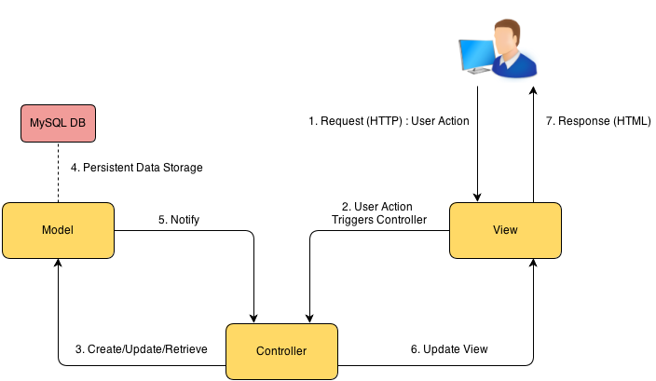
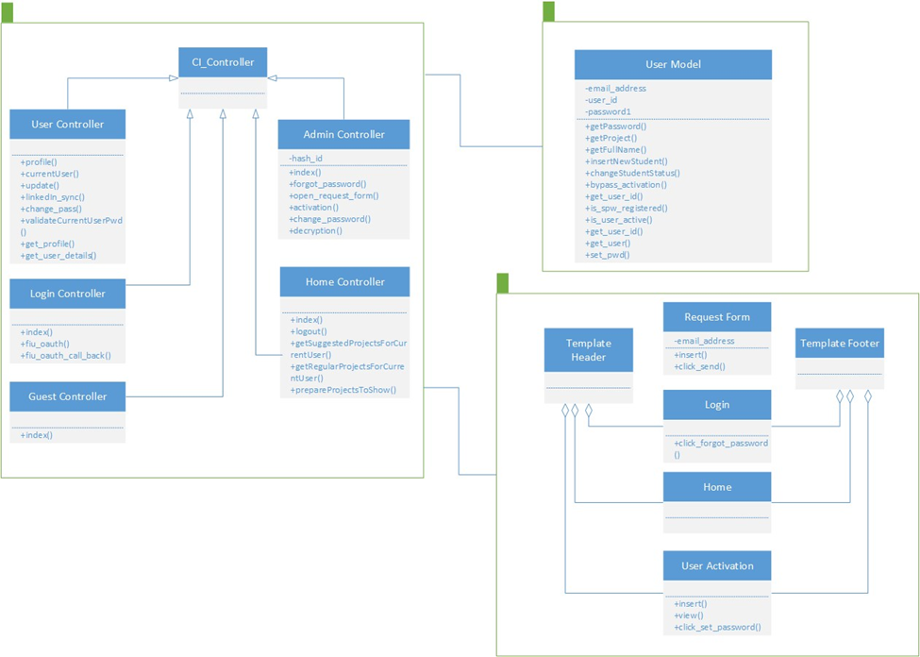
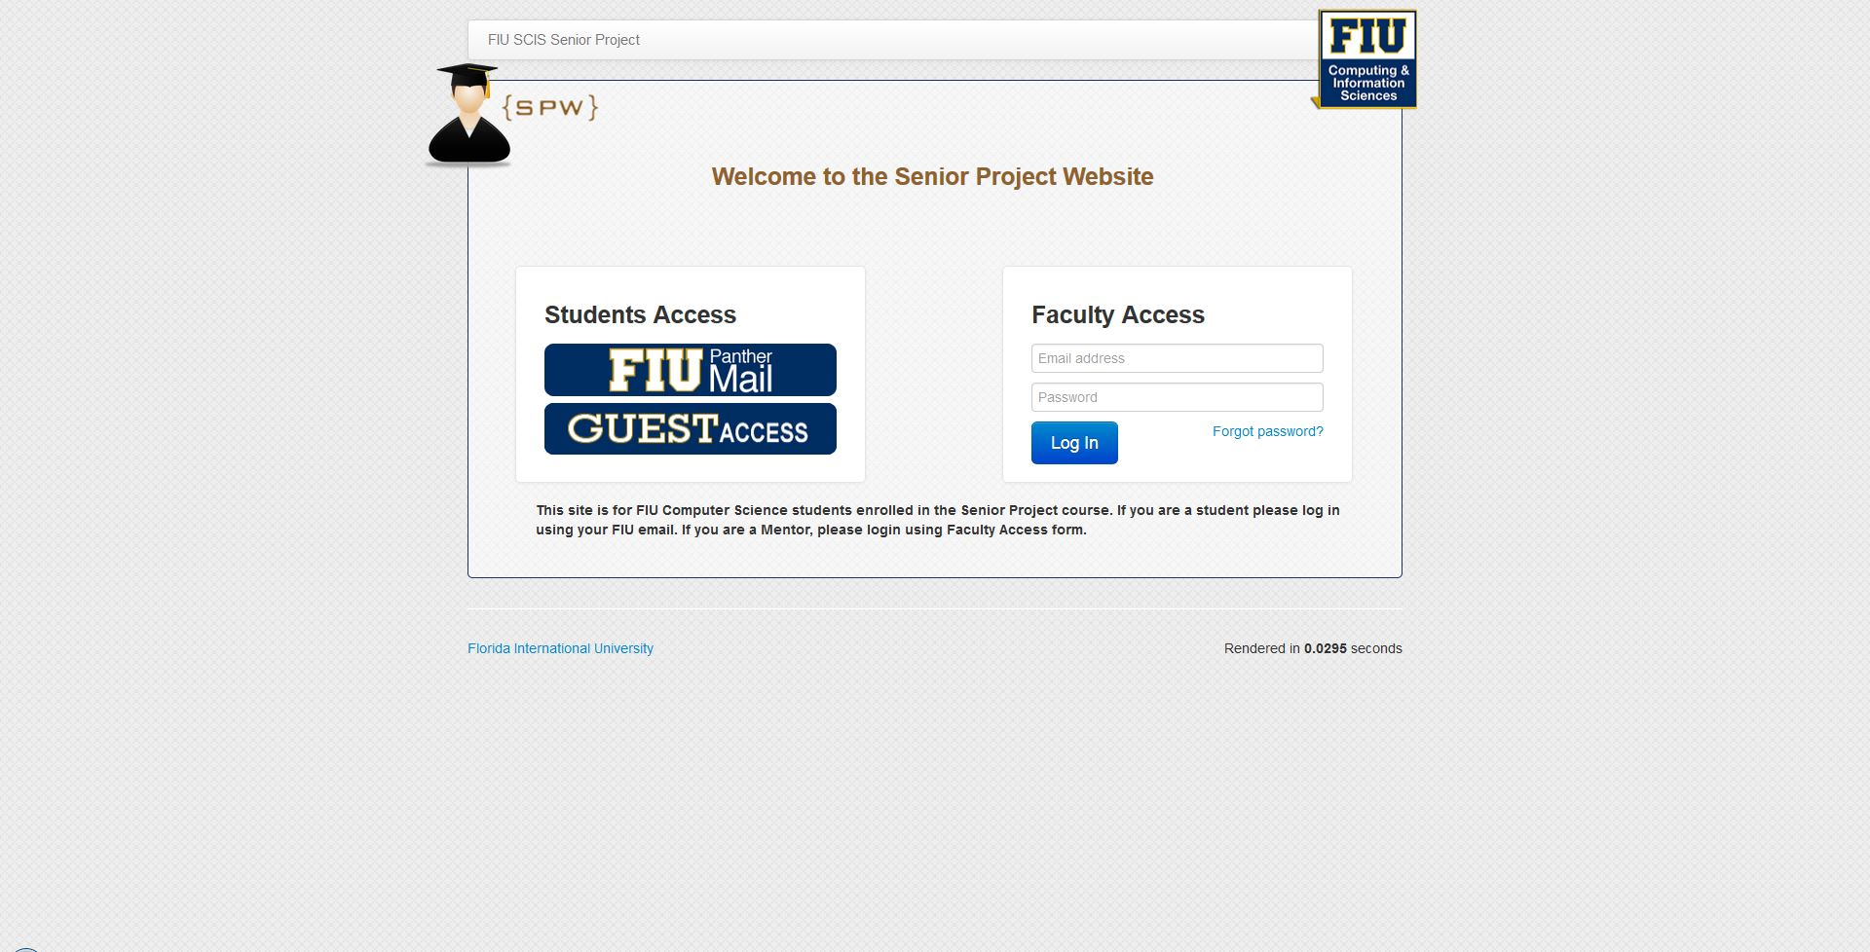
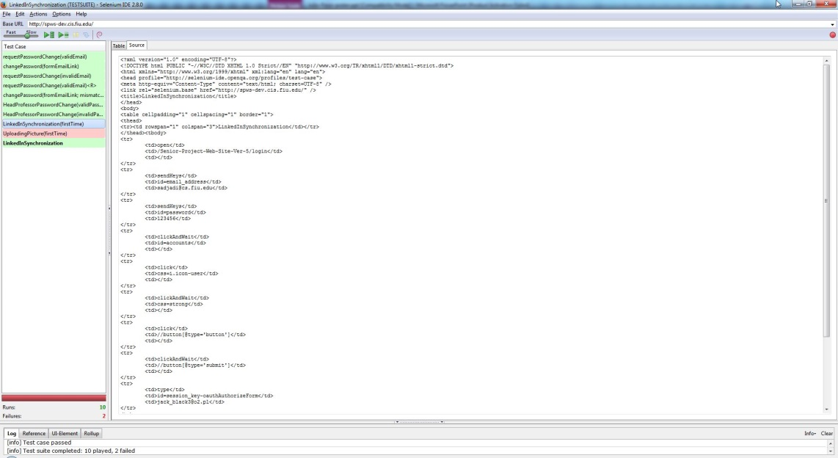
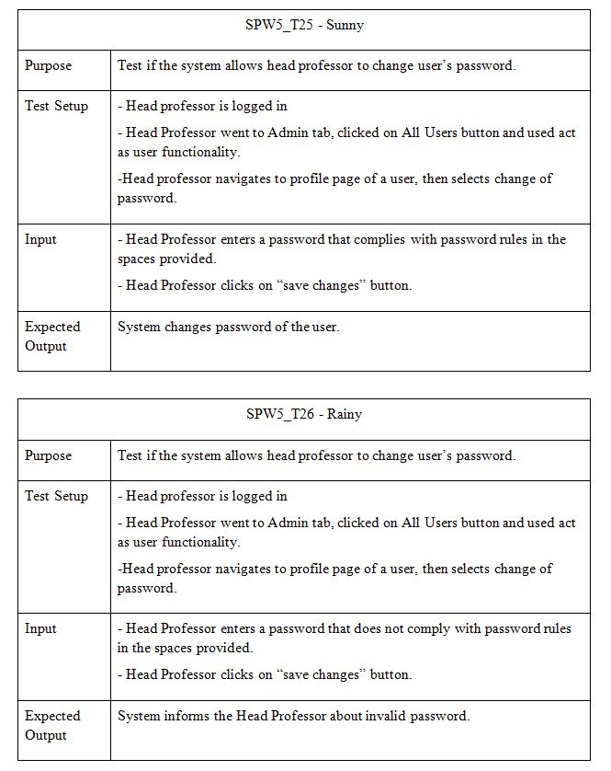
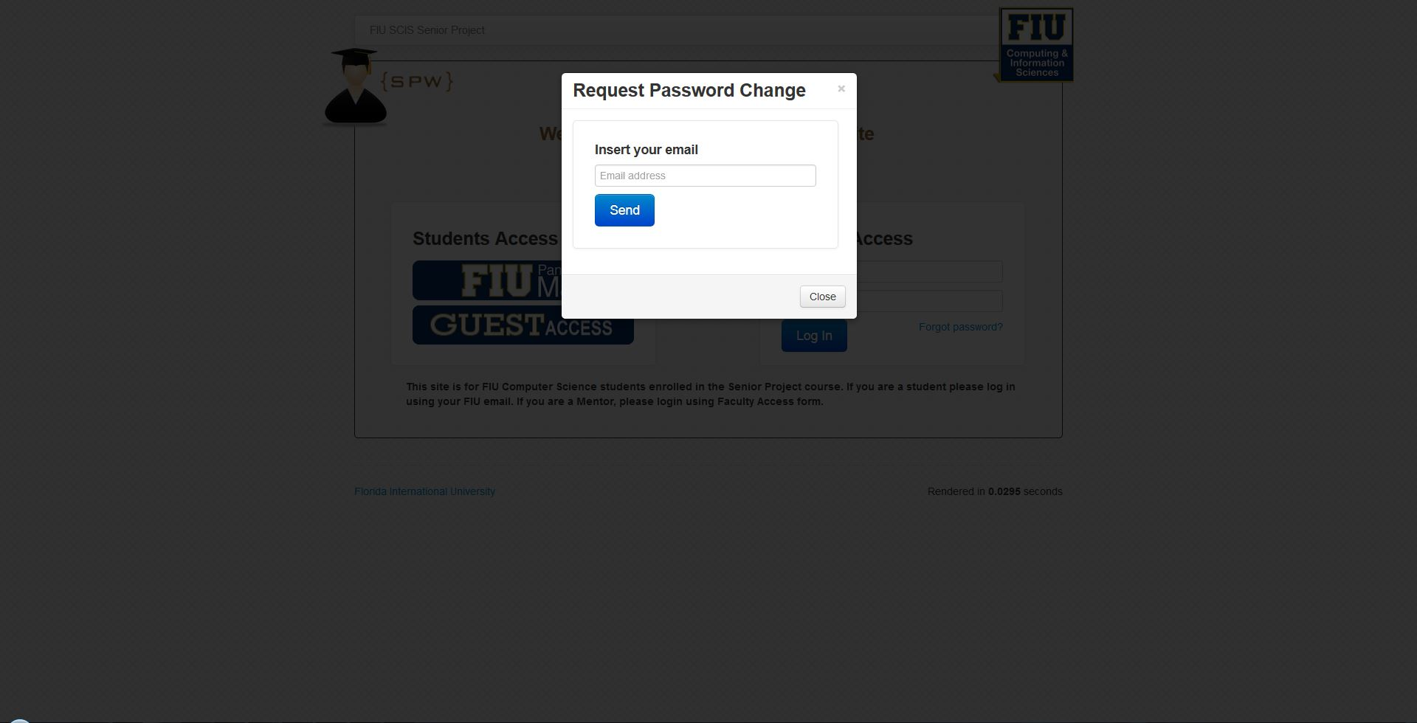
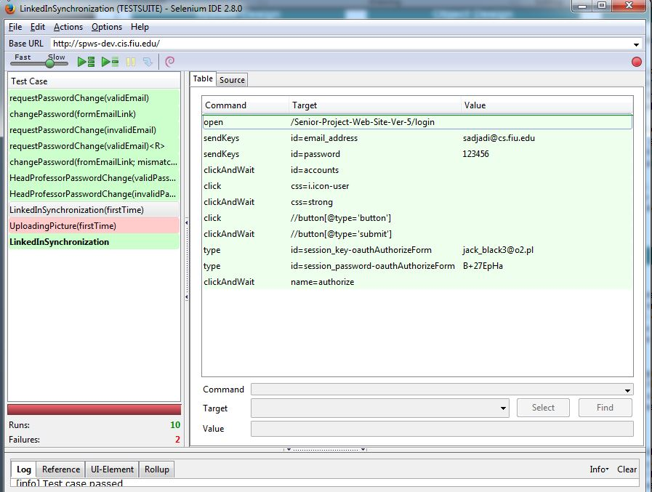
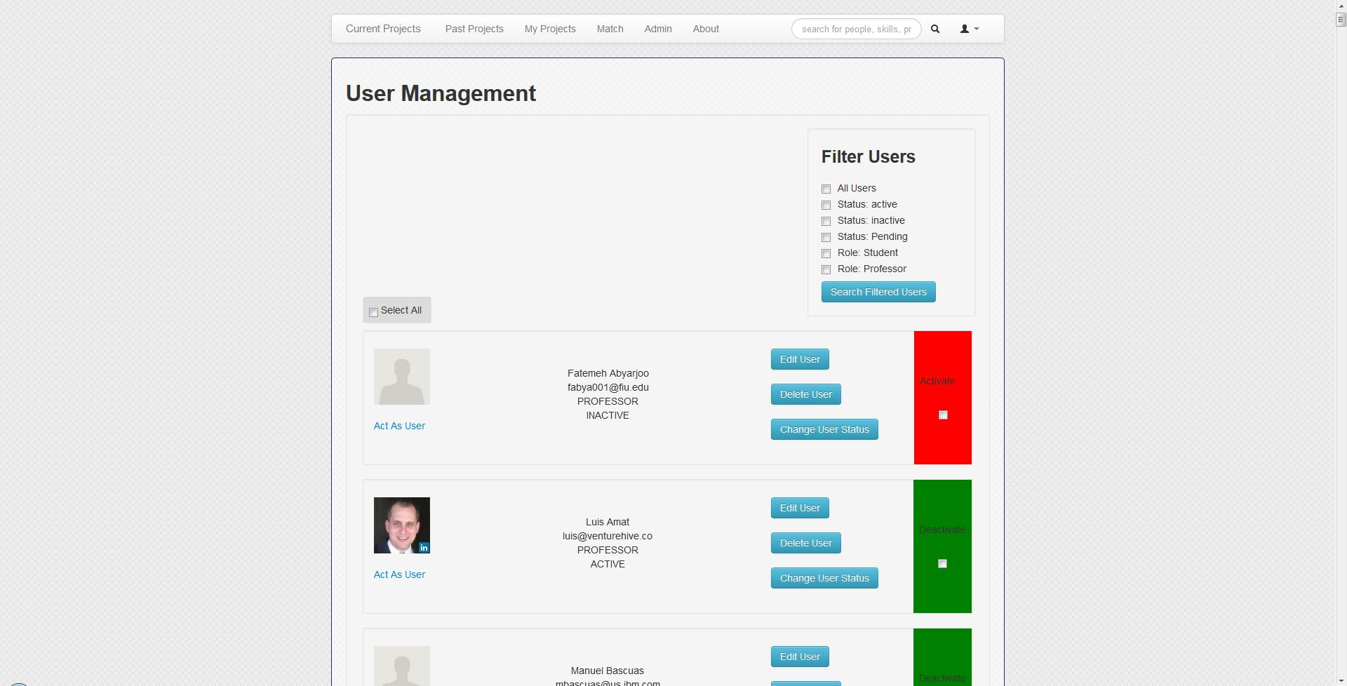
School of Computing & Information Sciences
Senior Project, 2015, Spring
Senior Project Web Site –Version 5
Student: Jacek Kopczynski, Florida International University
Mentor: Masoud Sadjadi, Florida International University
Instructor: Masoud Sadjadi, Florida International University
Problem
Current System
Requirements
The Senior Project Web Site does not offer the functionality for including students with incomplete grade from previous semester, nor the way for changing forgotten passwords. Additionally, it is problematic to set up environment for future versions of the project. Also, there are some deficiencies throughout the system, preventing or limiting its functionality.
Until now to include a student with an incomplete grade, Head Professor needed to disable Restful API, and manually add that student through admin dashboard page. Also, users of the site were not able to change their passwords in a situation where they did not remember it. When a user was not able to log in, they had to contact Head Professor to delete and recreate their account.
Senior Project Web Site was developed with a goal of providing senior project class with a tool that would ease the management for the professor in charge, facilitate the process of assembling a team, and choose projects for students; also, allow product owners to propose their projects to be completed.
Senior project web site has an intuitive graphical user interface, a convenient authentication system and matchmaking system that facilitates the process of choosing projects and assembling development teams. In order to make the site easy to manage for the faculty, it was developed with PHP using the Model-View-Controller architectural model.
Provide functionality allowing Head Professor to change passwords of users when in impersonation mode.
Provide functionality allowing users to change their forgotten passwords,
Fix functionality of impersonating users, LinkedIn synchronization, students' list in edit project view and select all users option.
Provide functionality to create accounts for students with an incomplete grade in senior project class.
Allow REST API to work with custom lists of students,
Improve picture uploading process for spws accounts.
Allow links in the code to be created dynamically, with the goal of facilitating future development of the site.
Allow user account activation and request password change to use expirable--one use--tokens.
System Design
Object Design
Implementation
Widely stable technologies are used on the system.
Senior Project Website is developed based on the MVC architectural pattern using Code Igniter framework, which is very common for the development of web-based applications.
The User Interface layout, tables, buttons, filters, etc were created around Bootstrap, JavaScript and JQuery that allow for a rapid and intuitive development process.
MySQL database is used for persistent data storage. The database was manipulated using phpMyAdmin and MySQL Workbench.
The system was developed using the three-tier and MVC architectural pattern
Verification
Screenshots
Summary
The system was tested using Selenium, which is primarily used for testing purposes in automating web applications. The Selenium IDE was installed into the web browser Mozilla Firefox and test scripts were created to simulate user’s input.
Changes in REST API and site allow for adding students with incomplete grades from previous semesters.
New functionality of changing forgotten passwords alleviates the problem of users not being able to access their accounts.
Changes in code facilitate future development of the project.
Fixes to deficiencies limiting the functionality of the system allow for better user experience.
Acknowledgement
The material presented in this poster is based upon the work supported by Masoud Sadjadi . I am thankful for the help that I received from my group member Yamel Peraza. I would also like to thank the previous team that developed SPWS, their hard work created a solid structure for great extensibility.

