Slide 1
HyperDesk 1.0
Installation Guide
Daniel Alvarez
Rachelle Tobkes

Slide 2
Requirements
NodeJS
MongoDB
IDE or Text Editor
Clone repository to start working on project
Sass Transpiler (Compass or other)
SourceTree (optional)

Slide 3
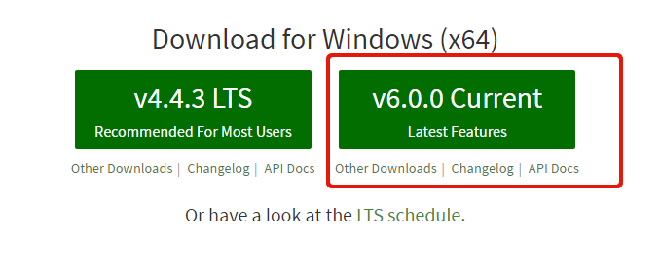
Installing Node
Visit www.nodejs.org
Install latest version according to your machine
After installation, make sure you have node and npm in your path by opening a terminal and typing: node --version and npm -version
If they’re in your path you will see the versions you installed.

Slide 4
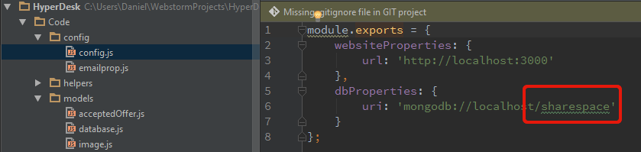
Mongodb installation
Visit www.mongodb.org -> Select download
Choose your operating system and download the appropriate one
Once done installing, you can verify installation by opening a terminal and running the command ‘mongod’ to start the mongodb server, then run ‘mongo’ in a separate terminal to connect to the mongodb server and view your database
To create a new database just type ‘use hyperdesk’ and it will create the new database.
Whatever you name your database, change the name in the config file to match

Slide 5
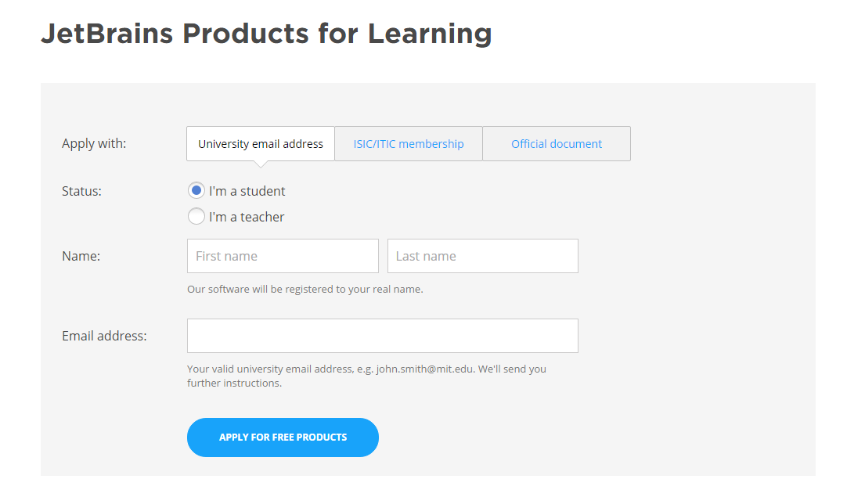
Webstorm installation
Visit www.jetbrains.com/webstorm/ and download the latest version.
Visit www.jetbrains.com/student/ and sign up using your FIU e-mail to get the free one year student license.

Slide 6
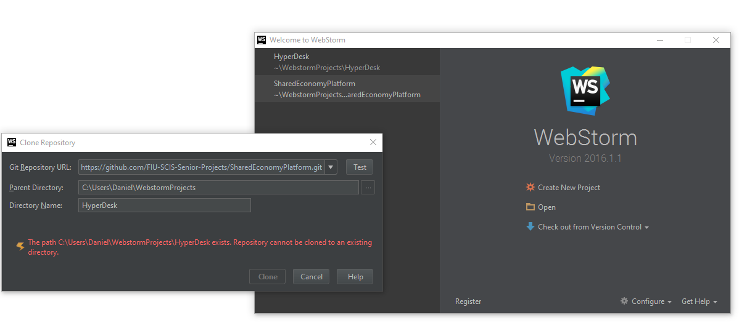
Cloning repository
To begin working on the project, open Webstorm and select ‘Checkout from Version Control’ -> select ‘github’. Then enter the github repository link and change the directory name to whatever you want.

Slide 7
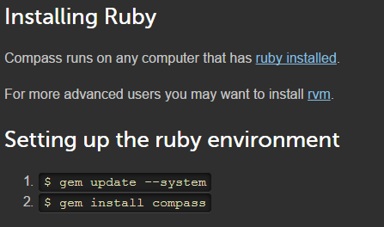
Compass installation
Visit www.compass-style.org/install/ and follow the instructions to install compass on your machine. Remember to first install ruby
Note: we are using CSS based syntax, NOT the outdated indentation syntax
Visit https://confluence.jetbrains.com/display/WI/Using+Compass to configure compass with webstorm.
Note: we’ve already provided you with a config.rb file to use with compass so you don’t have to create it.
Note: When you set it up in webstorm, make sure to select style.scss as the file to watch and transpile, rather than selecting the entire sass folder to watch.

Slide 8
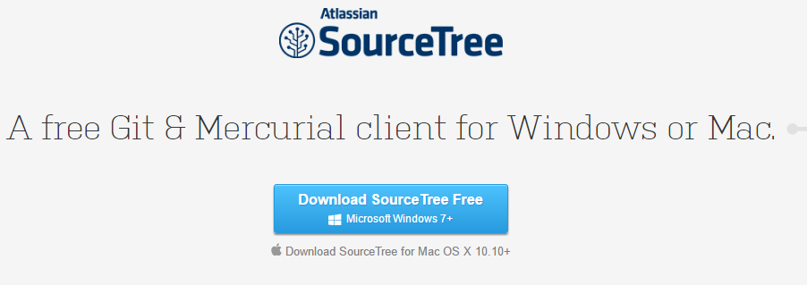
Sourcetree installation
We recommend using sourcetree because it is more robust than the built in version control system in webstorm.
Visit https://www.sourcetreeapp.com/ and download the latest version

