Slide 1









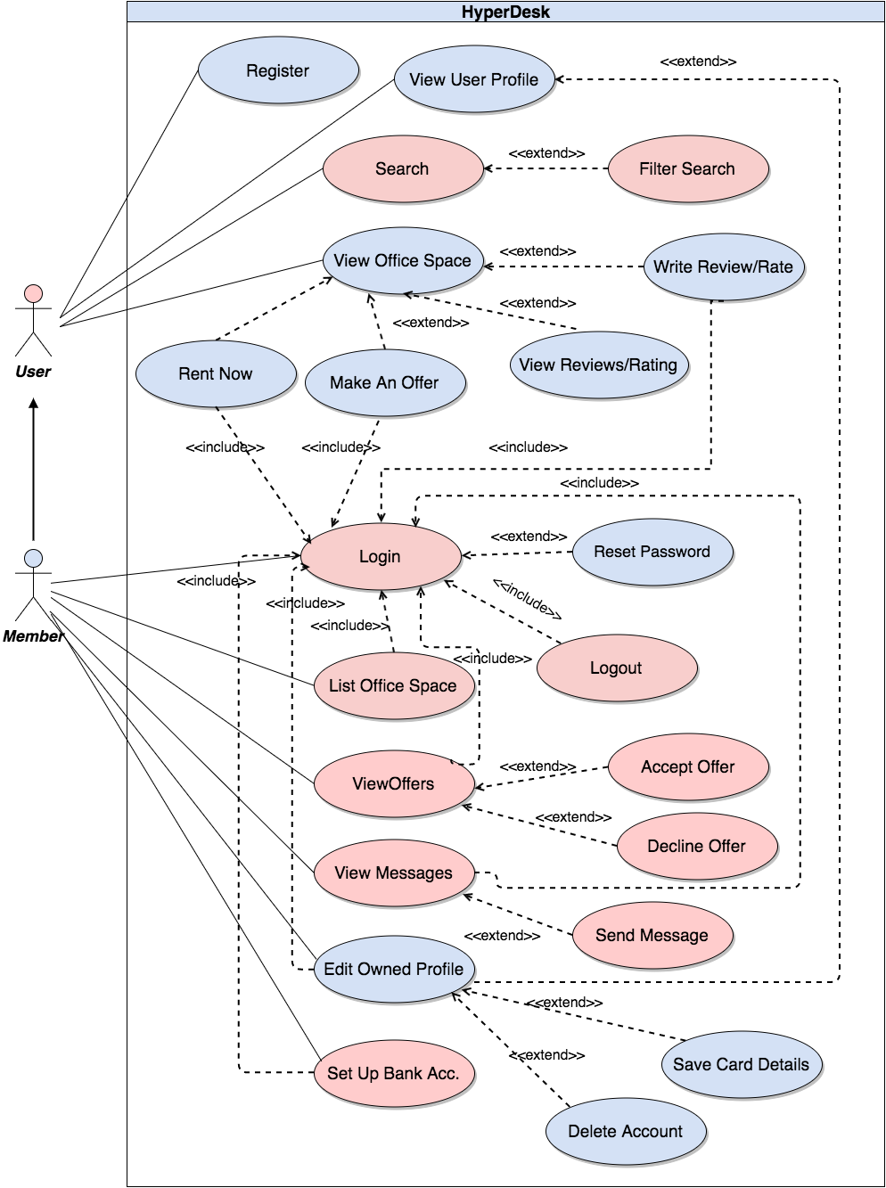
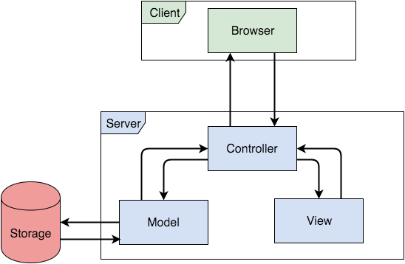
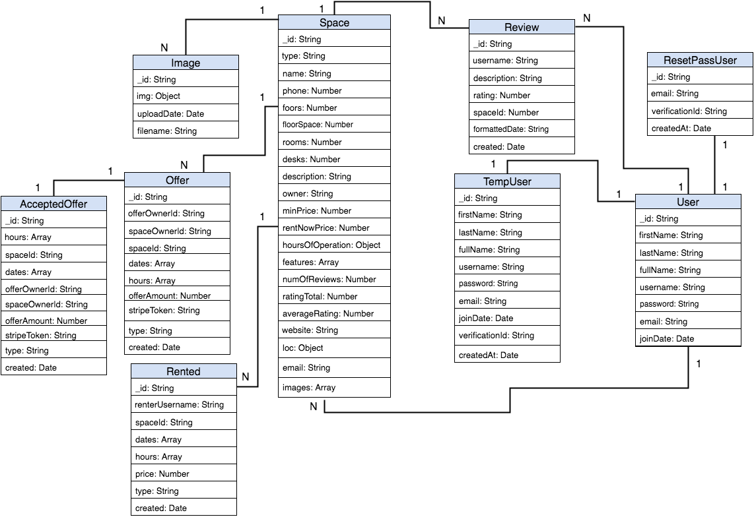
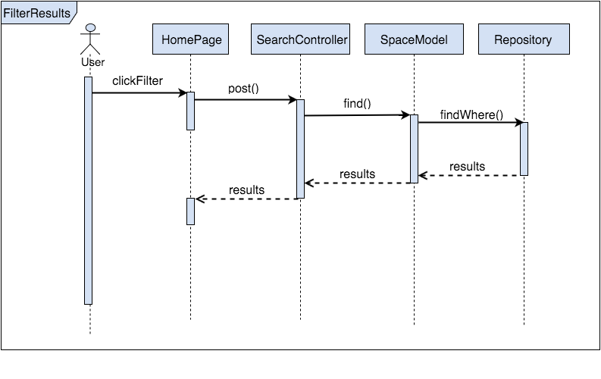
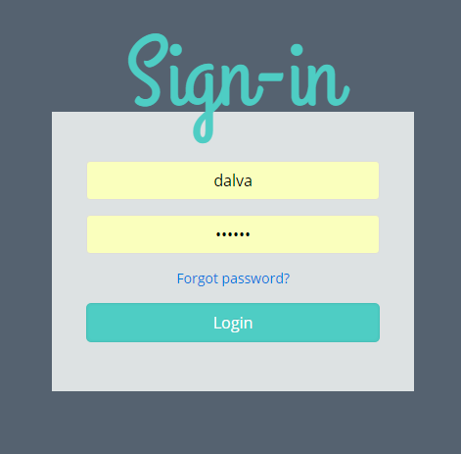
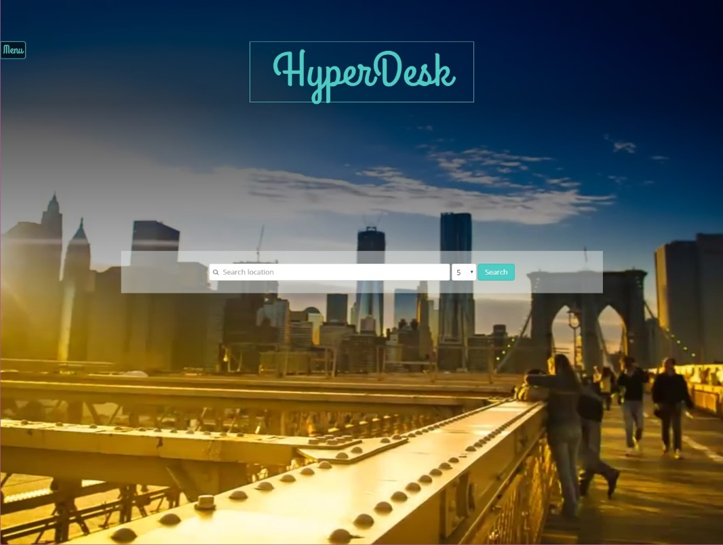
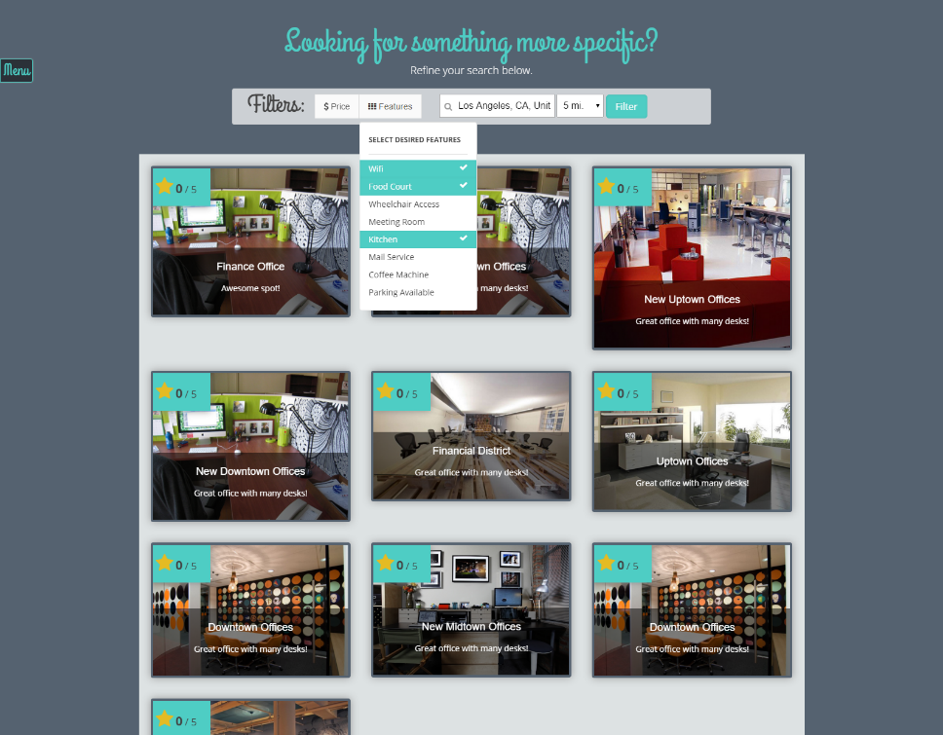
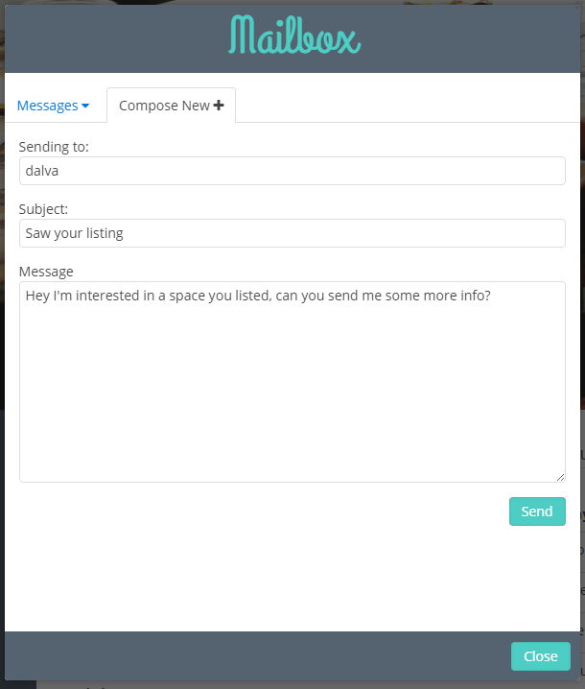

Senior Project, 2016, Spring
HyperDesk 1.0
Student: Daniel Alvarez, Florida International University
Mentor: Pia Celestino, Crea7ive CEO
Instructor: Masoud Sadjadi, Florida International University
Problem
Current System
Requirements
According to a 2014 survey commissioned by Freelancers Union, more than 53 million Americans are doing freelance work. Many of these individuals are working from home without a professional space to meet potential clients in or to conduct efficient work.
Similarly, many office buildings in populated work hubs are left with unfilled offices or desks, causing owners to lose potential earnings.
Few solutions exist to consolidate these two dilemmas, providing HyperDesk a unique opportunity to fill this niche.
There are no previous implementations of HyperDesk, and as such, this system was designed and built from the ground up.
Similar systems exist, such as Sharedesk, but provide limited functionality in terms of user to user communication and listing/accepting offers.
Class Design
All of the depicted use cases are required. The system has two actors: User and Member. Member extends User and inherits all of its use cases.
System Design
This diagrams depicts our minimal class diagram and illustrates the relationships between the three layers of our architectural pattern.
Implementation
This system uses the well known backend-MVC architectural pattern. Express uses Handlebars templating to render Views in a NodeJS server. These views are then sent as an HTTP Response to the client which is in turn rendered by the browser.
ER diagram showing the relationships in persistent storage between our models.
This sequence diagram depicts the sending of a message from one user to another.
Verification
Screenshots
Selenium WebDriver and Manual testing were used to verify our system.
Login Page
Home Page
Test Case ID: HyperDesk_0016-1 | (Sunny Day)
Purpose | To test the functionality when the user searches by location, and then selects a filter.
Preconditions | The user should have access to the application The database needs to properly bind to the application and be accessible to the web services. The user should be on the homepage.
Input | Search: Los Angeles Click: Price Filter Click $50
Expected Output | The system first displays all offices in the Los Angeles area. Then, updates the search result list and only displays office spaces that cost under $50 per day when the filter is chosen.
This diagram shows a user filtering his/her search results. The model queries the database based on the parameters sent to the controller in the post request.
Search Results Page
User Mailbox Modal
Summary
HyperDesk is a platform that connects freelancers or individuals looking for a working space with available locations at prices they can afford.
Individuals listing their available work spaces can set their starting prices and accept/decline offers made to by interested members.
Some of my contributions were:
Backend code for session persistence
Password encryption
Integrating our Database and our models
Logic and front end design for sending/receiving messages and accepting/declining potential offers.
Backend and frontend for listing new office spaces
Uploading and storing images
Google maps integration
Other..
Test Case ID: HyperDesk_0016-3 | (Rainy Day)
Purpose | To test the functionality when the user searches a nonexistent location and then chooses a filter.
Preconditions | The user should have access to the application The database needs to properly bind to the application and be accessible to the web services The user should be on search results page.
Input | Search: hfksksjd
Expected Output | The search results are empty.
New Listing Page - Images
Acknowledgement
The material presented in this poster is based upon the work supported by Pia Celestino. I am thankful to the help that I received from my group member Rachelle Tobkes.
Summary
Platform for listing/renting office spaces.
Unlike existing systems, users have the freedom of naming their own price for an office space.
Listers can choose which offer to accept.

