Slide 1








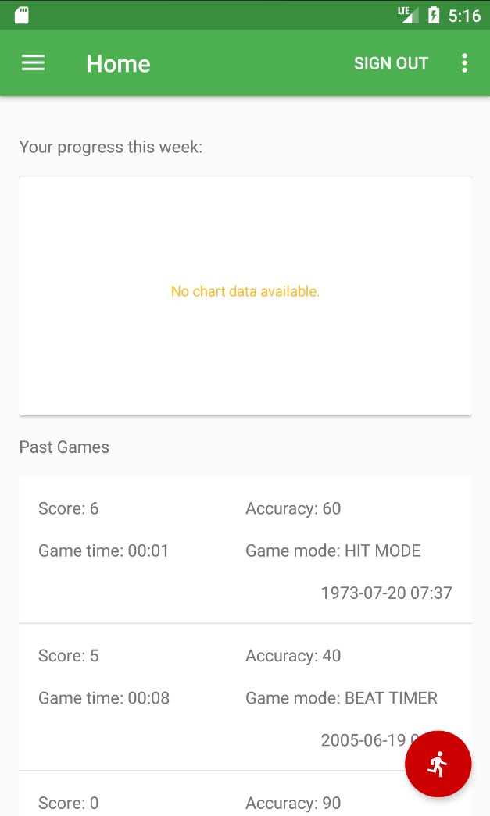
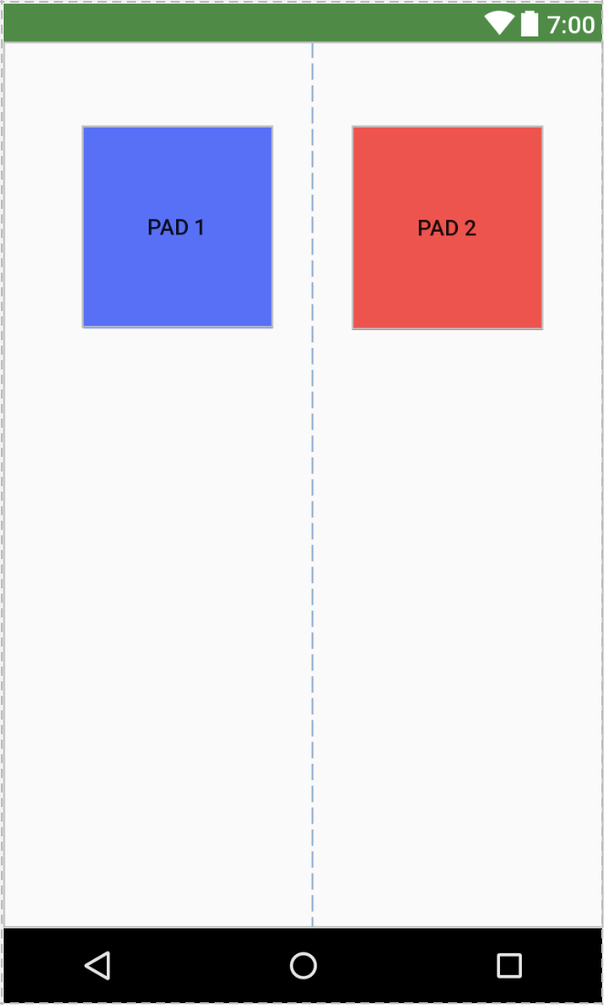
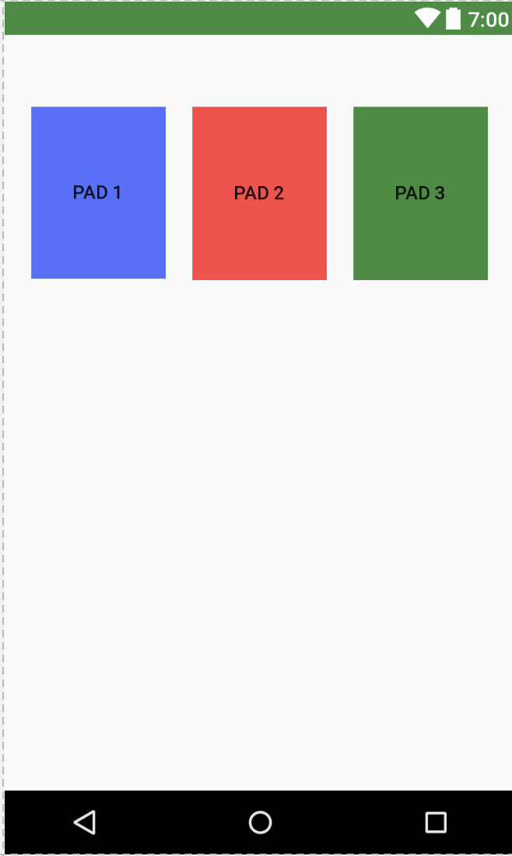
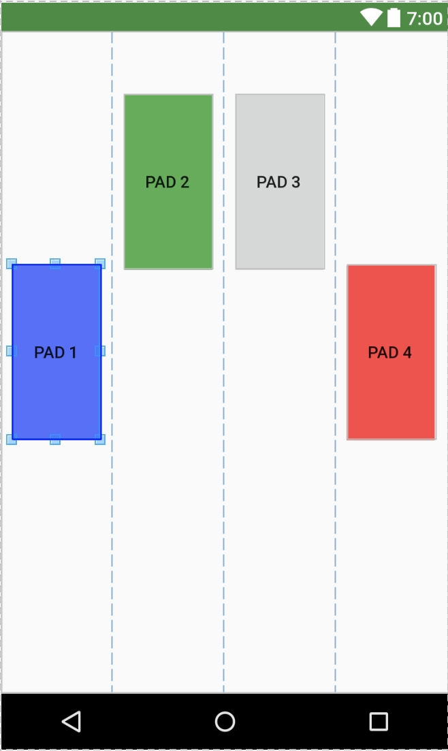
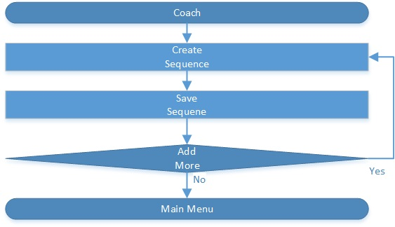
School of Computing & Information Sciences
VIP, 2017, Summer
Skill Court 8.0
Student: Richard Rodriguez, Florida International University
Mentor: Guðmundur Traustason, Founder and CEO at SkillCourt
Instructor: Masoud Sadjadi, Florida International University
Problem
Current System
Solution
Soccer is one of the oldest sports in the world. Players are regularly trained by a coach, but a coach cannot attend to all the players at the same time. SkillCourt solves this problem by providing players with sequences; it provides coaches with the statistics on the players’ performances.
SkillCourt has many features built in, but it currently does not have a way to alert players that a game is about to start. The current implementation lacks a way for the coaches to create predetermined sequences which can be used by players to train their skills in the court.
The new version of SkillCourt has been implemented to provide an alert to let the player know that a game is about to start. It implements pre-determined sequences, which can be created by the coaches so players can use them to train and improve their skills.
Screenshots
Figure 1 Sound plays when red man is tapped.
Figure 2 Predetermined sequence with 2 pads.
Figure 3 Predetermined sequence with 3 pads.
Figure 4 Predetermined sequence with 4 pads.
Requirements
System Design
Implementation
As a user I would like to hear an audible sound when a game starts and when a game ends so that the user can pay attention to the game.
As a user I want to be able to set-up a predetermined sequence to be used in game play, so that other users can use it as a template.
As a manufacturer I want to cut costs of my hardware and have a more responsive system in order to have a more affordable and reliable product.
SkillCourt is an app designed in Android Studio, which uses Java to design and compile applications. It also makes use of libraries provided by Arduino, and Raspberry Pi to connect the external hardware. Through the use of Intel’s HAXM utility, we are able to emulate the application visually. Android Studio allows the programmer to compile the app and transfer it to an Android device. This allow the programmer to complete the software with the Arduino and Raspberry Pi.
The SkillCourt app is a native Android app written Java using the Android Studio IDE.
SkillCourt uses the Google FireBase as its primary storage.
External hardware includes Arduino and Raspberry Pi.
Emulation was done using Intel HAXM (Hardware Accelerated Execution Manager).
Verification
Object Design
Summary
Unit testing was done throughout the development cycle to reduce future defects.
Black box testing was used to ensure that the actual results matched the expected results.
Audio/Visual testing was also performed via human interaction for the audible portion.
SkillCourt is a creative app that assist coaches by allowing them to monitor several players at the same time. Coaches can improve a player’s performance by providing specific sequences to help the players reach the next level. It alerts players when a game is about to start and coaches can monitor the players’ performance via the statistics.
Acknowledgement
The material presented in this poster is based upon the work supported by Felix Garcia and Michael Thompson. I am thankful to the help that I received from my group member David Schiumerini.
Notes:
1

