Slide 1







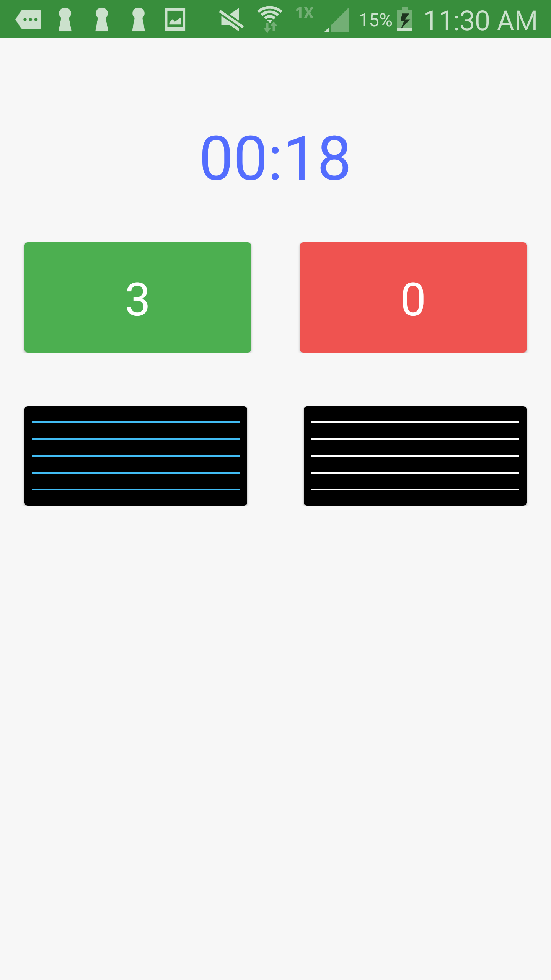
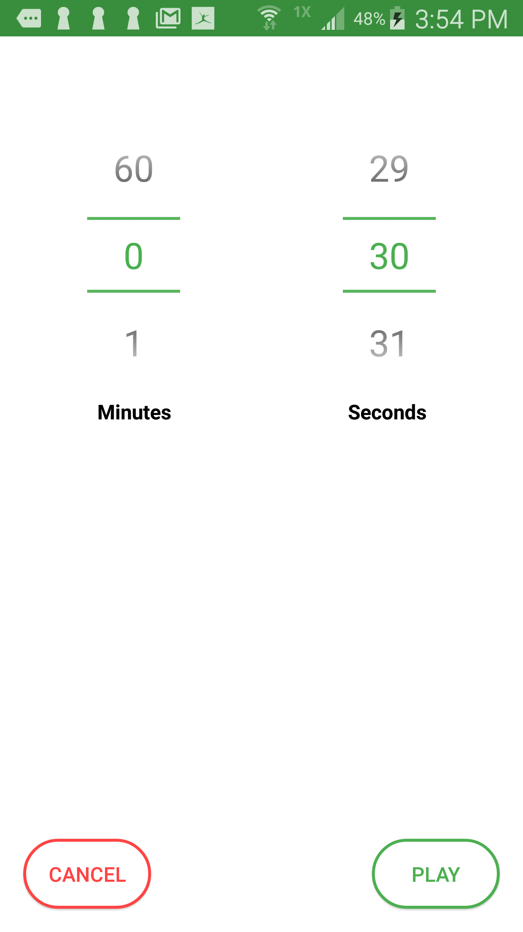
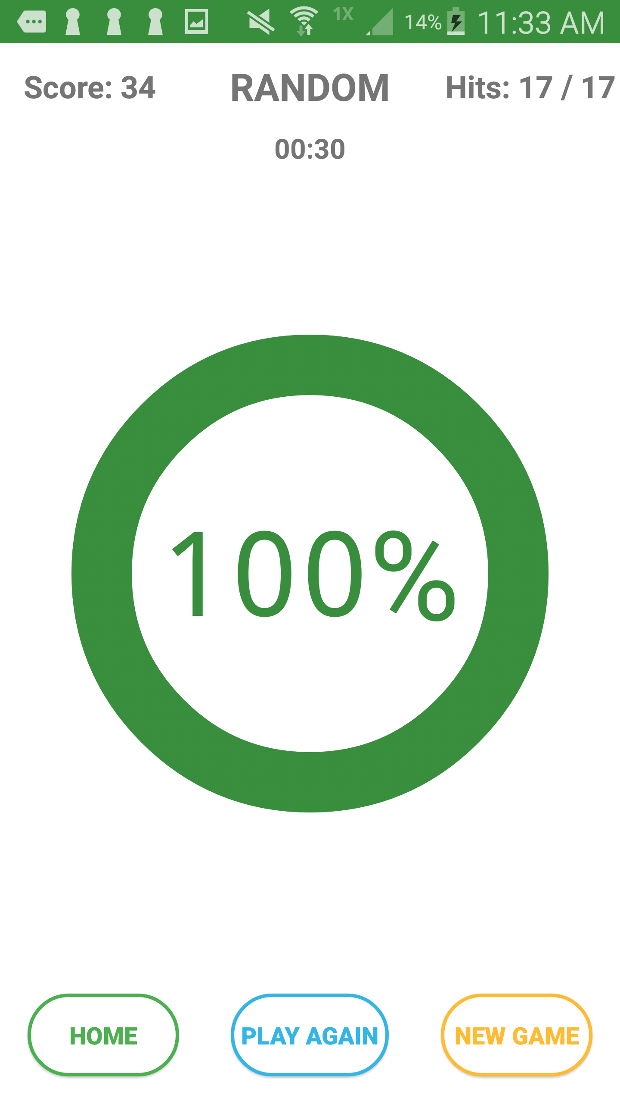
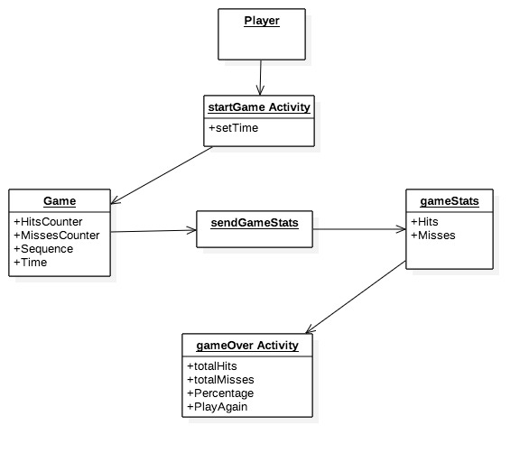
School of Computing & Information Sciences
Fall 2017
Skill Court 9.0
Student: Leonardo Varon, Florida International University
Mentor: Guðmundur Traustason, Founder and CEO at SkillCourt
Instructor: Masoud Sadjadi, Florida International University
Problem
Current System
Solution
The sport of soccer has been around for over 100 years. With the evolution of technology, SkillCourt can be a solution that provides a way for coaches to individually measure real time metrics and view individual statistics for each player.
SkillCourt previously had a game over screen, however that version did not display any statistics with the game that was previously played. Furthermore, the previous version did not have a user friendly UI.
The new version of SkillCourt has been implemented to provide a Circular Progress Bar that displays the previous game statistics. This new version also displays the percentage of hit vs. misses along with a play again screen to let the user replay that game.
Screenshots
Figure 1.
Figure 2 .
Figure 3.
Requirements
System Design
Implementation
As a user I would want to see my statistics from the previously played game.
As a user I want to be able to see the percentage of hits vs. misses.
As a user, after I’m done playing the game, I would like to replay the game without having to return to the Home screen.
SkillCourt is an app designed in Android Studio, which uses Java to design and compile applications. It also makes use of python coded Raspberry Pi to connect via wifi. Through the use of Intel’s HAXM utility, we are able to emulate the application visually. Android Studio allows the programmer to compile the app and transfer it to an Android device. This allow the programmer to complete the software with the Raspberry Pi.
The SkillCourt app is a native Android app written in Java using the Android Studio IDE.
SkillCourt uses the Google FireBase as its primary storage.
External hardware includes Raspberry Pi.
Android phone with SDK 16 or higher was used.
Verification
Object Design
Summary
A combination of Black/White box testing was used to ensure that the actual results matched the expected results.
Visual testing was also performed via human interaction for the UI portion and game interaction.
SkillCourt is a coaching app that assist coaches by allowing them to monitor a player’s skill set. Player’s can view their current metrics and strive to improve them. This app brings a new dimension to training by providing real time statistics.
Acknowledgement
I am thankful for the help that I received from my group member Joshua McLendon and Nicholas Dabdoub.
Notes:
1

