Slide 1







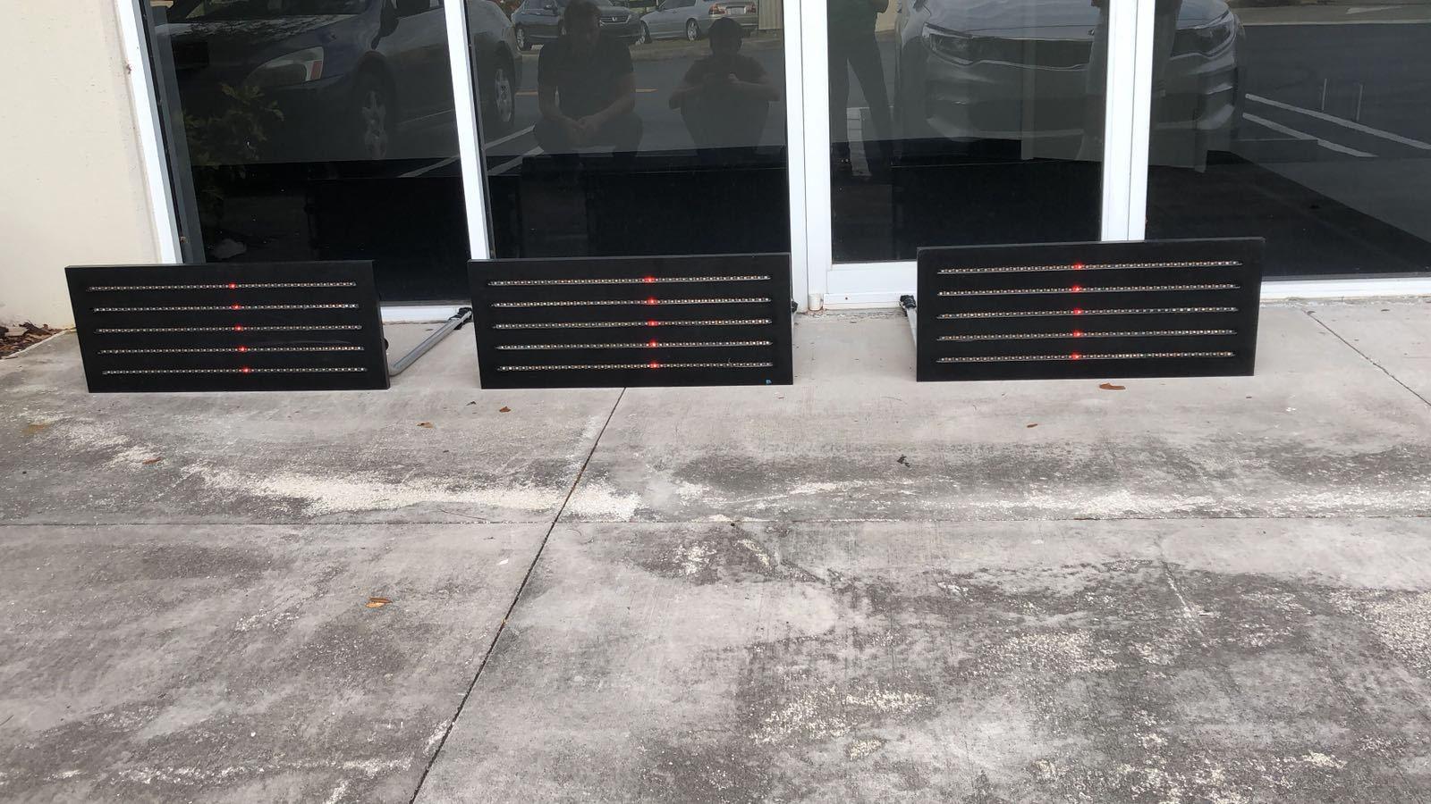
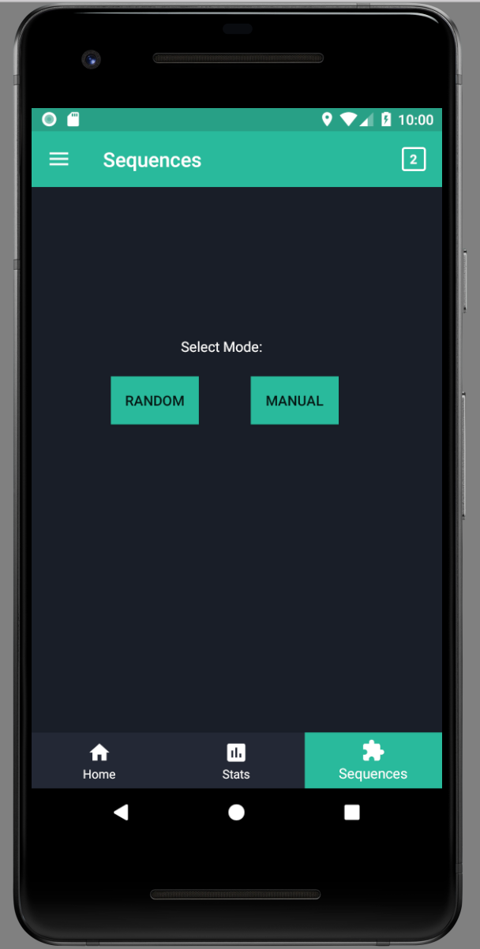
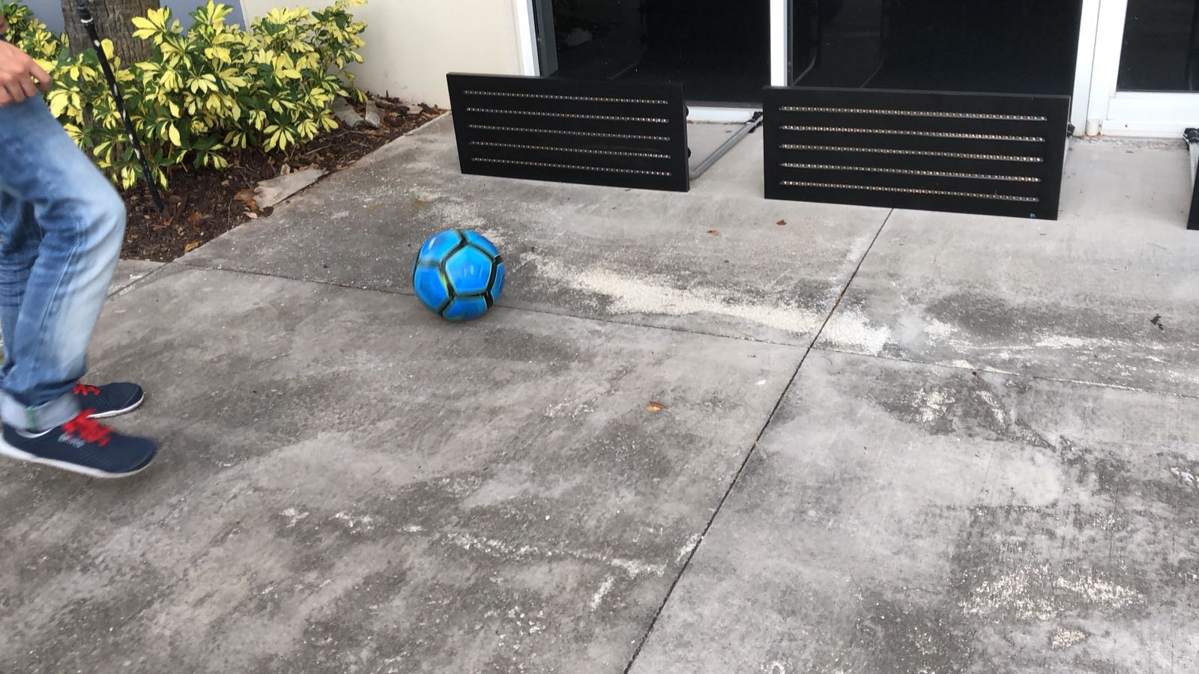
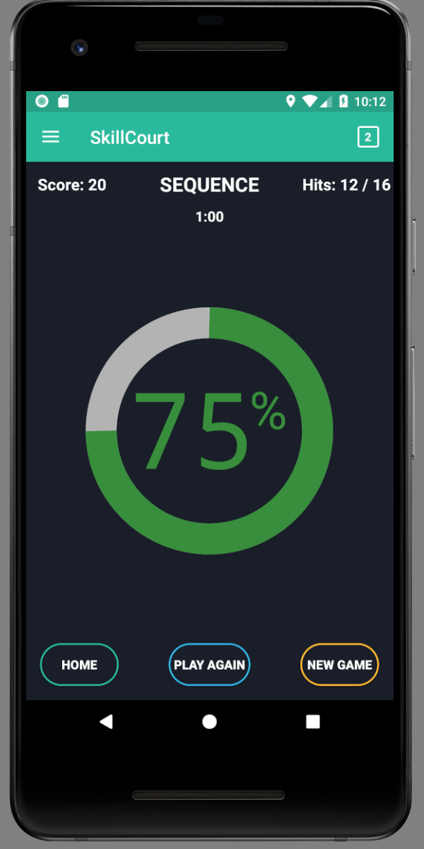
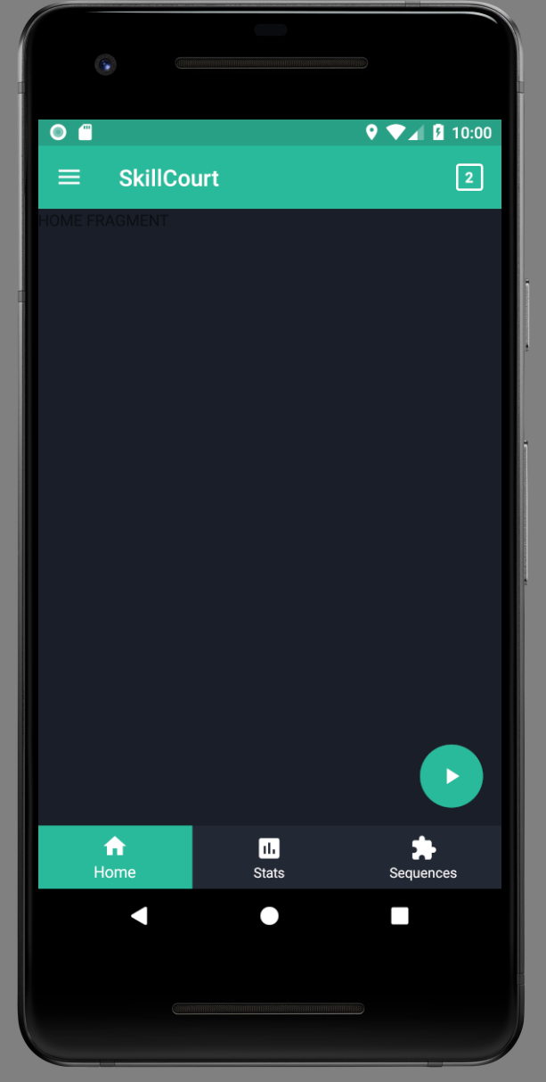
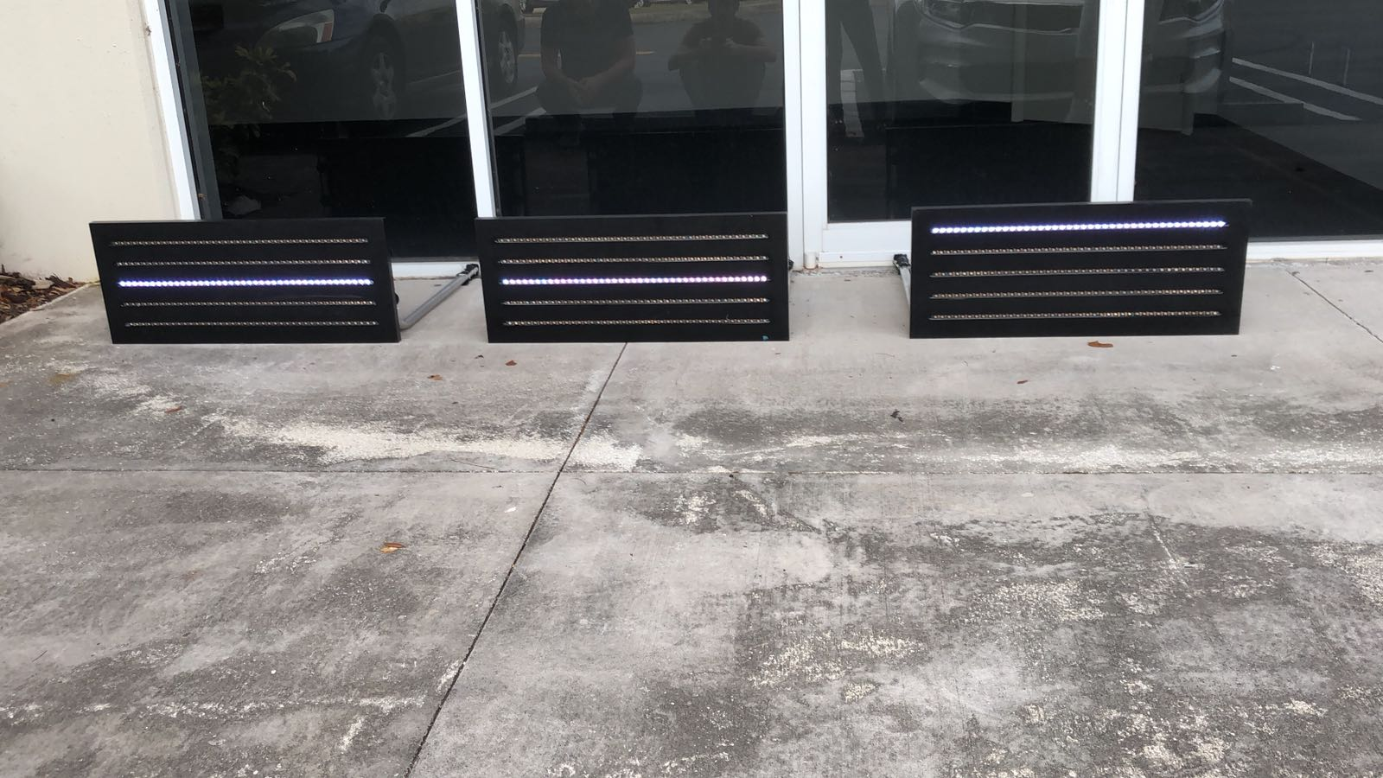
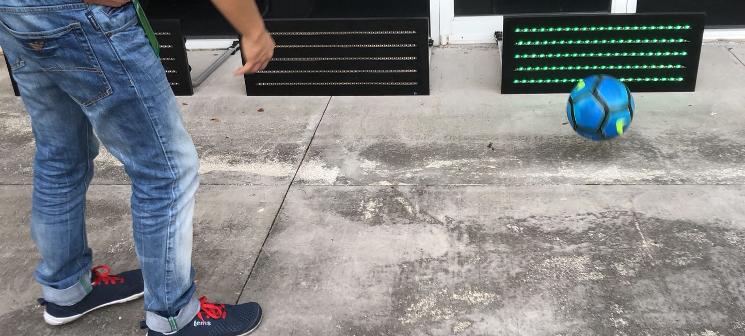
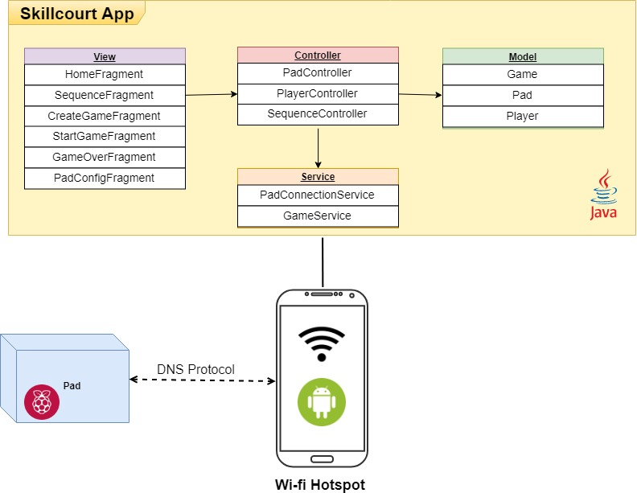
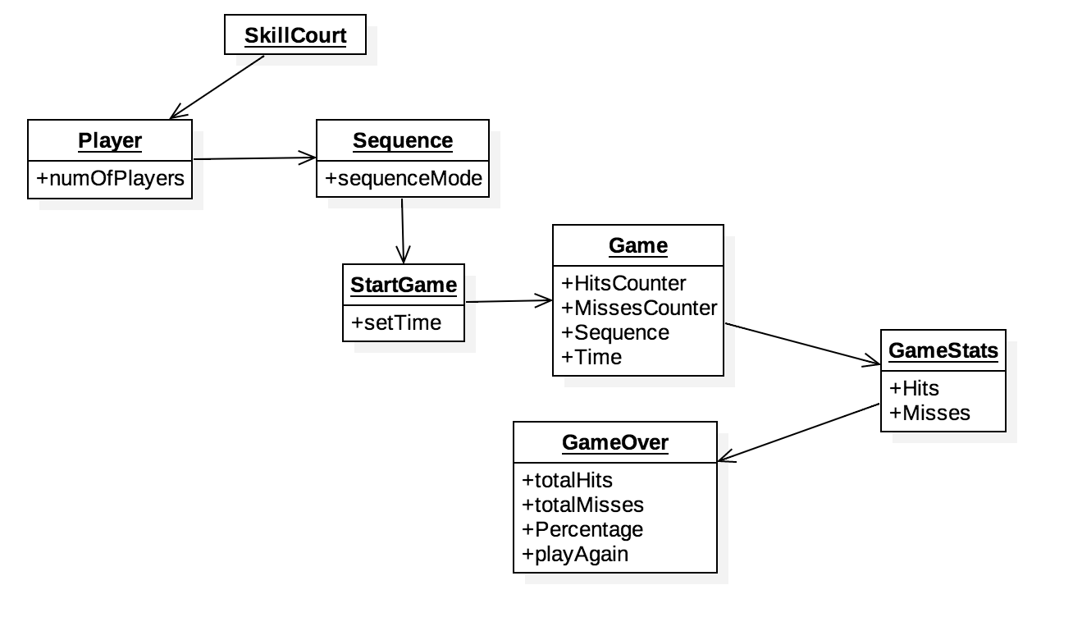


School of Computing & Information Sciences
Senior Project, 2018, Spring
SkillCourt 10.0
Student: Sandra Hurtado, Florida International University
Mentor: Guðmundur Traustason, Founder and CEO of SkillCourt
Professor: Masoud Sadjadi, Florida International University
Problem
Soccer is one of the most popular and competitive sports in existence. Using technology advancements, soccer coaches are seeking ways to train their students more efficiently. A way that can make it easier for the students to practice their skills at the comfort of their own home.
Solution
SkillCourt v.10 allows users to customize their games where and whenever they want. User can choose the game mode they want to train students. Game has a random sequence, and manual sequence. This helps measure the trainee’s maneuvers and reaction time.
Current System
SkillCourt’s previous version allowed users to only play in a random sequence mode that would continue the game if a pad was disconnected. Also did not contain a user friendly UI.
Screenshots
.
Connecting pads
Requirements
As a user I want to be able to personalize the way pads light up.
As a user, I want to be able to set what order pads will light up.
As a user I want to be able to determine a random pattern for the pads to light up.
System Design
Implementation
SkillCourt is an Android app written in Java using Android Studio IDE.
External hardware uses Raspberry Pi and python for commands.
Android phone with SDK 16 or higher was used.
Verification
There were several unit tests done to test code changes. Acceptance tests were created to tests full functionality between user and UI interaction.
Object Design
Summary
SkillCourt is an application that helps user improve their soccer technique. It is a personalized app that allows you to train anywhere at any time. You can include the type of sequences that can best challenge the trainee and get an overall metrics on hits and misses one got.
Acknowledgement
The material presented in this poster is based upon the work supported by Guðmundur Traustason, I am thankful to the help that I received from my group members, Carlos Alva and Sergio Rosales and our mentor Joshua Mclendon.
FOLLOW US @FIUSCIS
Notes:
1

