Slide 1







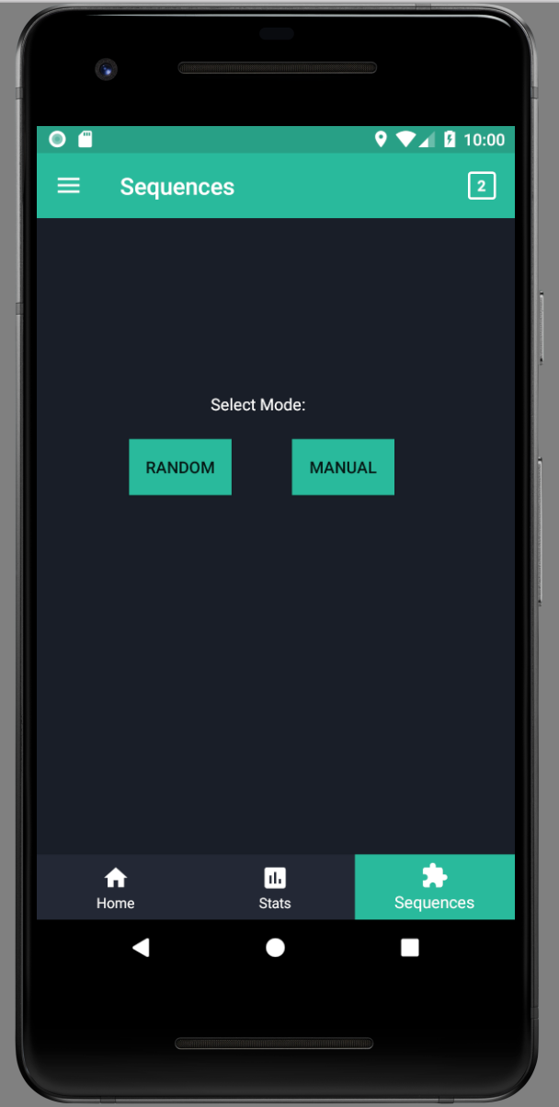
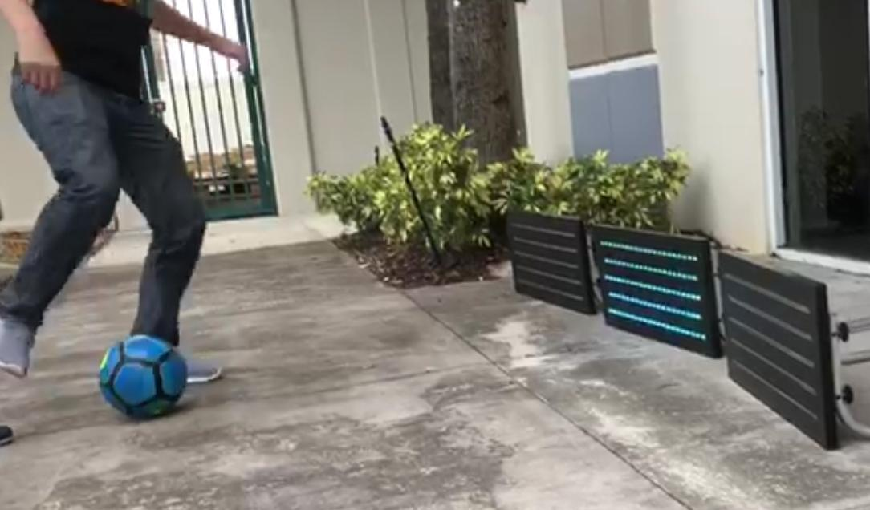
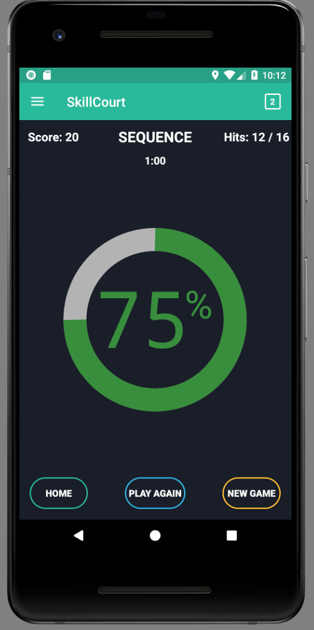
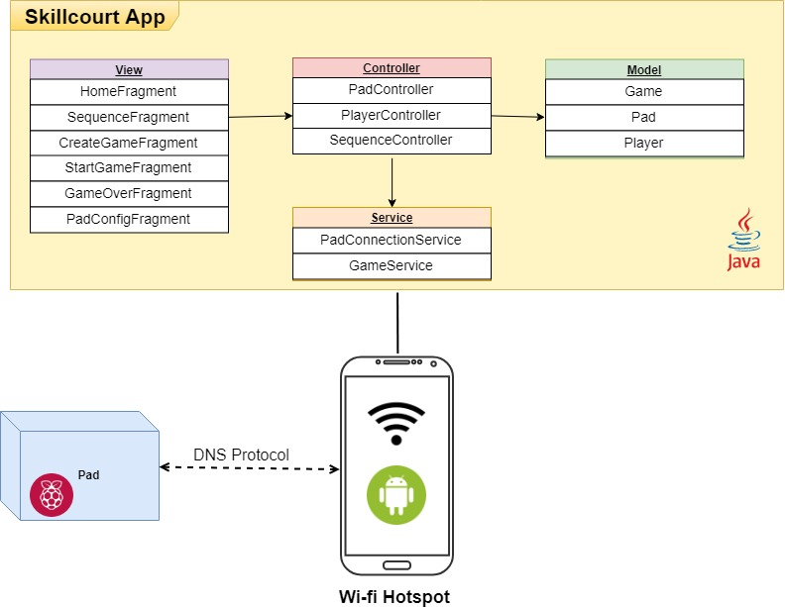
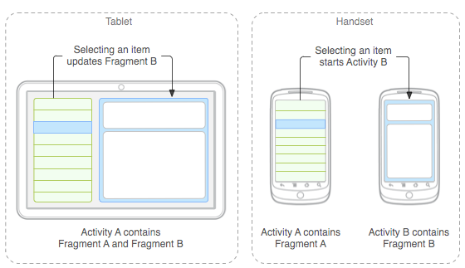
School of Computing & Information Sciences
Senior Project - Spring 2018
SkillCourt 10.0
Student: Sergio Rosales, Florida International University
Mentor: Joshua McLendon, Developer
Professor: Masoud Sadjadi, Florida International University
What is SkillCourt?
SkillCourt is an android application that provides users with a powerful tool to improve key soccer skills. It does so by providing users with accurate data on their improvements. The application is also customizable to allow for all types of players and goals.
Current System
Limited features:
Single Player ONLY
Random Mode
Poor design:
No Multiplayer Support
Outdated UI
Solution
Change UI communication:
Activity-to-activity to fragment-to-fragment
Introduce new structures to separate flow of data:
Player Class
Multiplayer Game Template
Screenshots
Contribution
Application UI:
SC-1137 Change UI from Activities to Fragments
SC-1160 Fix “Play” Floating Button Bug
SC-1170 Implement Multiplayer Game Over Template
Application Design:
SC-1145 Implement Player Class
SC-1158 Implement Multiplayer Game Template
System Design
Implementation
Software:
Android Studio
Java
Hardware:
Raspberry Pi
Python
Target Devices:
SDK 16 or higher
Design tools:
Creately
Microsoft Project
Verification
Unit Test:
UT-1158_startGame
Description: startGame() should consider multiplayer mode.
Precondition: User must be in Create Page
Expected: Contents of “Multiplayer” condition triggered
Actual: Contents of “Multiplayer” condition triggered
Fragments vs Activities
Summary
SkillCourt is an efficient tool for optimizing your soccer skills with quantifiable results. The New System has a more polished UI and is capable of supporting multiplayer. Therefore, a future implementation of such mode is now a possibility.
Acknowledgement
The material presented in this poster is based upon the work supported by Guðmundur Traustason. I am thankful to the help that I received from my group members, Carlos Alva and Sandra Hurtado.
Notes:
‹#›

