Slide 1






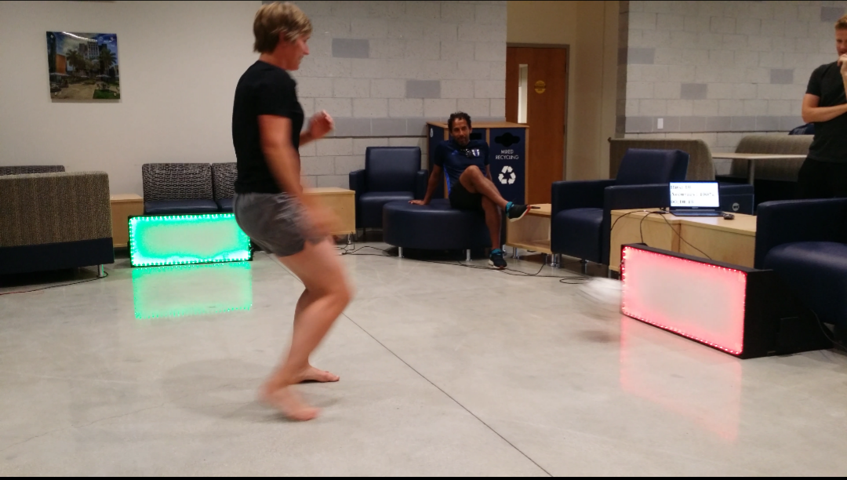
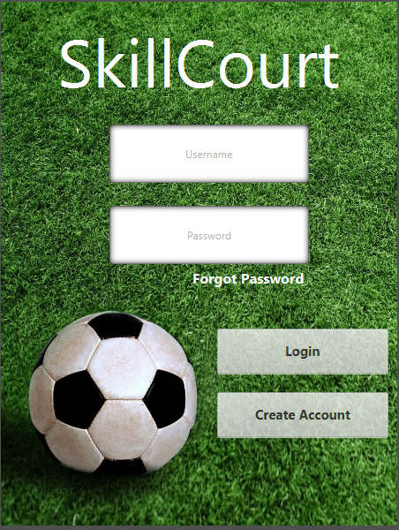

School of Computing & Information Sciences
SkillCourt 5.0
Student: Gajenthiran Gunasegaram, Florida International University
Instructor: Masoud Sadjadi, Florida International University
Product Owner: Gudmundur Orn Traustason
Senior Project, 2016, Summer
Problem
Since its inception, training for soccer has always been the same. To be able to effectively train, one must have a coach, a field, and a team. These all require significant time and financial investment to maintain. This makes training for soccer difficult to approach, even with how significant it is.
Current System
The current system utilizes multiple pads that are bordered by LED strips, which allow them to illuminate multiple colors. The colors being utilized are green and red signifying the correct and incorrect pads to hit during any part of a game. The player will be awarded points for hitting green pads and deducted points for hitting red pads, the pads also change to a new random pattern each time they are hit.
Requirements
The product owner for this project wanted the application moved to a Java environment as the first major requirement, and once the project is rebuilt there, create a way to give instant feedback back to the player during a game.
System Design
Previous versions of the system utilized a very limited development environment called Processing, which has now been replaced with a full Java environment. The system uses Java to communicate information over USB ports to Arduinos that handle all game activity. The results of the activities are then sent back to Java for processing and displaying back to the user. The system also uses a database for maintaining user accounts.
Implementation
My contributions for the project involved establishing the communication between Java and the Arduinos along with sending instructions to Arduino. I also implemented the database and instant feedback features. The communication was established using the Java RXTX library over the serial port, the database was implemented using SQL and the instant feedback used JFrame for display along with multithreading to run concurrently with a game.
Verification
The system was put through a series of tests after each major feature was implemented. Since the core game was completely redesigned in Java, a lot of testing had to be done iteratively to make sure that the new logic matched the design of the old system. Once the system was fully rebuilt, the database features were tested using account creation and logging in behaviors. The instant feedback was tested using multiple games to test that statistics were updated properly.
Object Design
When the user logs in, an object of type User is created and maintained throughout the time the user spends in the application, this object is used to keep access to the user's username for when the time arises to use the database. The Arduino communication is handled using a class we created in Java called Arduino, which handles all USB port communication. To allow for any number of pads to be used, the Arduino objects are instantiated in an array, adding a layer of customization to each game.
Summary
The ultimate goal of this product is to give people a more efficient and cheaper alternative to practice and learn soccer. This approach can translate to any sport, and can be adapted to accommodate any environment. Finally, this product blends the coginitive and physical aspects of sports in a fun and engaging way.
Notes:
‹#›

