Slide 1







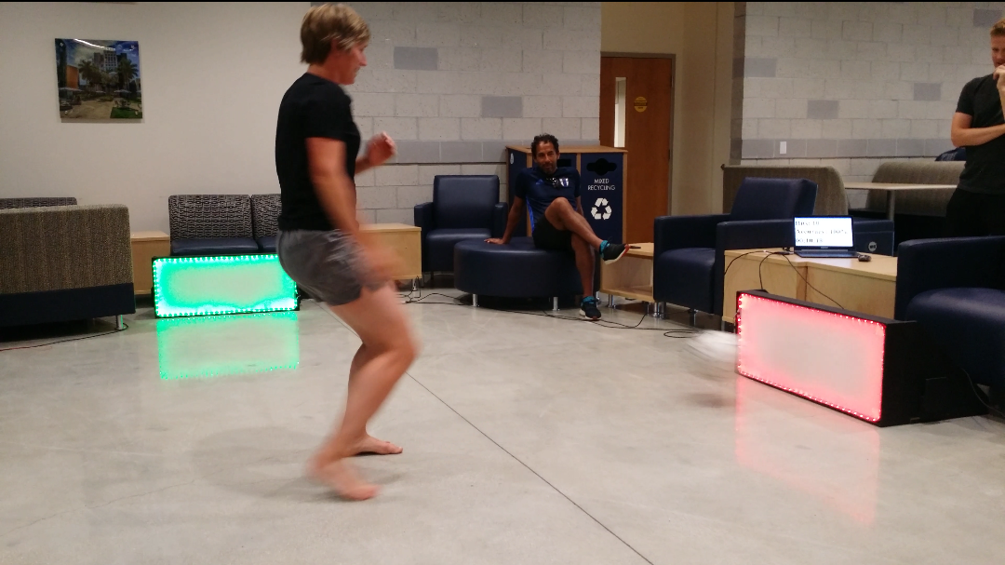


SkilCourt 5.0
Student: Sean F. Borland, Florida International University
Instructor: Masoud Sadjadi, Florida International University
Product Owner: Gudmundur Orn Traustason, SkillCourt
School of Computing & Information Sciences
Senior Project, 2016, Summer
Problem
For years, soccer training has been the same, with a few new ideas here and there and as a result, a lot of players do not reach their max potential. In this day and age, technology can no longer be ignored. The world of analytics and cognitive training is disrupting the sports world and SkillCourt hopes to be a leader in that charge.
Current System
The current system utilizes multiple pads that are bordered by LED strips, which allow them to illuminate multiple colors. The colors being utilized are green and red signifying the correct and incorrect pads to hit during any part of a game. The player will be awarded points for hitting green pads and deducted points for hitting red pads, the pads also change to a new random pattern each time they are hit.
Requirements
Initially the project was written in a programming language called “Processing” which is very limited. The first major feature requested by the product owner was to rebuild it entirely in Java. The next major feature requested was to have a displayed instant feedback screen which displayed Hits, Accuracy and a countdown timer.
System Design
One of the major goals in the analysis process was to redesign the program making it more cohesive, lowly coupled and much more efficient. So, the result is a program that is IDE agnostic, 1/3 the amount of code and only 5 classes as opposed to 14 making this version the most efficient to date. With the introduction of threads, the system now has live instant feedback as well as a running countdown timer. Next, the system will be completely wireless. So stay tuned!
Implementation
The implementation process involved the creation of several algorithms to change the pad color sequence, display a live running timer and record a score based on which pad was hit. Some of the programming concepts used were:
Multithreading
Serial Port Communication
Embedded Systems
Network Socket Programming
Verification
The system was put through a series of tests after each major feature was implemented. Since the core game was completely redesigned in Java, a lot of testing had to be done to make sure the new logic matched the design of the old system. Once the system was fully rebuilt, tests were performed to ensure the scalability of the number of pads, synchronization of the timer and robustness of the serial communication.
Object Design
During object design, the system was restructured and optimized. Various class libraries were used such as rxtxComm and Runnable for code Reuse and Interface communication such as SerialEventListener to cover the four major group activities in object design. The use of these libraries expedited the programming process and seamlessly crossed legacy methods with new implementations as the Adapter pattern implies.
Summary
In the analytics driven world that we live in today, this product will easily penetrate the world of soccer as many other cognitive, tech systems have in all the other major sports. The mental aspect of sports is now equally important as the physical and this tool highlights that fact like no other.
Notes:
‹#›

