Slide 1



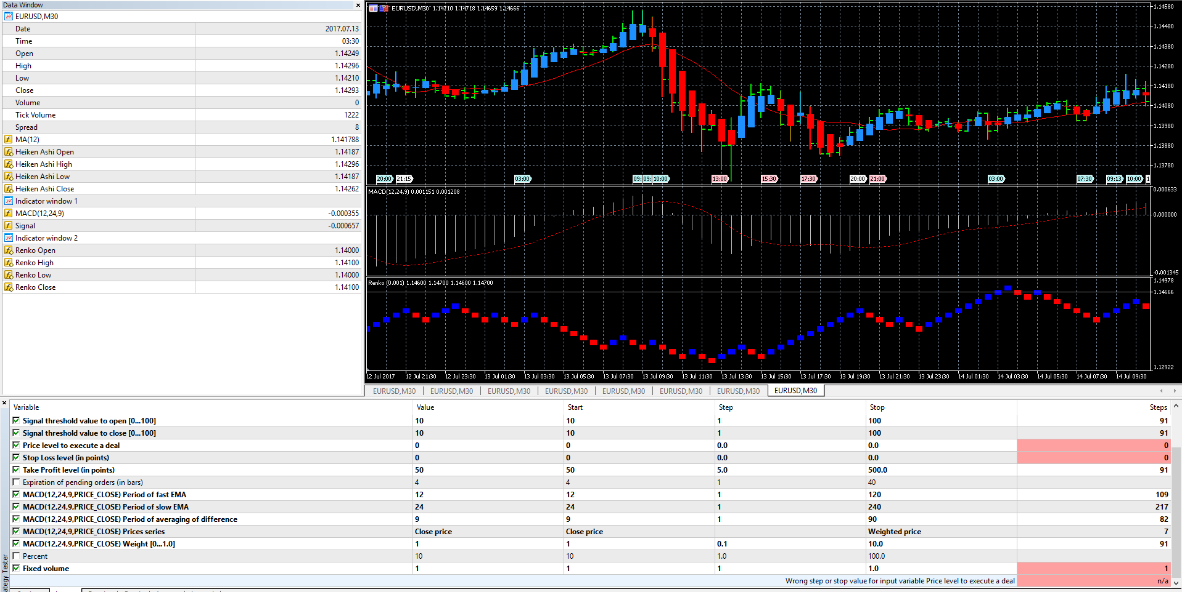
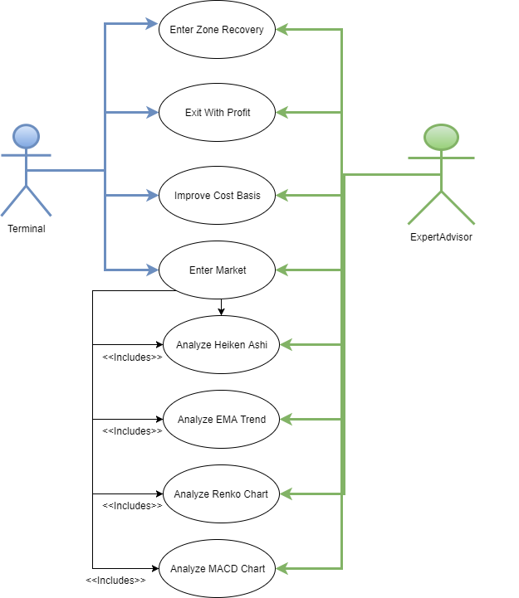
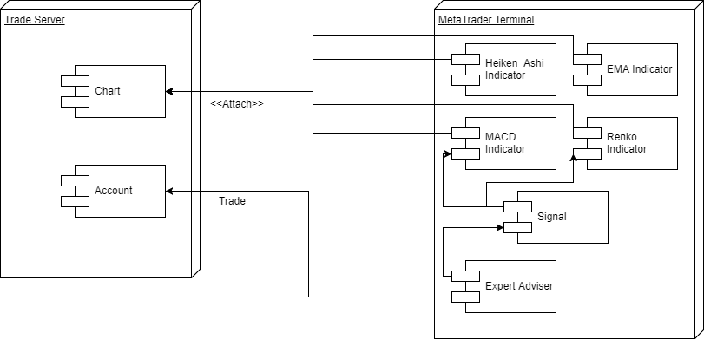
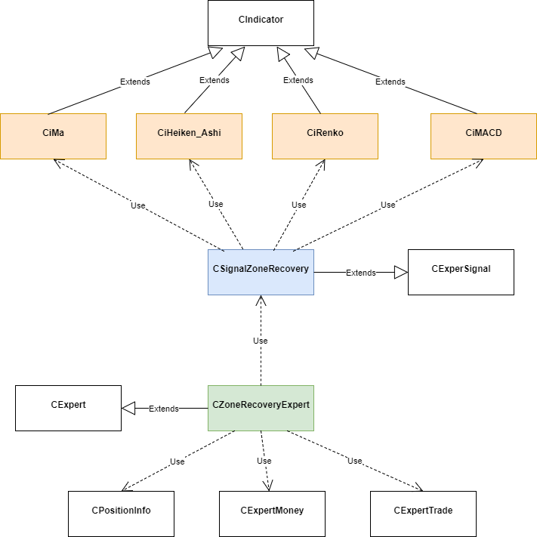
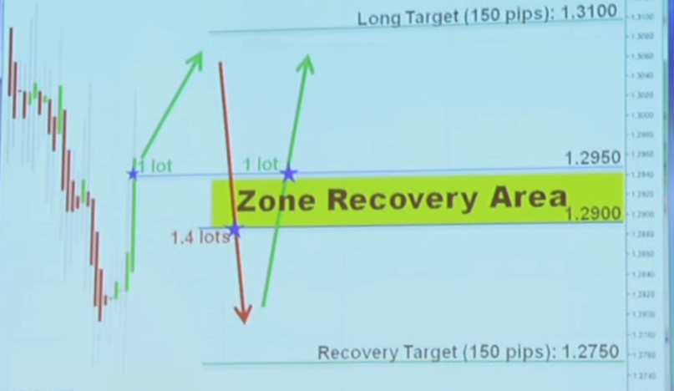
School of Computing & Information Sciences
Senior Project, 2017 Summer
Smart Billionaires 1.0
Student: Josue Mirtil, Florida International University
Mentor: Masoud Sadjadi, Instructor
Instructor: Masoud Sadjadi, Florida International University
Problem
Trade with zone recovery algorithm
Zone Recovery
Enter Market when chart shows signs of market going up
Exit with profit or improve cost basis when not in profit
Use zone recovery when market condition changes (See figure 4)
Solution
Provide a trading bot called Expert Advisers. (See Figure 5)
Only manual requirements would be to provide inputs if default is not desired (See Figure 1)
New System
Expert Adviser will enter the market when the market is signaled to go up.
Adviser will close positions when the market turns but with profit.
Without profit adviser will enter zone recovery otherwise
Screenshots
Screenshots are to be relevant to the problem and solution statement.
MT5 Terminal Window
Requirements
Figure 2 - Use Case Diagram
System Design
Figure 3 - Deployment Diagram
Implementation
The program was written MQL5.
Expert Adviser implemented with zone recovery
Indicators for the four charts
Heiken Ashi, EMA Trend, MACD, and Renko
Trade signal that subscribes to the four indicators.
Zone Recovery Area
Used when the market turns and there is no profit from original trade.
The boundaries are the threshold to open an opposite trade
Figure 4 - Zone Recovery Area
Object Design
Figure 5 - Class Diagram
Summary
This system follows the Zone Recovery Algorithm created by Joseph Nemeth.
It is event driven because MQL5 programs are event driven by nature.
Acknowledgement
The material presented in this poster is based upon the work supported by Joseph Nemeth. I am thankful for the support of my mentor, Masoud Sadjadi. I am also thankful for the MQL5 community for allowing access to useful indicators.
Notes:
1

