Slide 1



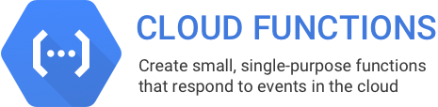




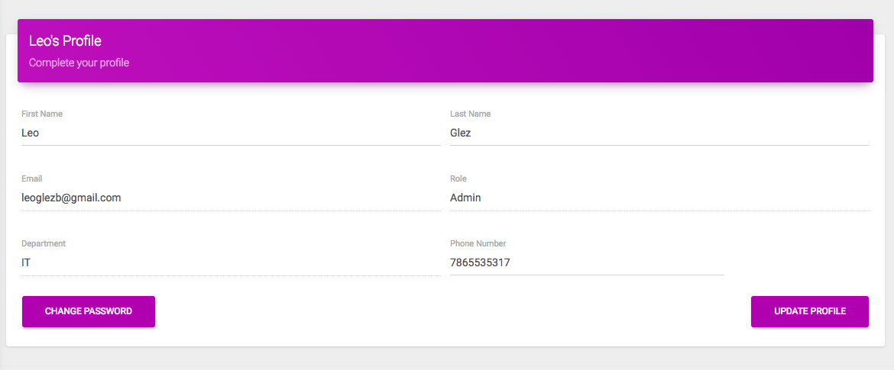
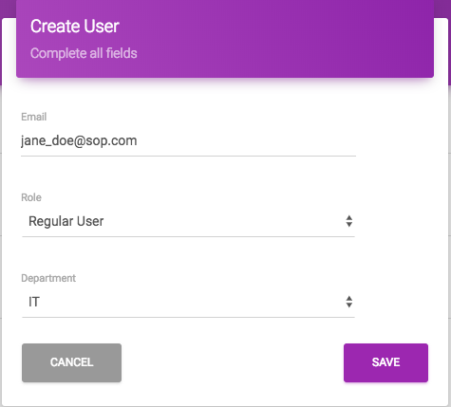
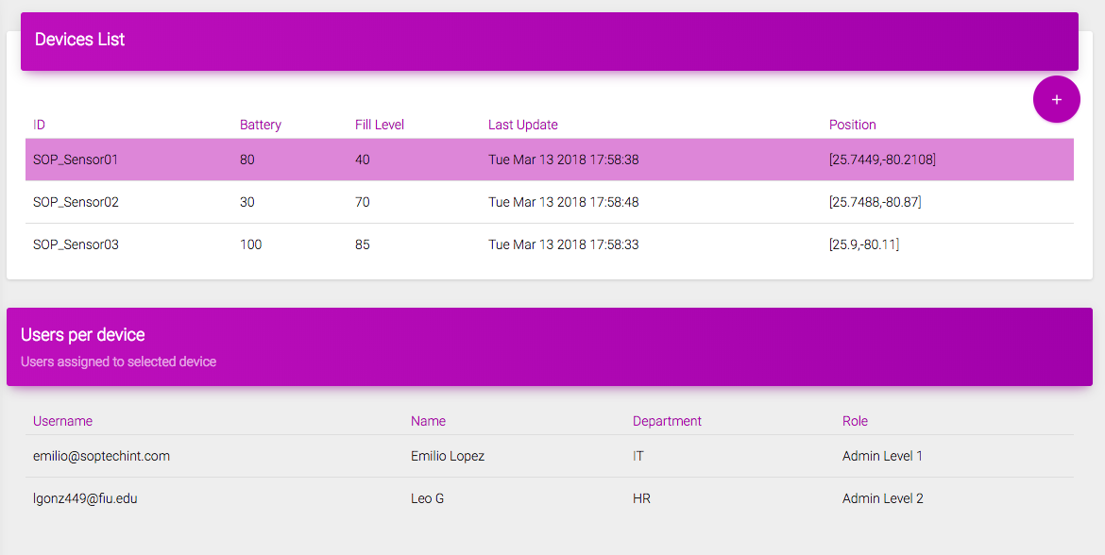
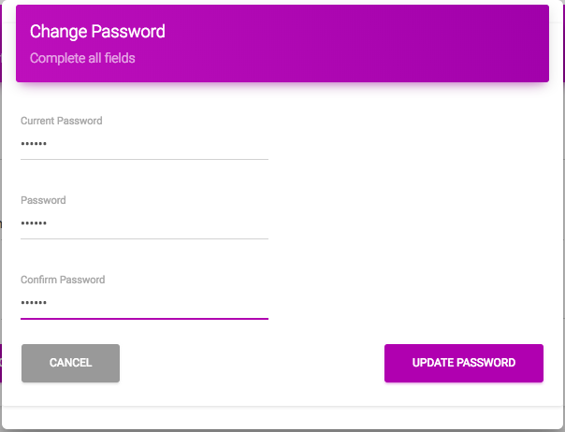
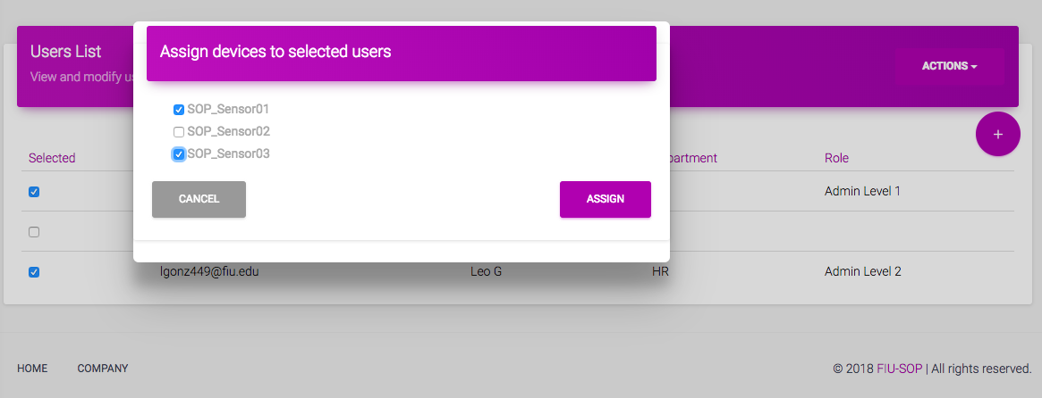
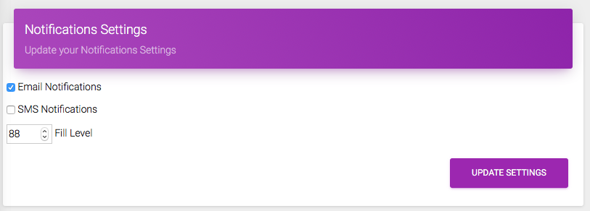
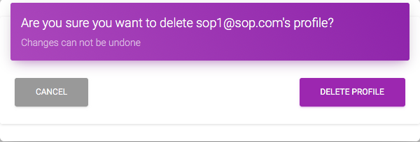
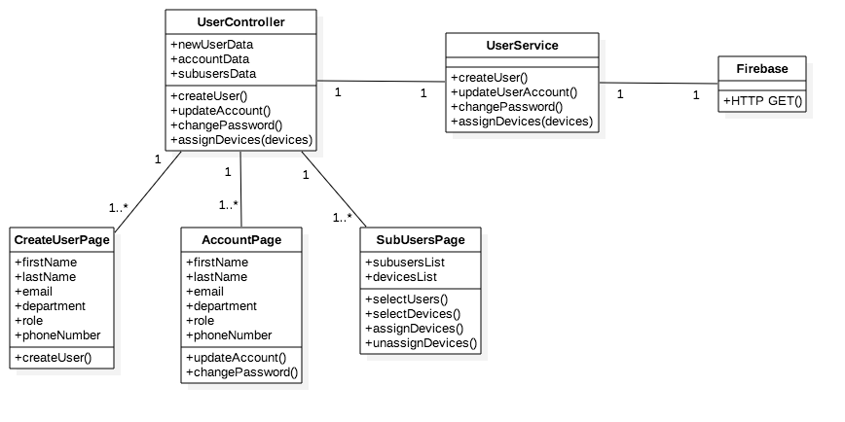
School of Computing & Information Sciences
VIP Senior, 2018, Spring
Smart Stormwater – Smart City System
Student: Leandro Gonzalez, Florida International University
Mentor: Emilio Lopez, SOP Technologies CEO
Professor: Masoud Sadjadi, Florida International University
Problem
SOP Technologies is an environmental startup with one mission: Stop Ocean Pollution
Current system owned by third party company
Clients’ requests for software changes not always approved
Limitations on sensors that can be used
Solution
Build proprietary web app to view, analyze, and share data gathered by sensor devices
Design multi-tenant system for cities to easily manage their users and devices
Provide web analytics to aid cities in the decision making process
Current System
Current system does not meet end users’ requirements
Inability to communicate with different types of sensor devices
Device assignment data is not available
Screenshots
Profile Management Functionality
User Management Functionality
Device Assignment Functionality
Requirements
Build web system that allows creating/deleting users
Add User Management functionality (Update Profile, Change Password)
Allow users to update their Notifications Settings
Allow admins to assign/remove devices to users
Allow admins to see device assignment information
System Design
Implementation
HTML, CSS, Bootstrap for user interface
AngularJS as a frontend framework
Firebase Authentication for Login/Logout functionality
Firebase Realtime Database for data storage
Google Cloud Functions
Firebase Hosting to host web app
Verification
Object Design
Summary
Web system to view and analyze data collected by sensor devices located in sewer bins
User/Profile Management functionality
Admins are able to assign/remove devices
Admins are able to see device assignment information
Test Case ID | CreateUser001
Preconditions | Admin is logged in and in Users page
Input | New user’s email, role and department
Output | New user is created. A row containing the new user’s information appears in the ‘Users List’ table. New user receives an email to reset password
Test Case ID | AssignDevices003
Preconditions | Admin is logged in and in Users page
Input | Multiple users selected Multiple devices selected
Output | All selected devices now appear under ‘Devices per user’ for each of the selected users
Acknowledgement
The material presented in this poster is based upon the work supported by Luis Herrnsdorf. I am thankful to the help that I received from my group member, Luis Herrnsdorf, product owner, Emilio Lopez, and professors Juan Caraballo, Francisco Ortega, and Masoud Sadjadi.
Follow us @FIUSCIS
Notes:
1

