Slide 1



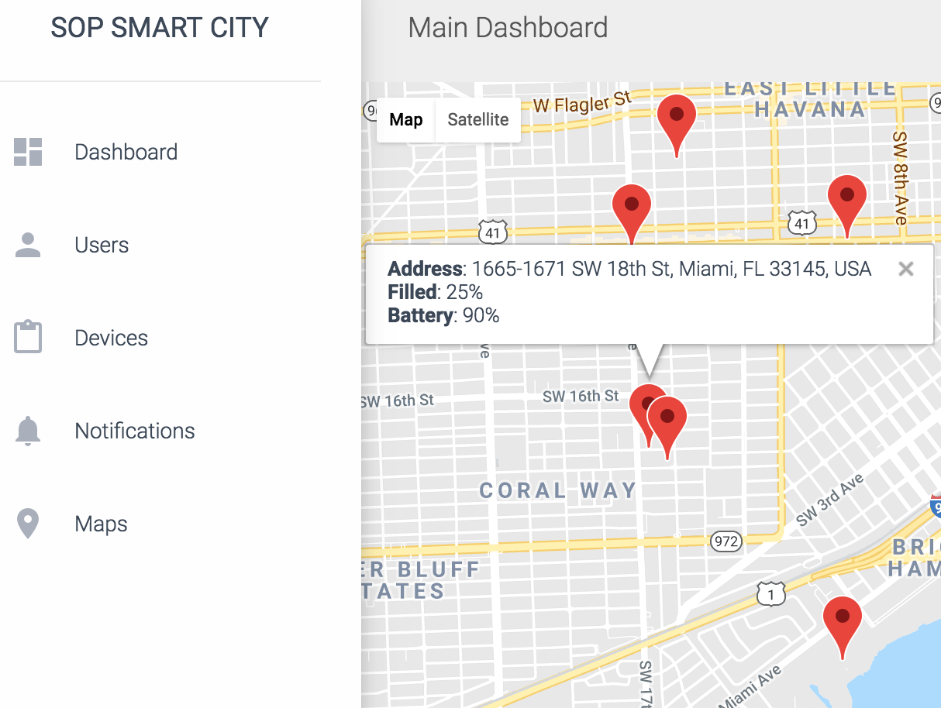
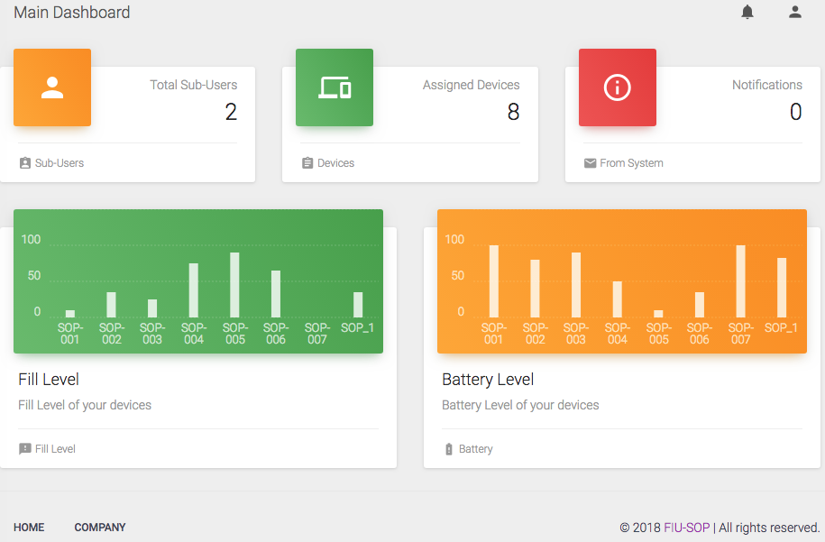
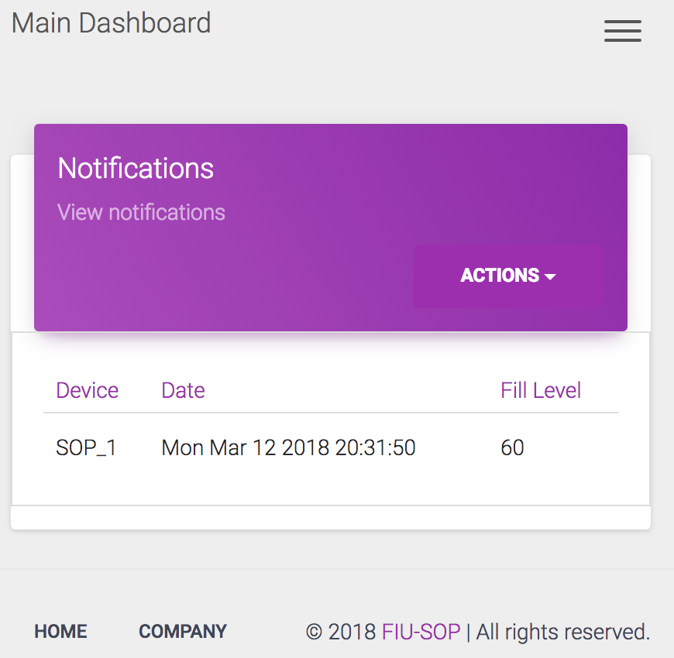
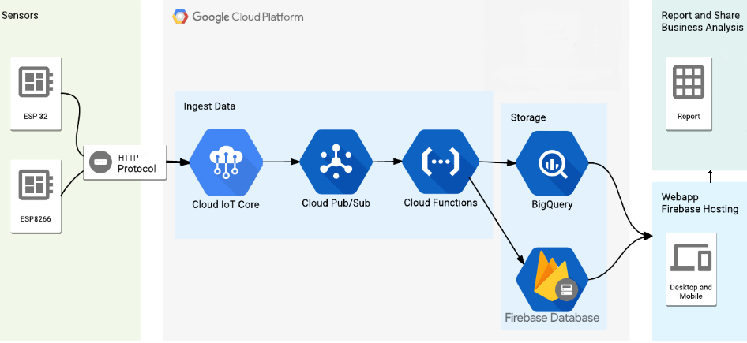
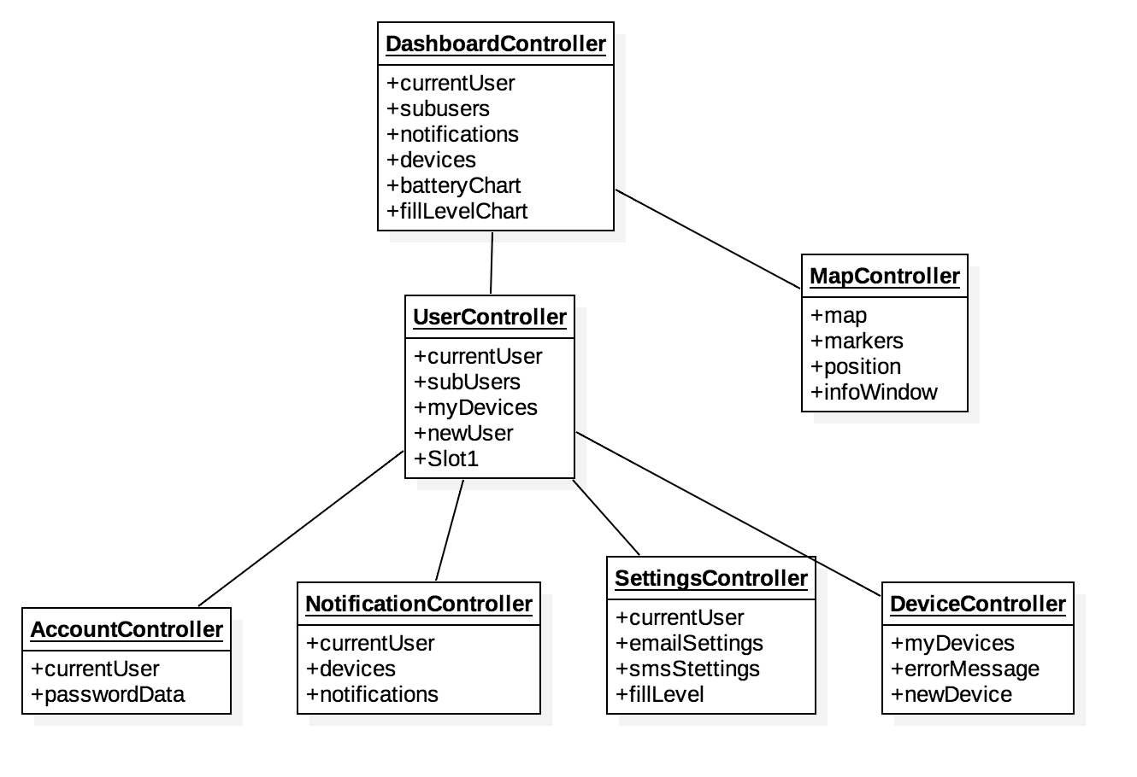
Stop Ocean Pollution
School of Computing & Information Sciences
VIP, 2018, Spring
Smart Stormwater (Smart City System) 2.0
Student: Luis Herrnsdorf, Florida International University
Mentor: Emilio Lopez, CEO SOP Technologies
Professor: Masoud Sadjadi, Florida International University
Problem
Product owner currently use a third party provider for the device management.
Their system is not user friendly and does not fit the need of the product owner.
It can handle only one type of device.
Solution
Design a system from the ground up, that meets the requirement of product owner.
System should be an scalable PaaS (Platform as a service).
Serverless architecture running in google cloud platform.
Current System
Low performance
Not scalable
Require more management and maintenance
Interractive sensor map with real-time monitoring
System dashboard with real-time data
Email and SMS notification to users
Screenshots
roblem and solution statement.
Requirements
Build a platform that allows to add and manage sensors.
See fill level of bins on the main page.
See list my sensor devices updating in real-time.
Track on a map, location and status of sensors activity in real-time.
Get email notifications of my sensor devices about fill and battery levels.
System Design
Implementation
Firebase Authentication for user management.
IoT Core for sensors management.
Firebase functions for serverless logic.
AngularJs for front-end logic.
Bootstrap 3 for front-end user interface.
Verification
Object Design
Summary
Web app to:
Manage users and sensors.
Visualize bin status and data reporting.
Real Time database to track data in real time.
Admins can add user/sensor devices.
Admins can assign/remove sensors to users
Display Devices Fill Level Graph:
Test case ID: ViewFillLevelGraph
Description/Summary of Test: User navigates to dashboard page to view graph containing fill level of all his/her bins.
Pre-condition: User is logged in.
Expected Results: Fill Level Graph is accurate.
Actual Result: Fill Level Graph displays the correct fill level of all bins where the user’s devices are installed.
Status (Fail/Pass): Pass
Acknowledgement
The material presented in this poster is based upon the work supported by Emilio Lopez. I am thankful to the help that I received from my group member, Leandro Gonzalez and professor Francisco Ortega.
FOLLOW US @FIUSCIS
Notes:
1

