Slide 1










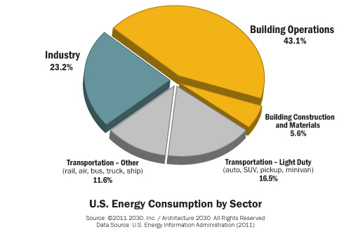
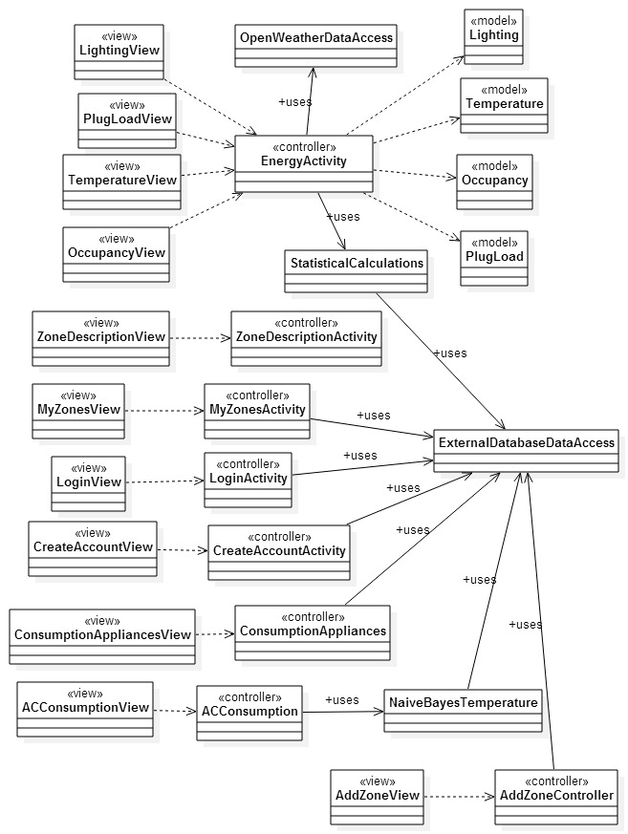
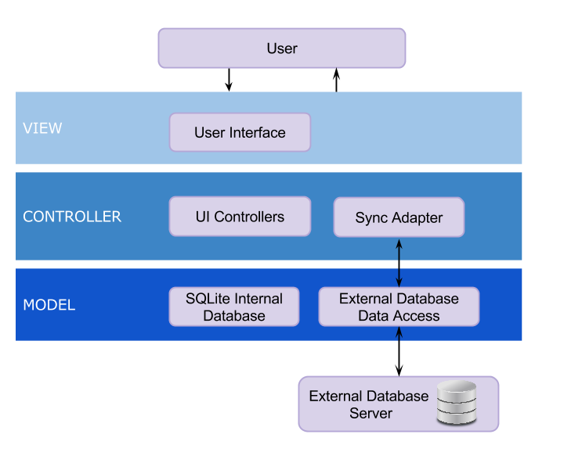
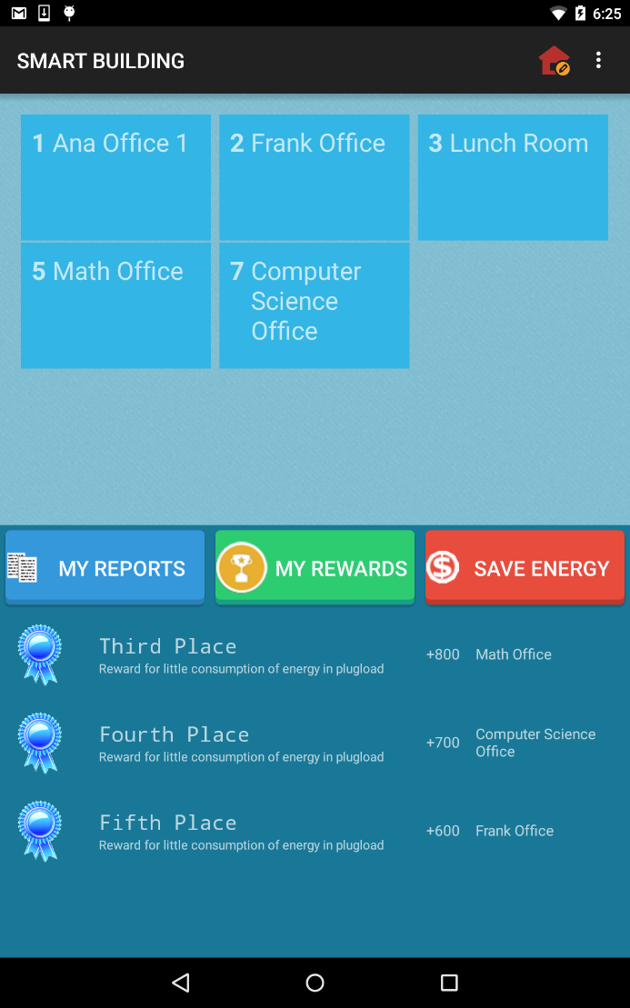
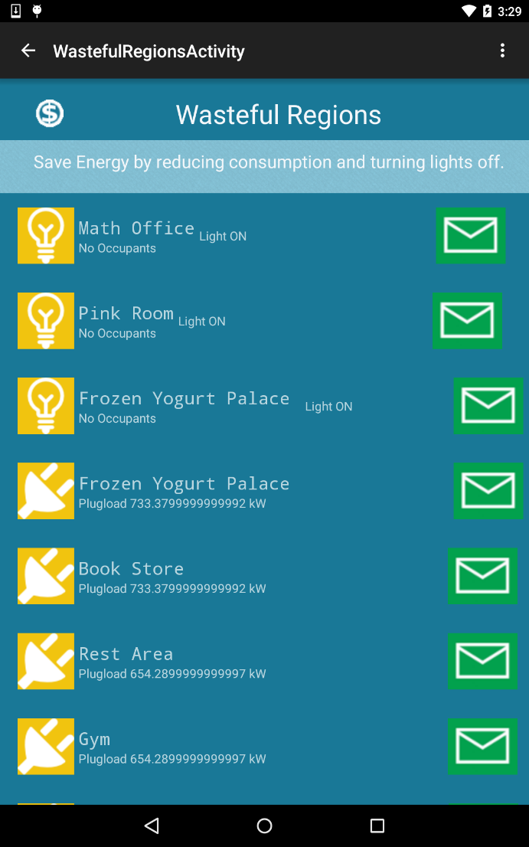
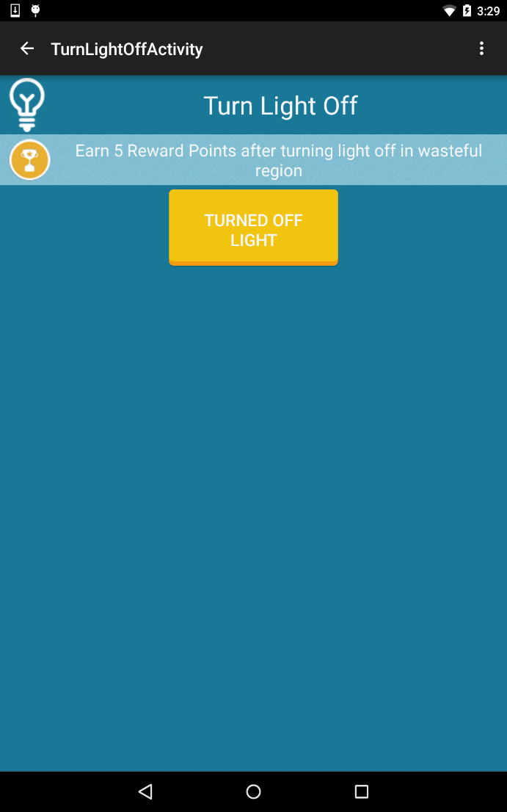
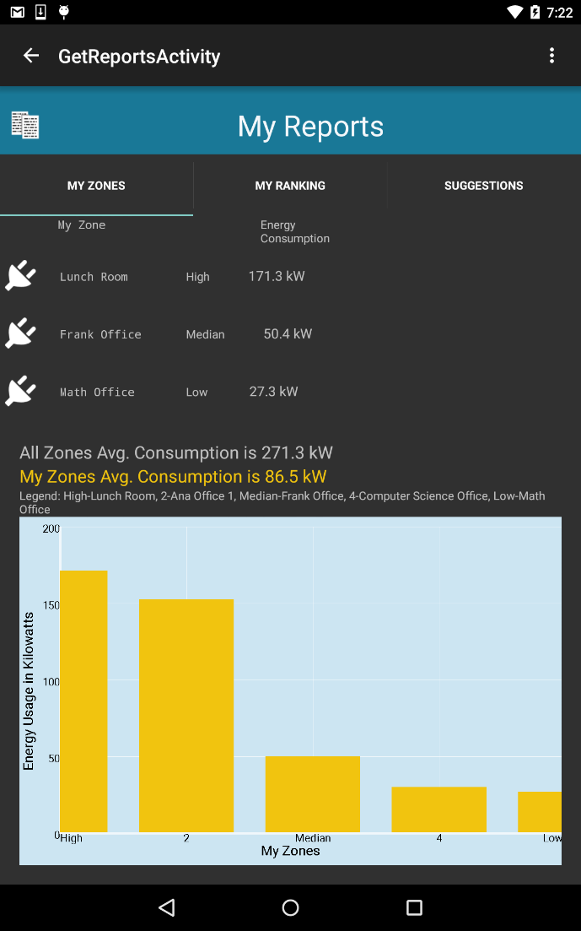
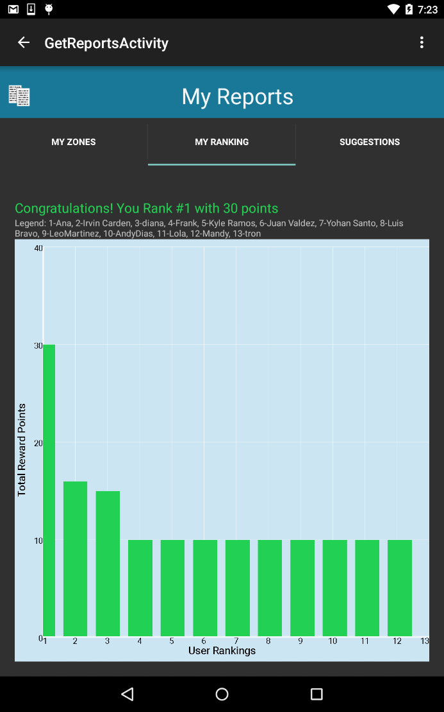
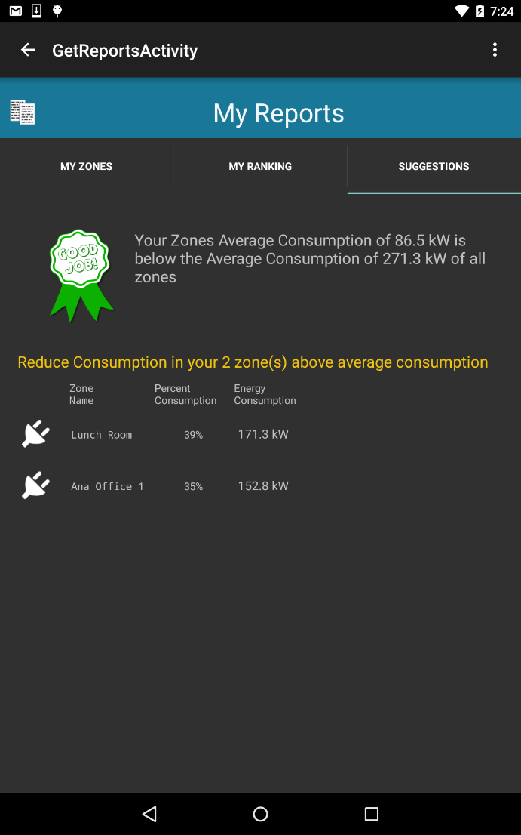
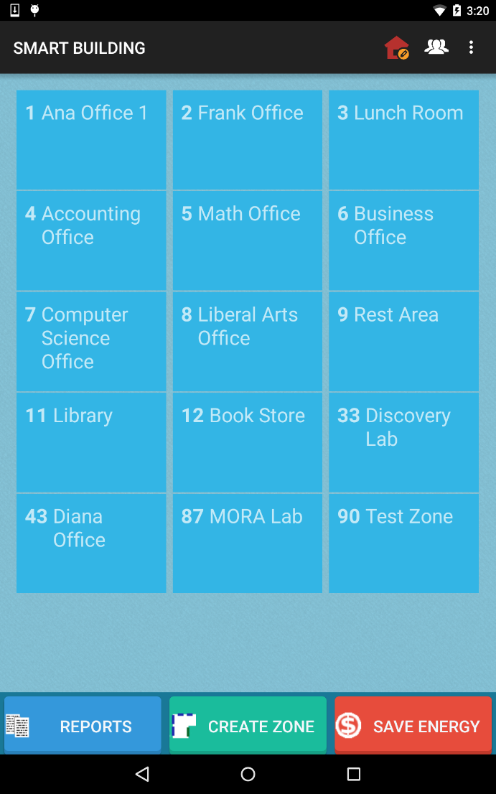
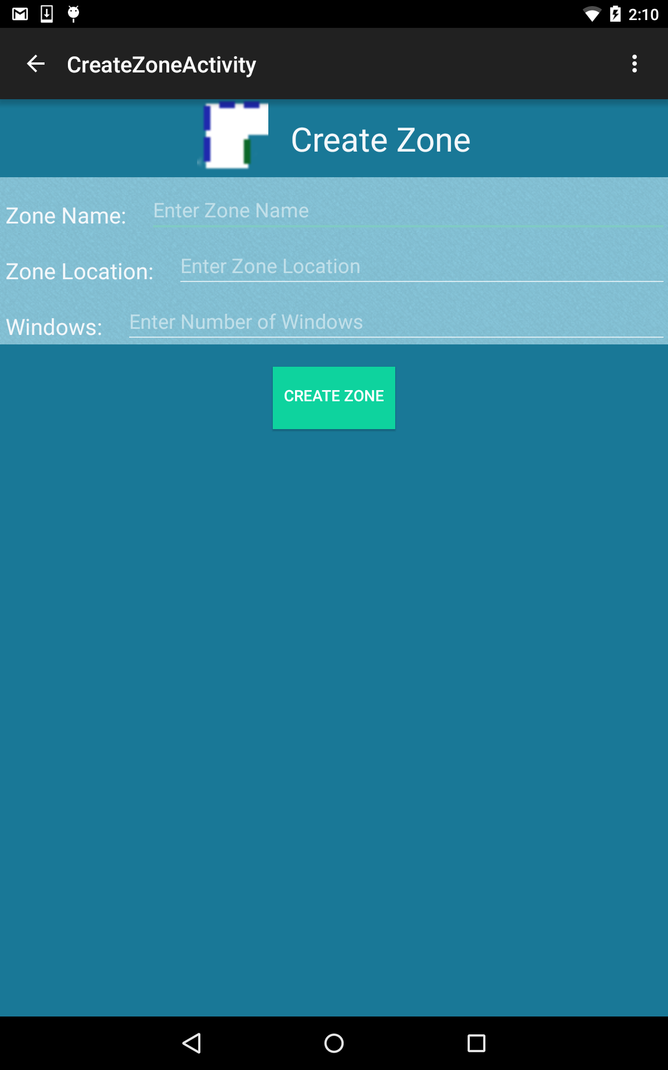
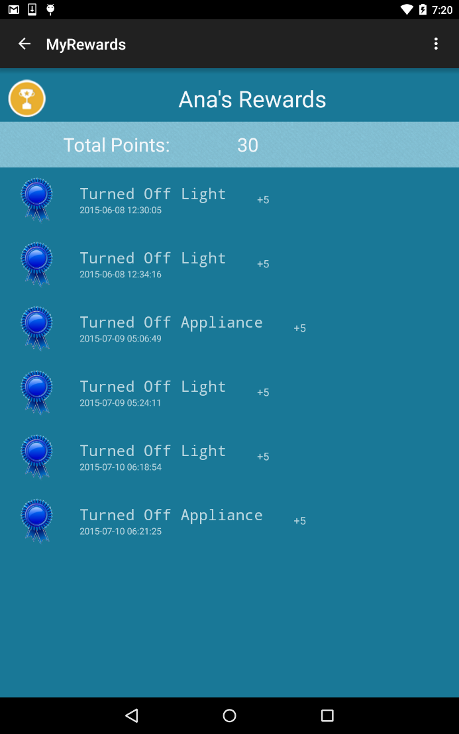
School of Computing & Information Sciences
Senior Project, 2015, Summer
Smart Systems for Occupancy and Building Energy Control
Student: Diana Leante Boné, Florida International University
Mentor: Ali Mostafavi and Leonardo Bobadilla, Florida International University
Instructor: Masoud Sadjadi, Florida International University
Problem
Current System
Requirements
The current system for viewing energy consumption involves the users seeing their electricity bill through their statements or the online portal of their electricity provider. As a result, the users lacks the ability to obtain statistical analysis of their energy consumption and cannot determine which zones in a building or residence consume the most energy and which appliances and lights can be turned off to reduce energy waste. There is currently no other mobile application available in the market that provides a smart approach to help users save energy by modifying their behaviors.
The system shall…
Allow the role of Facility Manager.
Allow a Facility Manager to create a zone.
Allow user to view his\her account reward points.
Allow any user to view wasteful regions.
Allow any user to turn off light in wasteful region and earn points.
Allow any user to turn off appliance in wasteful region and earn points.
Allow a Facility Manager to view users statistics reports based on reward points.
Allow a Facility Manager to view zones statistics reports.
Allow a general user to view his\her ranking and the user’s zones statistics.
Allow users to view personalized feedback suggestions based on energy consumption statistics.
Building operations constitute the highest sector of energy consumption in the United States. It has been estimated that around 30% of the electricity consumed is wasted through inefficient use. The proposed system provides a mobile approach to allow users to have access to their energy consumption personalized statistics within a building and uses intervention techniques and a user rewards system to motivate users to save energy and to help teach users how to reduce energy waste.
Object Design
Implementation
Android Studio was used as the IDE for implementing the SSOBEC system. The User Interface was done using XML while the controller and model was developed using Java. SQlite was used for data storage in the mobile device.
Through HTTP the system accesses an External MySQL database which contains the data about the users and the energy performance of the zones in the building. A Sync Adapter is used in order to transfer the data between the device and the server. PHP is used to query the External MySQL database.
System Design
For the architectural pattern of the system, a model-view-controller was implemented and a client-server model.
Screenshots
General User Main Screen
View Wasteful Regions
Turn Off Light & Earn Points
Summary
The objective of our project was to develop a smart system that would help teach users about their energy consumption and how to improve their behavior to save energy in buildings. This goal is accomplished through the use of intervention techniques such as viewing wasteful regions in the building and identifying which zones have the light on without occupants or which zones consume more energy using plugload data. The system motivates users to save energy by allowing users to earn points by turning off lights in a wasteful region or by turning off appliances. The users can also see statistical comparison of the energy consumption of their zones, their ranking with respect to other users by reward points, and suggestions to focus on improving their energy efficiency.
As a result, the developed system helps educate users in saving energy and promotes using the app as a tool to improve energy performance within a building.
General User My Zones
General User My Ranking
General User Suggestions
Verification
The Smart Systems for Occupancy and Building Energy Control verification was done using Unit Testing, Integration Testing and System Testing. The purpose of our System Tests was to ensure that the system was behaving appropriately, as defined by the requirements provided by our product owners.
Facility Manager Main
Facility Manager Create Zone
General User My Rewards
Acknowledgement
The material presented in this poster is based upon the ongoing research being conducted by Professors Ali Mostafavi and Leonardo Bobadilla. Special thanks to my family, my team partner Irvin Cardenas, our product owners Dr. Ali Mostafavi and Dr. Leonardo Bobadilla and our professor Dr. Masoud Sadjadi for their support and advice.

