Slide 1
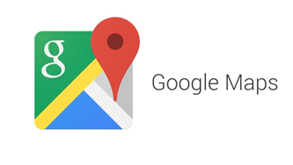











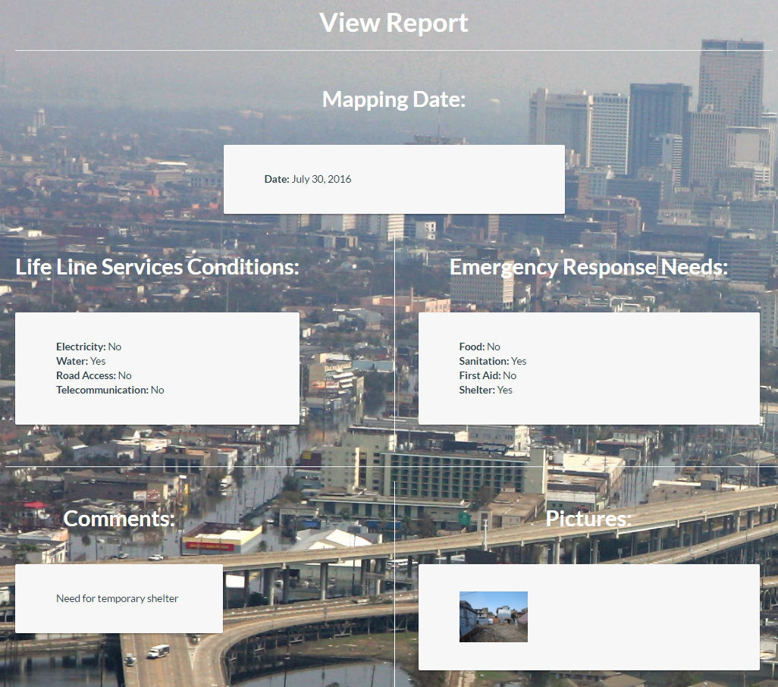
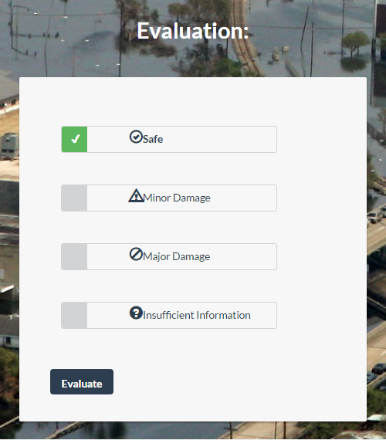
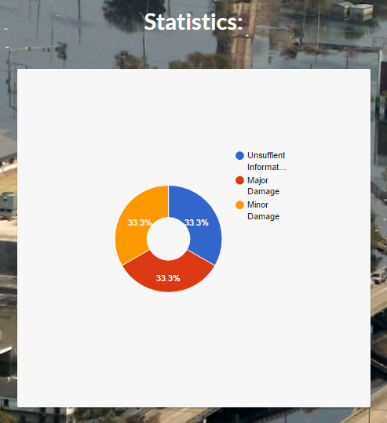
School of Computing & Information Sciences
Senior Project, 2016, Summer
Smart Buildings 5.0 (DRAMA)
Student: Roberto Murillo, Florida International University
Mentor: Ali Mostafavidarani, Florida International University
Instructor: Masoud Sadjadi, Florida International University
Problem
Current System
Requirements
The frequency of natural disasters has increased exponentially over the last 50 years. In the aftermath, disaster agencies need to assess the damages of the affected persons so that they can distribute the resources appropriately. Victims do not have a reliable way to relay to disaster agencies the state and needs of their area. As a result, it often takes several months before an area can get assessed for needs and damages.
In the aftermath of a disaster, agencies try to distribute resources to all areas uniformity but, they do not know the specific needs of those areas. It is not known immediately what the affected persons really need or how to deliver the resources because in some places the streets could be blocked. Also, there are people all over the world with expertise that can volunteer to assess damages, but they cannot go physically to the location.
The system shall allow for users, depending which role the user has, to be able to
Register
Login
Logout
Edit user profile
Create Mapping Report
View Mapping Report
Filter Marker Report
View Grouped Report Statistics
Evaluate Mapping Report
View Evaluation Statistics
Review Evaluators
Solution
My Role
The solution is to provide a fast method of need and damage assessment in the aftermath of the disasters. Our web application creates a platform for crowdsourced information collection regarding needs and building conditions and a crowdsourced platform for evaluation of damages by people who have expertise.
Created login form for the users.
Created a view for the report, where users can see date, needs, pictures, and comments a of every marker.
Implemented an evaluation system so “evaluators” can give an evaluation according their knowledge and the problems of the buildings.
Created statistics for every report after the evaluation.
Create navigation bar with tabs and logo.
System Design
Object Design
Implementation
HTML5/CSS3 and Bootstrap framework was used for designing the UI components.
CakePHP framework was used to handle the backend logic .
MySql was used for our database to hold our consistent data.
Google Maps API was used to create functionality related to user location.
Verification
Screenshots
Summary
Test Case ID | SB_EvaluateAssessmentReport_UT_01(Sunny Day)
Purpose | Verify Assessment form is displaying the evaluation section
Preconditions | The server and application are up and running The user is in the View Assessment page
Input | The user navigates to the evaluation section of the form
Expected Output | The user will see the evaluation section of the form displayed correctly.
This project is the first version of a system that will be in the works for years to come. This version provides a fast and reliable method of need and damage assessment. It has been very beneficial to apply software engineering methodology to such a unique system Developing this project began with a feasibility study which lead to requirements elicitation and documentation and finally system design. This was followed by an iterative cycle of object design, implementation, and verification which finally resulted in an unique system which allows users to use DRAMA.
Test Case ID | SB_EvaluateReport_IT_01(Sunny Day)
Purpose | Verify that user can evaluate the report
Preconditions | The server and application are up and running The user is in the View Assessment page
Input | The user clicks one of the options for evaluation; safe, warning, danger. The user clicks evaluate button to submit
Expected Output | The evaluation of the assessment will be successful and an entry in the repository has been created.
Acknowledgement
The material presented in this poster is based upon the work supported by Roberto Murillo I am thankful to the help that I received from my group member Yonicel Leyva, our mentor and product owner Ali Mostafavi, our instructor Masoud Sadjadi, and Teaching Assistant Mohsen Taheri.
Notes:
1

