Slide 1
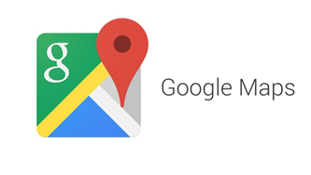








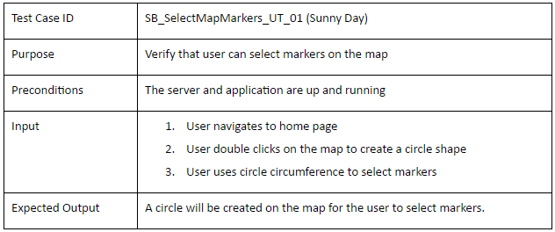
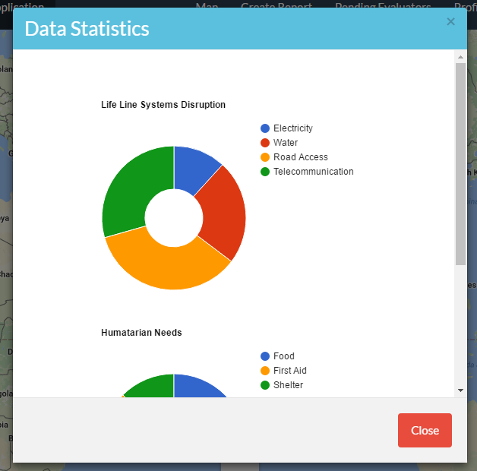
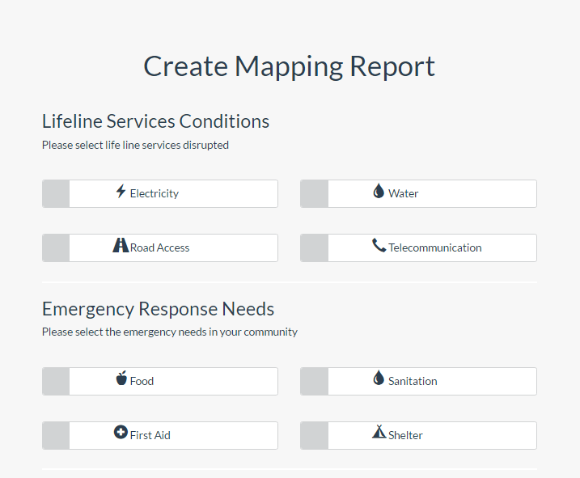
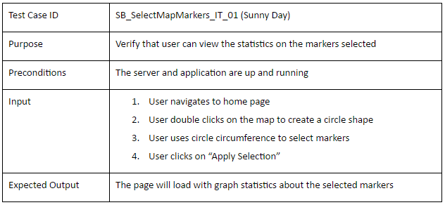
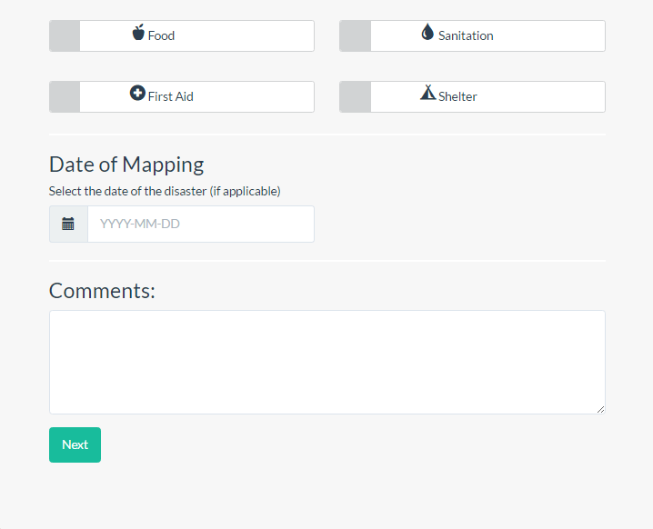
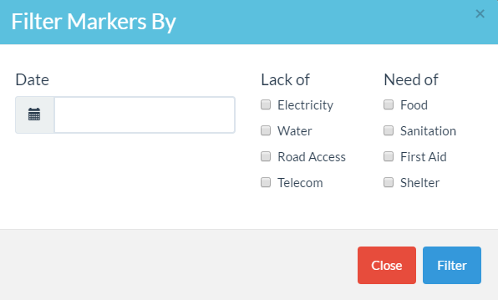
School of Computing & Information Sciences
Senior Project, 2016, Summer
Smart Buildings 5.0 (DRAMA)
Student: Yonicel Leyva, Florida International University
Mentor: Ali Mostafavi, Florida International University
Instructor: Masoud Sadjadi, Florida International University
Problem
Current System
Requirements
The frequency of natural disasters has increased drastically over the last 50 years. In the aftermath, disaster agencies need to assess the damages of the affected persons so that they can distribute the resources appropriately. Victims do not have a reliable way to relay to disaster agencies the state and needs of their area. As a result, it often takes several months before an area can get assessed for needs and damages.
In the aftermath of a disaster, agencies try to distribute resources to all areas but, they might not know the specific needs of those areas. It is not known immediately what the affected persons really need or how to deliver the resources because in some places the streets could be blocked. Also, there are people all over the world with expertise that can volunteer to assess damages, but they cannot go physically to the location.
The system shall allow for users, depending which role the user has, to be able to
Register
Login
Logout
View and edit user profile
Create Mapping Report
View Mapping Report
Filter Marker Report
View Grouped Report Statistics
Evaluate Mapping Report
View Evaluation Statistics
Review Evaluators
Solution
My Role
The solution is to provide a fast and reliable method of damage assessment in the aftermath of disasters. DRAMA (Disaster Reconnaissance Assessment Mapping Application) creates a platform for crowdsourced information collection regarding needs and building conditions and a crowdsourced platform for evaluation of damages by people who have expertise.
Created registration form for account creation.
Created a report form to allow mapper users to upload images and provide needs and damages.
Implemented a marker selection feature that allows the view of grouped statistics of reports
Created a filter by date and content of reports
Implemented a feature for admin user to review newly registered evaluators
System Design
Object Design
Implementation
HTML5/CSS3 and Bootstrap framework was used for designing the UI components.
CakePHP framework was used to handle the backend logic .
MySql was used for our database to hold our consistent data.
Google Maps API was used to create functionality related to report creation.
Verification
Screenshots
Summary
This project is a new system that will be in the works for years to come. This version provides a fast and reliable method of need and damage assessment. It has been very beneficial to apply software engineering methodology to such a unique system Developing this project began with a feasibility study which lead to requirements elicitation and documentation and finally system design. This was followed by an iterative cycle of object design, implementation, and verification which finally resulted in an unique system which allows users to use DRAMA.
Acknowledgement
The material presented in this poster is based upon the work supported by Yonicel Leyva. I am thankful to the help that I received from my group member Roberto Murillo, our mentor and product owner Ali Mostafavi, our Instructor Masoud Sadjadi, and Teaching Assistant Mohsen Taheri.
Notes:
1

