Slide 1






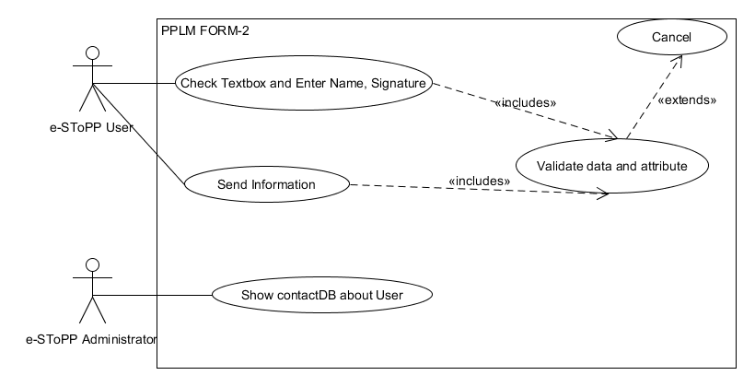

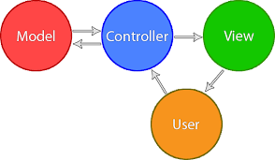

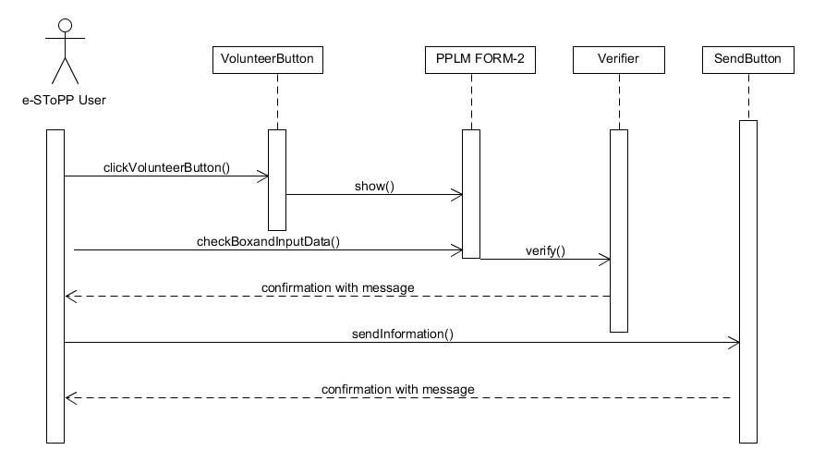



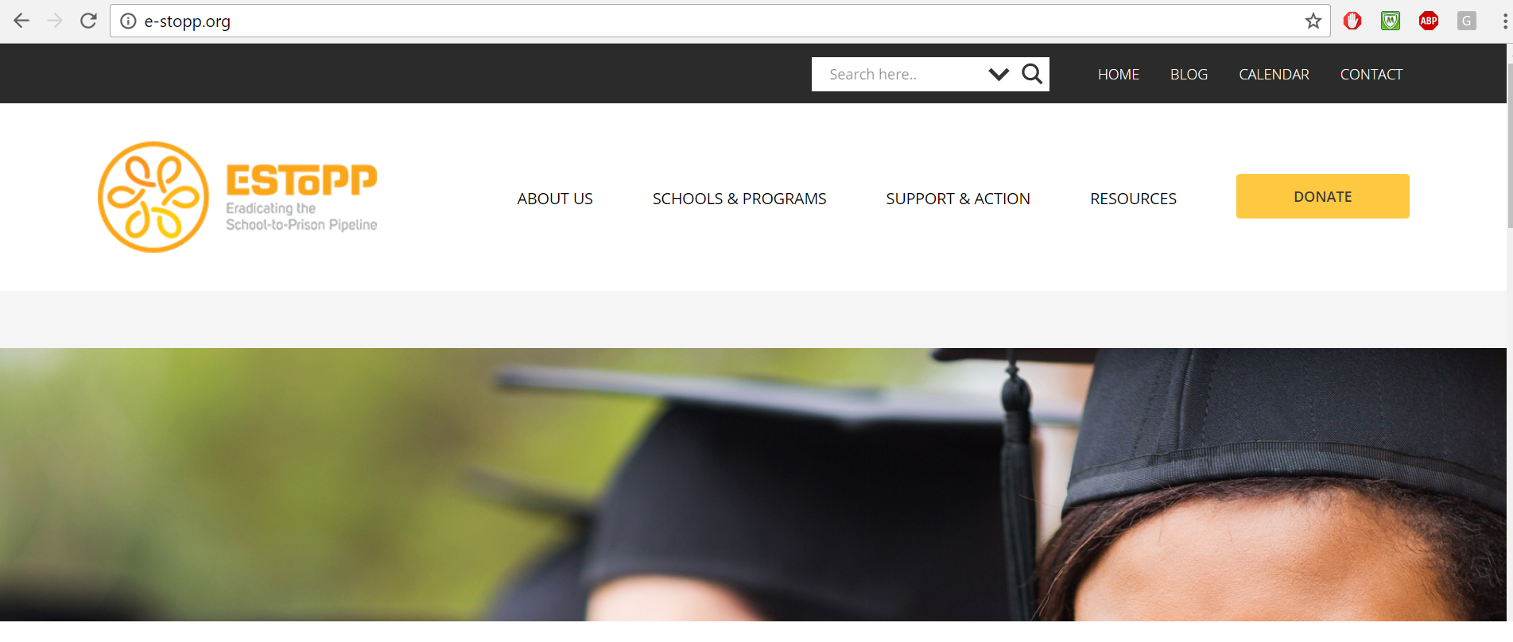
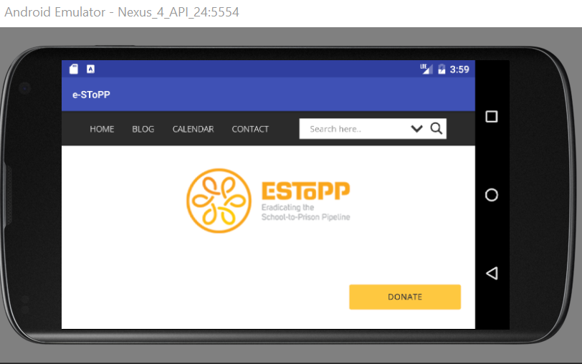
School of Computing & Information Sciences
Advanced Software Engineering, 2016, Fall
Social APP Ver 1.0
Student: Shamsed Mahmud, Florida International University
Mentor: Rick Little (E-SToPP), Mohsen Taheri, Florida International University
Instructor: Masoud Sadjadi, Florida International University
Problem
E-SToPP organization’s website task:
Adding Mail Chimp and Ajax Search plugin
Converting static forms to web enable forms
Converting it into Android Applications
Current System
Currently, e-stopp.org website is in operable state, most of the functions are working well. Core features are:
Adding Search Feature.
Adding Mail Chimp plugin
Import users from existing user and create administrative user.
Convert pdf based static form to dynamic web enable forms.
Adding database options with those corresponding form like ContactDB.
The Android version of the website is working well.
Requirements
System provide functionality to user:
Search text within the website.
Adding User info via mail Chimp Form.
Apply for E-SToPP membership via website.
Submit PPLM Volunteer form via website and Mobile app.
Submit Transformative Education Center form.
Submit Transformative praxis Center form via website and mobile APP.
Convert the website to Mobile APP.
Solution
The solution for problems are for the website:
Search option within the website
Mail Chimp Form Added
Campaign can be made easily
Static form converted to dynamic form
Full functional Android version of website
System Design
Object Design
Implementation
Model-View-Controller (MVC)Architecture:
Website design on WordPress
User Interface: HTML 5 and CSS3
Client Server Model:
Server Side Scripting done on PHP
Mobile Application is done on Android Studio
Verification
Screenshots
Summary
Personal Reflection:
Communication between E-SToPP subscriber and management system has improved via dynamic web enable form system
User Experience improved via Search option.
Overall Outlook:
E-StoPP has reached a major milestone of functionality.
The website has enriched with a set of new functionality.
All the users of E-StoPP can enjoy the mobile application of the website.
TEST: SEARCH SUCCESS
Test Id: Testing#133-TC001
Purpose: When I enter into the website and click on search component and write any search item it will show us all related topics within the website.
Precondition: The user should be in the e-SToPP.org website The website or Mobile app should be in the running state
Input: The user should input the search topic
Expected Result All search result will be available here. Then if he/she select any item and press the enter button then it will show the corresponding document , Thanks- Working OK
TEST: SEARCH FAILURE
Test Id: Testing#133-TC003
Purpose: If the user input such data that is not available in the website. It will say “No result”. Did you mean something related to it.
Precondition: The user should be in the Mobile App or in the home page of Website The App or website should be in the running state
Input: The user should input data that is not available in the website.
Expected Result We get:” No Result. Do you mean something close to it”.-working ok
Acknowledgement
The material presented in this poster is based upon the work supported by Rick Little. I am thankful to the help that I received from my group members and Mohsen Taheri.
Notes:
1

