Slide 1



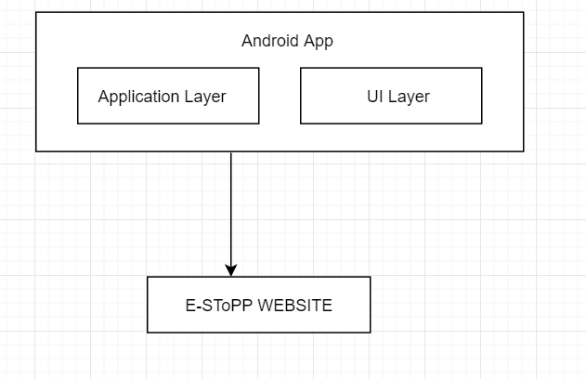
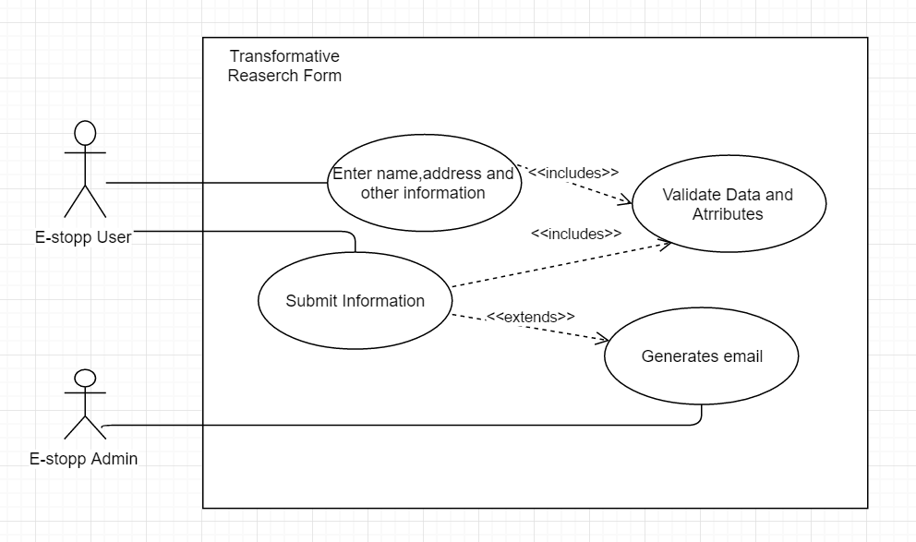




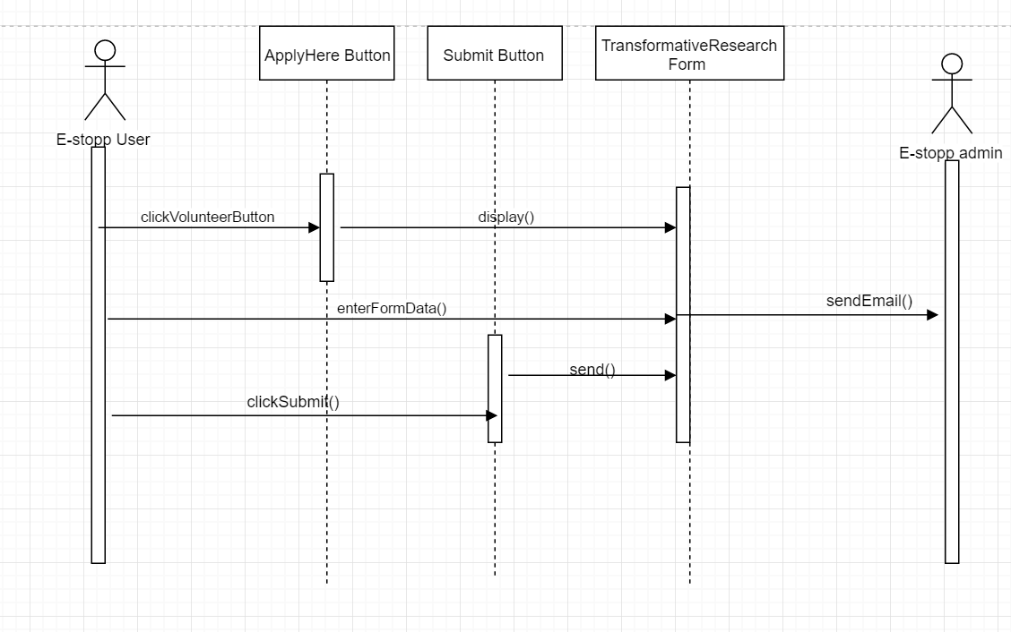
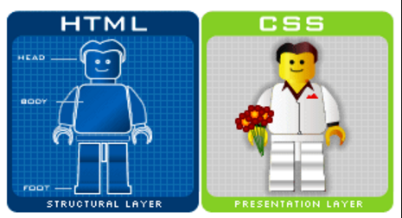
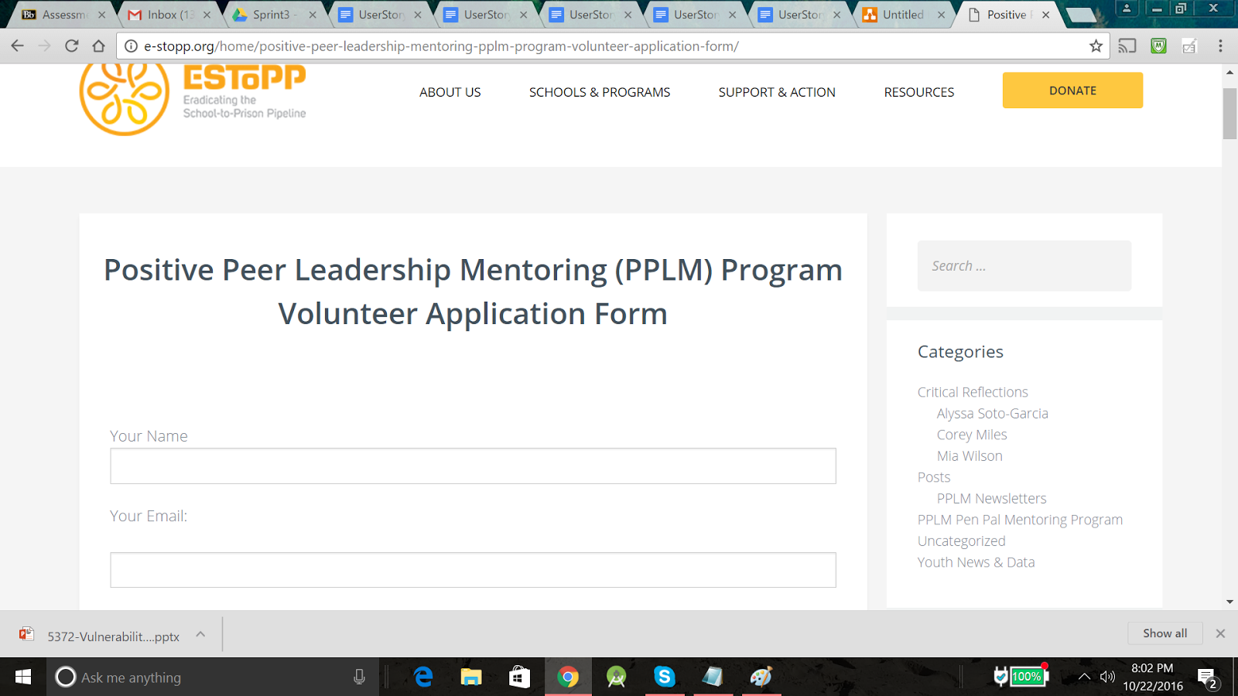
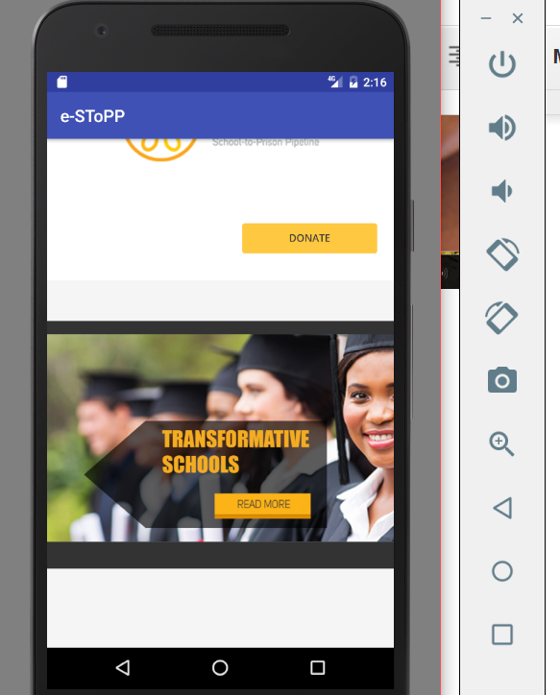
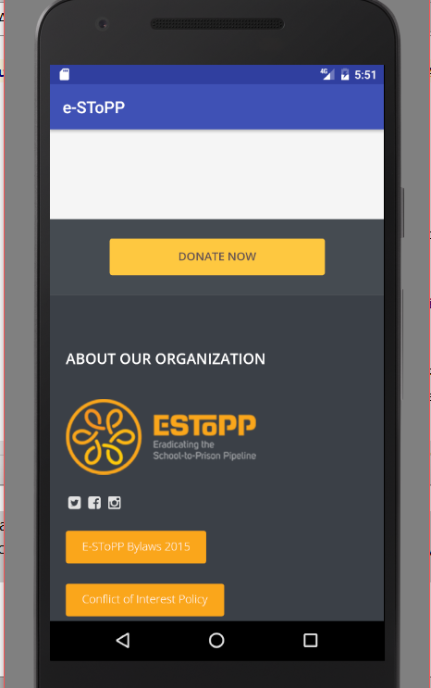
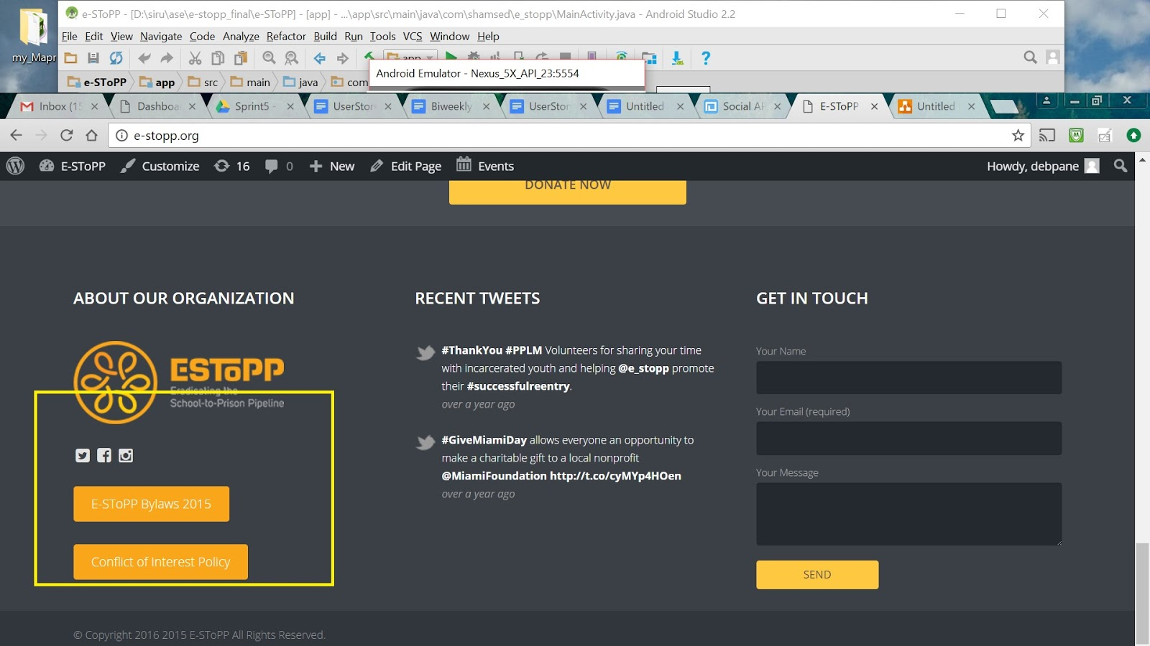
School of Computing & Information Sciences
Advanced Software Engineering, 2016, Fall
Social APP Ver 1.0
Student: Sirisha Singaraju, Florida International University
Mentor: Mohsen Taheri, Florida International University
Instructor: Masoud Sadjadi, Florida International University
Problem
Current System
Requirements
E-SToPP is a not-for-profit organization dedicated to eradicating the school-to-prison pipeline throughout southeastern Florida’s most economically disadvantaged communities. However, in order to reach out to a larger number of families and schools, a new social app needed to be developed for its website. Enhancements were also needed for the website and same had to be reflected on app.
Problems Solved:
Users needed easy access to the website information
Lot of paperwork involved for user attempting to enroll for any volunteer opportunities. Create online form submission process instead of offline PDF submission
Need to add new images to the website banner
App currently available for download in Google play store (E-SToPP App).
Website changes live at : http://e-stopp.org/
My Core Contributions :
--Build android app on android studio
--Add email functionality to contact us
webpage in Word press for website/app
--Convert the ‘Positive Peer Leadership
and Transformative Education Research
offline form submission to online
submission process
-- Create new banner with animations and
graphics for the website/app.
--Add new social media platform-
Instagram access from website/app
Provided functionality to users
-- Build a new app on android platform.
-- Convert the old offline form submission
process to an online one.
-- Create sign-up forms for users to subscribe
to.
-- Create new banner with animations and
graphics for the website/app.
-- Add search functionality to website
-- Expand horizons by linking the website to
new social media platform e.g.. Instagram.
System Design
Object Design
Implementation
App Built in Android Studio using Java
Website enhancements done in Word press using HTML and CSS
Banner images created in Adobe Photoshop
Verification
Screenshots
Summary
Test case 1 (Sunny Day) :
Purpose: When user enters the website and goes to Contacts page, after entering name, email and subject and message, it should send it to E-SToPP email address
Precondition:
The user should be in the Mobile App or in the Website
Input:
The user should input name, email and message correctly
Expected Result
The mail was successfully sent - Working OK
Test case 1 (Rainy Day) :
Purpose: Only email, no subject and message are given. Name is not given
Precondition:
The user should be in the Mobile App or in the Website
Input:
Click or touch on send button to attempt sending the email.
Expected Result
Message pops up - Validation errors occurred. Please confirm the required fields and submit it again.- WORKING OK
This Project is the first implementation (Version 1.0).
-- E-SToPP organization has tried to expand its
horizon and reach out to more people using
the Android App.
-- App offers the user the convenience of
accessing the website and all the
information regarding their volunteer
opportunities using their mobile phone itself.
--Signup for the opportunity of their interest
using the various online forms which are
now available.
-- As part of future work, an IOS app can be
developed too.
Acknowledgement
The material presented in this poster is based upon the work supported by mentor Mohsen Taheri and my professor Masoud Sadjadi I am thankful to the help that I received from my group members Shamshed.
Notes:
1

