Slide 1







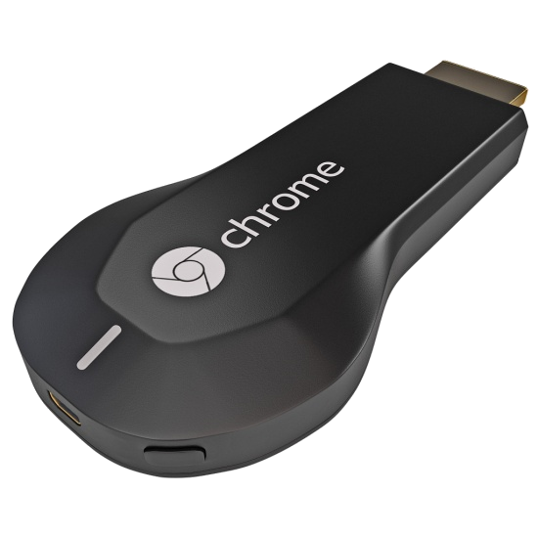
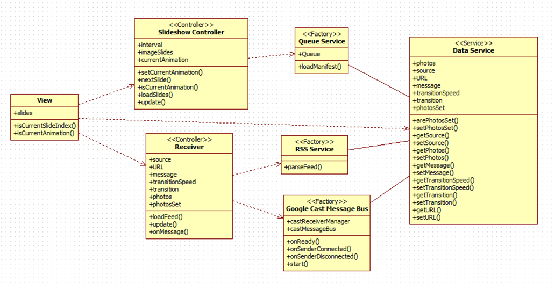
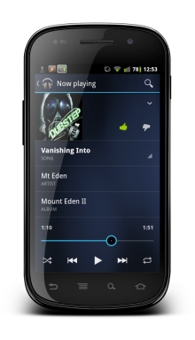
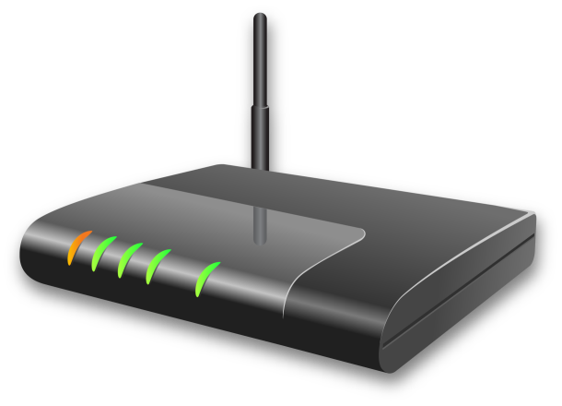

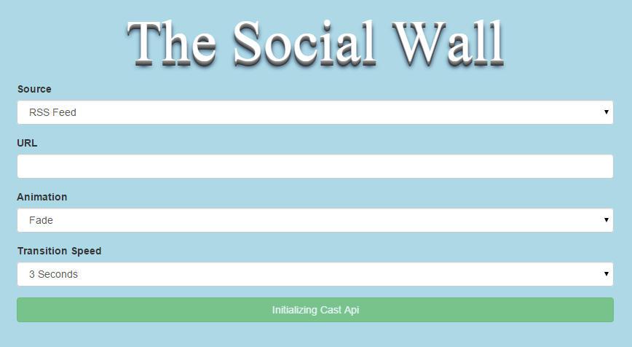
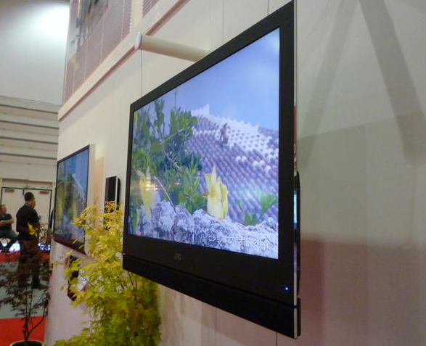
School of Computing & Information Sciences
Senior Project, 2014, Fall
The Social Wall
Student: Joseph Gonzalez, Florida International University
Mentor: Cortney Mills, Picture Marketing, Louis Zuckerman, Picture Marketing
Instructor: Masoud Sadjadi, Florida International University
The internet has become the largest database for media such as images, videos, music, and documents.
The problem our project, the Social Wall, seeks to resolve, is the inability for users to take advantage of media stored online. While it is currently possible to accomplish, it is normally tedious to set up and not highly available for most users. There does not exist a lightweight, yet powerful, and highly accessible method that takes advantage of today's highly accessible software and devices, both for the recreational and commercial users.
Current System
Requirements
Problem
In the current system, to retrieve photos from available resources online and display them to users in a slideshow format, both recreational and commercial users are forced to develop there own unique applications or depend on expensive services provided by companies. The functionality of creating a slideshow utilizing user photos stored online is one that is not currently available to users through highly accessible devices or software.
Allow users to set the source of the photos.
Allow users to cast a custom receiver application using a Chrome browser onto a Chrome cast.
Allow users to cast a custom receiver app using a mobile device onto a Chrome Cast.
Update the custom receiver application based on messages sent by user.
Allow user to digest photos from an RSS Feed
Allow communication of messages between User and Chrome cast receiver application.
System Design
Class Design
Implementation
The sender applications that allow interaction between users and Chrome cast devices running on both the Chrome desktop application as well as android devices were created using the AngularJS framework. The Cordova framework along with AngularJS allowed for the hybrid mobile application consisting of javascript, CSS, and HTML5.
The custom receiver application was implemented using the AngularJS framework, along with CSS, and HTML5.
The AngularJS framework was used in order to promote dependency injection, allow for an extensible project, and allow to facilitate testing of the application.
1 Sender Request
2- Retrieve
3- Request
4- Load Receiver App
Custom Receiver App
Class Diagram showing interaction between classes as well as MVC framework implementation.
Views
Updates
Controllers
Requests
Model
Sends Data
For this project, the MVC Architecture(Model-View-Controller) was used.
Verification
Images
Summary
Unit Testing:
Performed using behavior-driven development framework Jasmine. Tests were created utilizing this framework. Karma Test Runner was used in order to perform and run the tests on the system.
System Testing:
Performed utilizing behavior-driven development framework Jasmine. Tests were created utilizing this framework. In order to perform these tests on the system Protractor End-to-End test runner was used.
There exists a need for both recreational and commercial users to take advantage of the extensive media resources found online.
My solution to this problem is too have created a part of the Social Wall System. A lightweight, portable solution that provides a way for users to digest photos from the internet, and allow them to do this in an accessible way.
By utilizing highly accessible devices and software, such as android devices and the Chrome desktop application. My solution allows for users to communicate with Chrome cast devices through the creation of sender applications, and using this functionality to take advantage of media available online.
Future releases may improve the system by: expanding the image sources to those such as Facebook Users, Facebook Pages, Dropbox. Performing extensive testing on existing functionality.
Acknowledgement
The material presented in this poster is based upon the work supported by Cortney Mills and Louis Zuckerman. I am thankful for the help that I received
from my Family and group member: Juan Gonzalez

