Slide 1







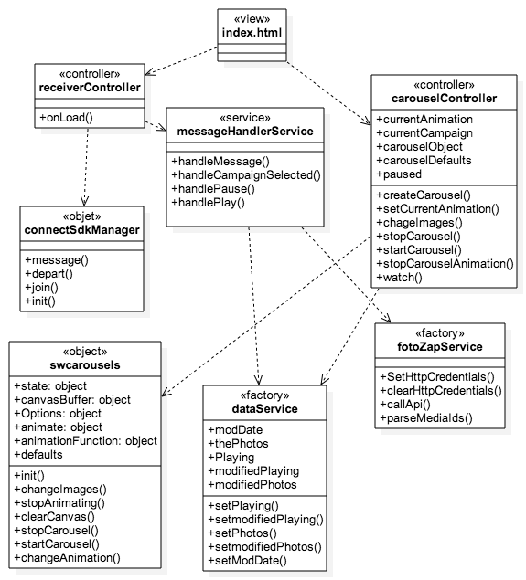
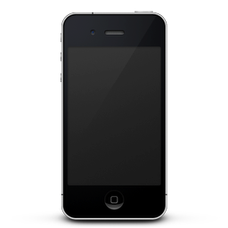

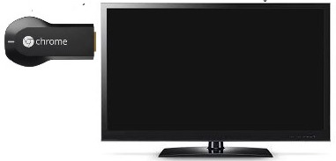
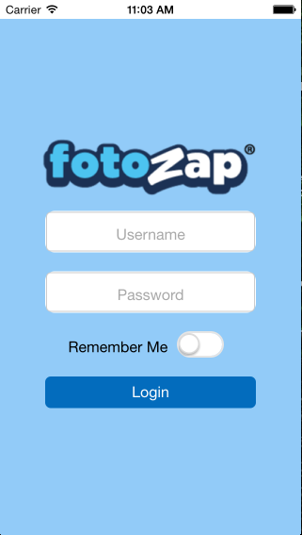
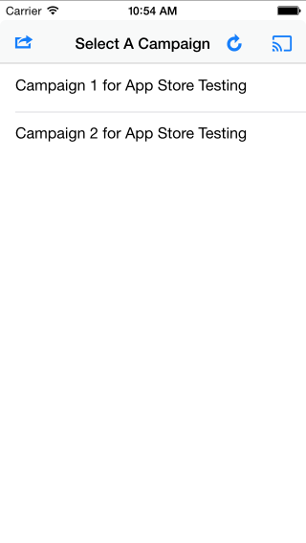
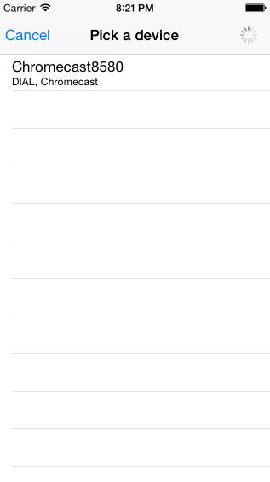
School of Computing & Information Sciences
Senior Project, 2015, Spring
The Social Wall Ver. 2
Student: Steve Noel, Florida International University
Mentor: Carlos Ocampo, Picture Marketing Developer
Instructor: Masoud Sadjadi, Florida International University
Problem
The Social Wall system aims to solve the inability of our users to easily and efficiently display their online photo albums in a slideshow format on any large screen they desire without the hassle of a complicated setup process. The system should also allow users to seamlessly customize their slideshows on the fly without hindering user experience.
With todays highly accessible software and hardware, the Social Wall project combines the latest innovations in mobile and web technologies to help users free and view their media wherever they want.
Current System
Requirements
There are many large screen image streaming alternatives available to users.
Presently users can either use web services from companies like Tintup which may charge $1000 dollars a month or more for certain features or users can use programs such as Microsoft's PowerPoint to create their own slideshows and deploy it on the screen. Some screens even have built in web applications that allow for viewing images.
However, all of these methods are either too expensive, too limited in their image sources, too tedious to setup or don’t offer the customization ability for users to customize to their liking.
All of the Requirements below where implemented by Steve Noel
The system shall allow users to login to the system.
The system shall allow users to connect to a Chromecast device.
The system shall allow users to disconnect from a Chromecast device.
The system shall allow users to select a campaign.
The system shall allow users to switch a campaign.
The system shall allow users to pause or play the slideshow.
The system shall allow users to logout from the system.
The system shall allow users to rejoin the web application.
System Design
Class Design
Implementation
This project was implemented using the web languages JavaScript, HTML, and CSS.The sender or mobile subsystem was created using the Sencha Touch Framework along with the Cordova native mobile platform to allow porting to the IOS device. The Chromecast receiver subsystem was created using the AngularJS Framework allowing for the use of the Model-View-Controller architecture.
Sender
Google Cast
Console
Receiver
Socket
Chromecast Receiver
Class Diagram
Verification
Screenshots
Summary
Unit Testing:
Tests where performed using the BDD testing framework Jasmine and Siesta. The Karma test runner was used in order to perform and run the tests on the Chromecast receiver subsystem.
Integration Testing:
Tests where performed using the BDD testing frameworks Jasmine and Siesta. The Karma test runner was used in order to perform and run the tests on the use Chromecast receiver subsystem.
The Social Wall system uses the latest web and mobile technologies to allow users to easily and efficiently display their images in a slideshow format on any large screen. It utilizes the Chromecast device and the IOS mobile platform to seamlessly combine the usability of the mobile platforms with the high definition display of big screens.
Login
Screen
Campaign
Screen
Device Picker
Screen
Acknowledgement
The material presented in this poster is based upon the work supported by Carlos Ocampo ad Louis Zuckerman of Picture Marketing.

