Slide 1











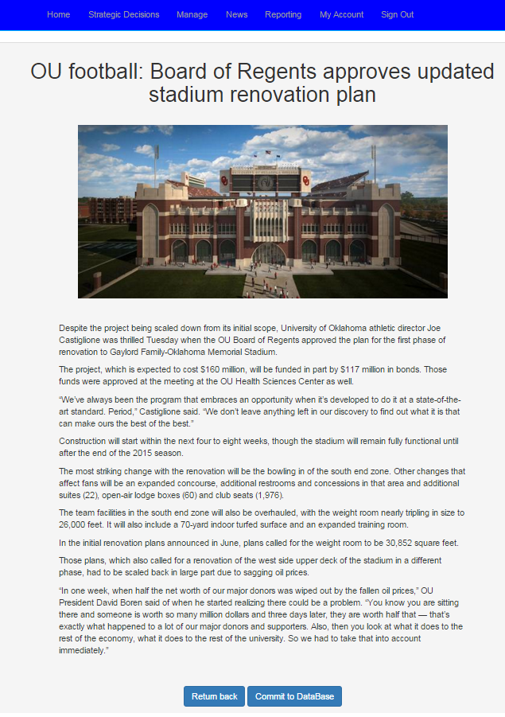
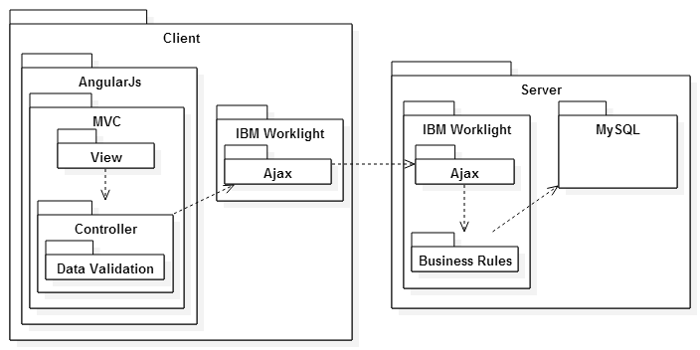
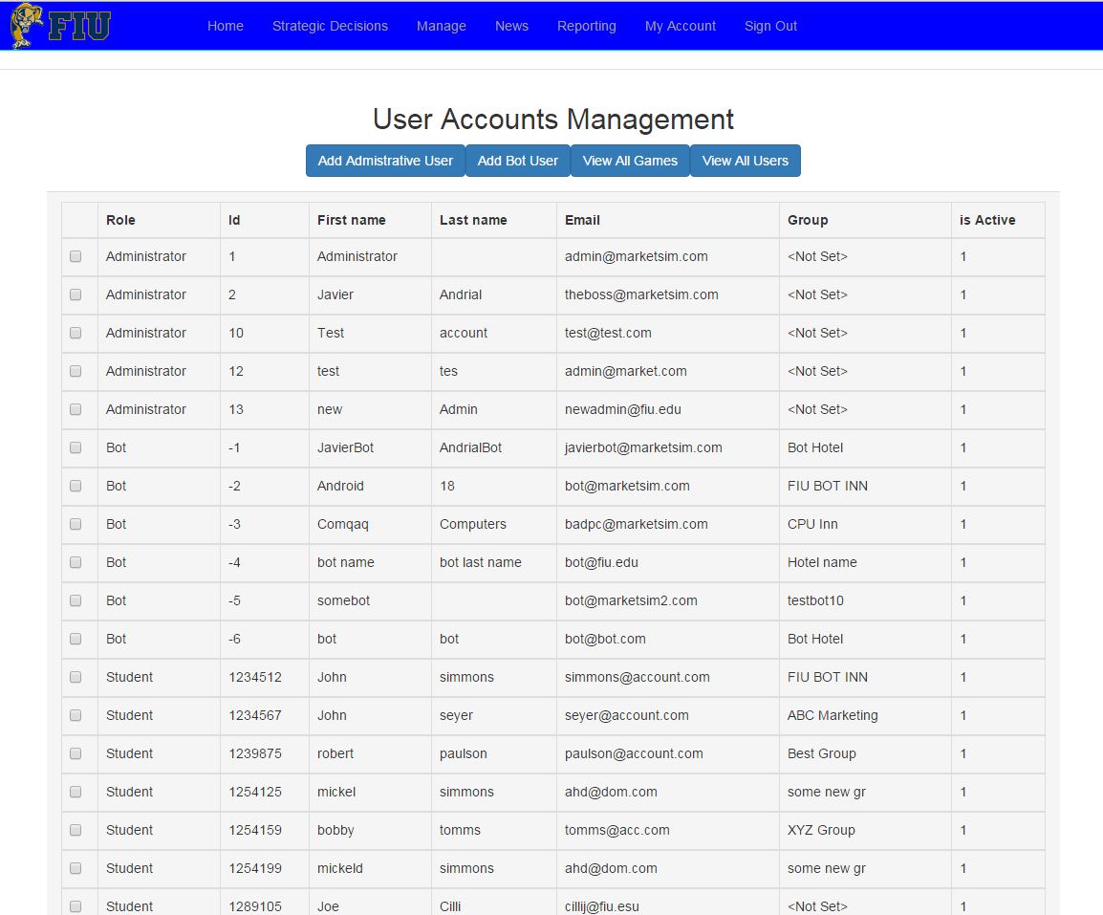
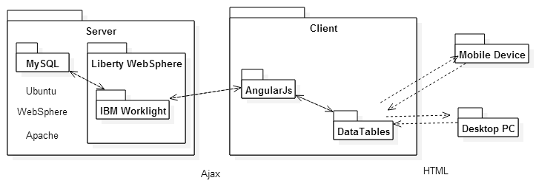
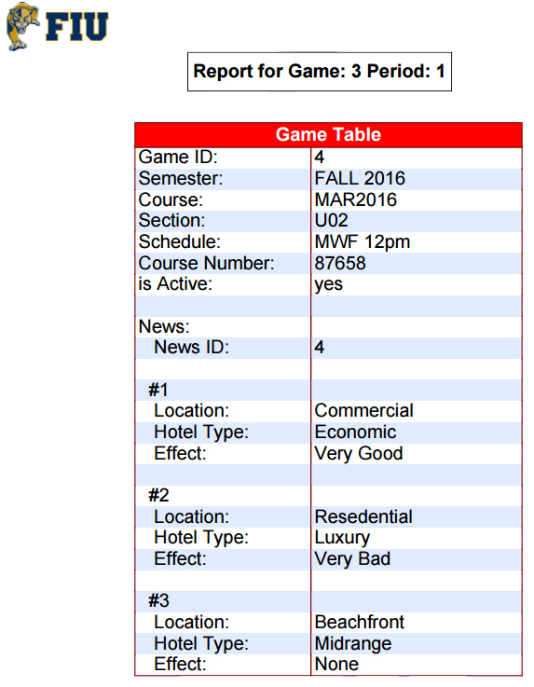
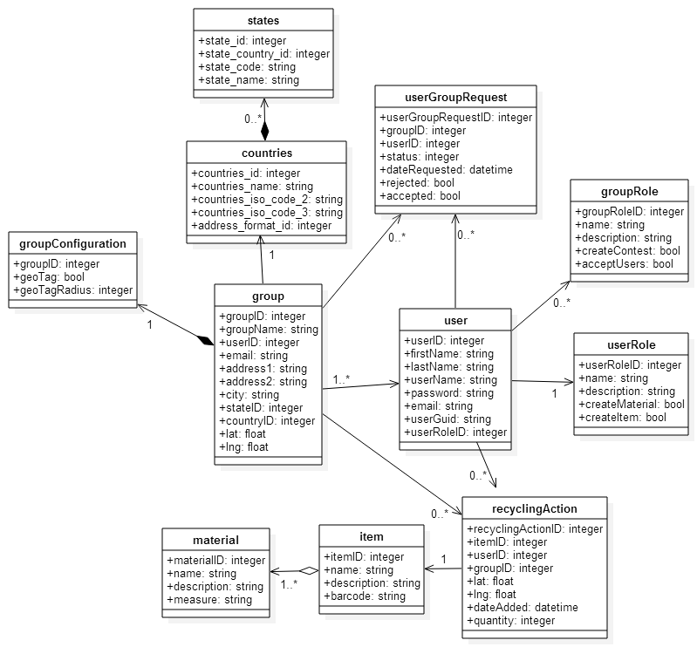
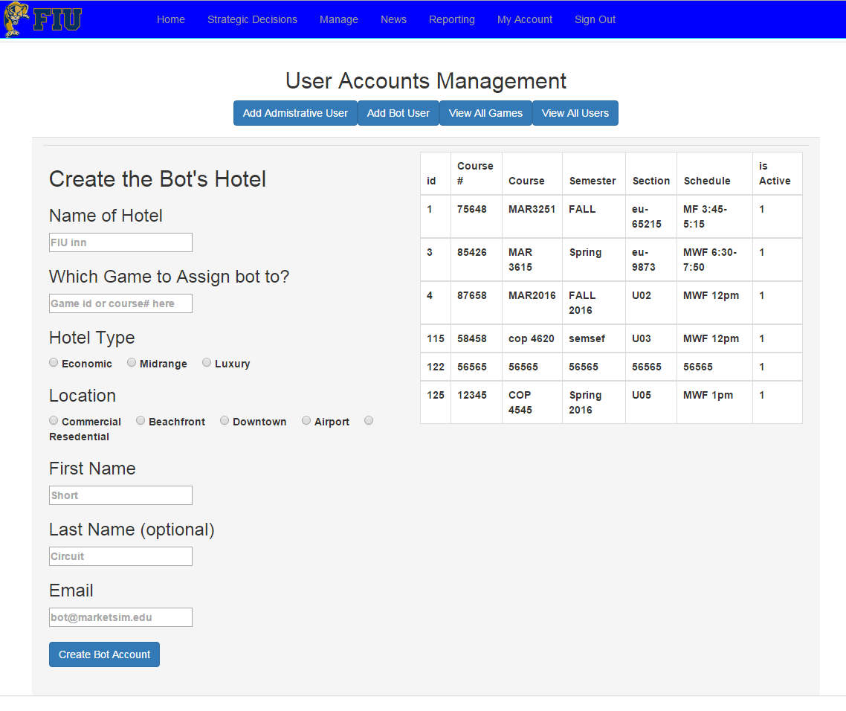
School of Computing & Information Sciences
Senior Project, 2015, Fall
Strategic Marketing Simulator 1.0
Student: Javier Andrial, Florida International University
Mentor: Josiah Bradley, FIU
Instructor: Masoud Sadjadi, Florida International University
Problem
Screenshots
System Design
FIU Marketing department is looking for a competitive market simulator, which can simulate a sudo realistic environment, where students can create and run their own hotels. Students will compete amongst each other for market share, as well as handling external variables, such as hurricanes or a super bowl.
We used a simple client-server architecture to develop the application overall.
On the client side we are using AngularJs which uses an MVC architecture.
The server side consists of only IBM worklight, which uses Javascript through out as its base programming language.
Current System
The current system in place is a lecture and debate system where the instructor and his or her students discuss how scenarios for marketing and how they might affect a market
Requirements
Figure 1: System Design
The system must adhere to 3 basic requirements:
Students select strategic decisions in small groups.
The market is affected proportionately to the decisions made.
Students must give reasons for their decisions and receive feed back from the instructor
A simulation must be broken down in intervals called periods to allow for their to be measurable progress in the understanding of how the market is being affected.
Figure 4: “News article ” News Page
Implementation
The system was implemented using the MVC pattern design which uses the client-side web browser with HTML and Javascript for the views and PHP on apache server for the backend calculation game simulations and manipulation of data.
The models was designed using a MySQL MariaDB using a 64 bit hash to protect sensitive user information using PHP mysqli class to carry out the queries.
Verification
Figure 5: “View All users” Management page
Figure 2: Implementation Design
Verification was accomplished using PHPunit to validate assertions for the model’s query functions and the system’s controller functions and objects
Object Design
Summary
My responsibility was to come up with the overall database design that you see below. I was also tasked with creating the pages and framework by which the data made its way to the database to be stored.
Acknowledgements
Figure 6: PDF generated Report
The material presented in this poster is based upon the work supported by Joseph Cilli.
Without the guidance and knowledge of computing from my mentor, Josiah Bradley. The learning curve for this project would’ve been much more difficult and would not have become the success that it is today.
I also am thankful to the help that I received from my group members, Jeffery Carman.
Figure 3: Implementation Design
Figure 7: Creating a bot user screen. Manage Page

