Slide 1








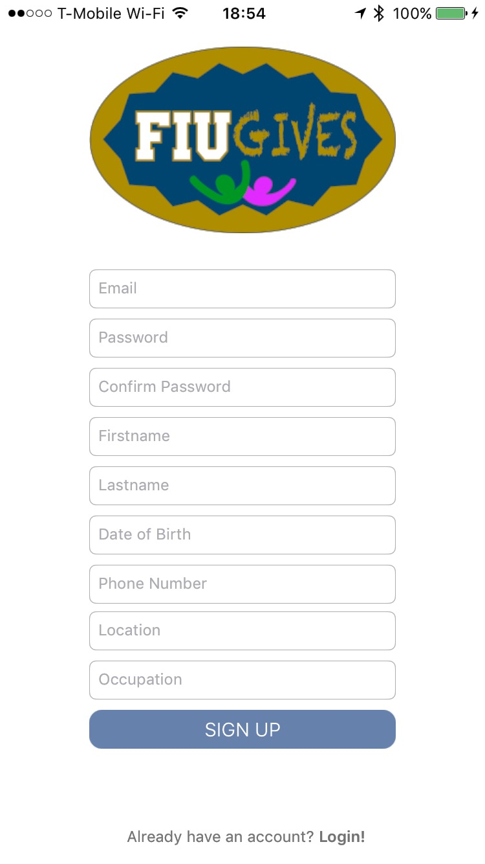
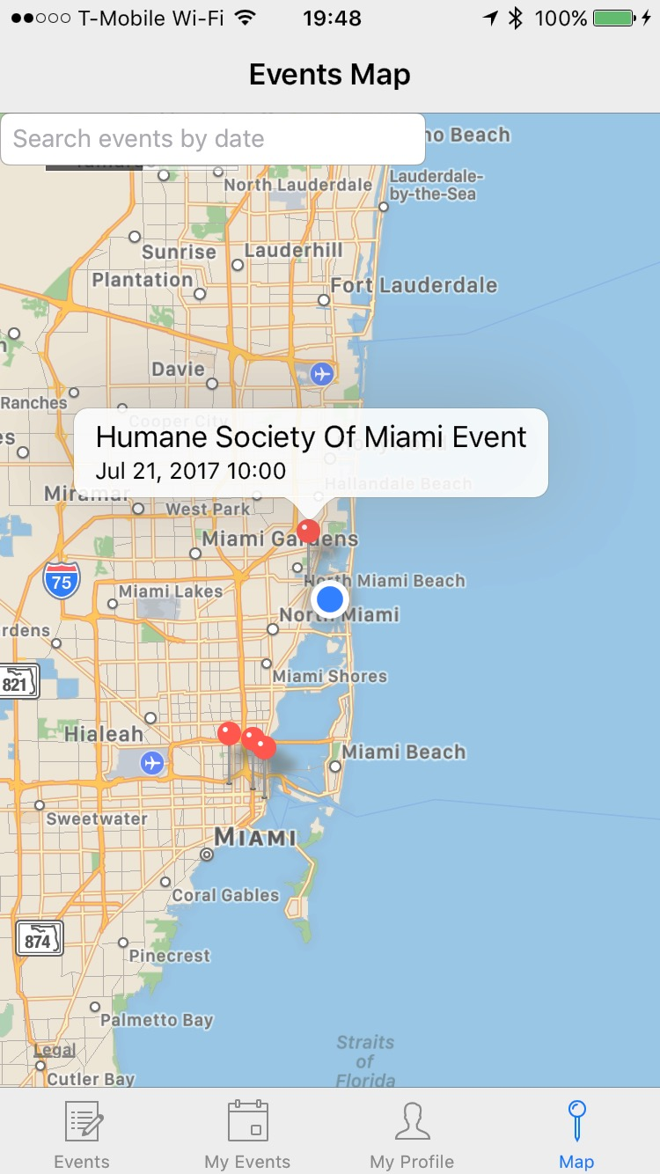
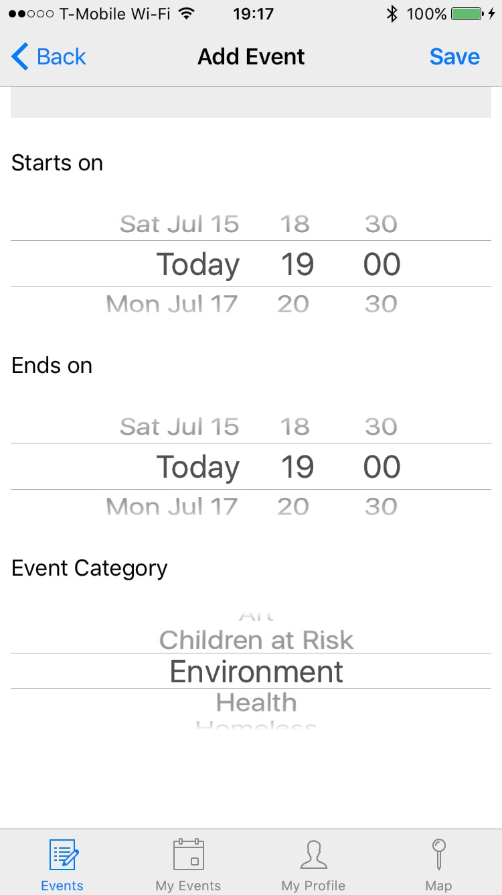
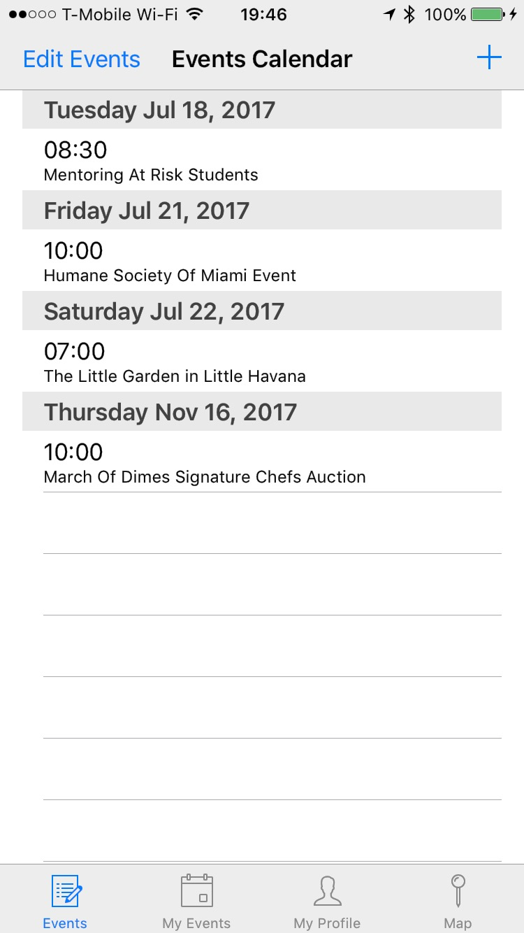
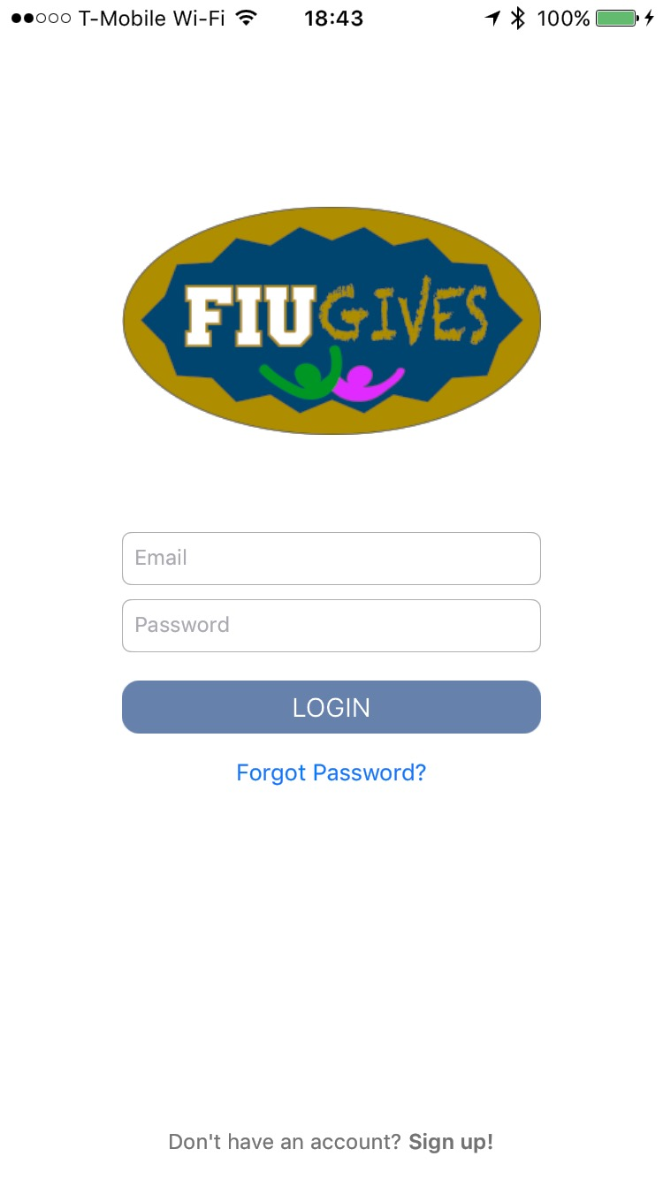
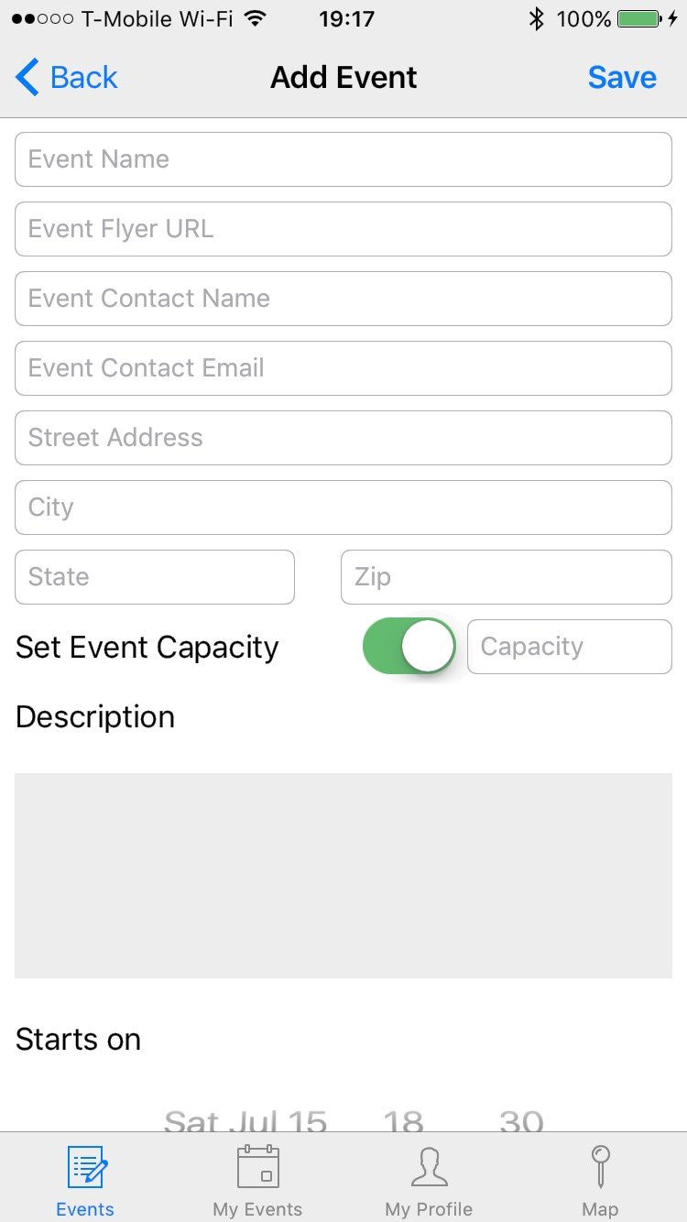
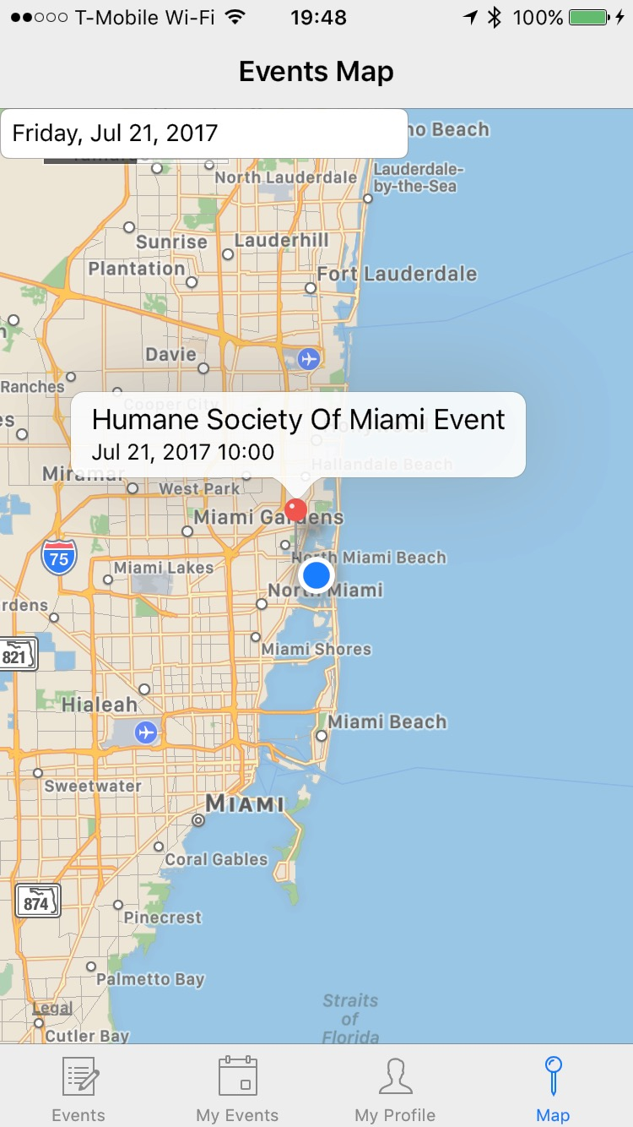
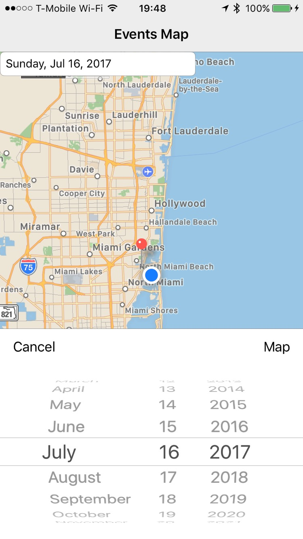
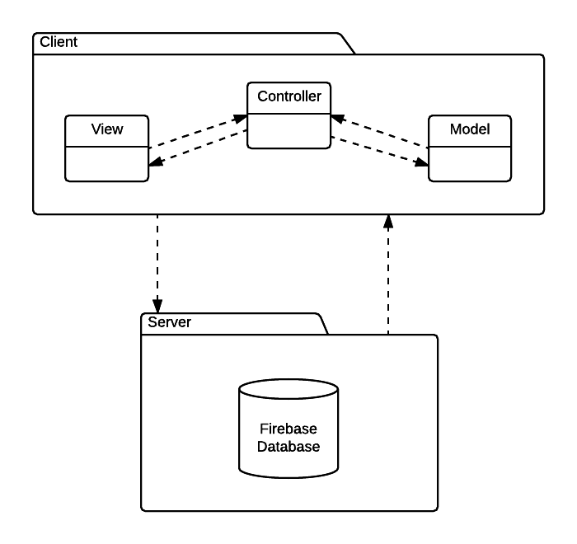
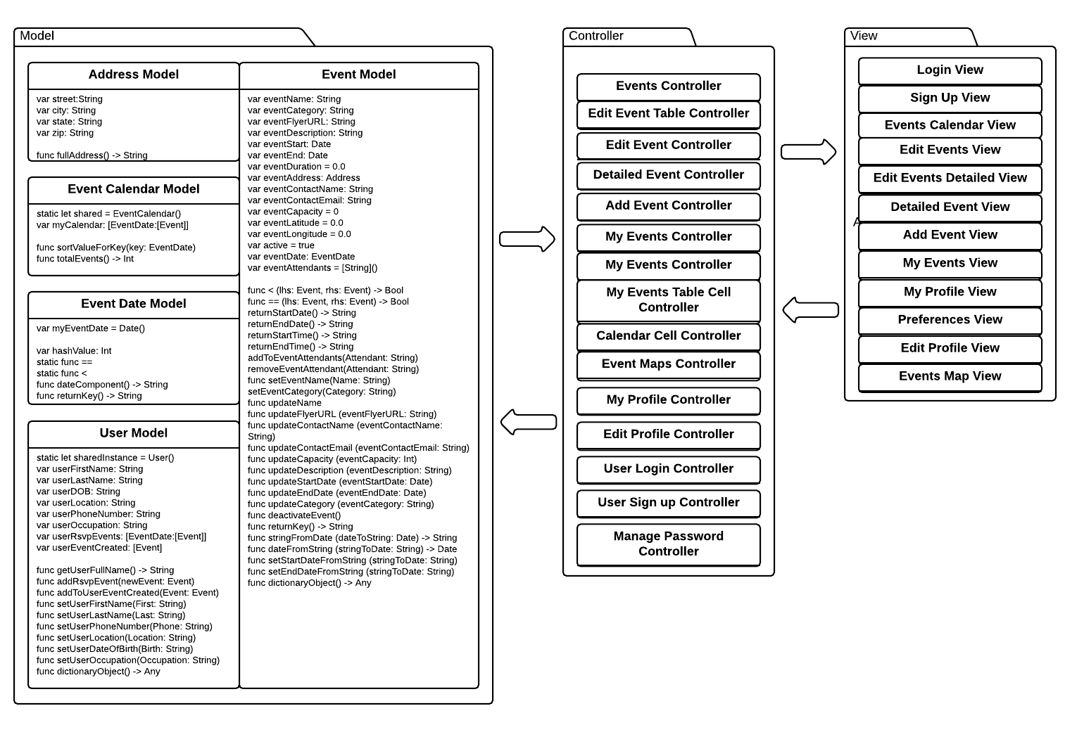
School of Computing & Information Sciences
Senior Project, 2017 , Summer
Streamlining Community Service Process at FIU 1.0
Student: Ekaterina Gumnova, Florida International University
Mentor: Allen Varela, Florida International University
Instructor: Masoud Sadjadi, Florida International University
Problem
FIU Honors College students need to have a simpler and more efficient way to access community service opportunities.
Students need to have a centralized access to volunteering opportunities in their area on the go.
The application needs to raise awareness among community members of the society problems.
Solution
FIUGives is an application that streamlines community service opportunities to a mobile device.
Students will be able to create, view, locate volunteering events, and schedule them to their devices’ calendars.
The application provides a combined functionality of an event scheduler, a calendar, and a map.
Current System
The current Honors College system allows students to view volunteering opportunities and to submit their community hours on the website.
Current system does not have a mobile application.
The current application does not provide a way to sort through all the events in the system.
Screenshots
Requirements
A User should be able to access the following functionalities:
Sign up and login.
View a list of volunteering events.
Add/edit/RSVP/cancel RSVP to an event.
Add event to the phone calendar.
View a calendar with events.
View and edit profile.
View events on a map.
Filter events by date on the map.
Share event on Facebook.
System Design
Implementation
The project was
implemented using Xcode SDK.
Implementation language: Swift.
Apple frameworks: UIKit, MapKit, CoreLocation.
Third-party frameworks library: CocoaPods.
Other frameworks: JTAppleCalendar, Firebase.
Database and user authentication are implemented using Firebase.
Verification
Xcode was used to perform unit testing for data models and their methods.
Functional testing was done manually using Xcode simulator and iPhone 6S.
Main focus was on manual usability testing to verify that the mobile application offers a flexible, intuitive, and user friendly experience.
Object Design
Summary
FIUGives was created to provide students and faculty easier access to the community services network.
The application provides an intuitive and user friendly experience to create and access events, thus engaging people in the community.
Acknowledgement
I am thankful to the help that I received from my group members, Kathryn Bello, and FIU Honors College students, Lucas Pizzutti and Betssy Rodriguez, who came up with an idea of FIUGives application .
Notes:
1

