Slide 1








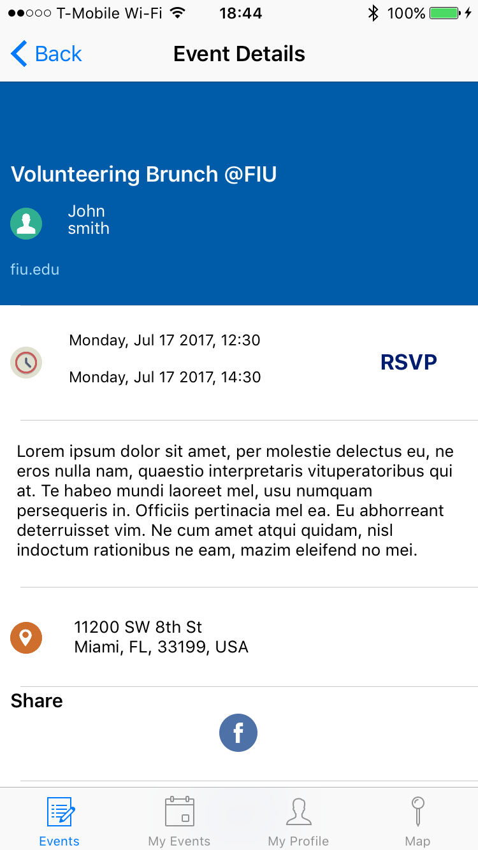
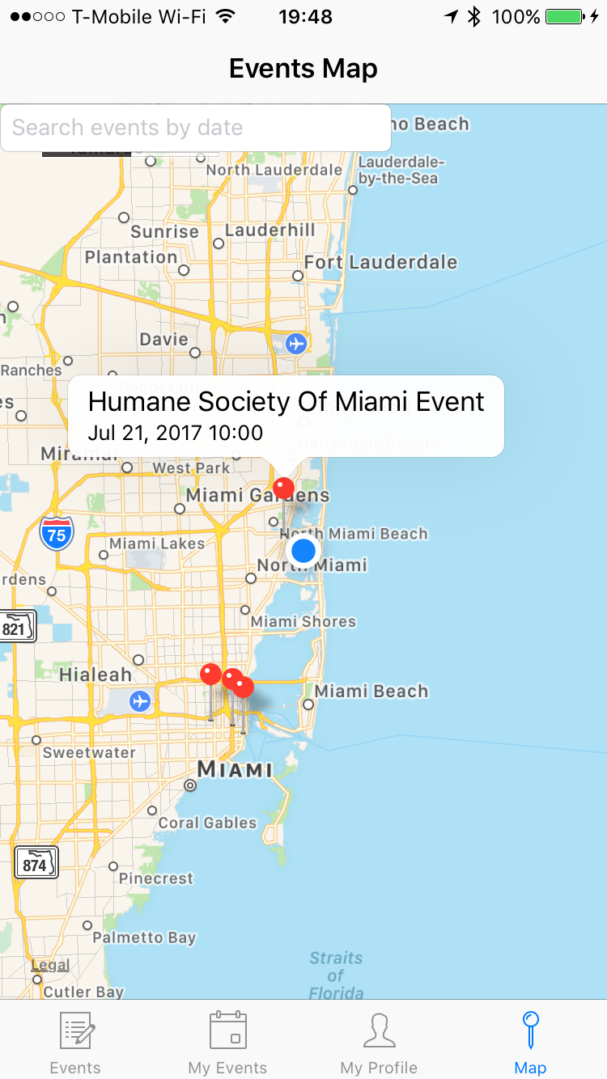
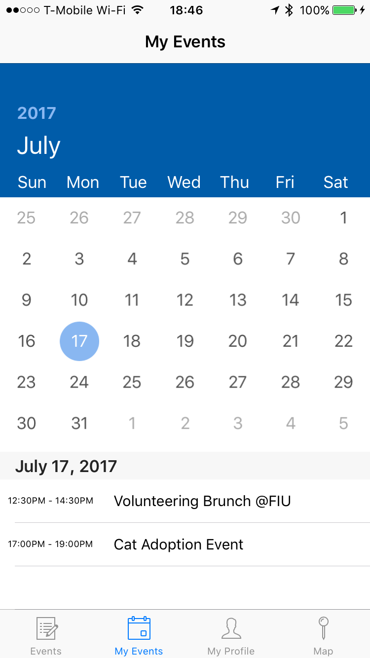
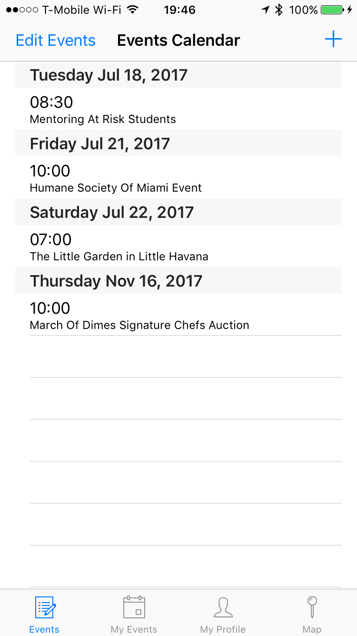
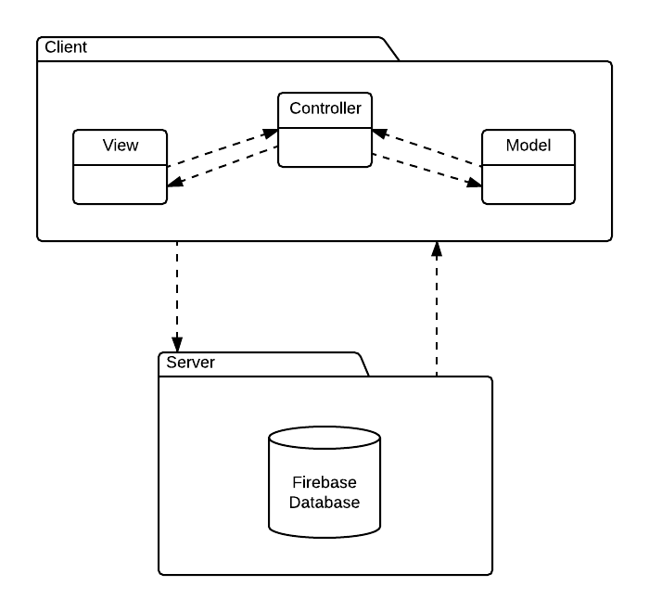
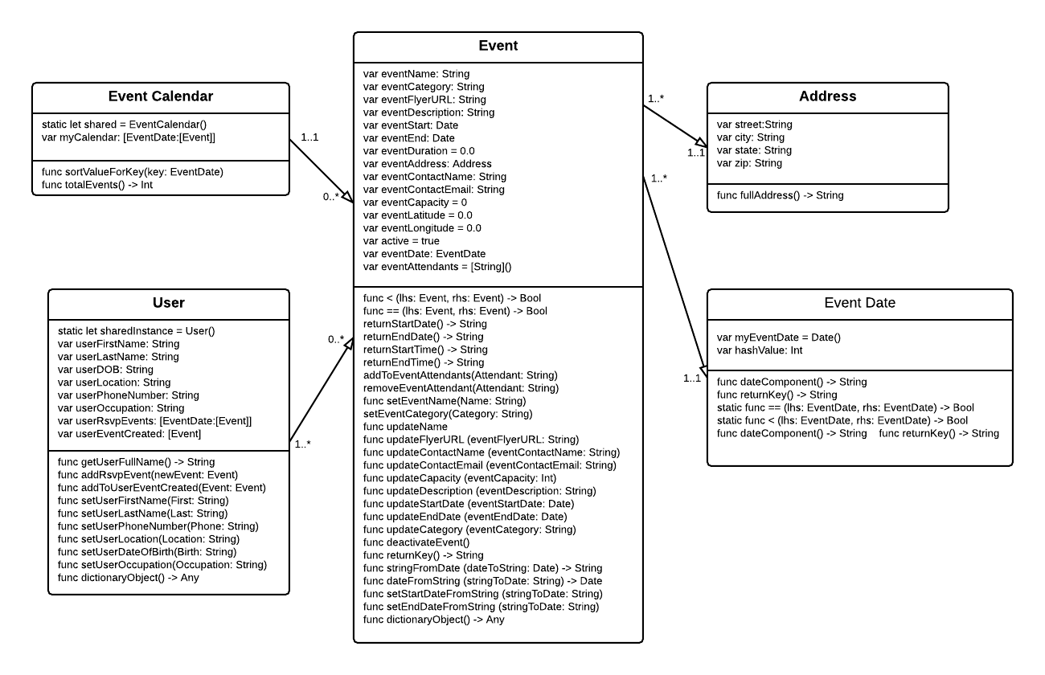
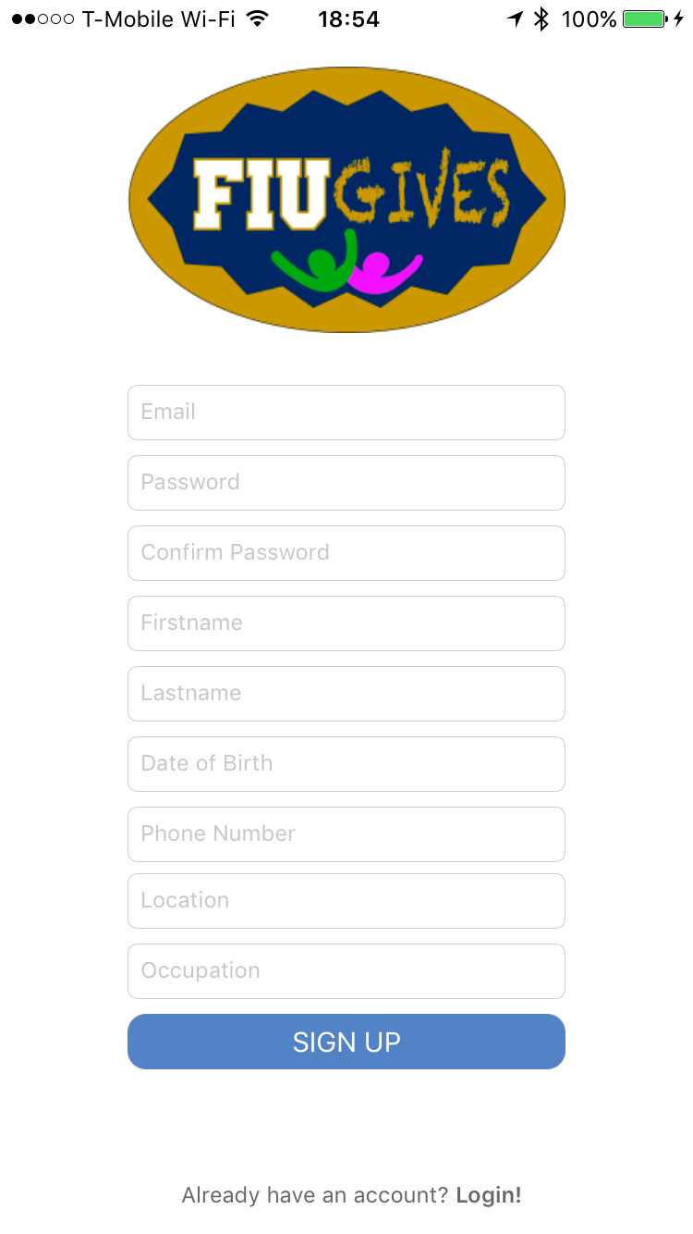
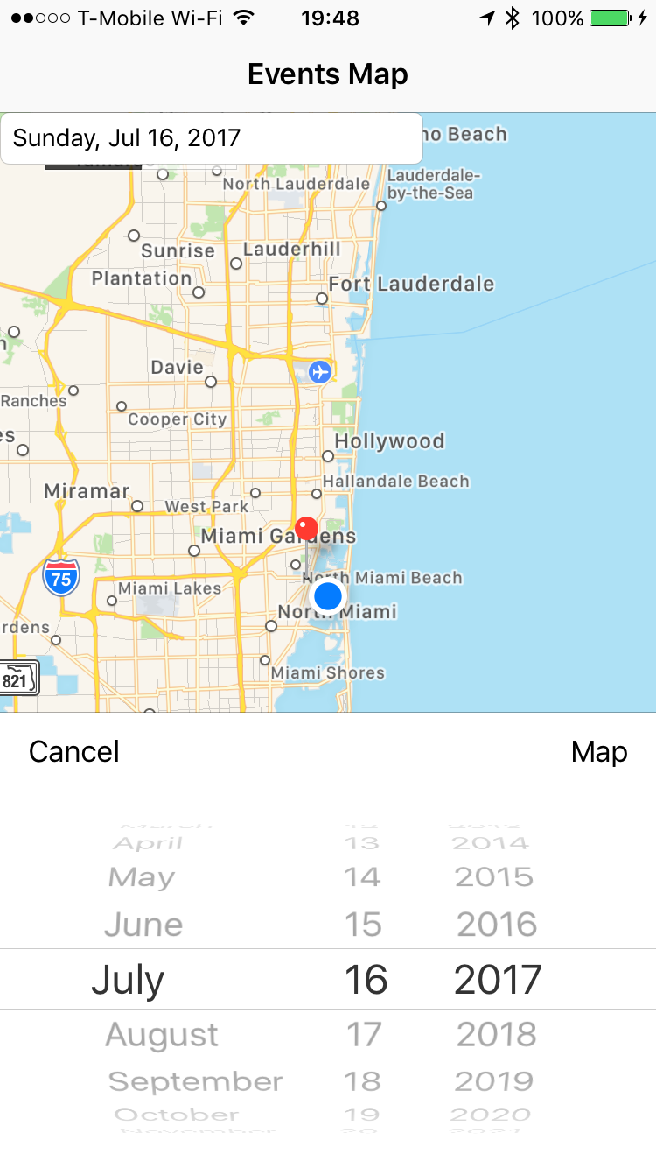
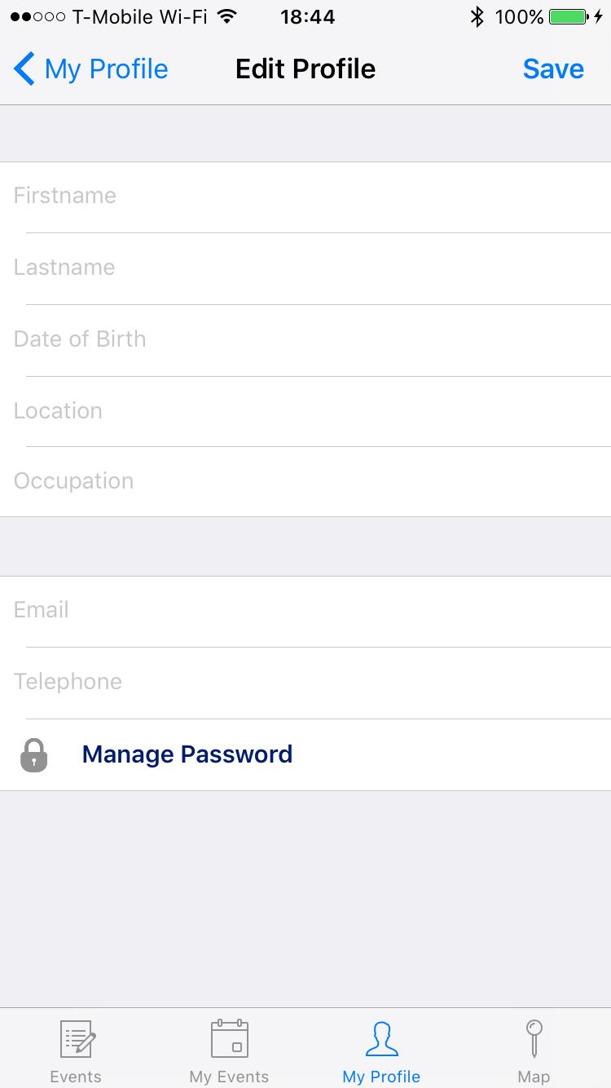
School of Computing & Information Sciences
Senior Project, 2017, Summer
Streamlining Community Service Process 1.0
Student: Kathryn Bello, Florida International University
Mentor: Allen Varela, Florida International University
Instructor: Masoud Sadjadi, Florida International University
Problem
Solution
Current System
The project owners requested a more efficient way to find and keep track of community service events available to honors college students.
This mission was expanded to members outside of the FIU community because there is no centralized place to view volunteering events.
Our proposed solution is a mobile application that streamlines community service search and the rsvp process.
This application allows users to create, view, filter, locate, and rsvp to volunteering events by combining the functionality of an event scheduler, calendar, and map.
The honors college website does not provide a convenient mechanism for keeping track of events that a user is interested in or rsvp’s to.
There is no way to sort through all of the events in the system and there is no mobile application.
Outside of the FIU community, there exists mobile applications for volunteering but they are not intuitive for users.
They do not have standardized requirements for event registration.
Figure A. All of the event’s information can be viewed in “Event Details”. This is also where a user is able to share the event, rsvp, and view a list of other people attending.
Figure B. The event map displays all of the registered events available in your area.
Requirements
676 – Sign up
663 – Login
671 – Rsvp to Event
Rsvp adds event to iPhone calendar
672 – View Rsvp Calendar
673 – Cancel Rsvp
664 - View User Profile
665 - Update User Profile
675 – Share Event on Facebook
Figure C. My Event Calendar
Figure D. Events Calendar
System Design
Figure A. Event Details
Figure B. Events Map
Implementation
Figure C. “My Events” is a calendar that displays the events that a user has rsvp’d to.
Figure D. “Events Calendar” is a calendar in table form that displays all of the registered events that have been filtered by user preferences and sorted by date.
The project was implemented using Xcode Software Development Kit. The main implementation language is Swift. Some apple native frameworks were used, such as MapKit, CoreLocation, EventKit and UIKit. We used cocoapods as a library for third party frameworks, such as JTAppleCalendar, Firebase, and Facebook share API. Authentication and database storage were both implemented using Firebase. The data is stored as JSON objects and synchronized in real-time.
Summary
Thus, the first prototype of Streamlining Community Service Process provides a simple and efficient solution to the owner’s problem of not having a centralized and user friendly place for volunteering events. This project can be expanded and improved into a social media platform to fully accomplish the owners goal of engaging people in the community.
Verification
The unit testing was implemented using Xcode to test the model classes and their methods. Functional testing was done manually through the Xcode simulator and iPhone 6S.
We performed usability testing with multiple users to verify that the mobile application offers a flexible and friendly user experience.
Object Design
Figure E. Signup.
Figure F. Events Map filtered by date.
Figure G. Edit Profile.
Acknowledgement
The material presented in this poster is based upon the work supported by Kathryn Bello. I am thankful to the help that I received from my group member Ekaterina Gumnova, mentor Allen Varela, project managers Betssy Rodriguez and Lucas Pizzutti, and lastly, instructor Masoud Sadjadi
Notes:
1

