Slide 1










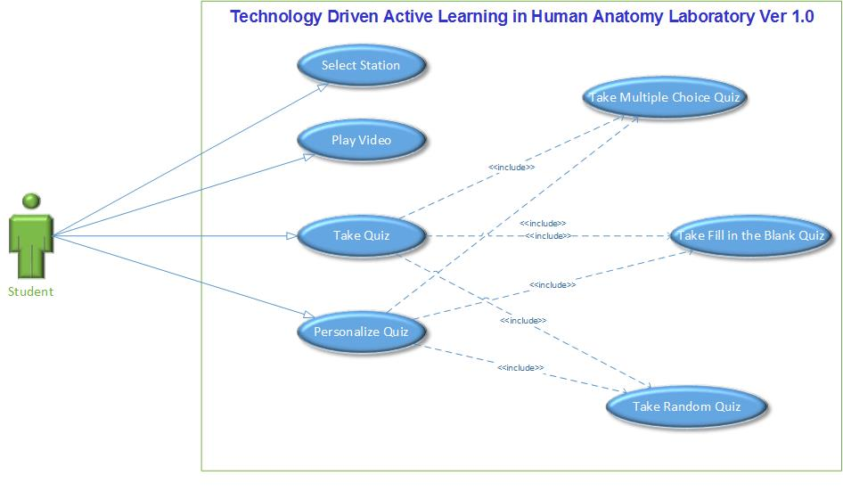
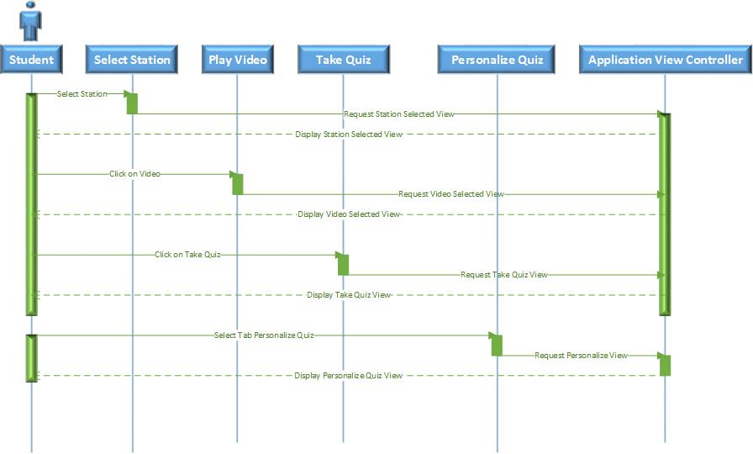
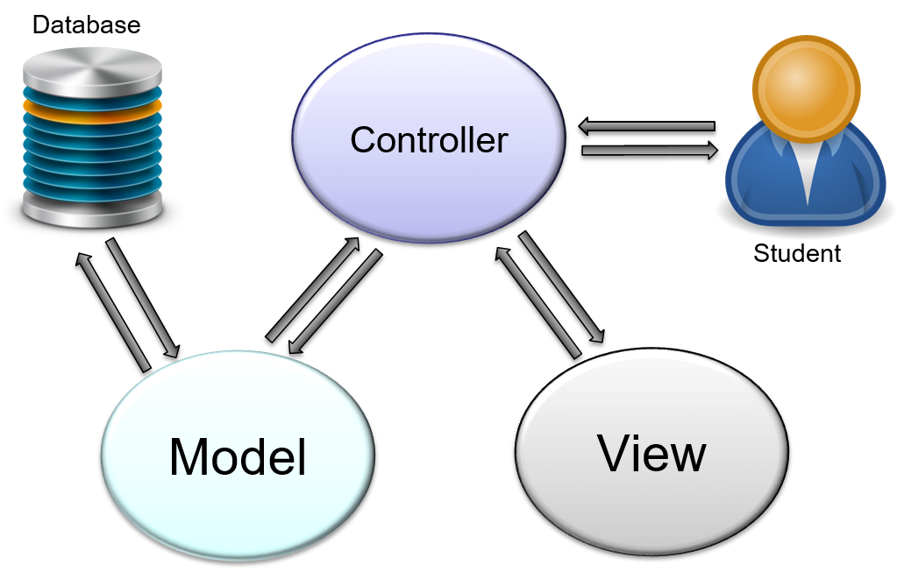
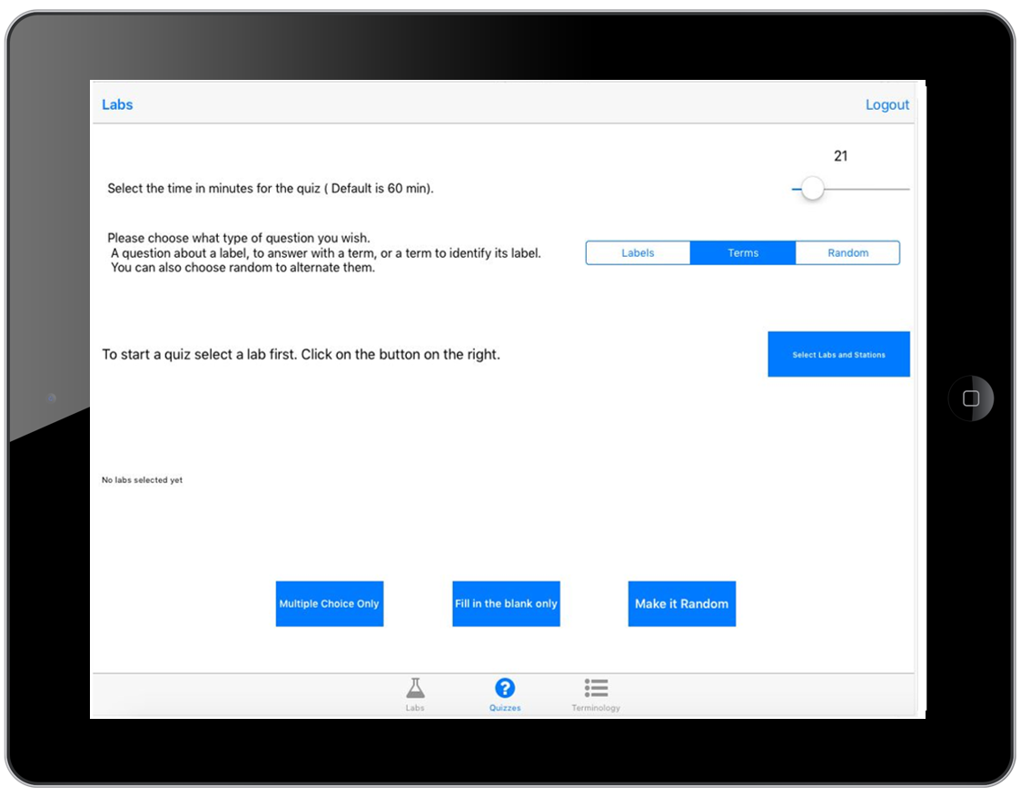
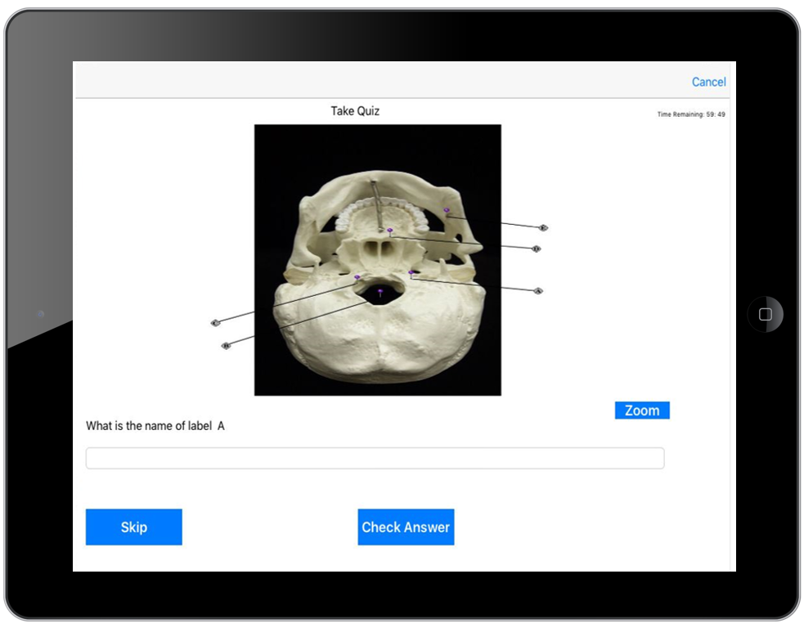
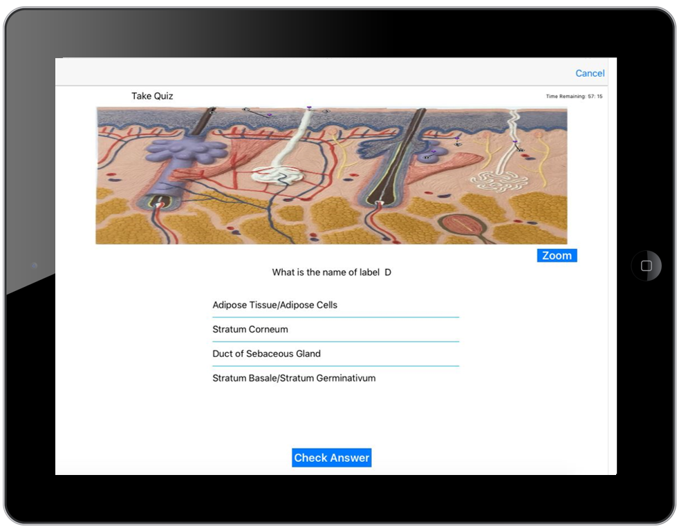

School of Computing & Information Sciences
Senior Project, 2016, Fall
Technology Driven Active Learning in Human Anatomy Laboratory Ver 1.0
Student: Darian Mendez, Florida International University
Mentor: Mohsen Taheri, Florida International University
Mentor: Dr. Lisa Brinn, Florida International University
Instructor: Masoud Sadjadi, Florida International University
Problem
Florida International University provides unique plastic human models for the Human Anatomy Lab. The students that takes this lecture can only see a specific part of the plastic human model one time during the lecture that covers this specific model. After that class the students don’t have access to the same model again. For this reason, students utilize the lecture time taking pictures of the model instead of learning it. This behavior is affecting their grades negatively. In addition, if the student don’t take the pictures, then they lack material to study for the tests later on. This is leaving students with the impossible choice of taking pictures or paying attention to the lecture.
Solution
The solution to the problem is provide students with an environment that will help them study for the test. The environment should provide the students with all the lecture materials, and necessary tools to study:
The students need to have access to pictures of the unique FIU plastic human models.
The students need to have access to videos explaining the models in detail.
The students need to take practice quizzes to test their knowledge.
An IPad application is perfectly suited to provide the solution to this problem. This is why The Technology Driven Active Learning in Human Anatomy Laboratory Ver 1.0 IPad application was developed to help student improve their Human Anatomy Lab experience.
Requirements
The Technology Driven Active Learning in Human Anatomy Laboratory Ver 1.0 IPad requirements are:
Simulate the class structure in the application by distributing the data into labs. Then for each lab, organize the data in stations.
Student should be able to select a station of a selected lab.
Student should be able to see the videos of the selected station.
Student should be able to take a quiz of the selected station.
Student should be able to take a Multiple choice quiz.
Student should be able to take a Fill in the blank quiz.
Student should be able to receive a grade after the quiz.
Student should be able to personalize the settings of the quiz.
Student should be able to change the time for a quiz.
Student should be able to change the type of question.
Student should be able select the material for the quiz.
Implementation
Anatomy Lab application was created in Xcode using version 2.3 of Swift. Third party libraries were also used, such as:
SwiftyJSON
PopupDialog
Font Awesome
IQKeyboardManager
Realm
Google Sign In
We used Cocoapods to manage the application, which is a dependency manager for Swift and Objective-C projects.
Application was developed using:
IDE: Xcode 7.3.1
Development OS: Mac OS X 10.11 (El Capitan)
Target iOS version: 9.3.5
Target device: iPad (Landscape orientation)
Language: Swift 2.3
Current System
There is currently no system that will help the FIU students taking the Human Anatomy Lab to study. The Technology Driven Active Learning in Human Anatomy Laboratory Ver 1.0 IPad application is the first of its kind. The IPad application have the following features that I had developed:
Select a station of a selected Lab.
Watch the video of the selected station.
Take a quiz for a selected station.
Personalize the quiz experience.
All the quiz data for Lab 1 is ready to be use.
All the videos for Lab 1 are ready to be use.
System Design
The system design that we selected was MMVC because it provides are more efficient way of accessing, and preparing the data for the view. This design also reduces the load of the Controllers classes.
Object Design
Verification
Screenshots
Summary
The Technology Driven Active Learning in Human Anatomy Laboratory is a groundbreaking IPad application that will transform the way that students at Florida International University study for the Anatomy Class. The students will be able to watch videos, take quizzes, and access pictures, of the plastic human models, with its corresponding terms definition. The application will provide the student with the option to change their quizzes experience to match what is best appropriate for them. The Technology Driven Active Learning in Human Anatomy Laboratory IPad will definitively provide the students with all the necessary tools to triumph in the Human Anatomy Lab.
As a version 1.0 the Technology Driven Active Learning in Human Anatomy Laboratory application is the backbone for future generations to come in, and improve it. This is why our design was focus on making it easy to add new material, maintain, and reuse. This design will facilitate the development of future versions of the application.
Our end goal is to revolutionize the way that teaching is done by moving to a more mobile friendly environment. We hope that our application will encourage other teaches to follow this approach for their classes.
Test case ID: UT_US_001 ( Sunny Day)
Test Title/Name: Select Personalize Quiz Tab.
Test Description: The user is in the Lab Tab, and decide to move to the personalize quiz view..
Pre-condition:
1-The user is log in with a valid user name
2- The user is in the Lab Tab View.
Test Steps:
The user clicks in the Quiz Tab.
Expected Result:
The Personalize Quiz view is displayed.
Actual Result:
The Personalize Quiz view is displayed.
Actual result: PASS
Test case ID: UT_US_001 ( Rainy Day)
Test Title/Name: Select Personalize Quiz Tab.
Test Description: The user is in the Lab Tab, and decide to move to the personalize quiz view, but the user select the Term View.
Pre-condition:
1-The user is in log in with a valid user name
2- The user is in the Lab Tab View.
Test Steps:
The user clicks in the Terms Tab.
Expected Result:
The Term view is displayed.
Actual Result:
The Term view is displayed.
Actual result: PASS
Acknowledgement
The material presented in this poster is based upon the work supported by Mohsen Taheri, I am thankful to the help that I received from my group members Hector Cen.
Notes:
1

