Slide 1





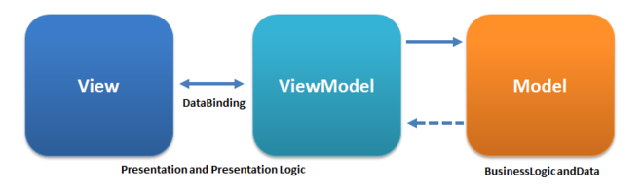
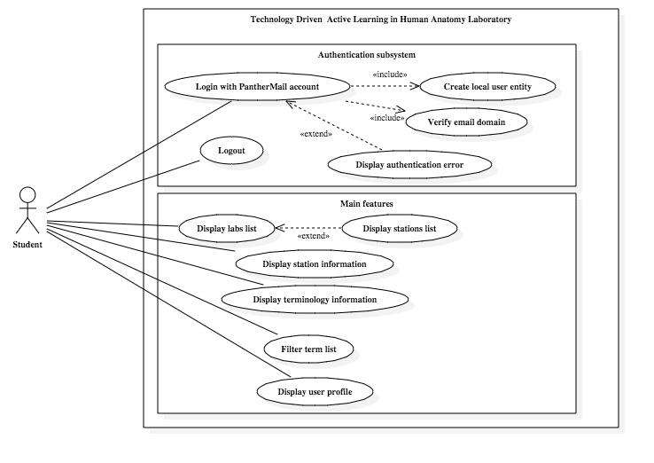
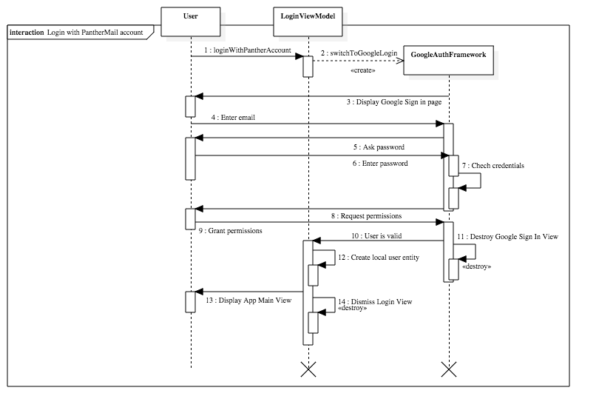


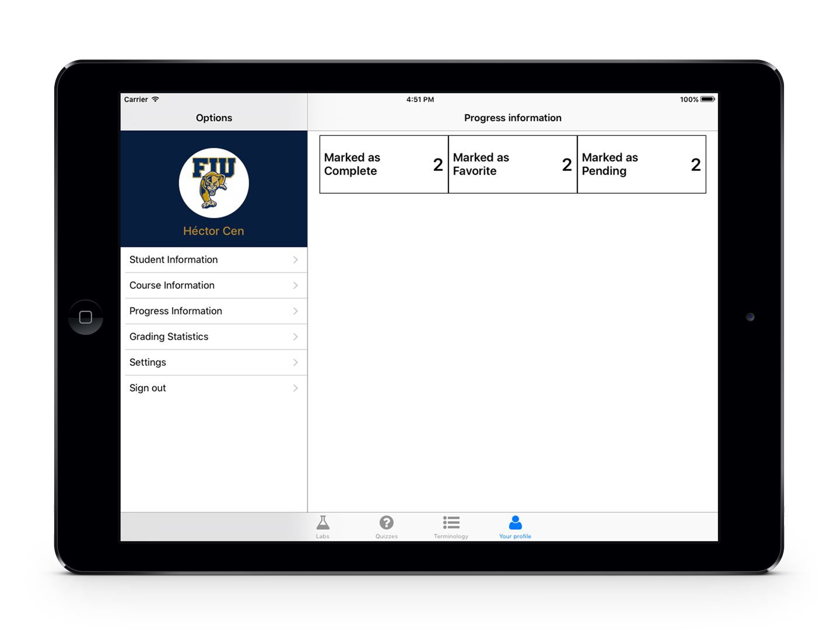
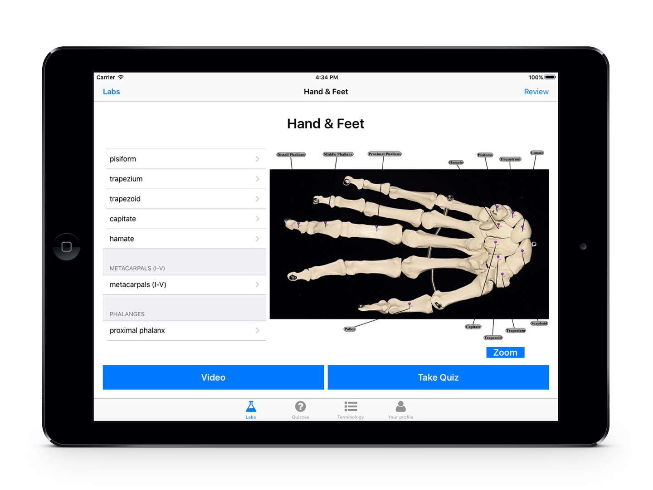
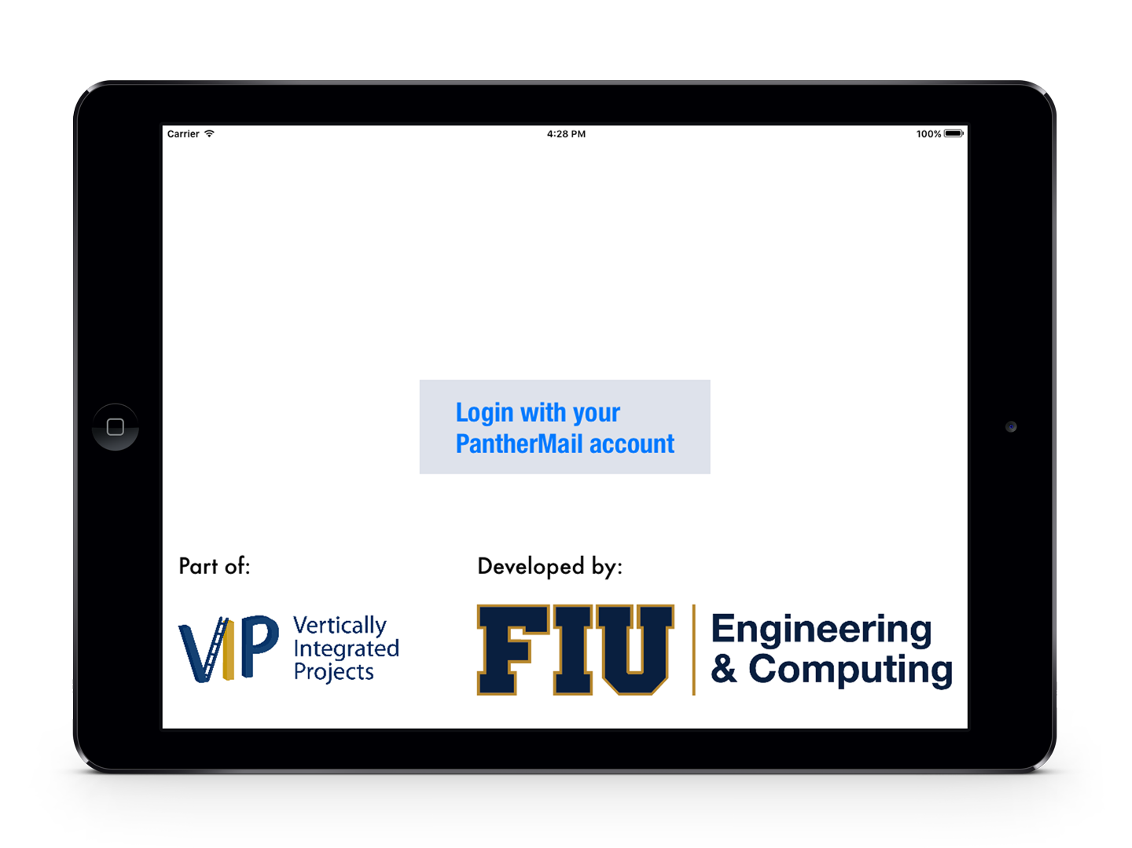
School of Computing & Information Sciences
Advanced Software Engineering, 2016, Fall
Technology Driven Active Learning in Human Anatomy – Version 1.0
Student: Héctor Cen, Florida International University
Mentor: Mohsen Taheri, Florida International University
Instructor: Masoud Sadjadi, Florida International University
PROBLEM
Currently, the Anatomy Laboratory class uses plastic models of the human body parts to help students identify them as part of their lecture and learning process. This approach has proven not to be the best, since students have to be in site and in class hours to have access to such plastic models, thus limiting their opportunities and time to review and test their knowledge.
Students spend a lot of time taking pictures of the models instead of focusing in actually learning the class materials. Additionally they lack the means to review their knowledge of such class materials.
Current System & Solution
There is no current solution or system developed to tackle the problems described. The proposed solution is the design of an personalized lab manual in the form of an iPad application, that will include and are not restricted to images of the anatomical models, definitions, lecture videos, and knowledge assessing methods. The Anatomy Lab class is comprised of six (6) Labs an each lab includes six (6) stations, each one with different course materials.
Requirements
The requirements for this initial version of the Anatomy Lab app were to design an application with fully developed features, such as:
Authentication through the student’s PantherMail account.
An efficient and organized way to locally store the course information in the device.
The ability to display the course information (terms, images) of a specific station of a specific Lab.
A glossary of all the terms of the course.
An user profile view where students can review their progress, grading and general course information.
System Design
The MVVM (Model-view-view-model) architectural pattern was chosen to develop the application. MVVM is particularly helpful to develop applications in Swift or Objective-C. Benefits include:
Simpler way to manipulate the interface.
ViewModel projects the data from the Model into a format that the View can handle.
The ViewModel acts as a separate layer that maps the data from the Model much closer to the View needs, thus preventing additional code in controller or views.
In iOS development, it helps to reduce the usually "fat" view controllers.
It is much easier to write tests for ViewModels than for Views. Testable without awkward UI automation and interaction.
OBJECT DESIGN
Implementation
Anatomy Lab application is built using version 2.3 of Swift, the language designed by Apple, Inc. to be the main language to develop applications for its iOS platform. Third party libraries were also used, such as:
SwiftyJSON
PopupDialog
Font Awesome
IQKeyboardManager
Realm
Google Sign In
They were managed through a third party application called Cocoapods, which is a dependency manager for Swift and Objective-C projects.
Application was developed using:
IDE: Xcode 7.3.1
Development OS: Mac OS X 10.11 (El Capitan)
Target iOS version: 9.3.5
Target device: iPad (Landscape orientation)
Language: Swift 2.3
Summary
The Anatomy Lab iPad app will provide new tools for students to improve their learning experience, by adding a mobile, interactive and more modern approach to course contents delivery. It will also allow instructors and teachers to interactively update the course content as they see fit.
Anatomy Lab app is built with reusability, maintainability and extensibility in mind and as fundamental groundwork that will allow further improvement and the addition new requirements and features.
We hope that this first approach towards an interactive and mobile application to deliver course content and materials, ignite the interest of another teachers in adding new tools and better ways to improve the chances of their student's success.
Verification
Test Case 1 (Sunny Day)
Purpose: Ensure that the table view filters the results according to the user input in the search bar.
Precondition: The table view loaded all the terms correctly.
Input: The user enters, through the device's onscreen keyboard, the letters, keywords, terms or words to search for.
Expected result: The table view should update its data as the user enter characters. If no single term is found to match the input by the user, then the table view should be displayed empty. If one or more terms match, then the table view should only display those terms.
Actual result: As expected. PASS.
Test Case 2 (Rainy Day)
Purpose: Ensure that the search bar on top of the table view doesn't accept special characters or numbers, just characters in the set of lower and uppercase alphabet letters, the '/’ character and the blank space character.
Precondition: The table view loaded all the terms correctly.
Input: The user tries to enter any non-allowed character through the device's onscreen keyboard.
Expected result: The search bar doesn't allow the character to be entered. No change is made to the table view or its content.
Actual result: The search bar prevented the input of non-allowed special characters. PASS.
Screenshots
Acknowledgement
The material presented in this poster is based upon the work supported by Mohsen Taheri, I am thankful to the help that I received from my group members, Darian Mendez.
Notes:
1

