Slide 1




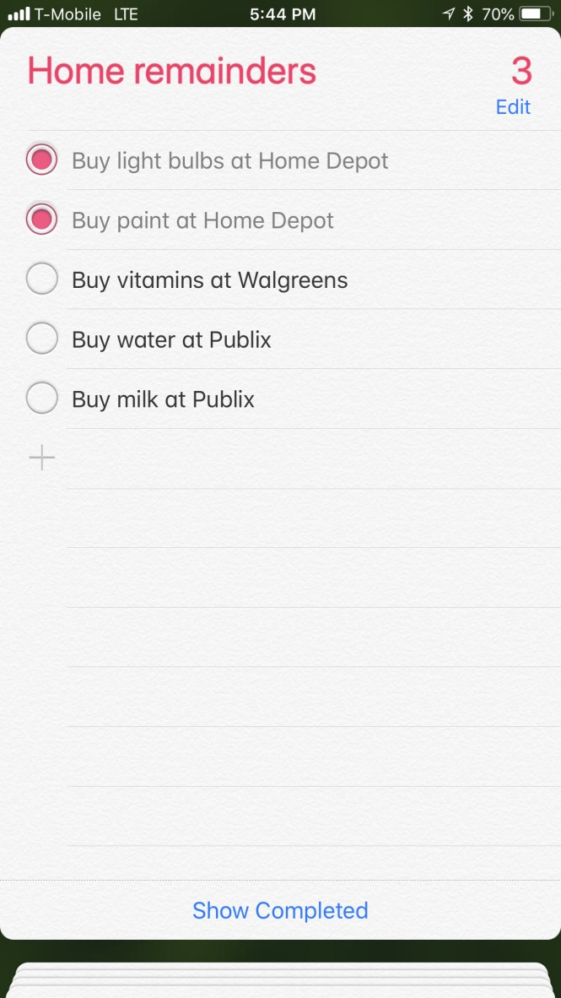
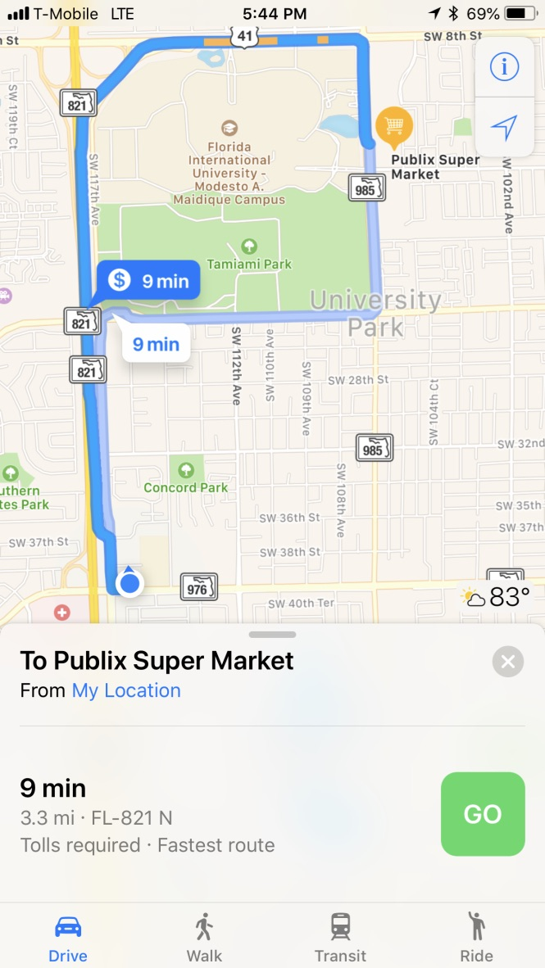
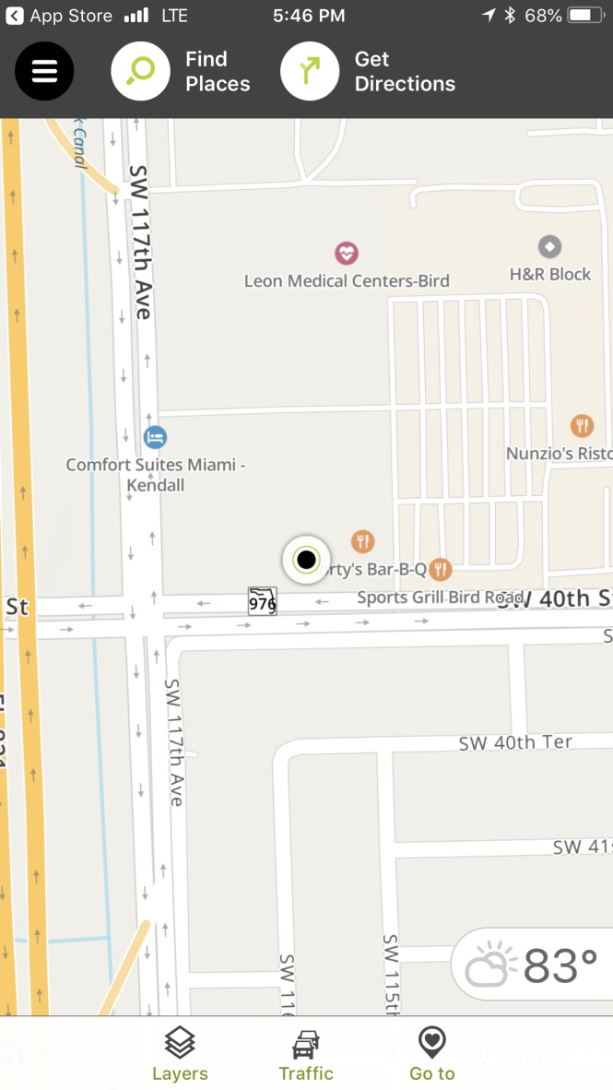
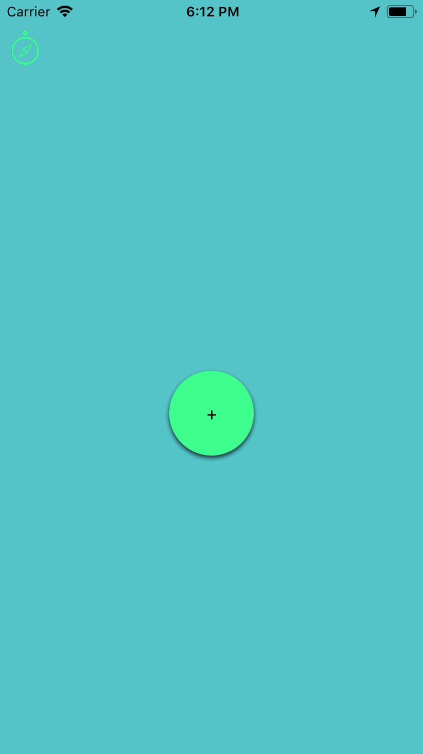
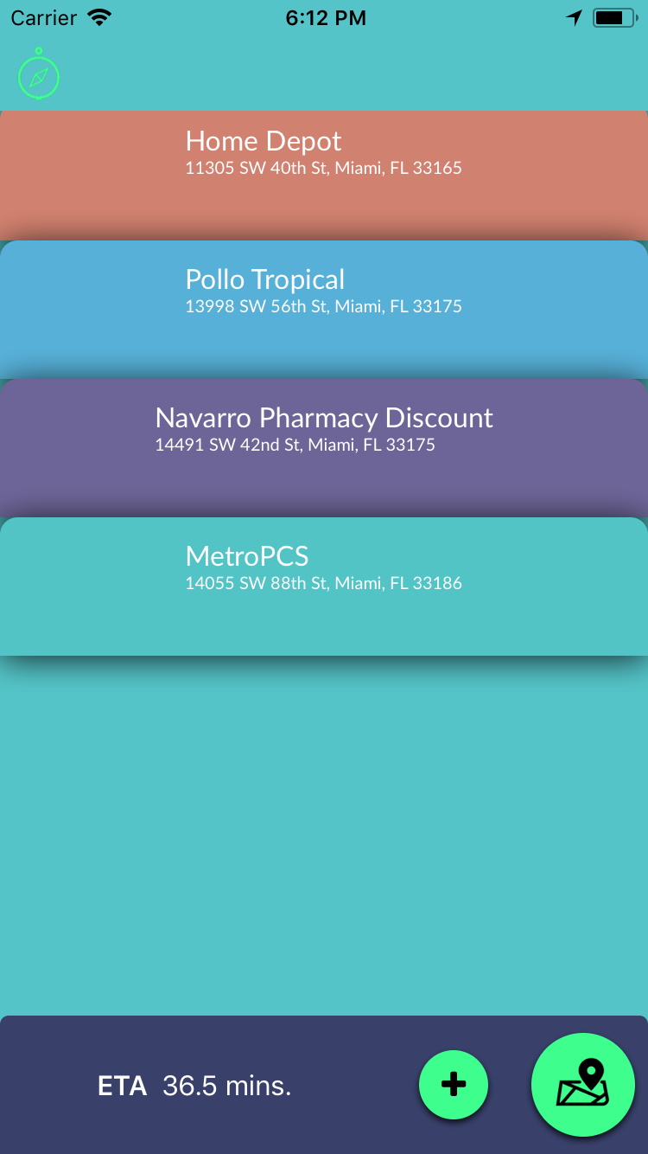
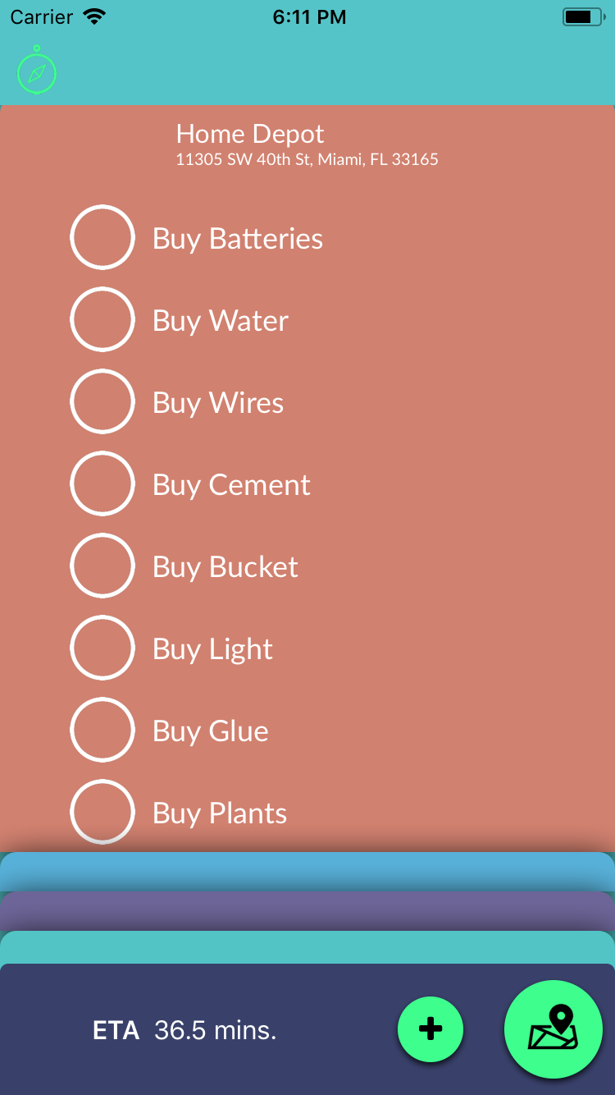
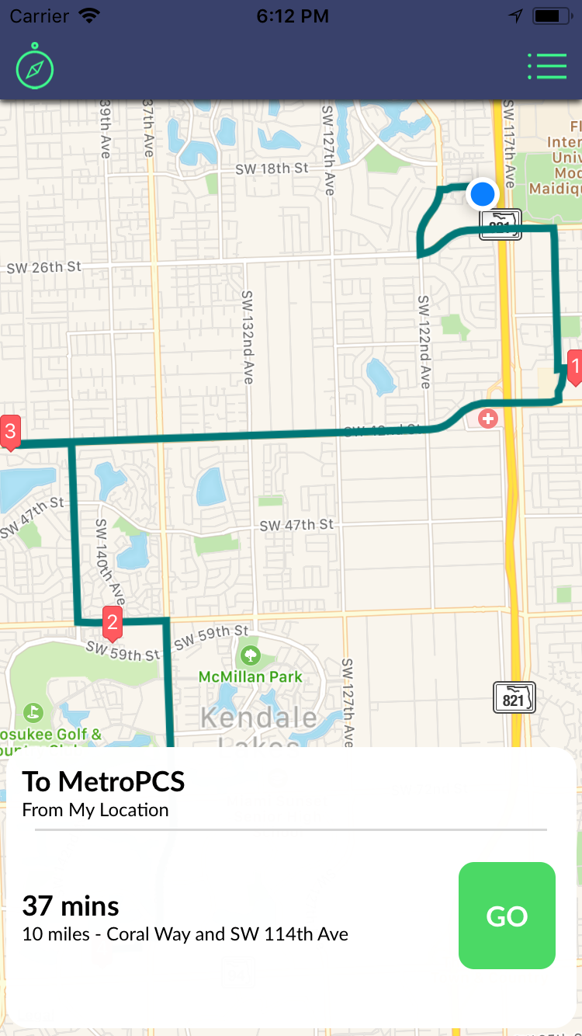
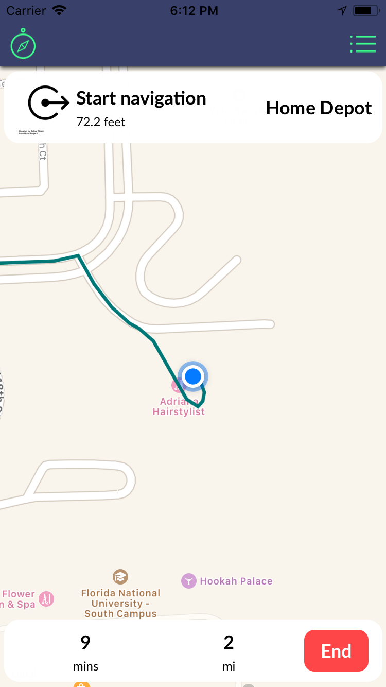
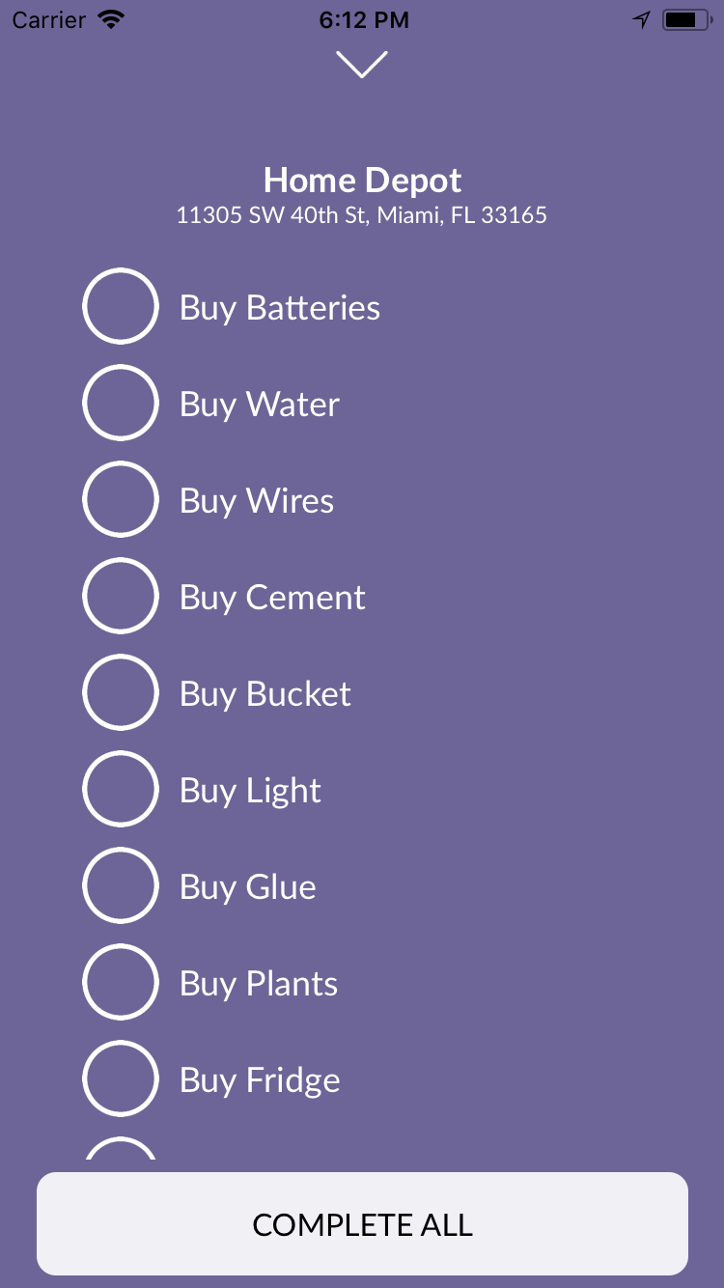

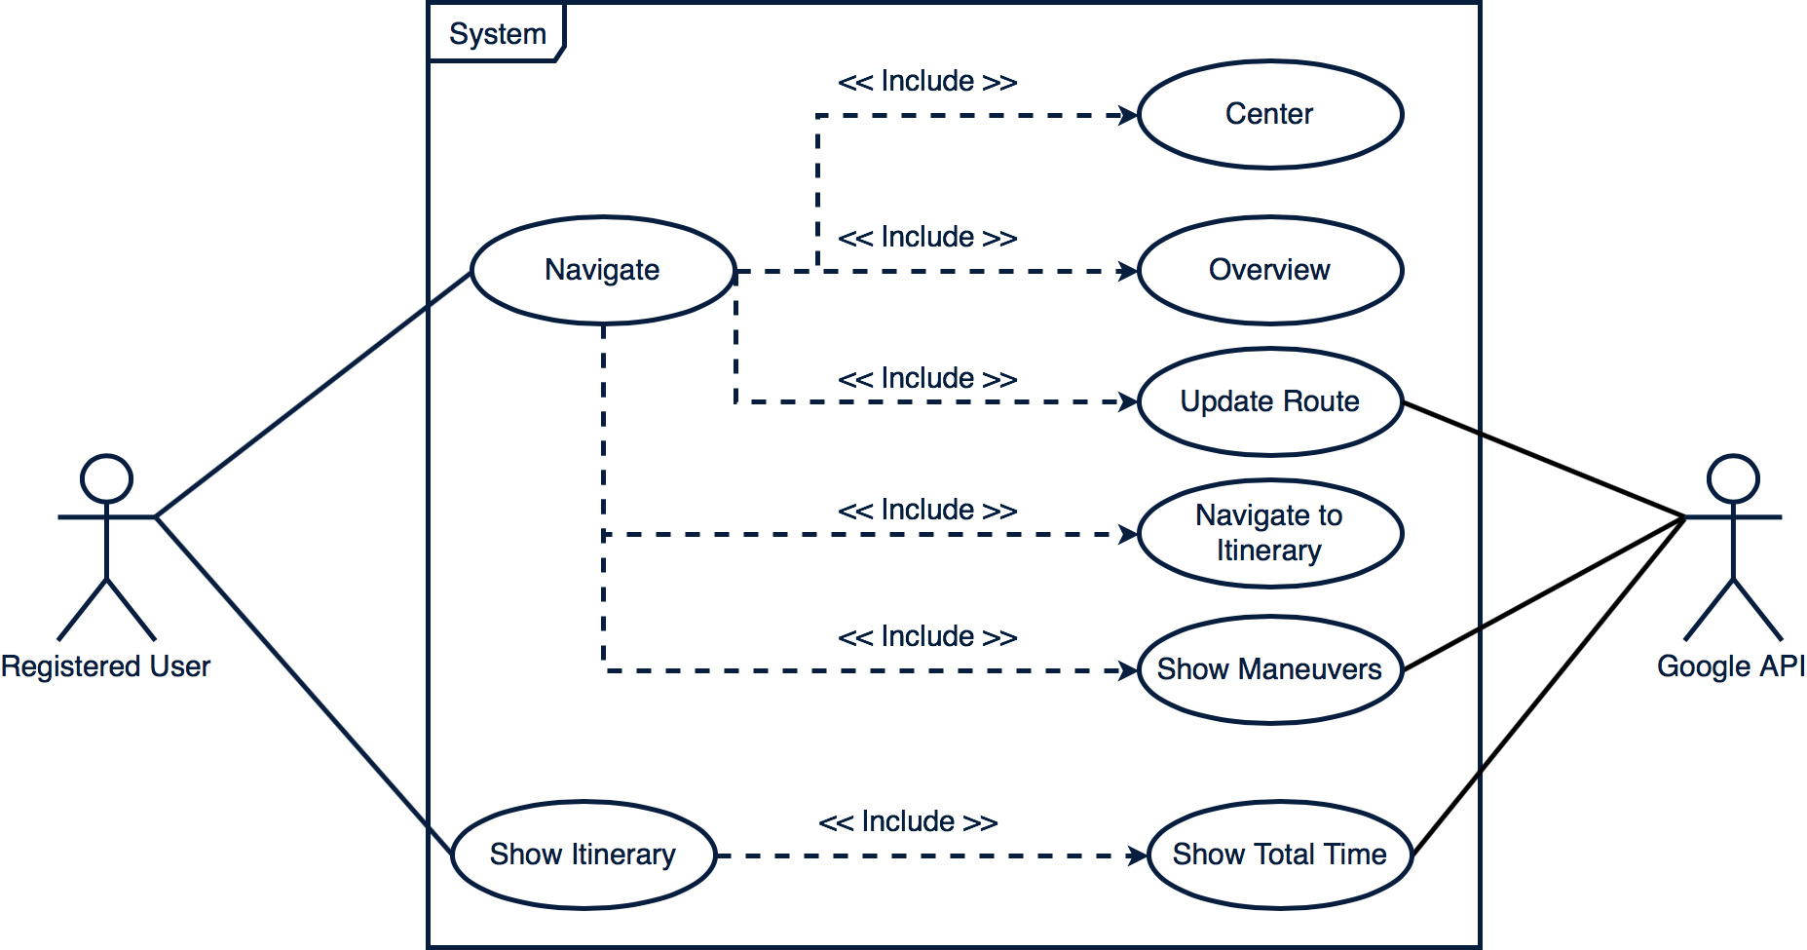
Senior Project, 2018, Spring
To-do List Optimizer 1.0
Student: Manuel Garcia, Florida International University
Mentor: Dr. Monique Ross, Florida International University
Professor: Dr. Masoud Sadjadi, Florida International University
Problem
Busy schedules comprised of several tasks in different locations
Non-intuitive apps for easy task management and navigation
Multiple applications need to be used to keep track of daily tasks
Annoying swap between apps (e.g. Apple Reminders and Maps)
Apps that integrate task management and GPS navigation were not found
Crowed UIs that result in a poor UX
Some web applications allow the user to navigate to multiple places but the link between places and tasks is non-existent and those websites lack portability
Current System
Solution
Creation of an app that integrates the best of task management and navigation
Improved UI/UX for better usage of the app
Use of Google Directions API to provide the user with real time GPS navigation
Convenient UI to easily display and manage all necessary data
To-do List Optimizer
Requirements
Create an intuitive interface to add and manage places and tasks
Provide the user with the order of the places to traverse and the total time each time a place is added
Include the proper transition from the place and task management to the navigation view
Give the user the proper instructions and alerts to navigate to all the desired places
Allow the user to manage tasks within each place
System Design
The system architecture was implemented leveraging the Model-View-Controller design
Implementation
The implementation of the mobile app UI was made using react-native (beta)
The server side of the application was implemented using Node JS and Express for user data storage for recovery and history purposes
The routing algorithms were possible thanks to the Google Directions API
User Input
Controller
Update
Notify
Update
View
Model
Object Design
Summary
Convenient application that integrates place and task management with GPS navigation
Provides a easy-to-use UI that reduces the learning curve of users
Dynamic detection of destination to provide the user with the most optimized version of the itinerary
Persistent data over different devices
Verification
Verifications were made by adding several places and manually confirming the recommended route using google maps
Trips were taken to assert that the app showed the proper maneuvers
The minimum distance to places to show the list of task was tested by driving to different places and confirming that the list was showing the right distance
Acknowledgement
The material presented in this poster is based upon the work supported by Monique Ross that without her help and guidance this project wouldn’t have been accomplished. I am thankful to the help that I received from my group members, Salvador Ricardo and Daniel Gonzales.
Notes:
1

