Slide 1
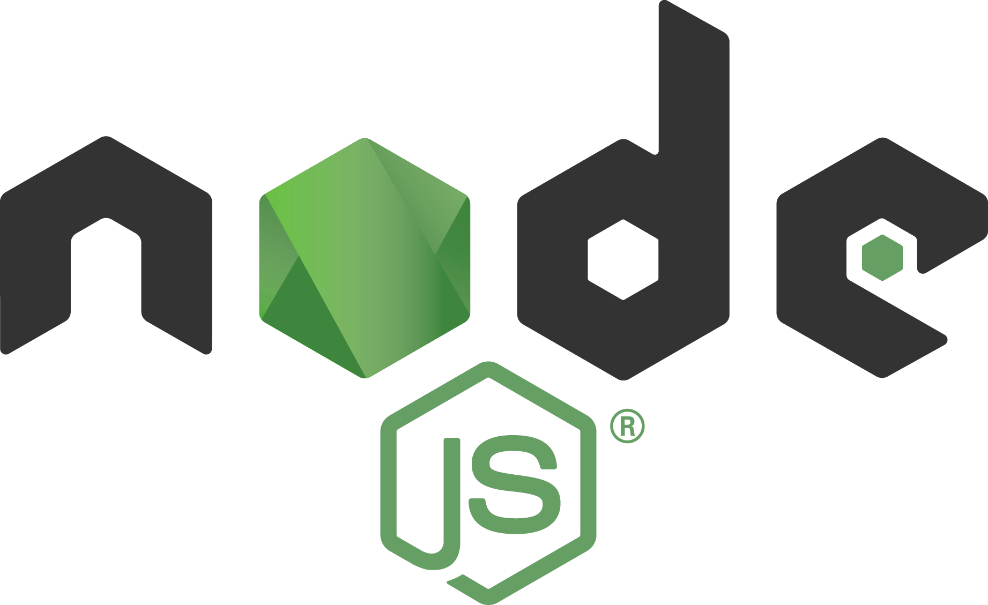


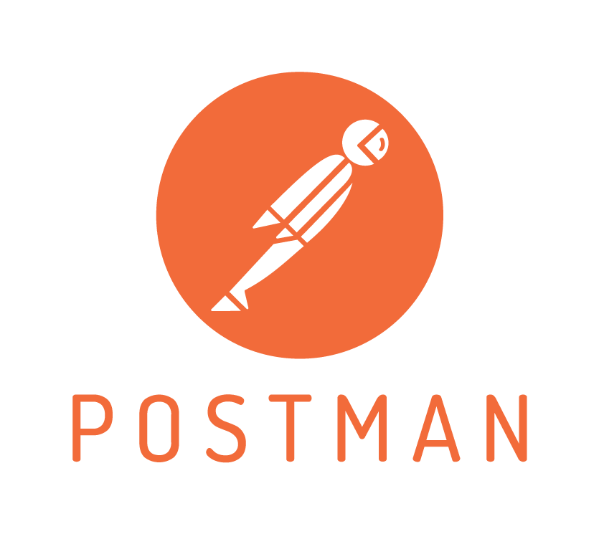





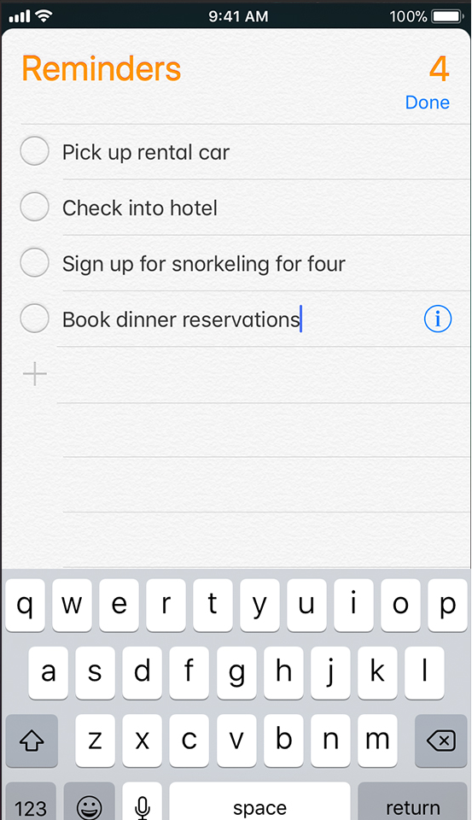
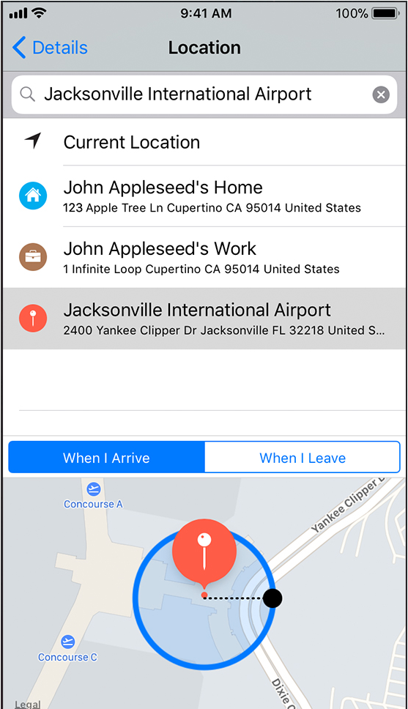
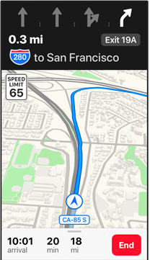
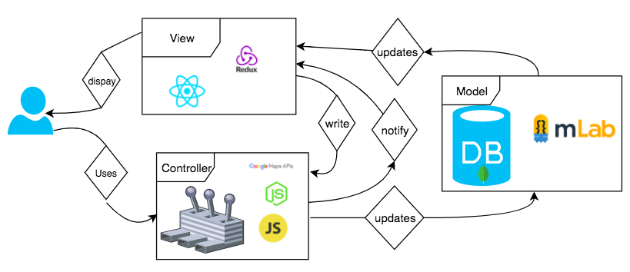
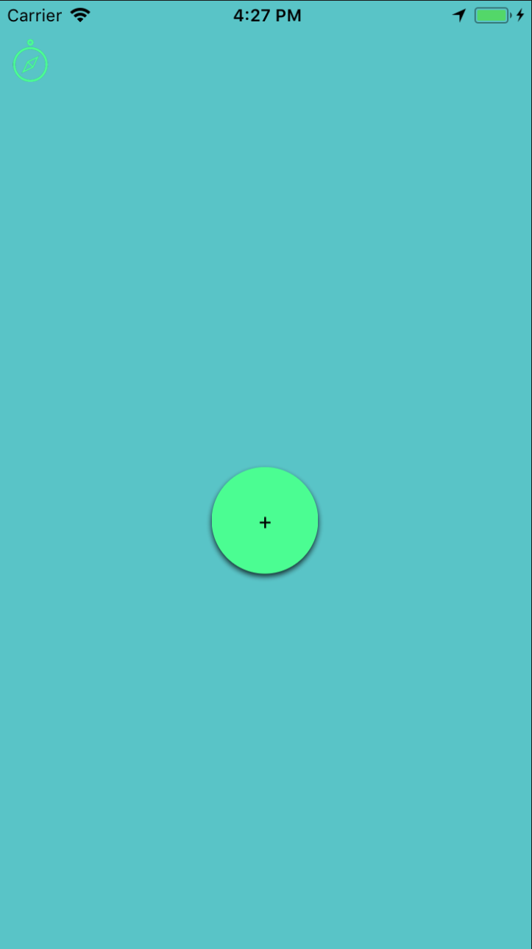
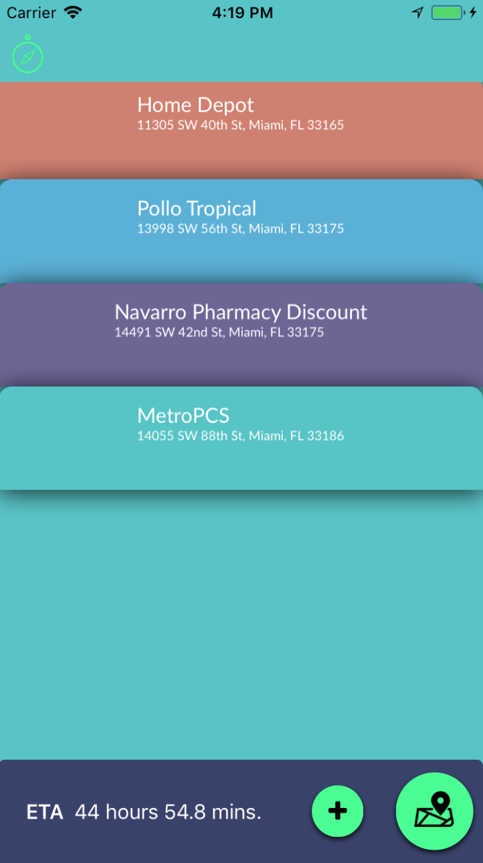
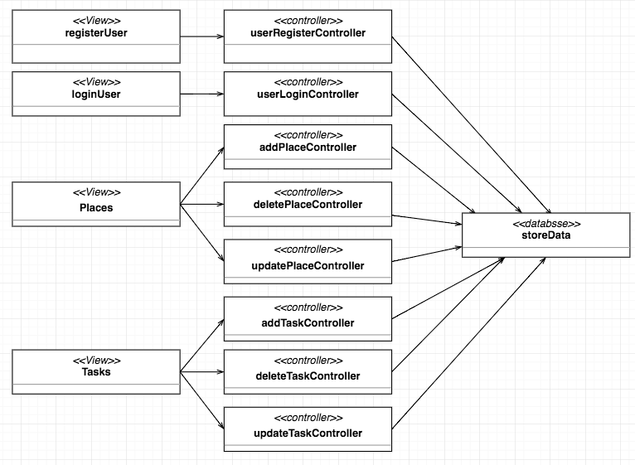
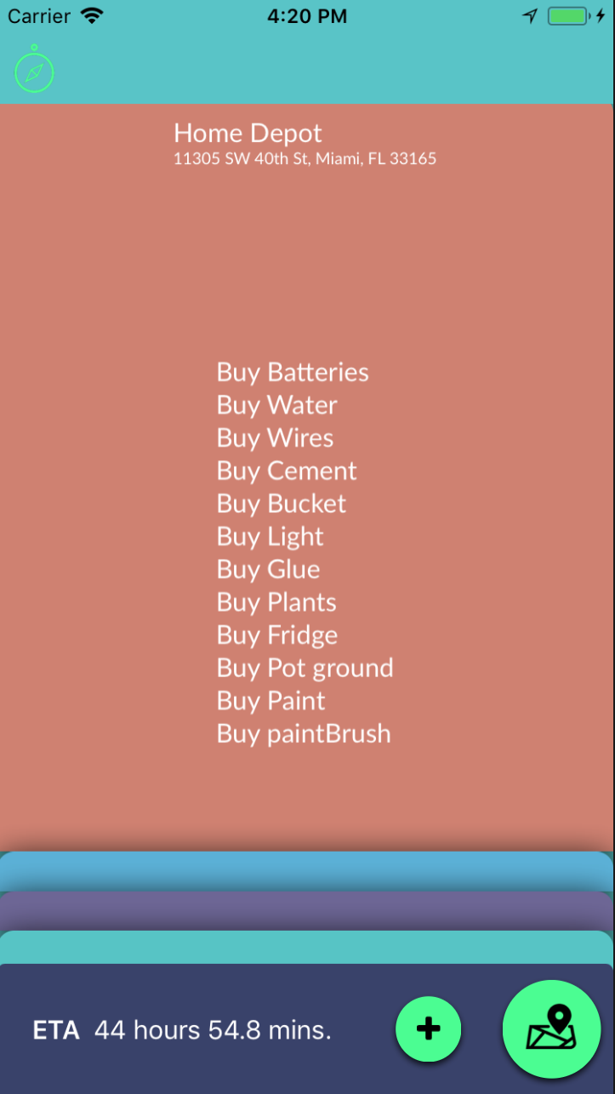
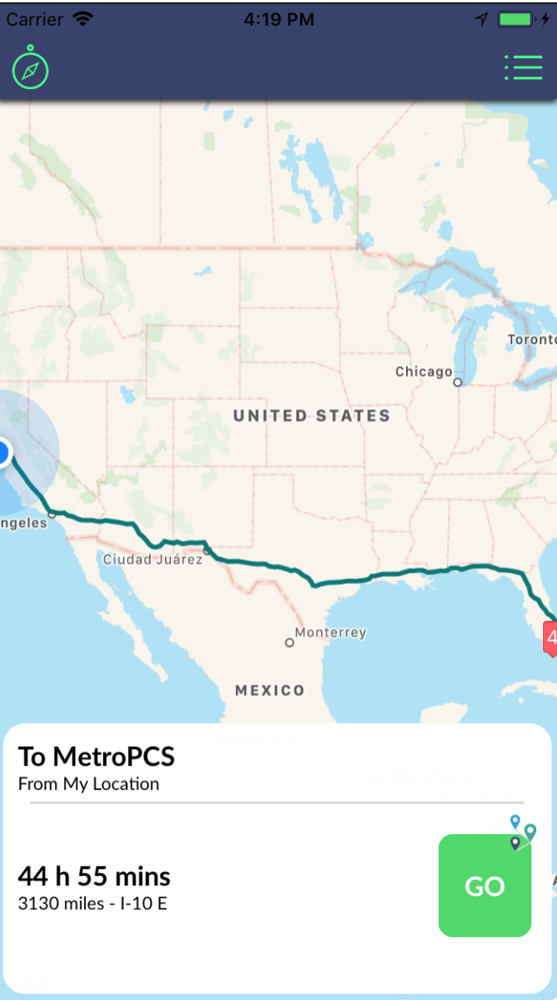
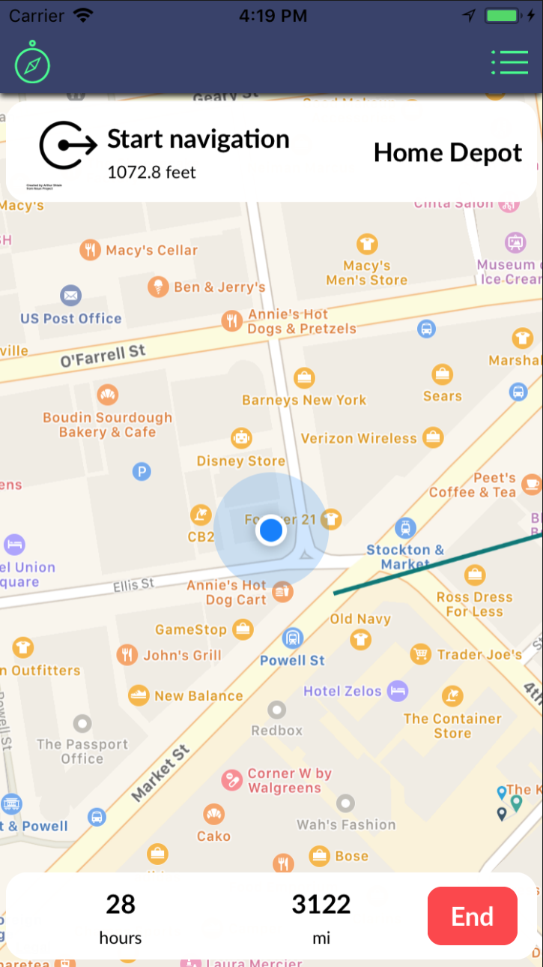
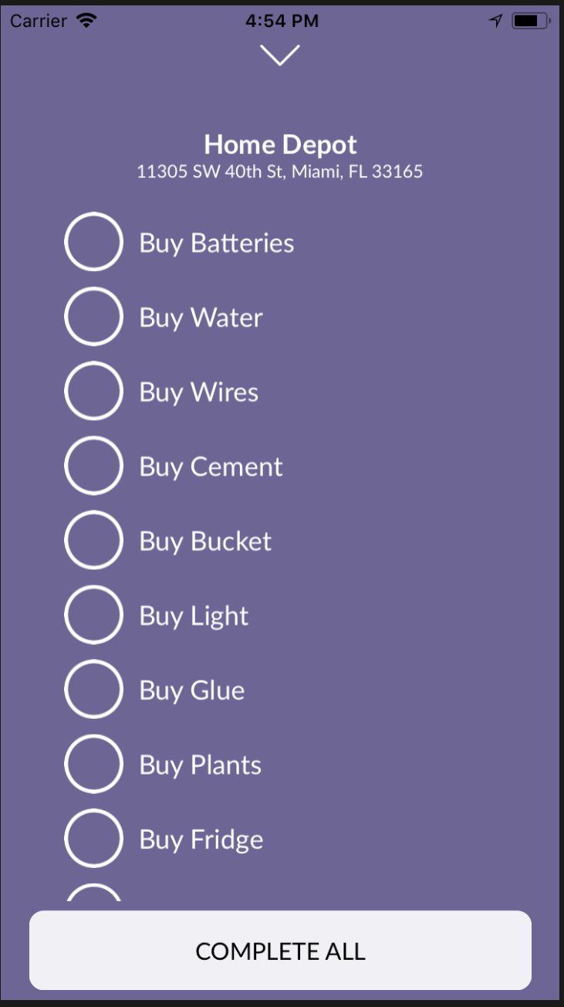
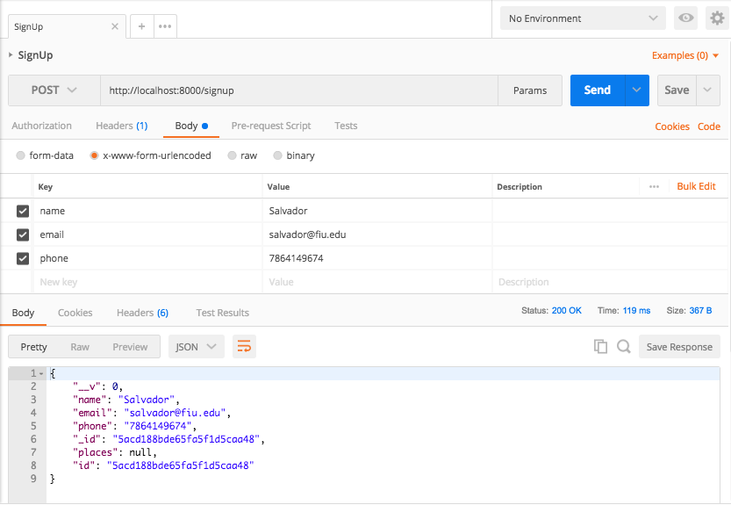
School of Computing & Information Sciences
Senior Project, Spring 2018
To-do List Optimizer 1.0
Student: Salvador Ricardo, Florida International University
Mentor: Monique Ross
Professor: Masoud Sadjadi, Florida International University
Problem
Solution
Current System
Million of people use To-do apps to plan their day and GPS apps to arrive at their destination. But planning the most efficient route to complete those daily task is cumbersome and time consuming. App hopping and route planning make for an unproductive day.
To save time and make the customer’s day more productive, To-Do List Optimizer integrates both the task management and GPS routing technology to create an immersive experience for the user where they can complete their tasks effectively and with ease.
My contribution to this project was based on the backend server. I worked on creating the database and the API endpoints. This integration helped save the user’s data for analysis and multi-device syncing.
While doing market research we didn't find currents applications in the market that offer seamless integration between an user task, and GPS routing
To-Do List Optimizer is bringing together two productivity apps into one.
Current System
Requirements
Create Models for the Users, Places and their tasks.
Create different database schemas.
Create server where application would run.
Populate databases with user information.
Return detailed queries about users and their list.
System Design
The system architecture is implemented in a Model-View-Controller design to facilitate the development for mobile devices.
Reminders
Apple Maps
To-Do List Optimizer
Implementation
System was implemented using the MERN Stack in order to create a native application for both iOS and Android.
The application server was implemented in NodeJs and Express which makes calls to the Database where the user’s information is stored, allowing for easy sync between devices.
The front end was implemented in React Native and JavaScript to a have a interactive UI which will update and render the right components when data changes.
Object Design
Summary
Application integrates both task tracking and GPS Navigation technologies.
Applications allows user to keep track of their tasks.
Applications will route users to their destinations in the most optimized way.
Application will sync between different devices.
Database API endpoint verification was done with Postman which allowed to test the Database schemas on a live server. Automation of the tests allowed for faster and more effective development.
Verification
Acknowledgement
The material presented in this poster is based upon the work supported by Monique Ross I am thankful to the help that I received from my group members, Manuel Garcia and Daniel Gonzalez
Notes:
1

