Slide 1






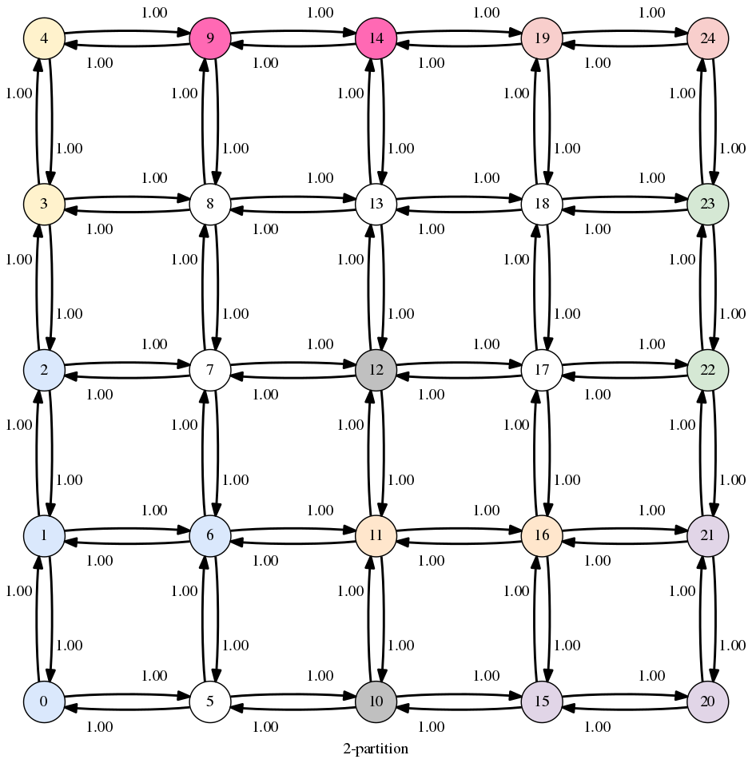
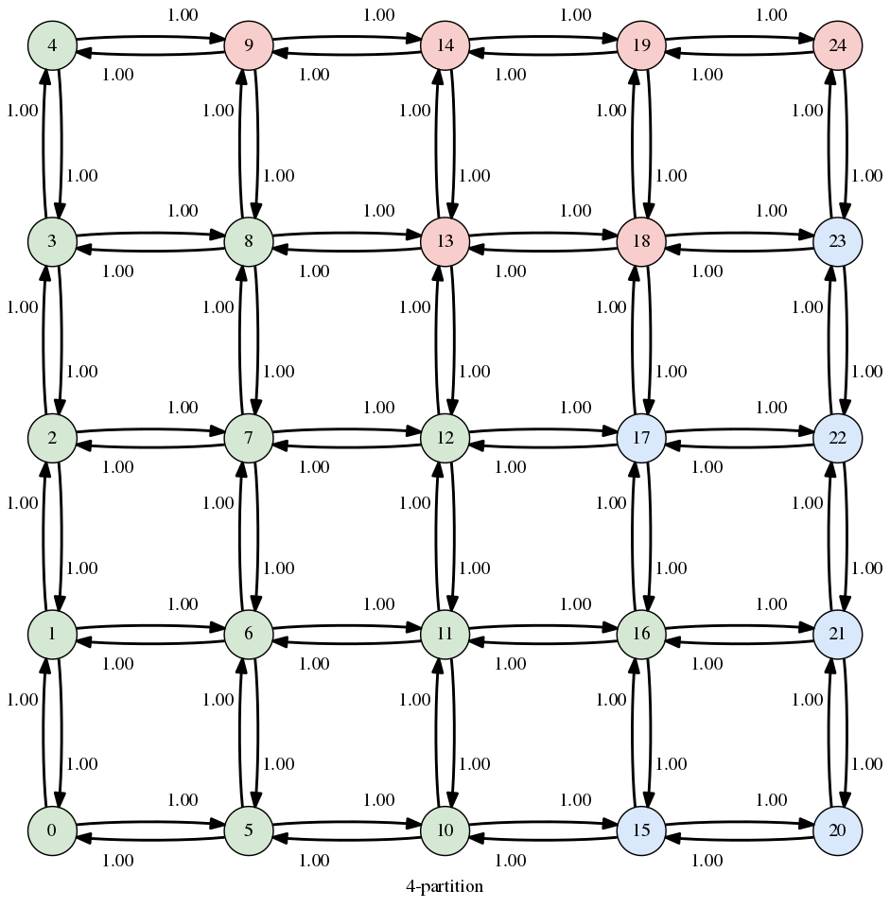
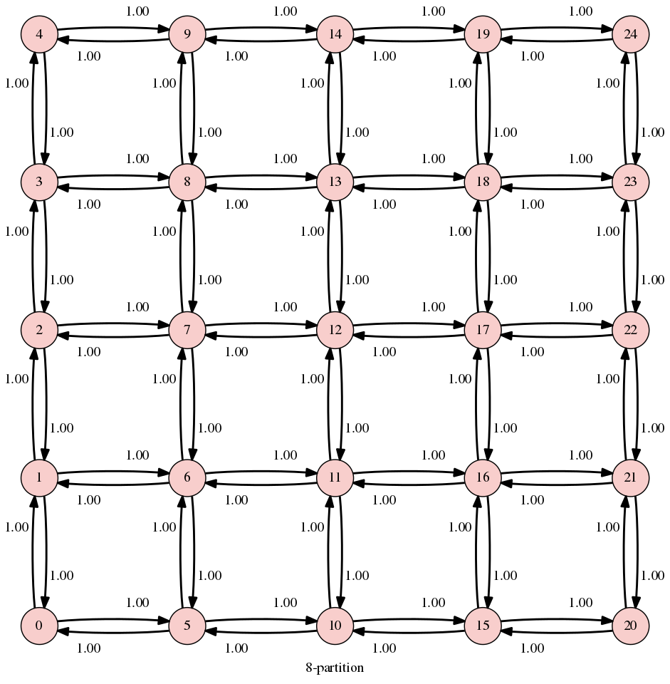
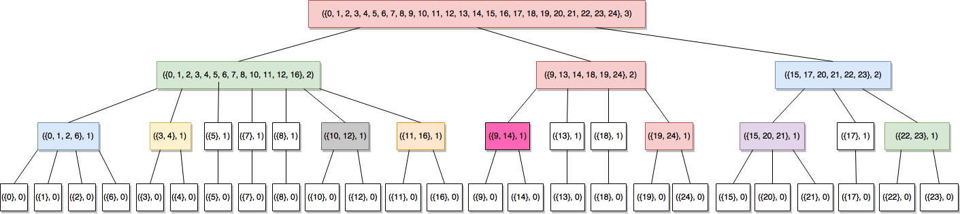
School of Computing & Information Sciences
Senior Project, 2017, Spring
Traffic Simulator 1.0
Student: Humberto Chacon, Florida International University
Mentor: Kianoosh G. Boroojeni and Mohsen Taheri, Florida International University
Instructor: Masoud Sadjadi, Florida International University
Problem
Autonomous vehicles will be prevalent in the near future.
Routing algorithms can greatly increase traffic efficiency.
Traffic patterns are oblivious or highly stochastic.
Classic network routing algorithms are not sufficient.
Solution
Oblivious network routing algorithms is the correct fit for the problem.
Using statistically proven algorithms to improve traffic flow.
Implementation of a top-down routing scheme.
Class Design
Visualizations of Algorithms
2-partition
4-partition
8-partition
Hierarchical Decomposition Tree (HDT)
System Design
Implementation
NetworkX used for classical graph algorithms and graph data structures.
Python and Cython used for new routing algorithms.
Numpy used for array/matrix data structures.
Graphviz used for visualization.
Algorithms implemented from “Oblivious Network Routing” by S. S. Iyengar and Kianoosh G. Boroojeni
Summary
Top-down integral routing scheme shows a considerable improvement in traffic flow as compared to shortest path algorithms.
Python allowed rapid prototyping/development.
Cython used in the hottest paths for performance.
Algorithms
Server API
Acknowledgement
The material presented in this poster is based upon the work supported by S. S. Iyengar and Kianoosh G. Boroojeni. I am thankful to the help that I received from my group members, Max Leone and Salvador Gandara, as well as guidance from Kianoosh G. Boroojeni.
Notes:
‹#›

