Slide 1





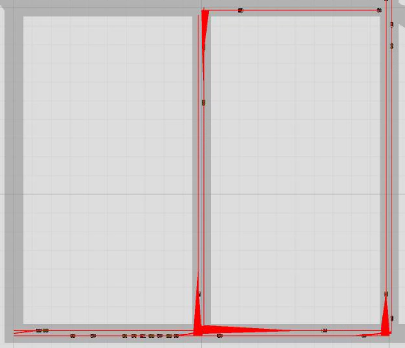
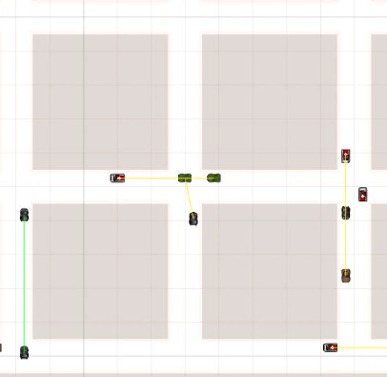
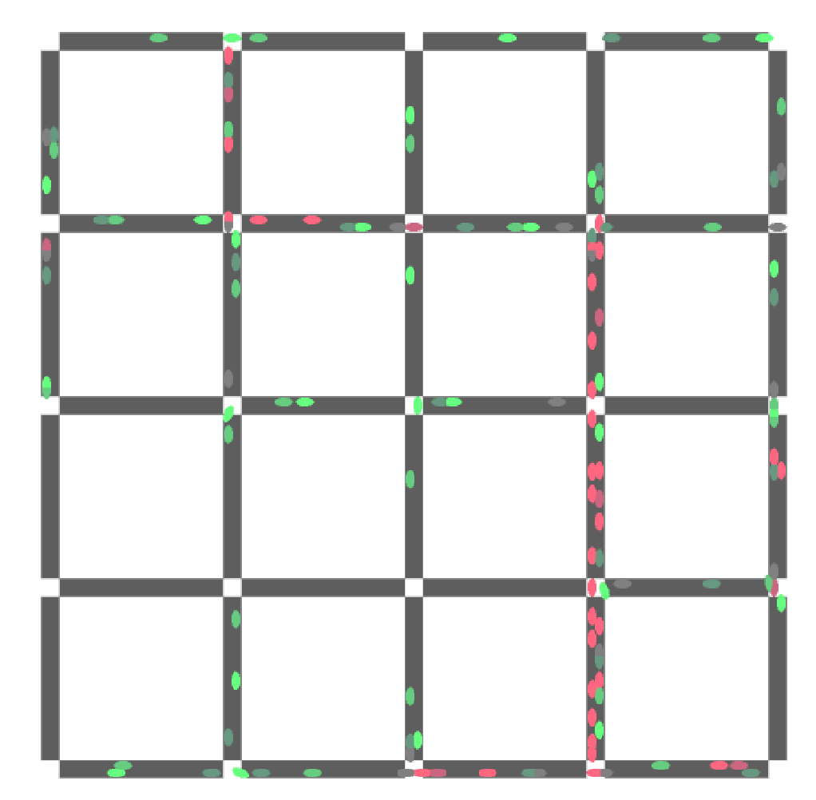
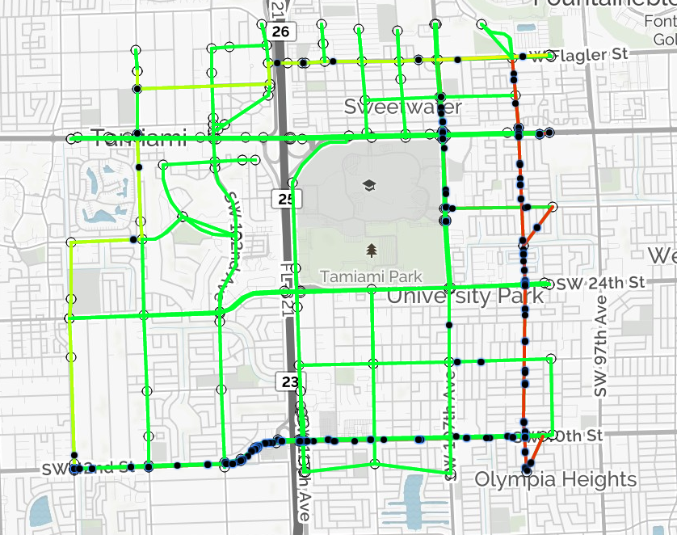
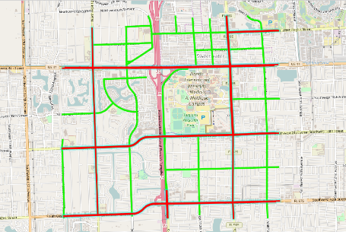
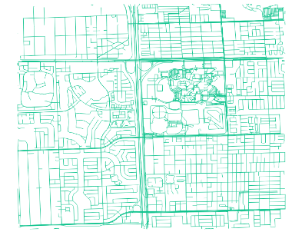
School of Computing & Information Sciences
CIS4911, 2017, Spring
Traffic Simulator
Student: Max Leone, Florida International University
Mentor: Kianoosh Boroojeni, Mohsen Taheri
Instructor: Masoud Sadjadi, Florida International University
Problem
Need a way to visualize and demonstrate the effectiveness of the routing algorithms.
Visualization needed to be impactful to any non technical audience.
Must simulate behavior of real traffic flow patterns to compare differences in routing algorithms.
Solution
Proposed solution is a traffic simulation client and a routing server.
One simulation implemented in C# using the Unity3D engine with generated data.
One implemented in JavaScript with geojson street data.
Current System
Current system consists two unique simulators and a routing API.
System effectively demonstrates differences in routing algorithms.
System works to visualize and simulate natural traffic flow patterns.
Evolution of the Simulation
Generate Traffic
2. Traffic AI
3. Visualize Algorithms
6. Analyze Traffic Flow
5. Generate Adjacency Matrix
4. Real Street Data
System Design
Object Design
Summary
Simulations were valuable to developers working on algorithms to help visualize results.
Simulations are highly customizable and can test algorithms on many different streets patterns and graphs.
Using real geojson street data helps make the simulations more realistic and impactful.
Acknowledgement
The material presented in this poster is based upon the work supported by Unity3D, Leaflet, MapQuest, and Mapzen. I am thankful to the help that I received from my group members, Humberto Chacon and Salvador Gandara.
Notes:
‹#›

