Slide 1





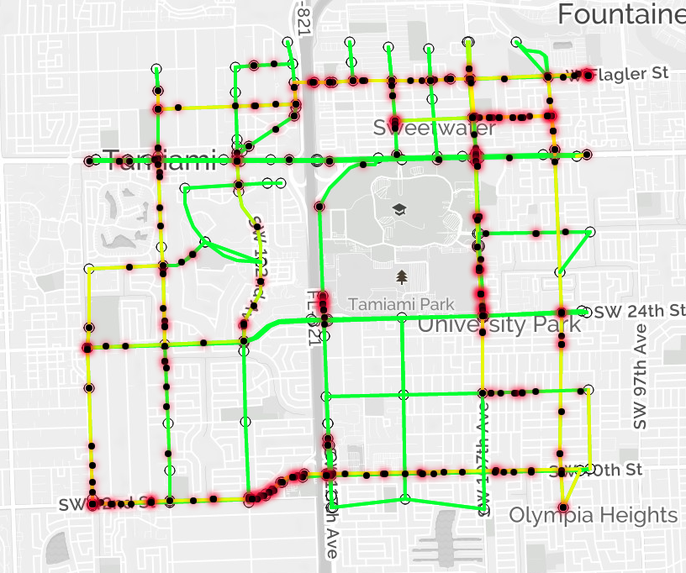
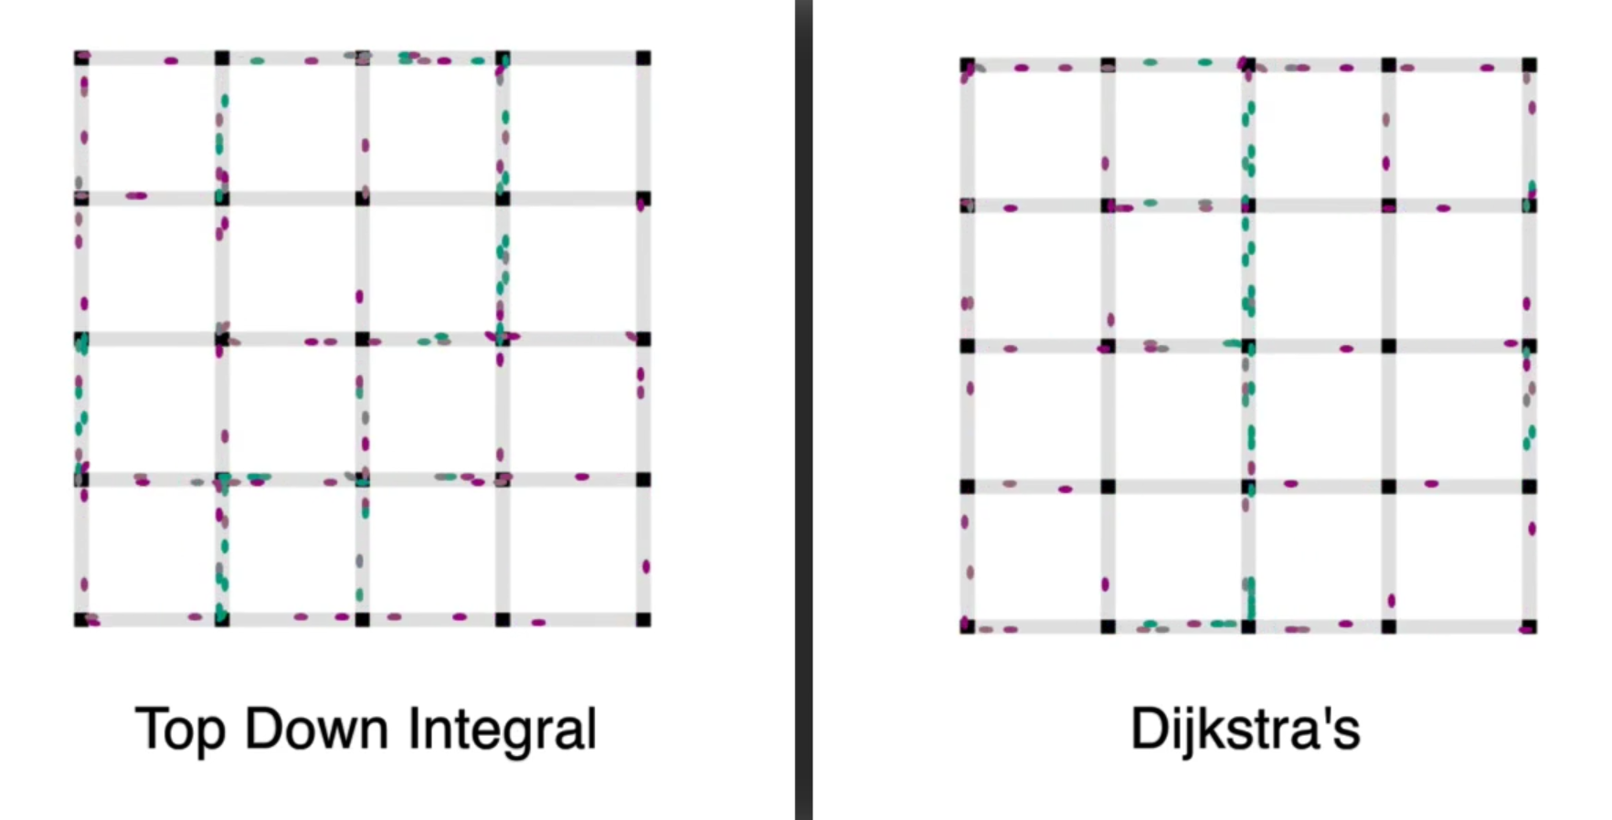
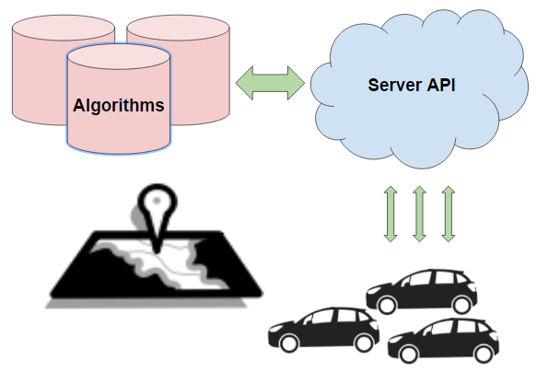
School of Computing & Information Sciences
Senior Project, 2017, Spring
Traffic Simulator 1.0
Student: Salvador Gandara, Florida International University
Mentor: Kianoosh G. Boroojeni and Mohsen Taheri, Florida International University
Instructor: Masoud Sadjadi, Florida International University
Problem
Autonomous vehicles require an open network platform to navigate streets
Classic network routing problems cannot be used due to stochastic traffic patterns
Solution
Oblivious network routing algorithms that use real-time smart grid routing analytics
Statistically proven algorithms to improve traffic flow
Provide rich API to service routing requests made by users
1
2
Implementation
Python used for portability among operating systems
Flask was used as an API provider to create endpoints
Endpoints were made to allow users to interact with graph
Routing object hosted on server persistently
Used Flask-Limiter package to meter user access. (3)
System Design
3
4
Requirements
The system must be able to accept requests over HTTP
Users must be able to ask for a path using a choice of algorithm
Users will provide: algorithm choice, starting point, and ending point.
The system will consider its graph and congestion, then return a path
The system must be able to handle many concurrent requests
Verification
Postman was used to make requests directly to API.
The Traffic API has been tested using two different simulators
Unity Engine Simulator (2)
JavaScript web-app using Leaflet (1)
These simulators allowed us to see the difference made to the overall network congestion by using the Oblivious Routing Techniques
Summary
Oblivious Routing Techniques are more effective at reducing overall network congestion than traditional routing methods
Our RESTful API lives on a remote server, provides the interface for users and developers to make new graphs and get new paths (4)
The notion of the “greater good” can improve the driving conditions for all cars: autonomous or not!
Acknowledgement
The material presented in this poster is based upon the work supported by S. S. Iyengar and Kianoosh G. Boroojeni. I am thankful to the help that I
received from my group members, Max Leone and Humberto Chacon, for their hard work on creating visualizations and implementing algorithms.
Notes:
1

