Slide 1






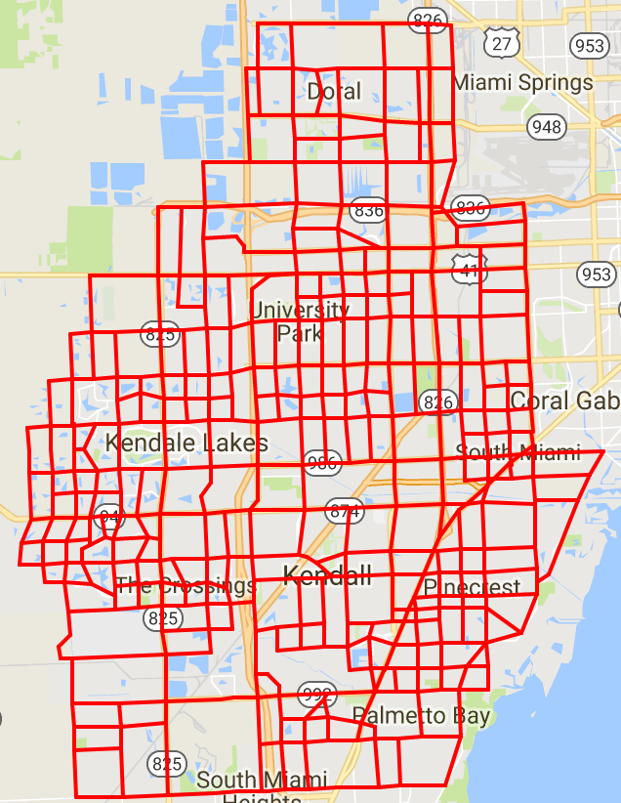
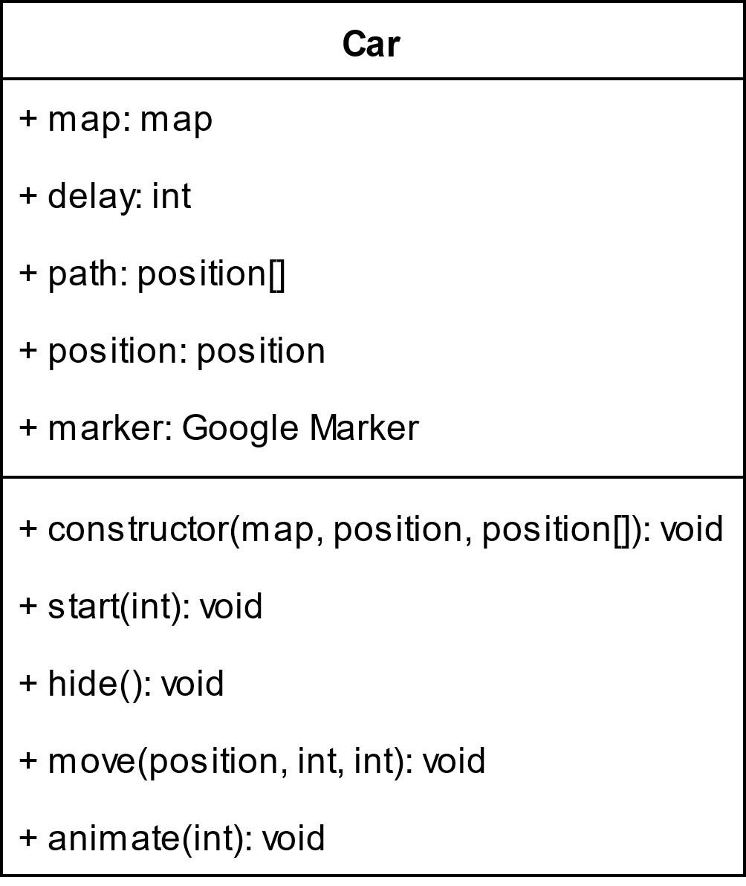
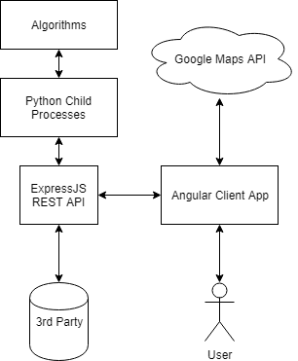
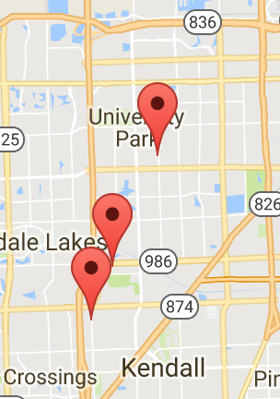
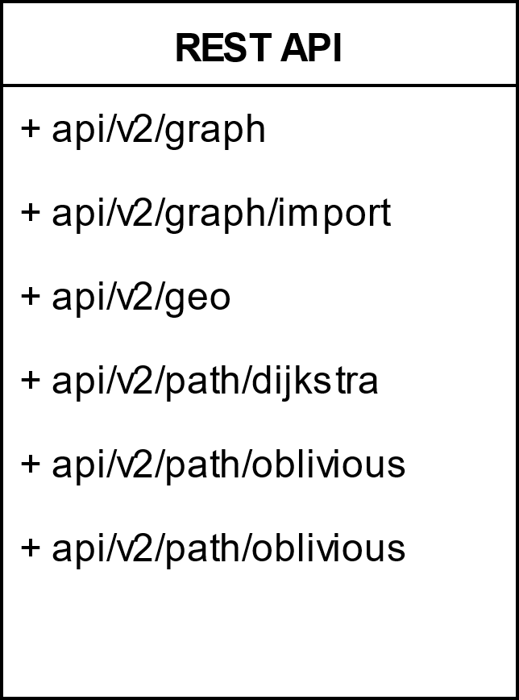
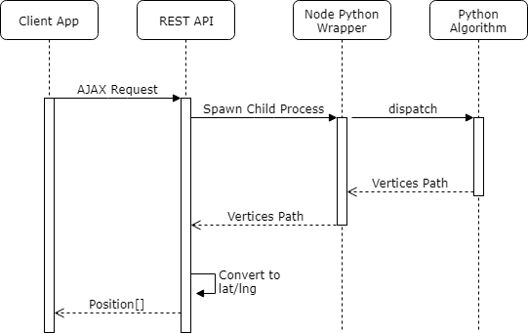
School of Computing & Information Sciences
CIS4911, 2017, Summer
Traffic Simulator 2.0
Student: Matthew Thomson, Florida International University
Instructor: Masoud Sadjadi, Florida International University
Problem
Get the product in a state where it can be hosted and used as a service.
Create a comparison simulation with Google Maps Navigation.
User Input for trips
Scalable car animations with velocity and timing control.
Solution
Unify the multi-segmented code base to a single NodeJS and ExpressJS web server that serves the client app and provides a REST API for routing algorithms.
Car object that represents a routing solution.
Current System
NodeJS+ExpressJS web server providing a REST API for routing algorithms.
AngularJS front end with Google Maps Navigation and Google Maps Custom Marker Navigation.
System Design
Screenshots
Object Design
Implementation
NodeJS and ExpressJS web server for serving pages and providing REST API access.
NodeJS spawns Python processes and passes data to the algorithms for processing.
AngularJS client app to request routes and sync results from multiple sources.
Verification
API validation was done through AJAX calls using the library superagent.
Algorithm wrapper and integration was validated through results comparison from version 1.0.
Summary
The product is now a single web application.
It provides a modern REST API for applications to access the routing algorithms.
Car class implemented for Google Maps and is extendable for dynamic velocity.
Acknowledgement
The material presented in this poster is based upon the work supported by Kianoosh G. Boroojeni. I am thankful to the help that I received from my group members Rolando Carralero.
Notes:
1

