Slide 1


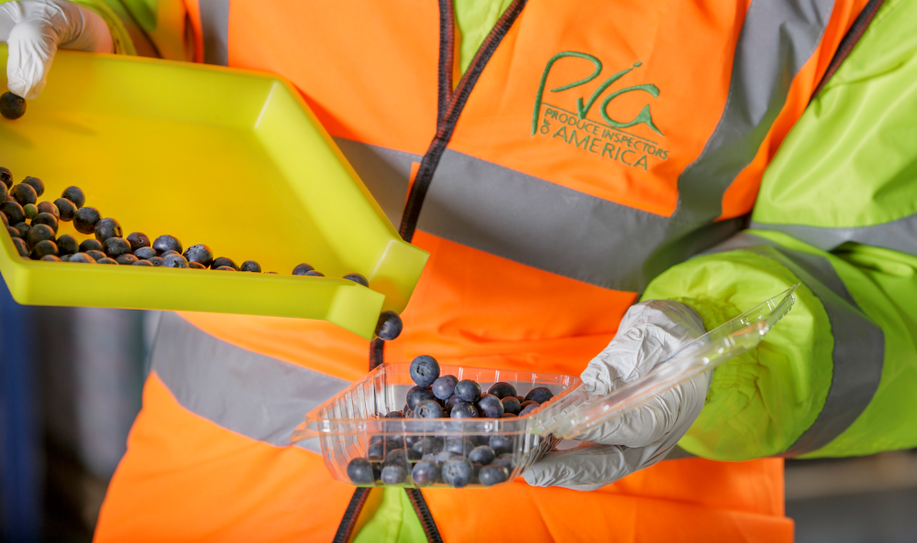
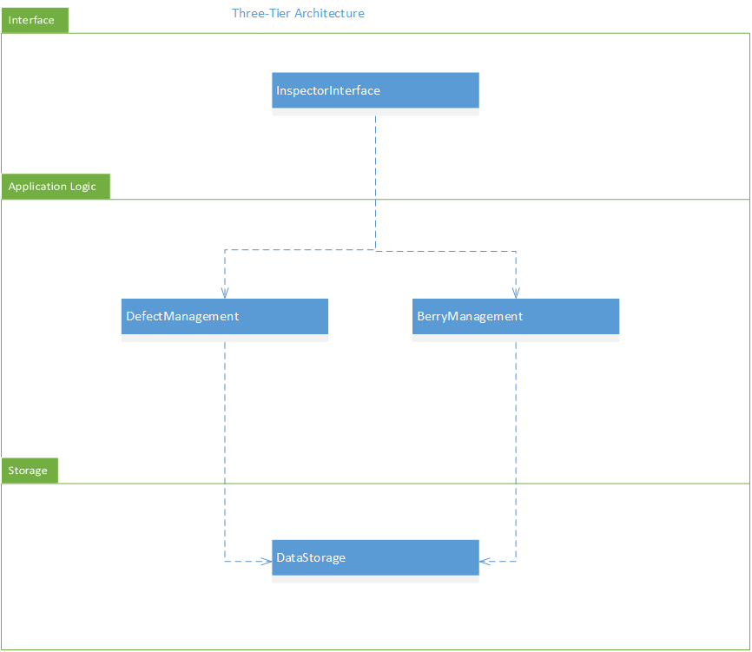
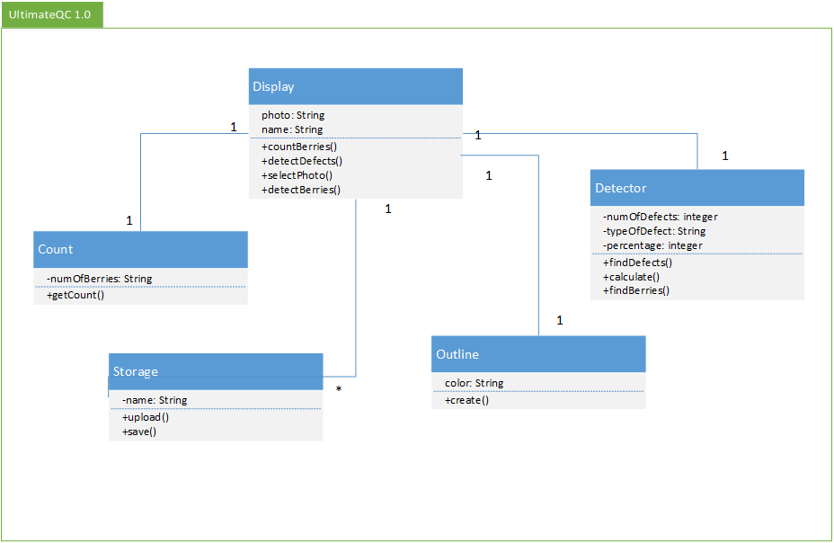
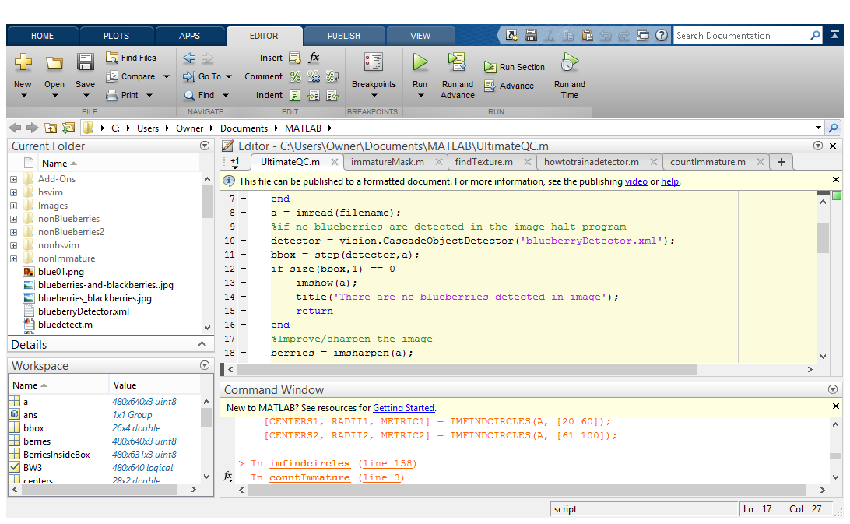
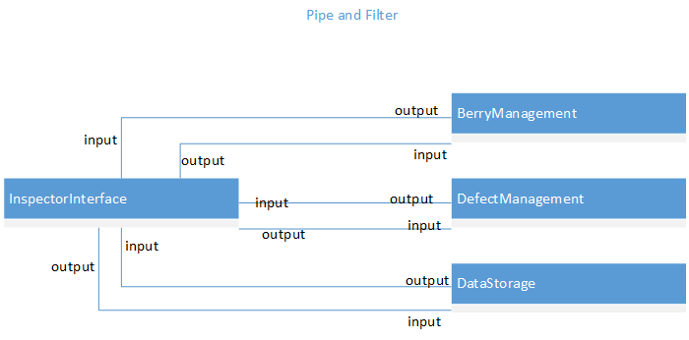
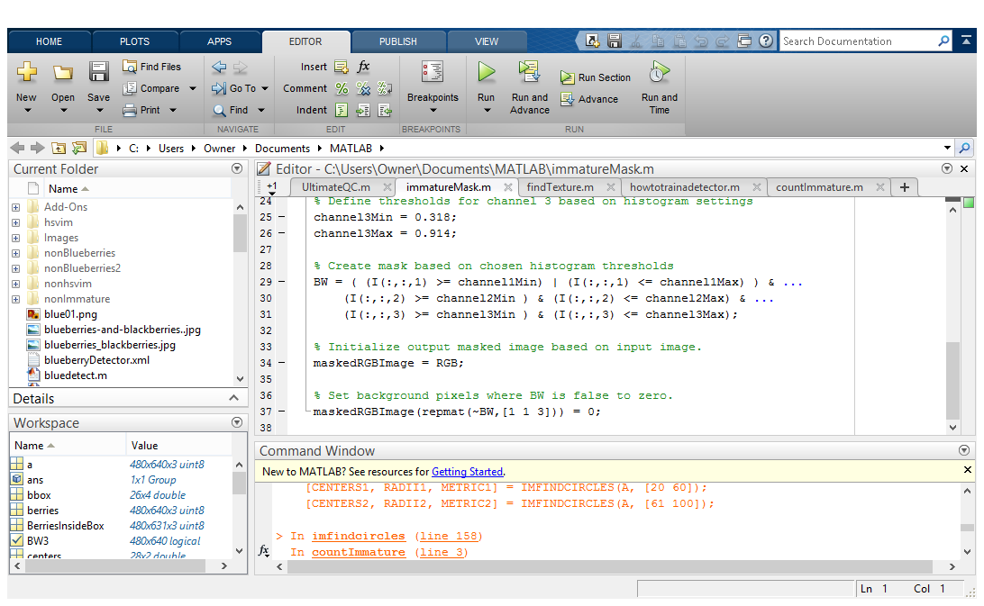
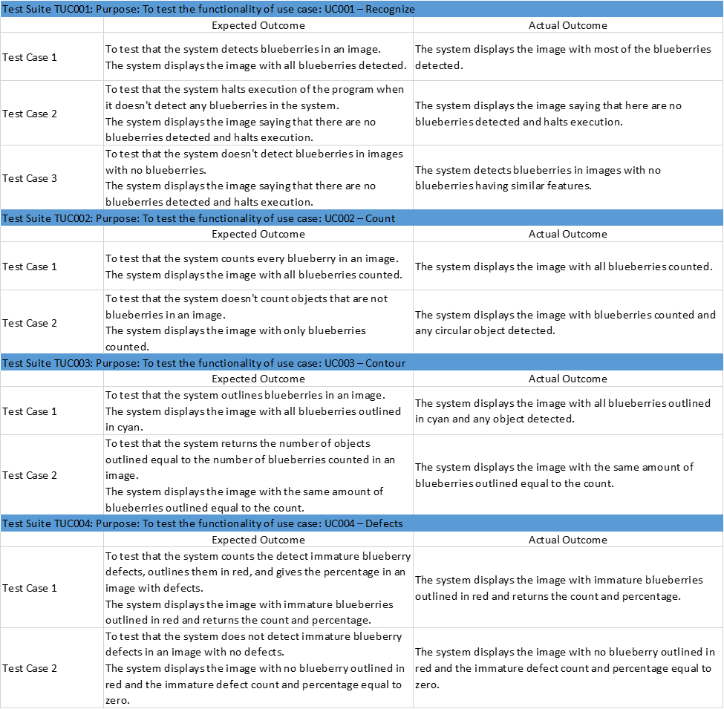
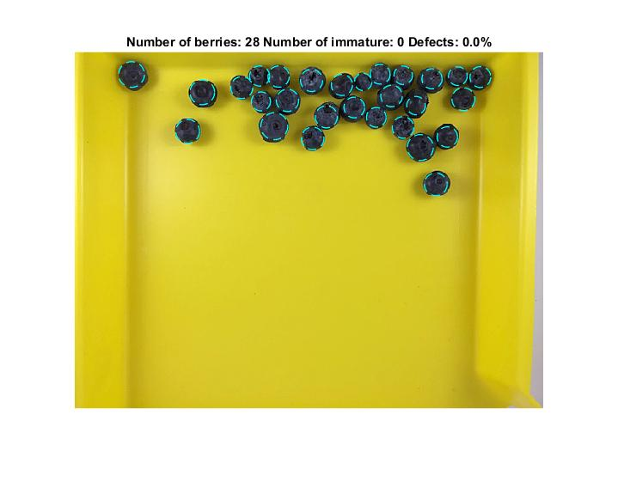
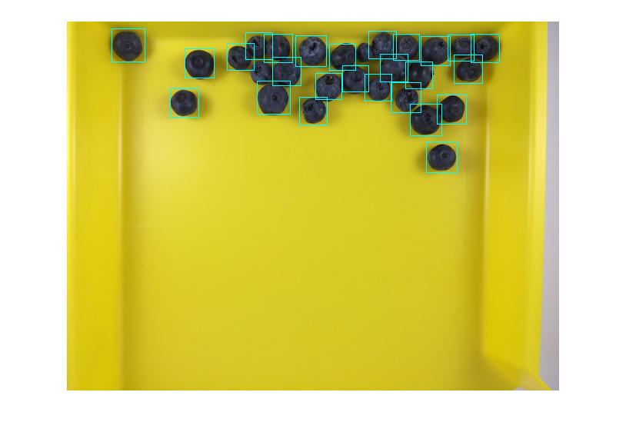
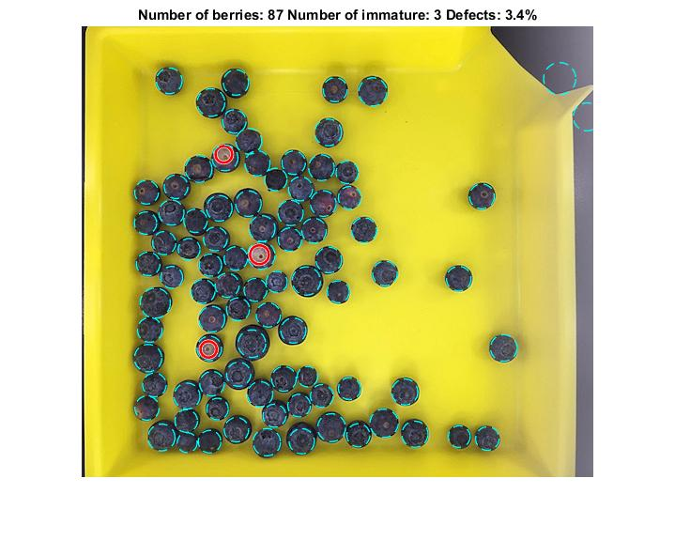
School of Computing & Information Sciences
Senior Project, 2015, Fall
Ultimate QC 1.0
Student: Marcine Kelly, Florida International University
Mentor: Rodrigo Morales, Produce Inspectors of America
Instructor: Masoud Sadjadi, Florida International University
Problem
Current System
Requirements
Most of the modern day practices used to inspect produce is visual. Visual inspections can result in human errors even with trained QC inspectors. They can miscount produce, fail to notice defects, and have typing errors in their reports to name a few examples. This process is slow and it takes a substantial amount of time to get a single QC report completed. The QC report is used by Produce Inspectors of America’s customers to make a decision as to whom and where to sell the produce to get the best profit for their merchandise possible. Therefore the longer it takes for the QC report to be completed the longer the produce sits there and the worse the quality of the produce becomes.
The current system for inspecting produce is a visual process. QC inspectors examine crates of produce in a refrigerated environment. They inspect every packet of produce in the crates. They manually count the produce in the packets, look for visible defects, take pictures of the produce and then enter their findings into a report.
UC001 – Recognize
The system shall identify the produce in the image.
UC002 – Count
The system shall provide an accurate count of the produce in the image.
UC003 – Contour
The system shall outline each individual produce that been counted and/or detected in the image in distinguishable and visible colors.
UC004 – Defects
The system shall identify defects in the produce, count them, and give a percentage of how much of the produce in the image is defective.
System Design
The InspectorInterface subsystem is responsible for realizing the user interface for the inspector. The BerryManagement subsystem is responsible for the detection of blueberries and its counting. The DefectManagement subsystem is responsible for the detection of defects and calculating the percentages. The DataStorage subsystem is responsible for the creation and storage of photos and reports.
Three-tier architecture – The interface layer includes the InspectorInterface subsystem because it deals with everything the user interacts with like making a request to get the count of the berries. The application logic layer includes the DefectManagement and BerryManagement subsystems. This layer processes the images, determining if there are blueberries, counts them and then looks for defects. The storage layer includes the DataStorage subsystem which deals with the storage and retrieval of images and reports.
Pipe and filter architecture – The InspectorInterface subsystem gets an image and sends it to the DataStorage subsystem or gets images from the DataStorage subsystem, and then it outputs that into the BerryManagement subsystem. The BerryManagement subsystem processes the image and sends its output to the InspectorInterface subsystem. The InspectorInterface sends information from this output to both the DefectManagemant and DataStorage subsystems. The DefectManagement subsystem processes the input and sends its output to the InspectorInterface which sends information to the DataStorage subsystem.
Object Design
Implementation
Class Diagram
When the program is executed the user will load an image and the program will verify that there are blueberries in the image. After detecting blueberries, the program will crop the photo to the size of the tray in the image to reduce the number of outliers detected. It then extracts the blueberries from the image and counts and outlines them in cyan. It also extracts the immature blueberry defects, counts and outlines them in red, then calculate the percentage. Finally, it returns the counts and the percentage.
Verification
Screenshots
Blueberries being counted
Summary
Blueberry Detector
In conclusion, for this project I was able to implement blueberry detection and immature blueberry detection, although they are not perfect. I was also able to count the blueberries and the defective blueberries and return a percentage of how much of the produce was defective.
Immature Blueberries Detection
Acknowledgement
The material presented in this poster is based upon the work supported by Rodrigo Morales and Carlos Villabona, and I am thankful to the help that I received from them in implementing this project.

