Slide 1
Urban Decision Theater
Team Member(s): Renan Santana, Developer
Olena Tkachenko, Developer
Product Owner(s): Ali Mostafavi
Instructor: Masoud Sadjadi
School of Computing and Information Sciences
Florida International University
Notes:
Greet your audience, thank them for attending your presentation, introduce yourself, introduce your project, introduce your team members, and quickly indicate what each of you did in a high-level manner, and put more emphasis on your part/contribution.

Slide 2
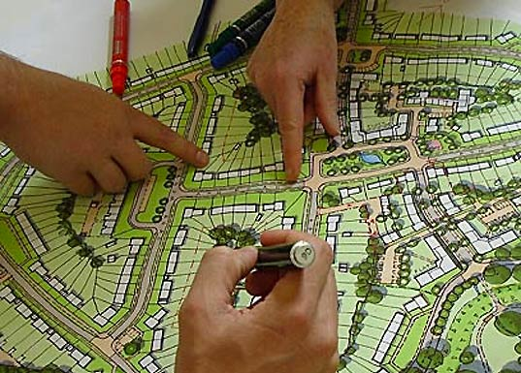
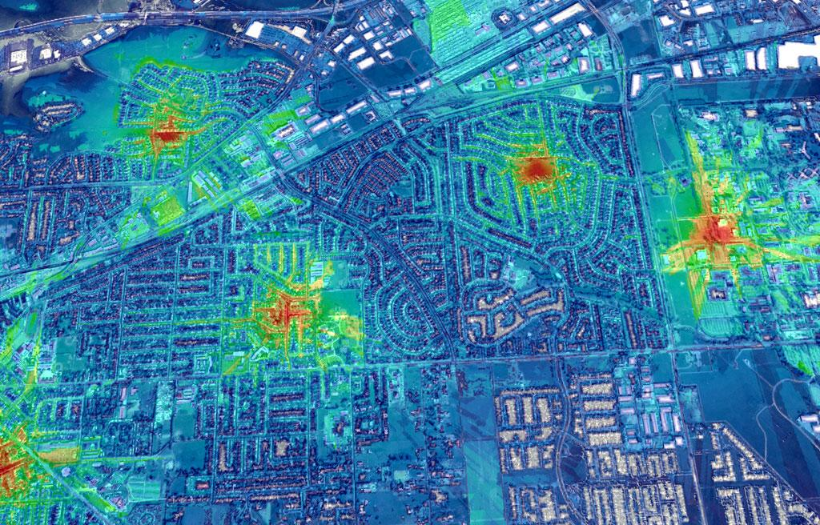
Problem Definition
Urban City Planners do not have robust tools to assist them in solving complicated flooding scenarios and storm surge events due to sea-level rise that threaten many urban areas. ​
Types of problems when facing persistent flooding or recurring floods: ​
Heavy traffic​
Health-issues​
Saltwater intrusion​
Sewer overflow​
Population Emotion​
Additionally, if a less than optimal layout decision in the placement of the new pumps and sewer systems would waste the city’s money while still leaving the underlying problem of flooding to be dealt with.
Notes:
Introduce the problem that the whole project tackles and stay focused on the parts that you have been working. Indicate if there is an existing previous system, enumerate its problems/limitations, etc.

Slide 3
Current System
Typically Urban City Planners rely on regional height data gathered from the satellite and geological terrain types from many parts of the urban city. However, there are many unknowns to the geological terrain, since over time there can garbage buildup that can cause toxins to change the permeability of the terrain. ​
​
In addition, the limitations to this system includes
Time constraints on planning and building
Budget evaluation
Team organization
Site evaluation
Other details for a large scale project execution.

Slide 4
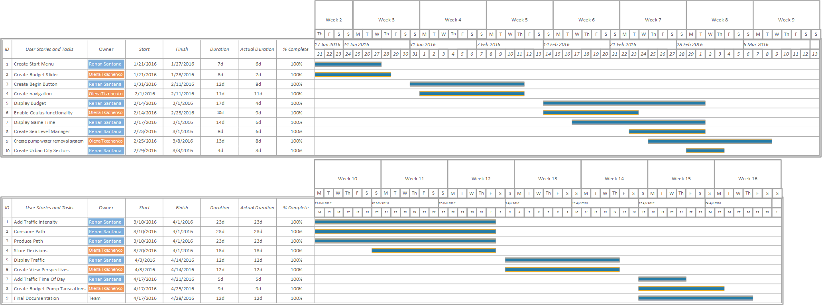
Project Management : Gantt
Notes:
Project Management (schedule for entire semester) (one slide; Gantt Chart).

Slide 5
User Stories Implemented
#663-Select Starting Budget
#666-Start Menu
#677-Begin Button
#682-Create Pump Water Removal System
#704-Create Navigation
#717-Enable Oculus
#722-Display Budget
#728-Display Game Time
#734-Create Sea Level Manager
#754-Create Urban City Sectors
#763-Consume Path
#768-Store Decisions
#778-Add Traffic Intensity
#782-Produce Path
#787-Display Traffic
#788-Create View Perspectives
#799-Add Traffic Time Of Day
#803-Create Budget-Pump Transactions
Notes:
4. Requirements:
4.1. User stories implemented (one or more slides).
4.2. UML use cases and the use case diagram for the implemented use cases (one or more slides).
4.3. UML sequence diagrams for the implemented use cases.

Slide 6
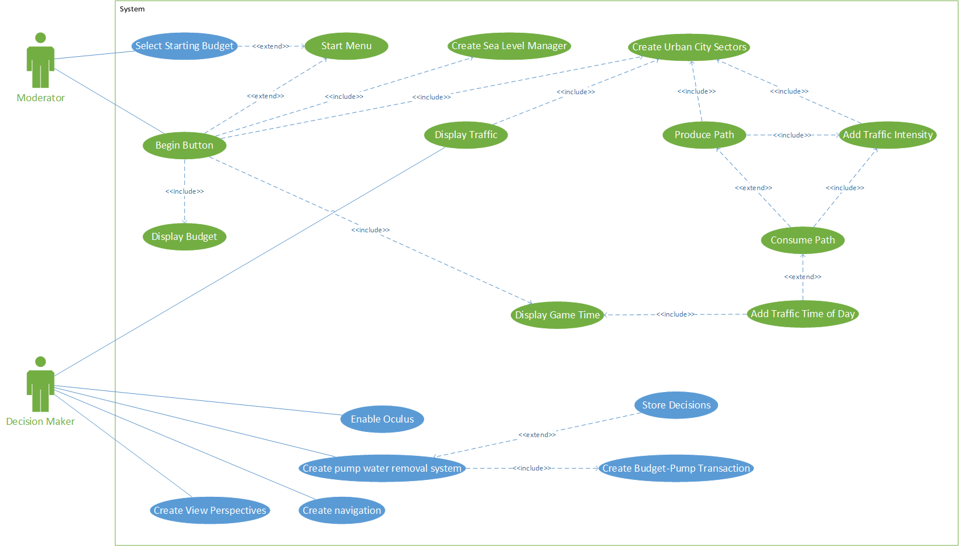
Requirements: Use Cases
Notes:
4. Requirements:
4.1. User stories implemented (one or more slides).
4.2. UML use cases and the use case diagram for the implemented use cases (one or more slides).
Show the Use Case Diagram for the whole project.
Highlight your use cases.
Show all the details of the most significant use case.
4.3. UML sequence diagrams for the implemented use cases.

Slide 7
UDT787- Display Traffic
USER STORY DESCRIPTION: As a Decision Maker, I would like to be able to view the traffic as a grid, so that I’m aware of the amount of traffic happening in the urban city.
ACTORS:
Decision Maker
PRE-CONDITIONS:
The Moderator clicked the “Begin” button in the start menu.
The Display Traffic script invokes the Start function.
The texture and color objects are created.
The asynchronous timer is created and assigned with the OnTimedEvent function.
The initial draw of the image is called and the color is assigned to the texture.
The asynchronous timer invoked to start.
DESCRIPTION:
Use case begins when the Decision Maker sends a request to the system by pressing the “CTRL” key down.
When the system receives the request, the system shall check for the input key event is the “CTRL” key.
The system shall invoke Update from MonoBehavior.
The system shall set the trafficDisplayPanel to active.
The system shall call the OnTimedEvent when the timer elapses.
The system shall loop foreach road node:
  Get initial traffic intensity.
  Get traffic intensity.
  Calculate the color amount of red and green.
  Mark the traffic as updated.
The system shall then check if the traffic is updated.
The system shall set the texture with the “textureColor”.
The system shall apply the “textureColor” to the texture object.
The system shall set the material of the traffic image with the texture.
Use case ends the system sets the traffic update to false.

Slide 8
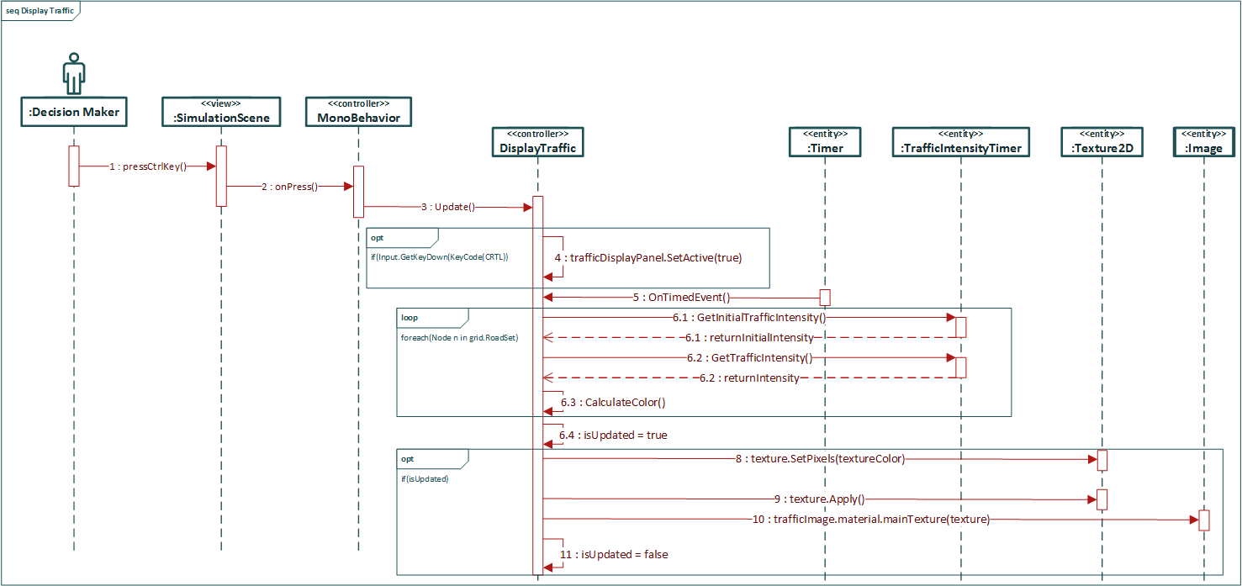
Sequence Diagram: Display Traffic
Notes:
4. Requirements:
4.1. User stories implemented (one or more slides).
4.2. UML use cases and the use case diagram for the implemented use cases (one or more slides).
4.3. UML sequence diagrams for the implemented use cases.
Show the sequence diagram of the most significant use case.

Slide 9
UDT754- Create Urban City Sectors
USER STORY DESCRIPTION: As a Moderator, I would like to have the city be divided into sectors or blocks, so that data (traffic, water height, and population emotions) can be generated for the individual sectors.
ACTORS:
Moderator
PRE-CONDITIONS:
The Moderator is on the StartMenu scene.
DESCRIPTION:
Use case begins when Use case begins when Moderator sends a request to the system by clicking the “Begin” button.
When the system receives the request, the system shall invoke the onClick event.
The system shall send a Awake message to Grid.
The system shall initialize grid attributes.
The system shall initialize the sector names currently selected.
The system shall call CreateGrid.
The system shall then loop the size of the grid creating Nodes relative to the world position.
The system shall find the sector name and road that the node is in.
Use case ends the system will check if a node is in a valid sector and if it has a layer name add the layer name as the first point in the sector else if it’s only in a valid sector add the last point of the sector.

Slide 10
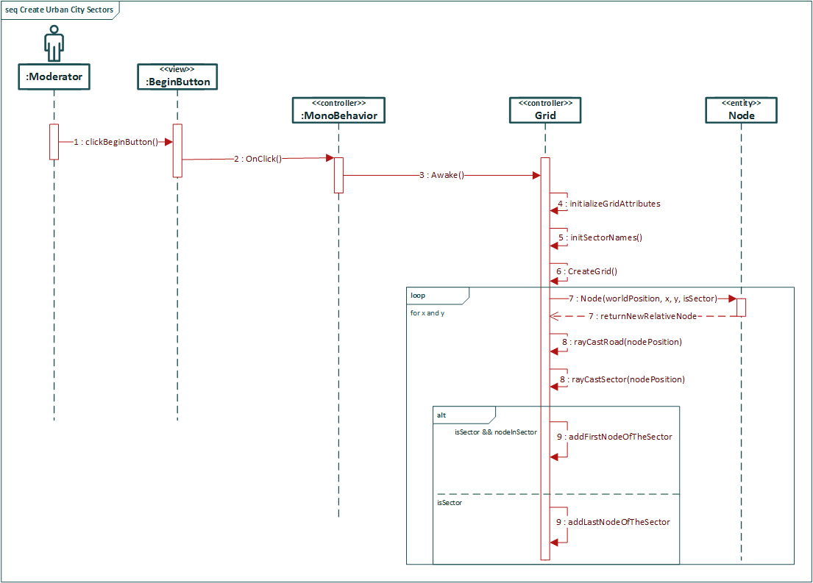
Sequence Diagram:
Create Urban City Sectors

Slide 11
System Design: Decomposition
Architecture begin used:
MVC
Client-Server
Notes:
5. System design:
5.1. System decomposition; identify the architecture patterns used (one slide).
System decomposition
Identify the architecture patterns used
Highlight the parts that you contributed to them
5.2. System deployment – h/w and s/w requirements (one slide).
5.3. Persistent data design (one slide).
5.4. Security/Privacy (one slide).

Slide 12
System Design: System Deployment
Hardware Requirements
PC
Oculus (latest version)
Software Requirements
Linux based server
Unity 5.3
Windows 10
Visual Studio 2016 (optional)

Slide 13
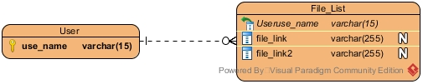
System Design: Persistent Data
MongoDB:
  Transfer a complete simulation file after the simulation is over.
Notes:
5. System design:
5.1. System decomposition; identify the architecture patterns used (one slide).
5.2. System deployment – h/w and s/w requirements (one slide).
System Deployment Diagram
Highlight the parts that you contributed to them
5.3. Persistent data design (one slide).
5.4. Security/Privacy (one slide).

Slide 14
System Design: Security
IRC is just to relay the decisions to the Moderator.
MongoDB service will be encrypted.
Notes:
5. System design:
5.1. System decomposition; identify the architecture patterns used (one slide).
5.2. System deployment – h/w and s/w requirements (one slide).
System Deployment Diagram
Highlight the parts that you contributed to them
5.3. Persistent data design (one slide).
5.4. Security/Privacy (one slide).

Slide 15
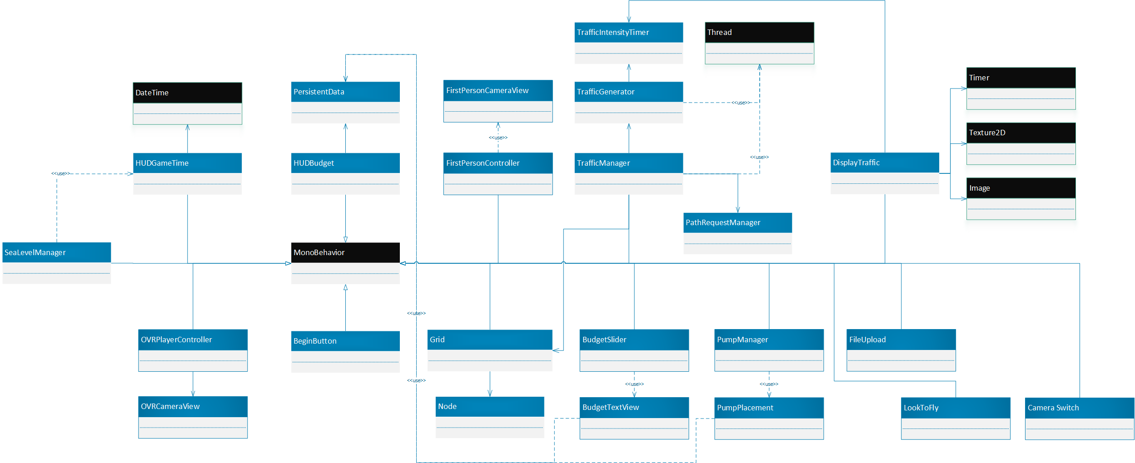
Detailed Design: Minimal Class Diagram
Singleton: Used in the application to represent the unique instances of an object
Notes:
6. Detailed design:
6.1. Minimal class diagram. Identify the design patterns used (one or more slides).
Identify the design patterns used
Highlight the classes that you created/modified
6.2. State machine for the main control object or the most important object of the implemented uses cases (one or more slides).
6.3. Main algorithm used related to an implemented use case described above (one or more slides).

Slide 16
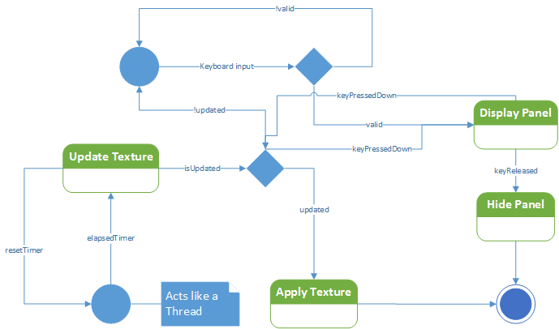
Detailed Design: State Machine

Slide 17
Main algorithm: Display Traffic
void Update() // Called every frame
if (Input.GetKeyDown())
Display the panel
else if (Input.GetKeyUp())
Hide the panel
if (isUpdated)
Update the image texture
isUpdated = false;
void OnTimedEvent(object source, ElapsedEventArgs e) // Timer calls function
float initWeight, trafficIntensity, red, green;
foreach (Node n in grid.RoadSet)
lock (n)
initWeight = n.trafficTimer.InitialTrafficIntensity;
trafficIntensity = Mathf.Clamp(n.trafficTimer.TrafficIntensity, 0, initWeight);
Calculate color (red / green)
textureColor[n.gridX + n.gridY * width] = red + green;
isUpdated = true;
Notes:
6. Detailed design:
6.1. Minimal class diagram. Identify the design patterns used (one or more slides).
6.2. State machine for the main control object or the most important object of the implemented uses cases (one or more slides).
6.3. Main algorithm used related to an implemented use case described above (one or more slides).

Slide 18
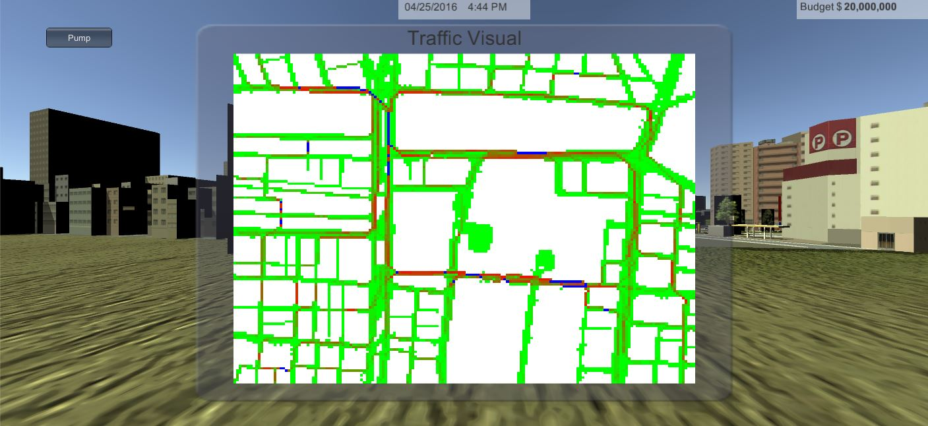
Main algorithm : Visual

Slide 19
Test Case: Create Urban City Sectors
Identifier | UDT754- Create Urban City Sectors_SUNNY01
Purpose | To ensure that the city is divided into road, city block, and n/a sectors.
Pre-conditions | The Moderator clicked the Begin button in the StartMenu.
Input | Left click the Begin button from the mouse.
Expected Output | Each sector will have a set of nodes that represents the city.
Notes:
7. Test Suites and Test Cases (one sunny day and one rainy day) for the use case represented in part (5) above (2 slides).
7.1 One sunny day and one rainy day for the implemented use cases (one or more slides).
7.2 Automated test scripts for the implemented use cases (one or more slides).

Slide 20
Test Case: Create Urban City Sectors
Identifier | UDT754- Create Urban City Sectors_RAINY01
Purpose | To ensure that the city is divided into road, city block, and n/a sectors.
Pre-conditions | The Moderator clicked the Begin button in the StartMenu.
Input | Left click the Begin button from the mouse.
Expected Output | The road may not be properly configured resulting in selecting the smaller piece of the disjoint set of roads.

