Slide 1
Urban Decision Theater 1.0
Team Member(s): Renan Santana, Olena Tkachenko Product Owner(s): Ali Mostafavi, Leonardo Bobadilla Instructor: Masoud Sadjadi
School of Computing and Information Sciences Florida International University
Senior Project Final Presentation Spring 2016
5/6/2016
Notes:
Greet your audience, thank them for attending your presentation, introduce yourself, introduce your project, introduce your team members, and quickly indicate what each of you did in a high-level manner, and put more emphasis on your part/contribution.

Slide 2
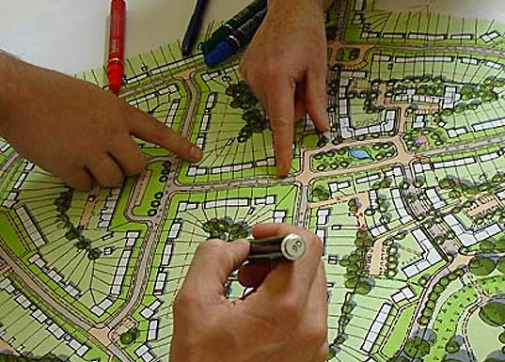
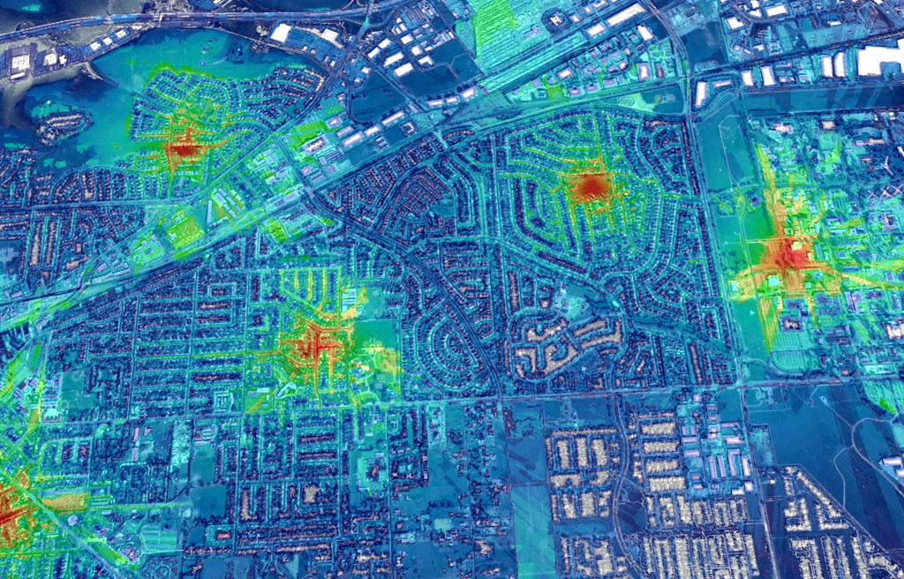
Problem Definition
Whole Project:
Current System: Urban-planners must solve complicated flooding scenarios and storm surge events due to sea-level rise.
Risk: Non-efficient process and can cause millions of dollars on a project that wasn’t done well
Notes:
Introduce the problem that the whole project tackles and stay focused on the parts that you have been working. Indicate if there is an existing previous system, enumerate its problems/limitations, etc.

Slide 3
Problem Definition cont.
New System: Urban Decision Theater is a 3D Unity simulation application that supports decision-making of urban-planners in flooding and storm surge events due to sea-level rise.
The new system will help prepare the urban-planners to make better decisions in tough situations.
Decisions include: pump / sewer placement, other
Affects: traffic flow, population emotion, other
My Part:
Provide urban planners :
Simulate Game Time
Simulate Sea Tides
Simulate Traffic
Structure the Urban City into sectors

Slide 4
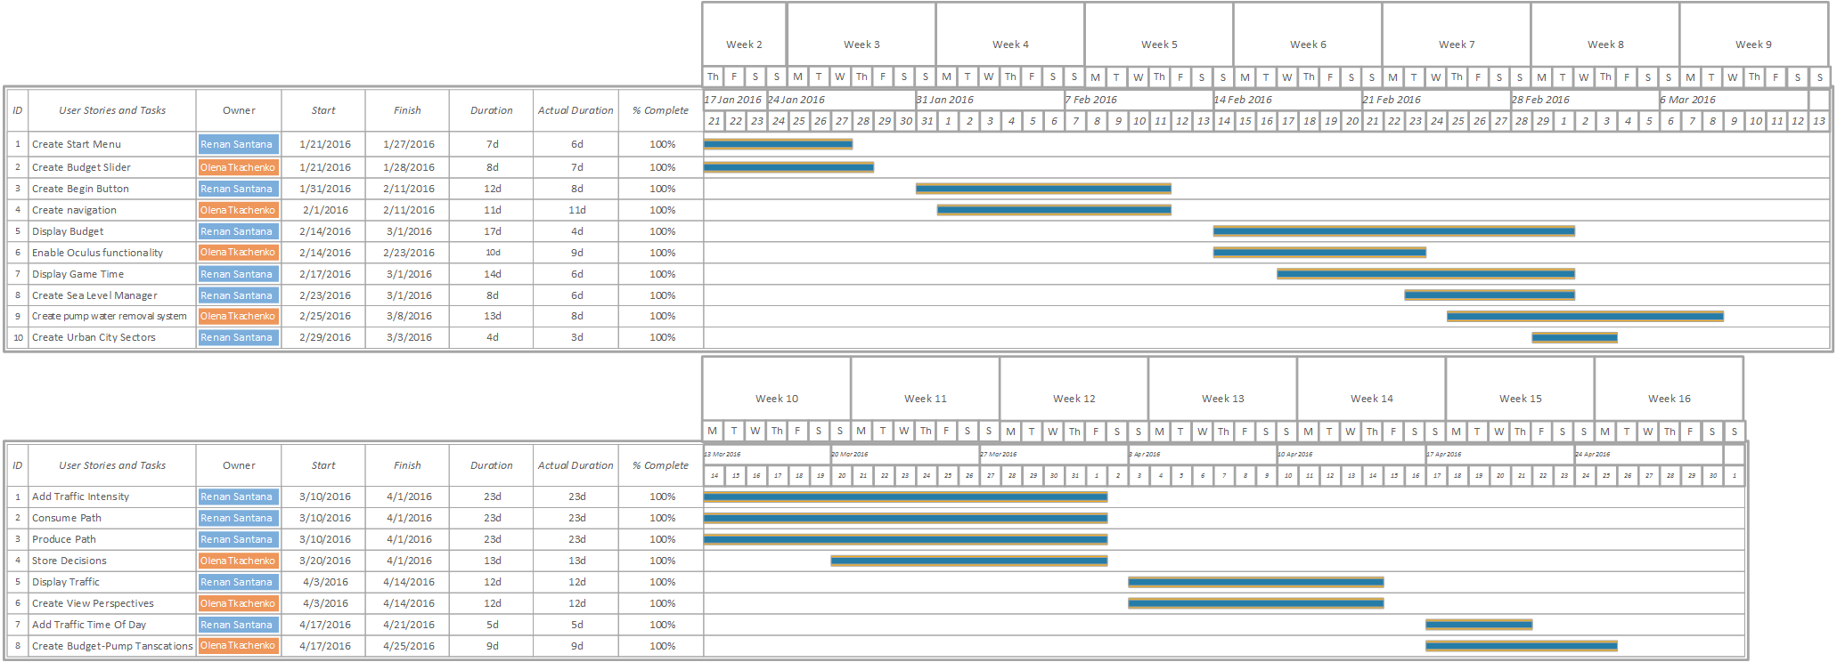
Project Management : Gantt
Notes:
Project Management (schedule for entire semester) (one slide; Gantt Chart).

Slide 5
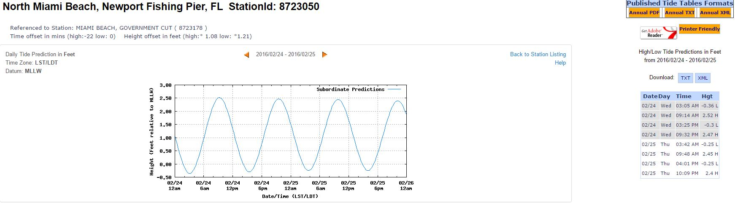
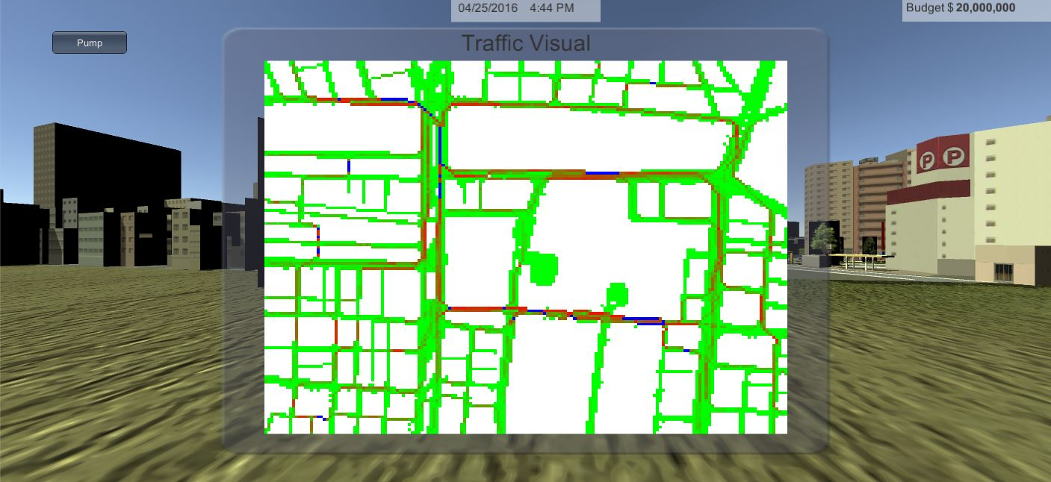
User Stories Implemented
#666-Start Menu
#677-Begin Button
#722-Display Budget
#728-Display Game Time
#734-Create Sea Level Manager
#754-Create Urban City Sectors
#763-Consume Path
#778-Add Traffic Intensity
#782-Produce Path
#787-Display Traffic
#799-Add Traffic Time Of Day
Notes:
4. Requirements:
4.1. User stories implemented (one or more slides).
4.2. UML use cases and the use case diagram for the implemented use cases (one or more slides).
4.3. UML sequence diagrams for the implemented use cases.

Slide 6
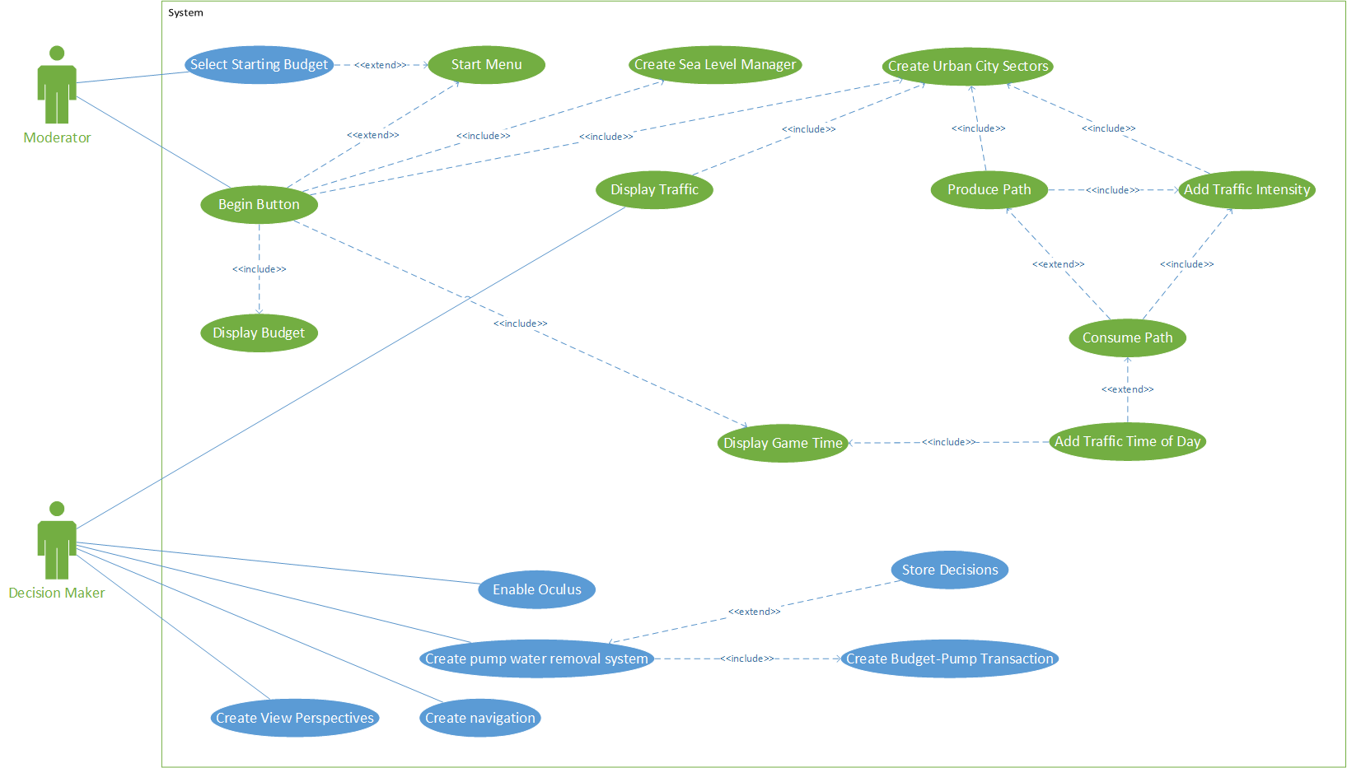
Requirements: Use Cases
Notes:
4. Requirements:
4.1. User stories implemented (one or more slides).
4.2. UML use cases and the use case diagram for the implemented use cases (one or more slides).
Show the Use Case Diagram for the whole project.
Highlight your use cases.
Show all the details of the most significant use case.
4.3. UML sequence diagrams for the implemented use cases.

Slide 7
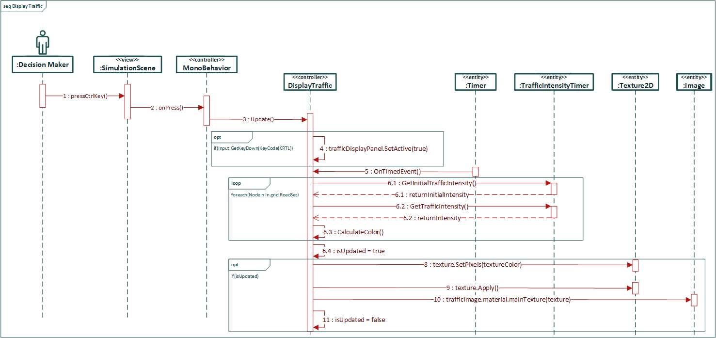
Sequence Diagram: Display Traffic
How can you display ~24,000 nodes (171 x 141) without any frame lag?
Notes:
4. Requirements:
4.1. User stories implemented (one or more slides).
4.2. UML use cases and the use case diagram for the implemented use cases (one or more slides).
4.3. UML sequence diagrams for the implemented use cases.
Show the sequence diagram of the most significant use case.

Slide 8
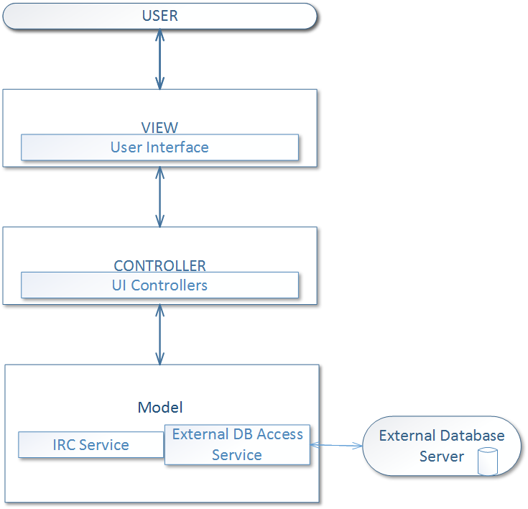
System Design: Architecture
Architecture begin used:
MVC
Client-Server
Notes:
5. System design:
5.1. System decomposition; identify the architecture patterns used (one slide).
System decomposition
Identify the architecture patterns used
Highlight the parts that you contributed to them
5.2. System deployment – h/w and s/w requirements (one slide).
5.3. Persistent data design (one slide).
5.4. Security/Privacy (one slide).

Slide 9
System Design: Persistent Data
MongoDB:
Transfer a complete simulation file after the simulation is over.
Notes:
5. System design:
5.1. System decomposition; identify the architecture patterns used (one slide).
5.2. System deployment – h/w and s/w requirements (one slide).
System Deployment Diagram
Highlight the parts that you contributed to them
5.3. Persistent data design (one slide).
5.4. Security/Privacy (one slide).

Slide 10
System Design: Security
IRC is just to relay the decisions to the Moderator.
MongoDB service will be encrypted.
Notes:
5. System design:
5.1. System decomposition; identify the architecture patterns used (one slide).
5.2. System deployment – h/w and s/w requirements (one slide).
System Deployment Diagram
Highlight the parts that you contributed to them
5.3. Persistent data design (one slide).
5.4. Security/Privacy (one slide).

Slide 11
System Design: Deployment
Notes:
5. System design:
5.1. System decomposition; identify the architecture patterns used (one slide).
5.2. System deployment – h/w and s/w requirements (one slide).
System Deployment Diagram
Highlight the parts that you contributed to them
5.3. Persistent data design (one slide).
5.4. Security/Privacy (one slide).

Slide 12
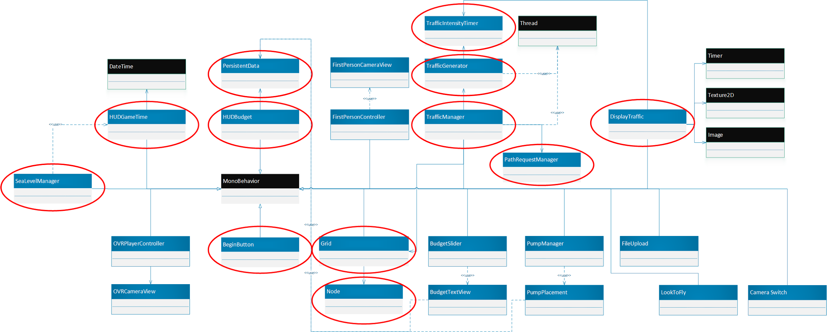
Minimal Class Diagram
Notes:
6. Detailed design:
6.1. Minimal class diagram. Identify the design patterns used (one or more slides).
Identify the design patterns used
Highlight the classes that you created/modified
6.2. State machine for the main control object or the most important object of the implemented uses cases (one or more slides).
6.3. Main algorithm used related to an implemented use case described above (one or more slides).

Slide 13
Main algorithm: Display Traffic
void Update() // Called every frame
if (Input.GetKeyDown())
Display the panel
else if (Input.GetKeyUp())
Hide the panel
if (isUpdated)
Update the image texture
isUpdated = false;
void OnTimedEvent(object source, ElapsedEventArgs e) // Timer calls function
foreach (Node n in grid.RoadSet)
Calculate color (red / green)
textureColor[n.gridX + n.gridY * width] = red + green;
isUpdated = true;
Notes:
6. Detailed design:
6.1. Minimal class diagram. Identify the design patterns used (one or more slides).
6.2. State machine for the main control object or the most important object of the implemented uses cases (one or more slides).
6.3. Main algorithm used related to an implemented use case described above (one or more slides).

Slide 14
Main algorithm : Visual

Slide 15
Test Case: Create Sea Level Manager
Sunny
Identifier | UDT734- Create Sea Level Manager SUNNY01
Purpose | To ensure that the water is being displaced with the given tide height.
Pre-conditions | The Moderator clicked the Begin button in the StartMenu.
Input | Left click the Begin button from the mouse.
Expected Output | The height of the water is being adjusted asynchronously to the game time.
Notes:
7. Test Suites and Test Cases (one sunny day and one rainy day) for the use case represented in part (5) above (2 slides).
7.1 One sunny day and one rainy day for the implemented use cases (one or more slides).
7.2 Automated test scripts for the implemented use cases (one or more slides).

Slide 16
Test Case: Create Sea Level Manager
Rainy
Identifier | UDT734- Create Sea Level Manager RAINY01
Purpose | To ensure that the Sea Level Manager captures the 9999 year boundary.
Pre-conditions | The Moderator clicked the Begin button in the StartMenu. DateTime is on the last possible year (9999)
Input | None.
Expected Output | The system will be paused.

Slide 17
Summary
The main purpose of Urban Decision Theater is to provide experience to urban-planners to make serious decisions based on the events and limited resources to simulate real life problems.
Some of my major contributions on the project were:
Provide urban planners :
Simulate Game Time
Simulate Sea Tides
Simulate Traffic
Structure the Urban City into sectors
Notes:
Summarize your contribution
Include your contact information
Ask if anyone has any questions for you.
Thank your audience

Slide 18
Thank you. Any Questions?
rsant143@fiu.edu
Notes:
Summarize your contribution
Include your contact information
Ask if anyone has any questions for you.
Thank your audience

