Slide 1









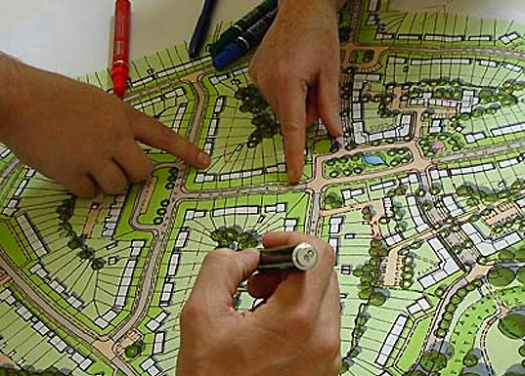
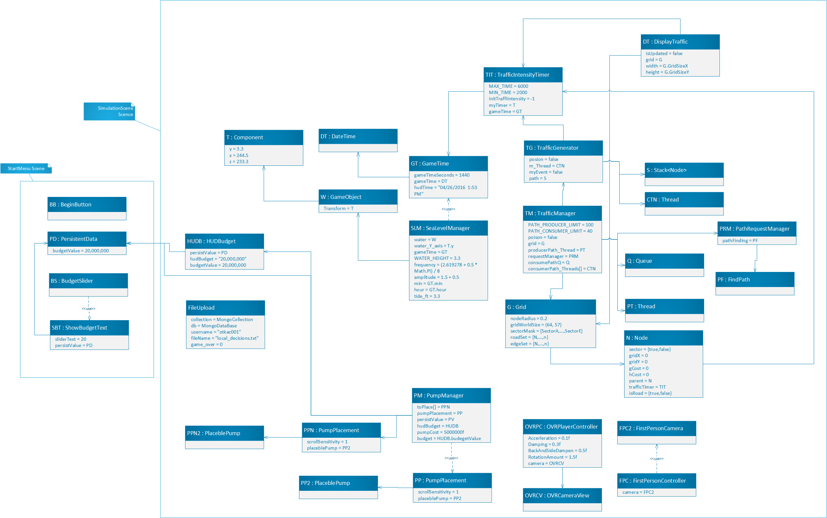
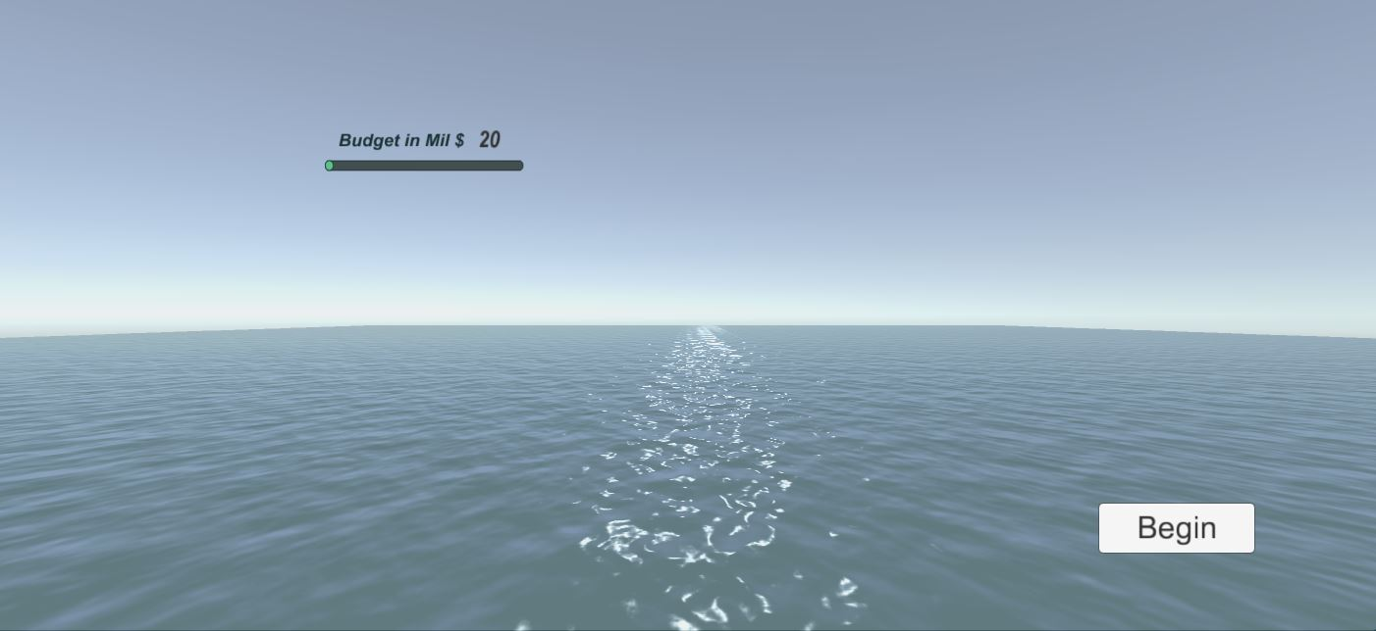
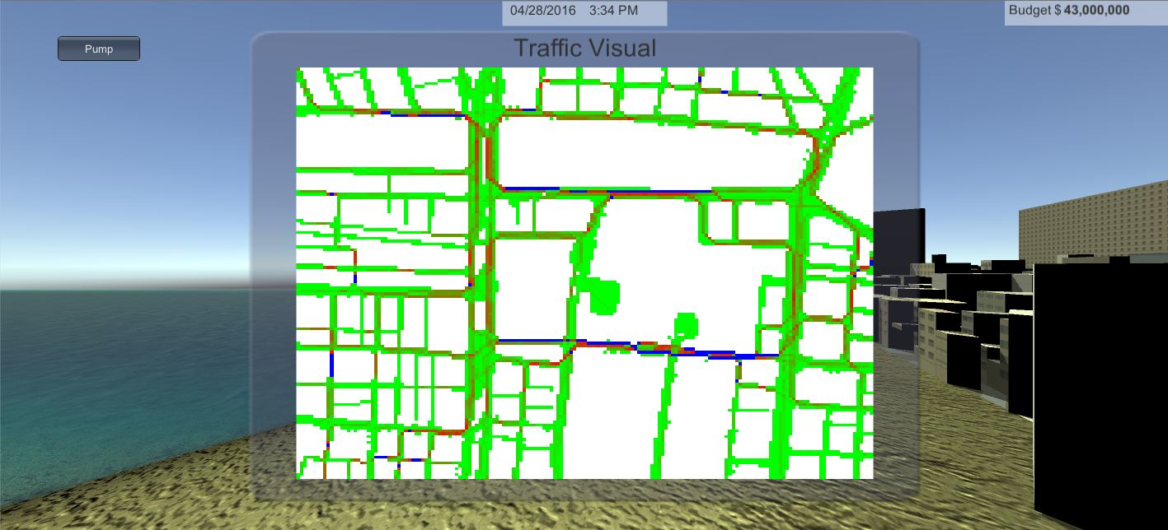
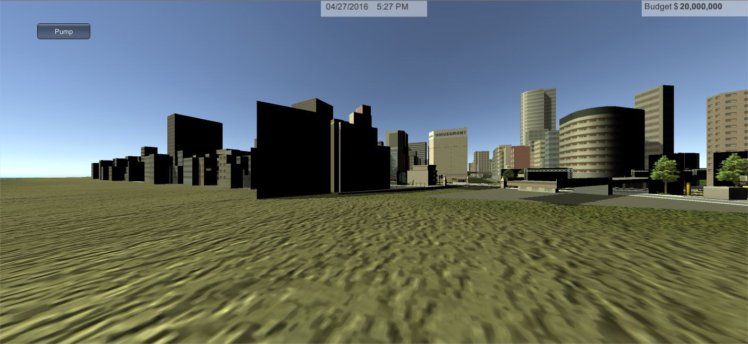
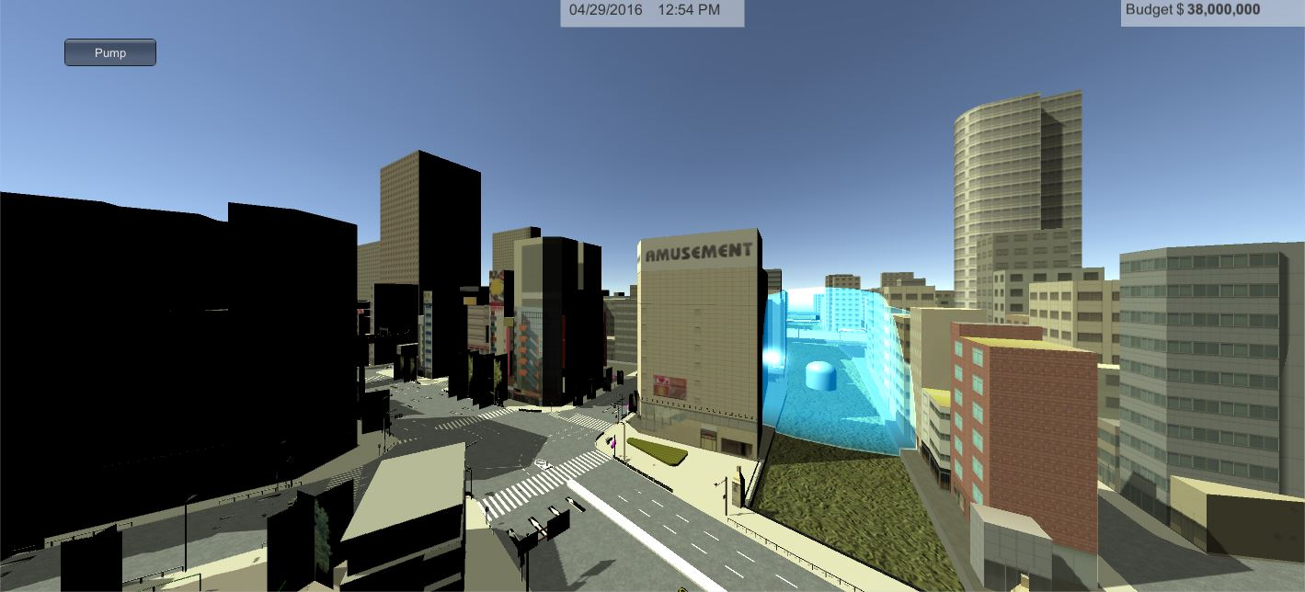
School of Computing & Information Sciences
Senior Project, 2016, Spring
Urban Decision Theater
Student: Renan Santana, Florida International University
Mentor: Juan Sotomayor Paez, Florida International University
Instructor: Masoud Sadjadi, Florida International University
Problem
Current System
Requirements
Urban City Planners do not have robust tools to assist them in solving complicated flooding scenarios and storm surge events due to sea-level rise that threaten many urban areas.
Types of problems when facing persistent flooding or recurring floods:
Heavy traffic
Health-issues
Saltwater intrusion
Sewer overflow
Population Emotion
Additionally, if a less than optimal layout decision in the placement of the new pumps and sewer systems would waste the city’s money while still leaving the underlying problem of flooding to be dealt with.
Typically Urban City Planners rely on regional height data gathered from the satellite and geological terrain types from many parts of the urban city. However, there are many unknowns to the geological terrain, since over time there can garbage buildup that can cause toxins to change the permeability of the terrain.
In addition, the limitations to this system includes time constraints on planning and building, budget evaluation, team organization, site evaluation and other details for a large scale project execution.
The system should allow Moderator to set the budget quantity.
The system should allow Moderator to begin the simulation for the Decision-Maker.
The system should generate traffic from the grid of the city.
The system should allow the Decision-Maker to view the traffic.
The system should allow the Decision-Maker to place pumps into the urban city.
The system should persist the decisions that were made in the simulation to a database.
Object Design
Implementation
The two main subsystems of Urban Decision Theater are the Unity application and Virtual Machine.
The Unity Application houses three subsystems: Model, View, and Controller.
The Model itself contains the entities of the game, which are called GameObjects. The other two subsystems are client services that are needed to communicate and connect to an outside server.
The View subsystem houses the different scenes in UDT. As well as the user-interaction the scenes, such as GUIs.
The Controller subsystem is composed of scripts that contain the logic to manipulate game objects and process user inputs.
The Virtual Machine is our external server and it contains the services needed to support the features of our Unity Application like MongoDB and IRC service.
System Design
Verification
Manual testing was used to test the different components of the system. Additionally, some components were tested using Unity Test Tools, which automated the unit tests and some integration tests.
The manual tests were conducted on components that need the application to run real time.
Automated tests were conducted on components that were simple.
Summary
Screenshots
Extreme events such as flooding and storm surges due to sea-level rise are significant threats to urban areas. The Urban Decision Theater is a 3D Unity application that simulates these extreme event scenarios to allow Urban City Planners to practice and model their decisions, with real world constraints, to find the best available outcome for their cities.
Acknowledgement
The material presented in this poster is based upon the work supported by my product owner Ali Mostafavi. I am thankful to the help that I received from my friends.

