Slide 1
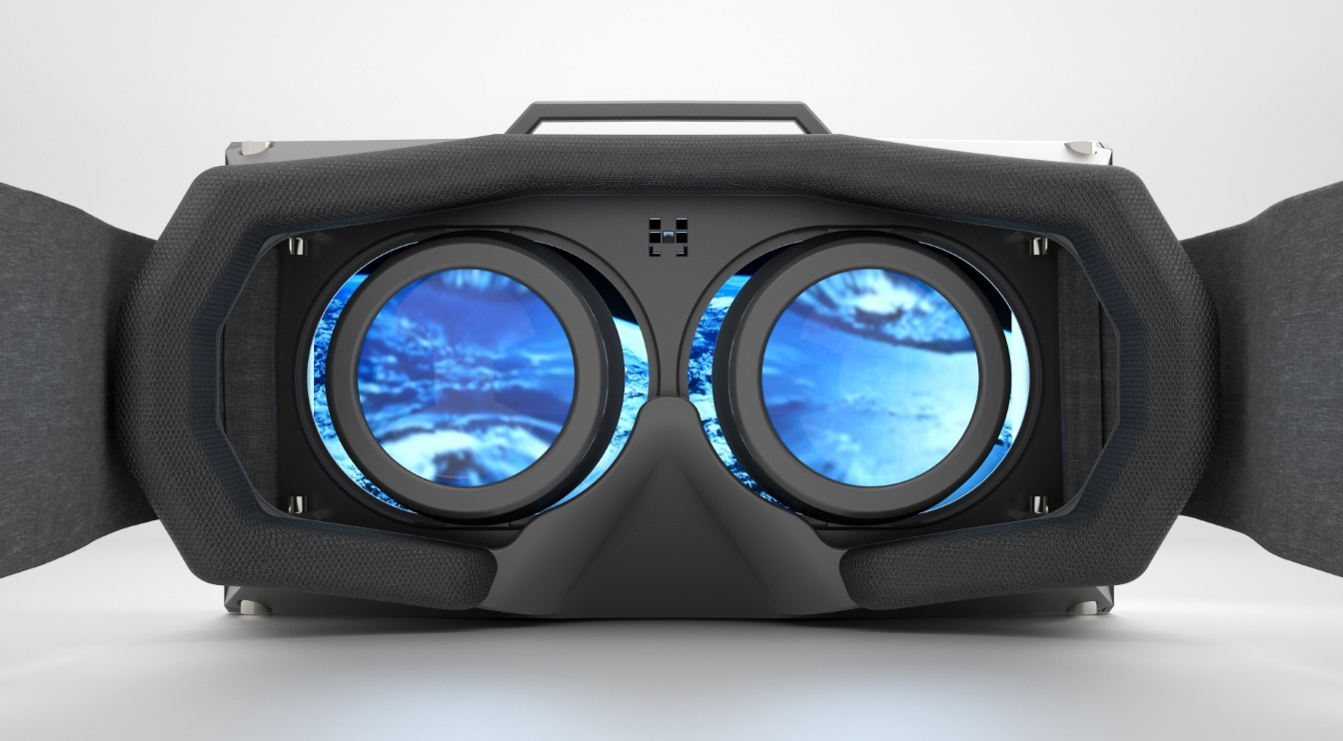














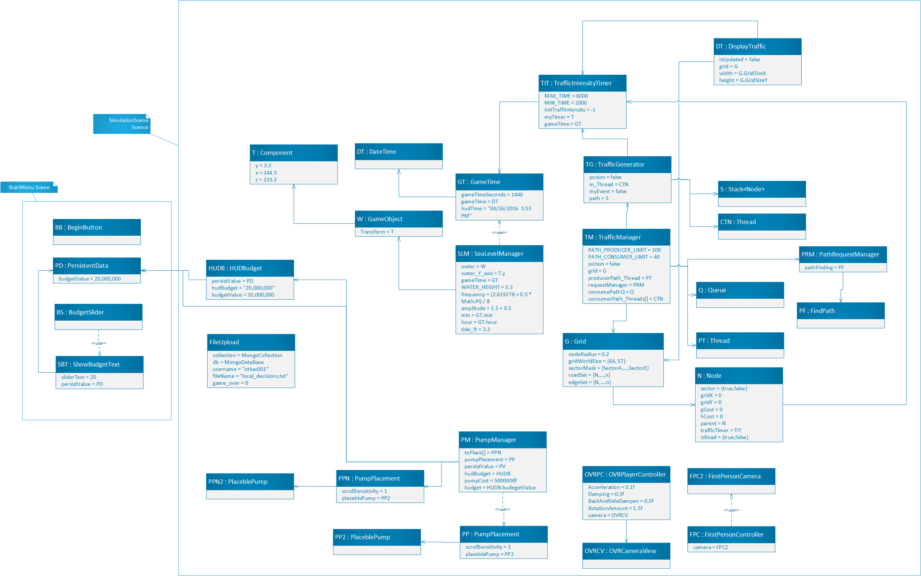
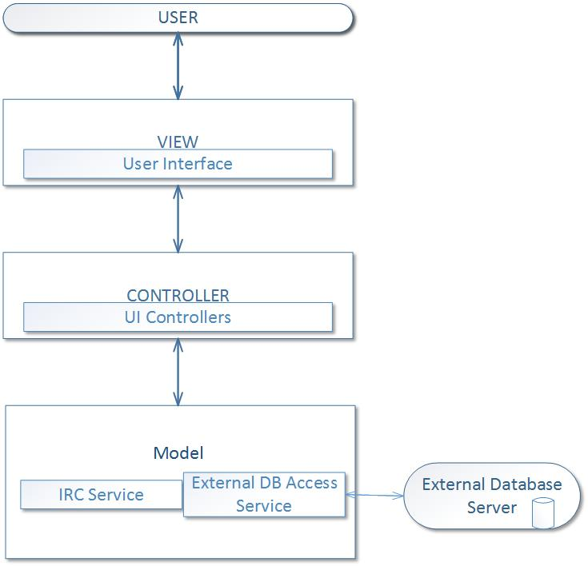
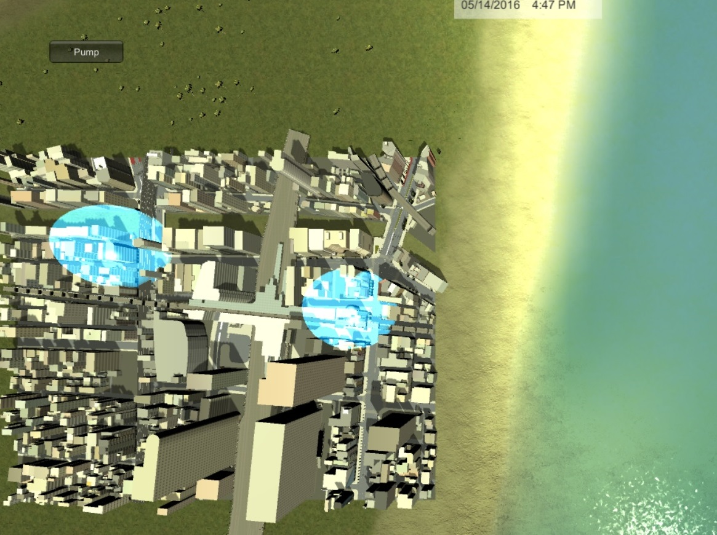
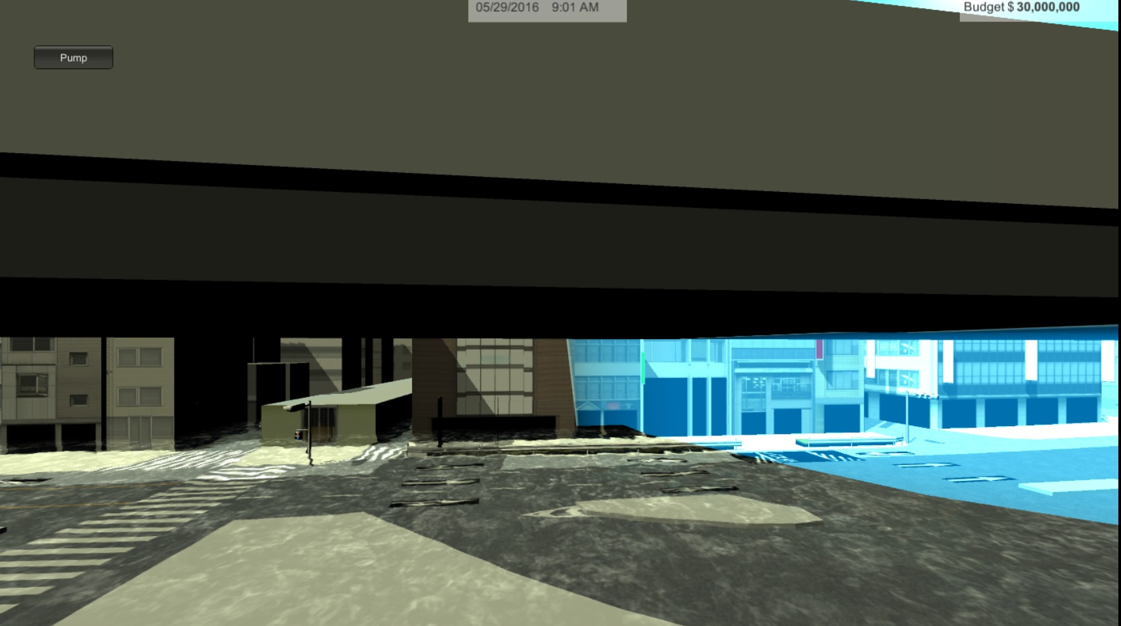
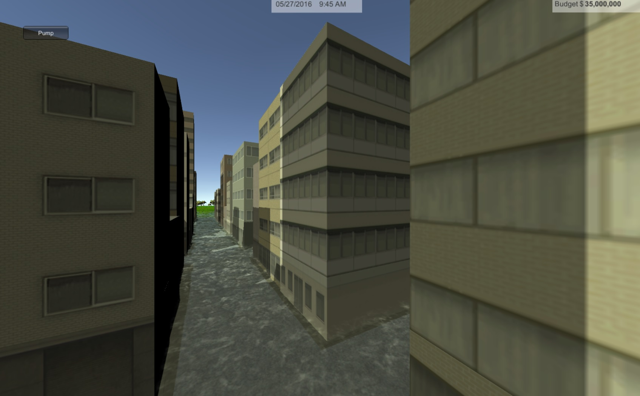
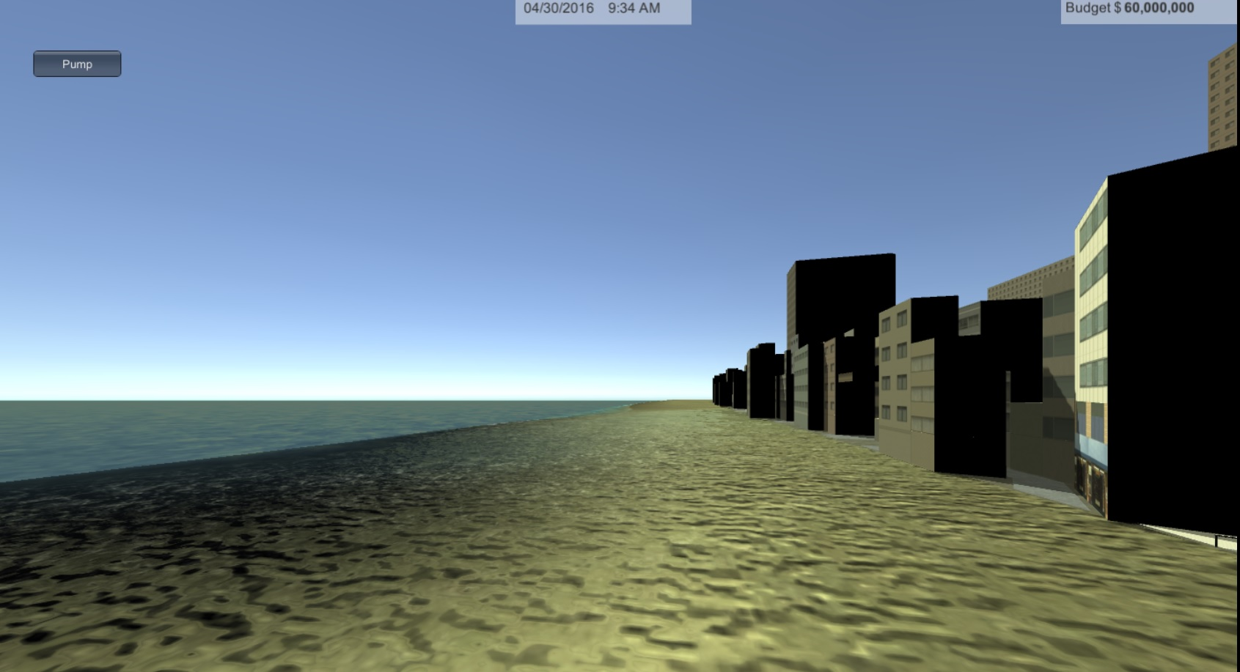
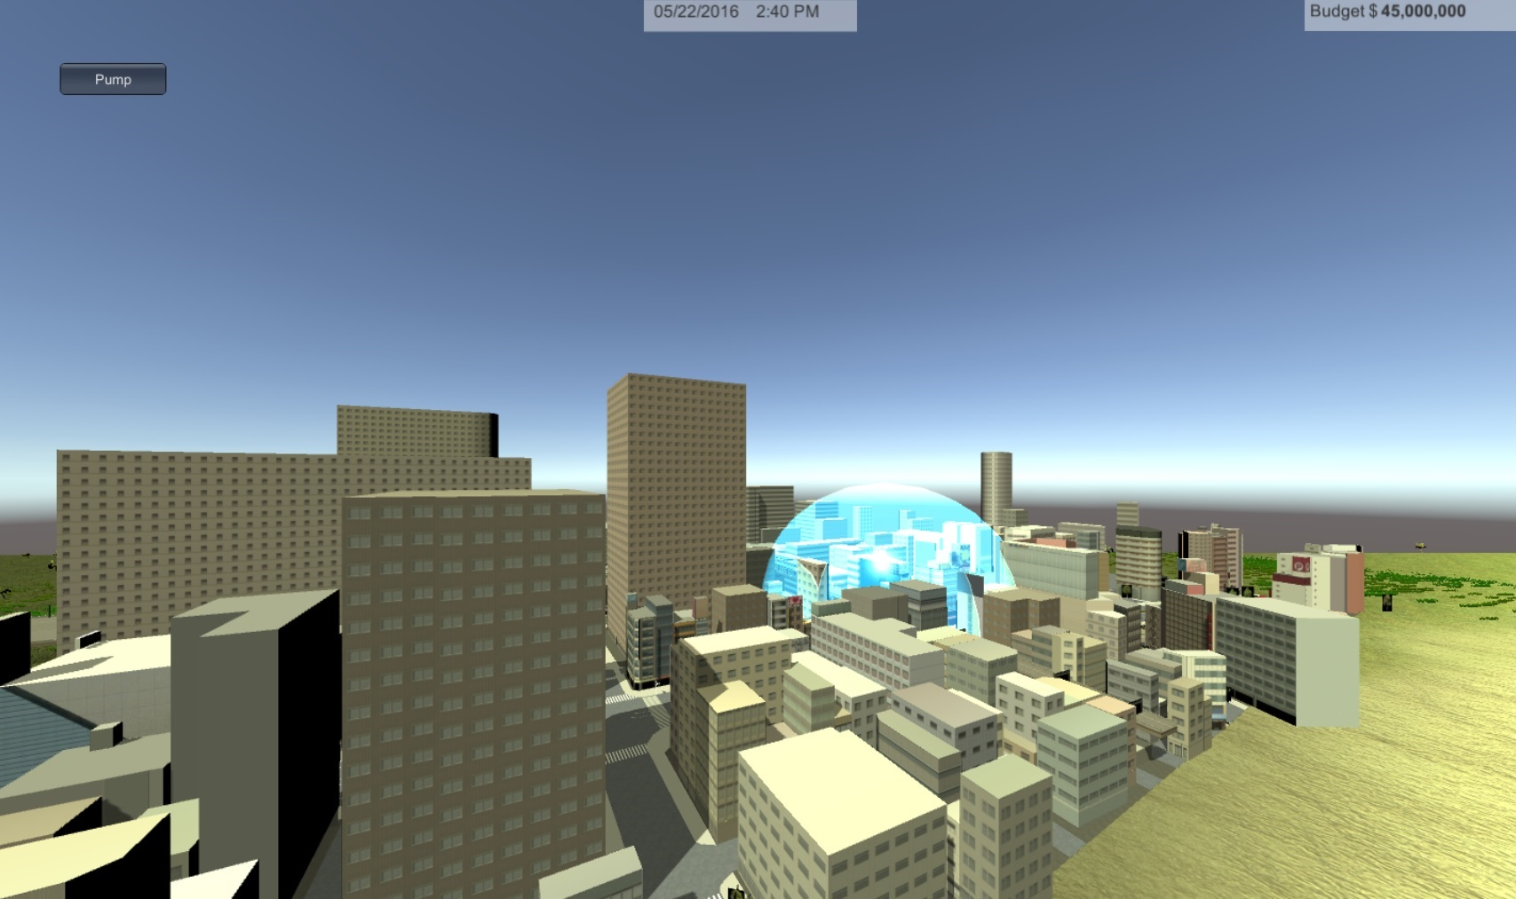
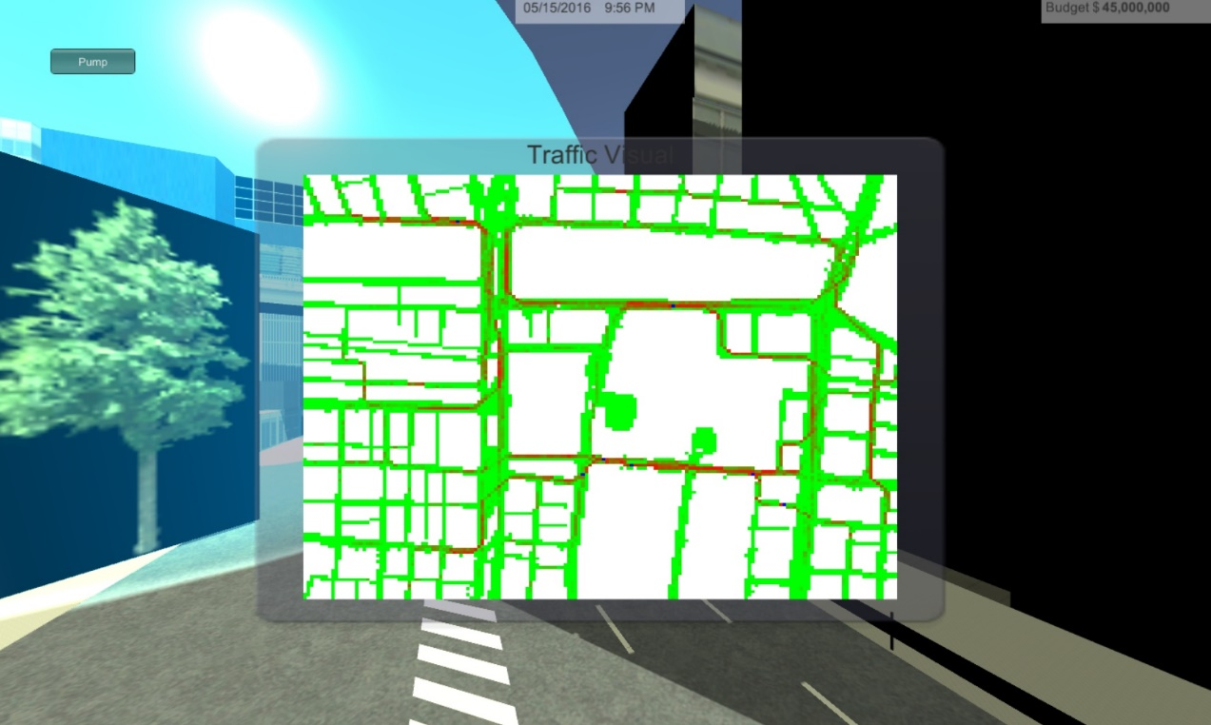
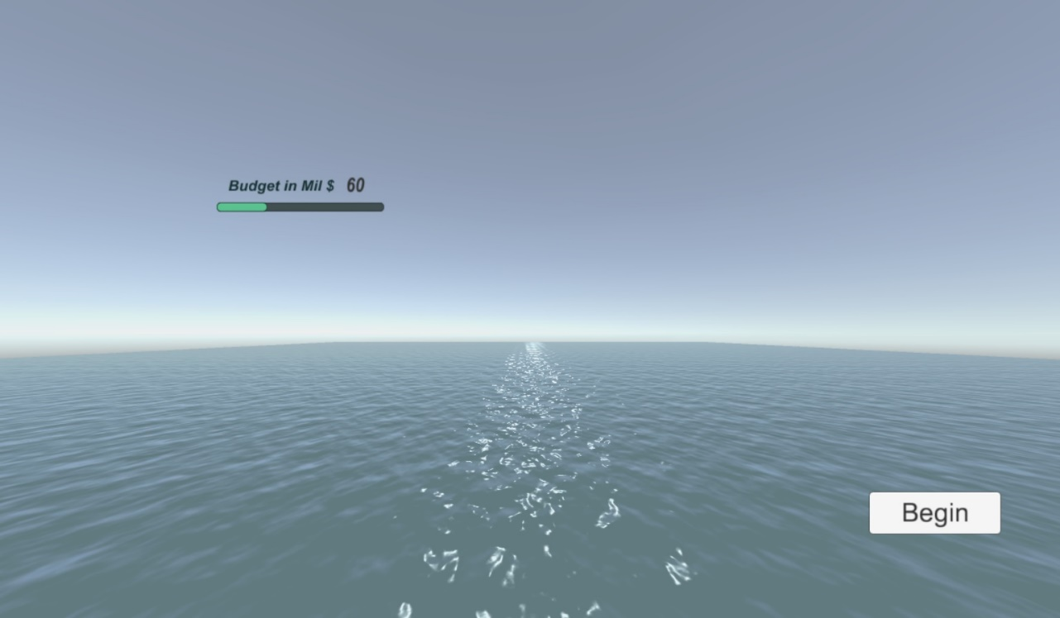
School of Computing & Information Sciences
Senior Project, 2016, Spring
Urban Decision Theatre 1.0
Student: Olena Tkachenko, Florida International University
Mentor: Maria Presa, Peeraya Inyim
Instructor: Masoud Sadjadi, Florida International University
Problem
Current System
Requirements
Extreme events such as flooding and storm surges due to sea-level rise are significant threats to urban areas and Urban City Planners do not have robust tools to assist them in decision-making.
This often results in risky trial & error learning process and multimillion $ mistakes.
Urban Decision Theatre 1.0 will simulate these flooding scenarios to allow Urban City Planners to practice and model their decisions with limited time and budget to find the best available outcome.
It will model:
Traffic
City flood pumps
Time of day
City Budget
Sea-Level
Tide
UDT uses virtual augmented reality to help Urban City Planners make robust decisions
The system should allow:
Decision Maker to buy and place pumps in the city
Store Decision Maker’s game attempts in remote database
Allow the Decision Maker to interact with the city in different perspectives:
FPV and Bird’s Eye views
First Person Navigation
For the use of Oculus DK
Moderator to select Initial Budget
Moderator to stream Decision Makers play
For modeling of Traffic interactions and sea-level
Object Design
System Design
Model-View-Controller Architecture
Implementation
The system is implemented with a MVC design, using Unity 5, Unity Asset Store, C# and more…
The system uses a MongoDB remote database server and virtual augmented reality in the form of Oculus DK1
Summary
The objective of our project is to provide a unique experience for Urban City Planners, to help them in evaluating various flooding and sea-level rise scenarios and make robust decisions.
Verification
Unit, Integration and System Tests were performed using manual and automated testing techniques. Unity Test Tools and Unity Integration Testing frameworks supported automatic testing. The purpose of our System testing was to make sure that the system was behaving appropriately according to UDT system requirements.
Figure 1. Bird’s Eye View of Miami
Figure 6. Flooded Street and City Pump (blue): Ground
Figure 3. Flooded Street: FPV-Floating
Screenshots
Figure 2. Beach: FPV-Ground
Figure 3. Beach: FPV-Floating and Pump (blue bubble)
Figure 4. CTRL: Traffic View
Figure 5. Start Menu: Moderator
Acknowledgement
The material presented in this poster is based on the work supported by Ali Mostafavi and Sadjadi Masoud. I am thankful for the help I received from my group member, Renan Santana, and friends. I am also grateful for the support from my family.

