Slide 1





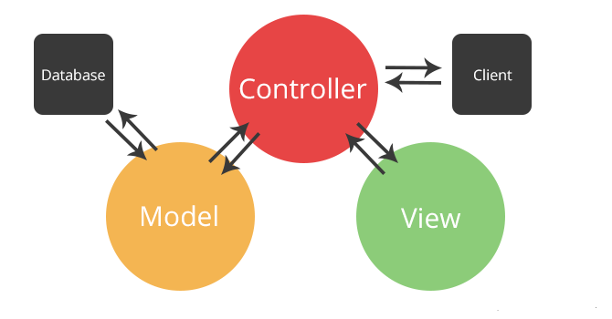
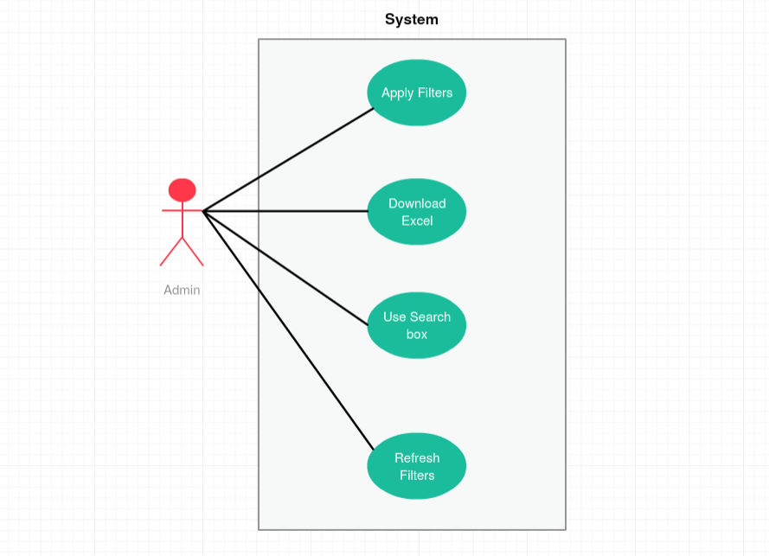

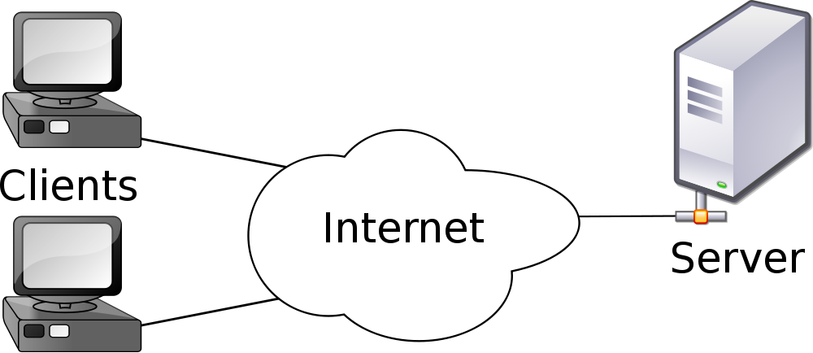
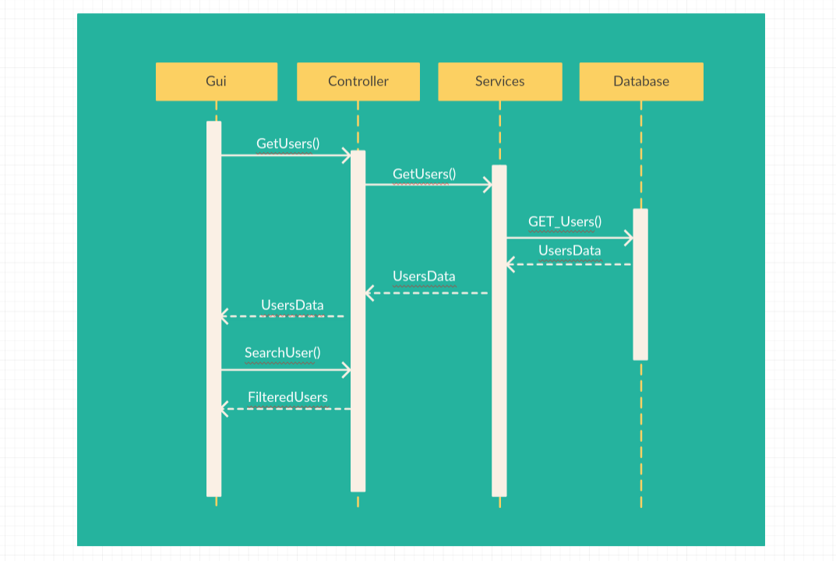

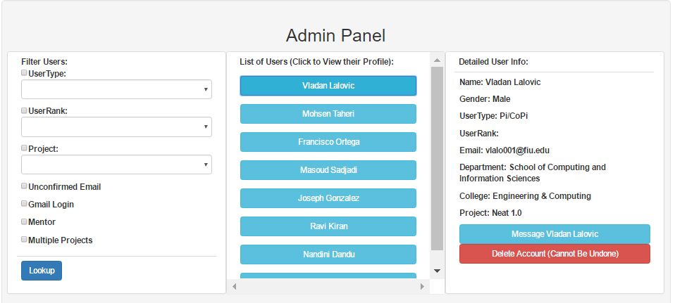
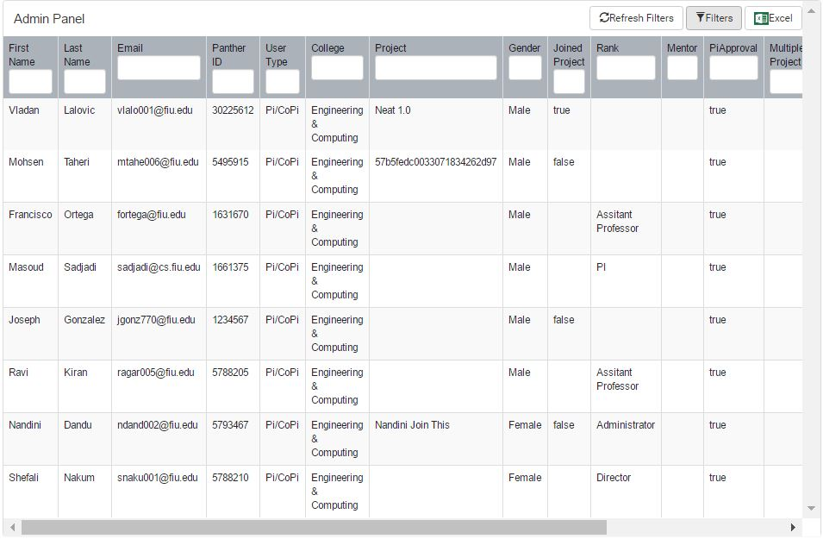
Vertically Integrated Projects, 2017, Spring
VIP 5.0
Student: Ravi Kiran Agarthi, Florida International University
Mentor: Mohsen Taheri, Florida International University
Instructor: Masoud Sadjadi and Francisco Ortega, Florida International University
Problem
Current System
Requirements
VIP provides a platform on which users can both join exciting new projects, and find other developers that are interested in joining said projects. With lot of users in the system, Admin needs a way to efficiently look for User's information. This lead to redesign the Admin Panel.
Problem
1. Excel in Admin Panel is giving a pop up after download.
2. Search in Admin Panel with user's specific property is not available.
3. Filters are not working efficiently.
4. Redesign Admin Panel
Status:
Live version of the site running on vip.fiu.edu
Dev version of the site running on vip-dev.cis.fiu.edu
Identical, but maintaining separate databases for development testing.
My Contributions::
Solving the existing problems.
Archiving Features
Integration to Dev Server.
Integrations to the Live Server
Excel option should not show any pop up after downloading.
Require Separate search boxes for each user property to enhance search.
Show/Hide feature for Filters option which has more filter options.
Look and Feel of Admin Panel has to be changed in order to have separate search boxes for each User Property.
System Design
Object Design
Implementation
Model View Controller (MVC) Architecture
User Interface: HTML5, CSS3
Code using Node.js
Database Engine:
MongoDB
Client-Server Model:
Version Control with Github
Verification
Screenshots
Summary
● Test Case 1(Sunny Day) ○ Purpose: Test that when Admin navigate to Admin page, he should be able to view all users in a table structured format.
○ Precondition: Admin has to open the VIP site and click on Admin panel logo and navigate to Admin Panel page
○ Input: Without any input, Admin should be able to view the table structured data with all the users.
○ Expected Result:Admin should able to view the table structured data with all the users. ○ Actual Result:Admin is able to view the table structured data with all the users. ○ Status: SUCCESS
● Test Case 2(Sunny Day) ○ Purpose: Test that Admin was able to search users with search options on every user property.
○ Precondition: Admin has to open the VIP site and click on Admin panel logo and navigate to Admin Panel page
○ Input: Admin has to enter the particular property of user in its respective particular column search box.
○ Expected Result: The search should result out to the list of users with matching search query. ○ Actual Result: While entering the search query itself, the search results the list of respective users based on the property. ○ Status: SUCCESS
Personal Reflection:
Searching for Specific User is easy now if we know at least one User property.
User Experience improved via new feature and search using filters is enhanced.
Overall Outlook:
VIP 5.0 continued the progress of it’s predecessors
All of the amazing students and faculty can enjoy this improved app!
Acknowledgement
The material presented in this poster is based upon the work done by me and I am thankful to the help that I received from my group member Shefali Nakum.
Notes:
‹#›

