Slide 1






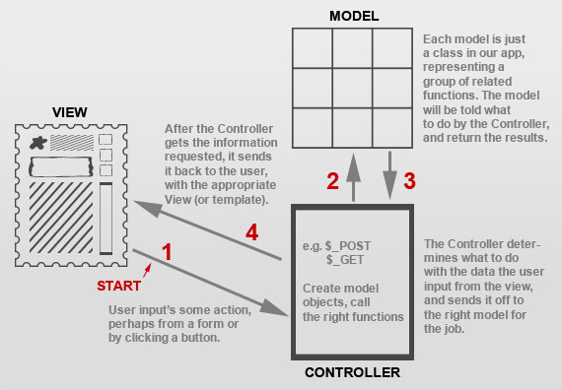
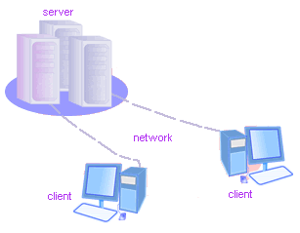
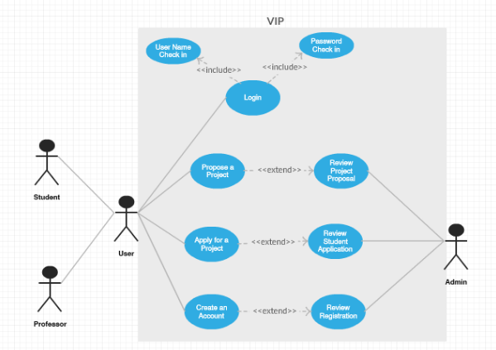
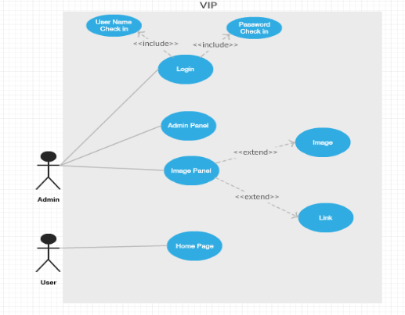
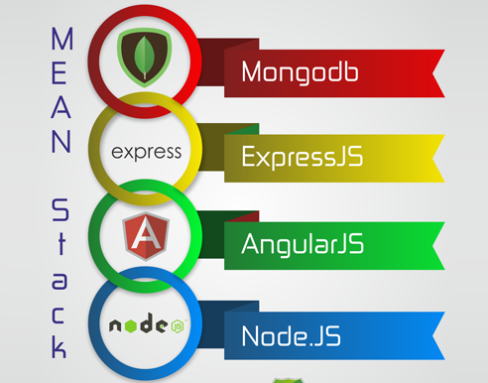
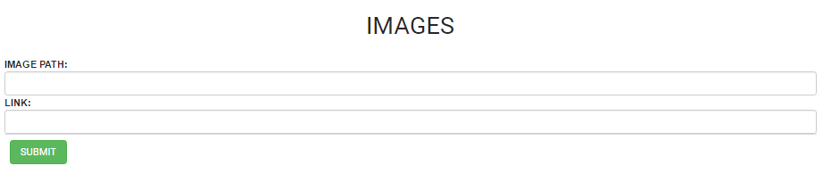
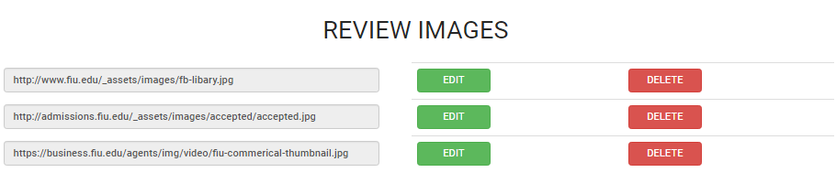
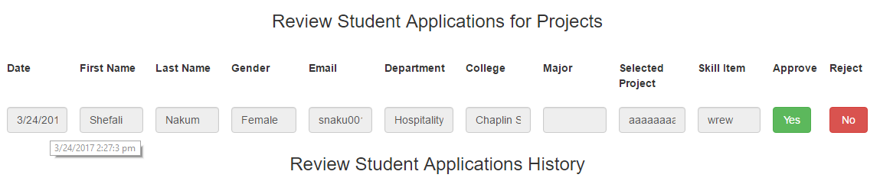
School of Computing & Information Sciences
Vertically Integrated Projects, 2017, Spring
VIP 5.0
Student: Shefali Nakum, Florida International University
Mentor: Mohsen Taheri, Florida International University
Instructor: Francisco Raul Ortega, Masoud Sadjadi, Florida International University
Problem
Current System
Requirements
No specific way for Admin to filter the users on the basis of activities performed on a particular day and time.
Now every review form is updated with a new filter called Date. Hence, making easy for Admin to take decision based on various user’s relative dates.
Functional/Non-functional for my focuses on the webapp:
Capturing and Displaying dates when user Apply to a project/ Propose a Project / Create an Account/ Login for the first time.
Making the footer design of the main page more intuitive and user friendly.
Include a new panel for Admin to add images and links of the event to be posted in the home page carousel .
A new section has been added for admin to review and make changes(Edit/ Delete) in the information already been existing in the home page
No platform for Admin on home page to share information regarding events with pictures and link
Home page is outlined with a new feature “Bootstrap Carousel” where Admin can make changes through admin panel that is then reflected with pictures and links.
System Design
Object Design
Implementation
Verification
Screenshots
Summary
Test Case 1(Sunny Day) ○ Purpose: Test the image uploaded by the admin is having a valid path.
○ Precondition: Admin has to open the VIP site and click on Admin panel logo and navigate to Admin Panel page
○ Input: Upload image with a valid path in the image field.
○ Expected Result: Admin should able to submit the image without any error. And if there is any invalid path, a message should be popped saying “Incorrect Path”. ○ Actual Result: Admin is able to submit the image without any error. ○ Status: SUCCESS
Getting users information is now easy if the date of the activity been performed is know.
User experience is enhanced via new carousel feature making the home page more responsive.
Test Case 2(Sunny Day) ○ Purpose: Test the image uploaded is within the range of maximum size allowed.
○ Precondition: Admin has to open the VIP site and click on Admin panel logo and navigate to Admin Panel page.
○ Input: Uploading image in the field .
○ Expected Result:Admin should able to submit the image with a valid. And if there is any invalid size, a message should be popped saying “Error in the size of the image”. ○ Actual Result:Admin is able to submit the image without any error. ○ Status: SUCCESS
VIP today has been brought to a usable state and its core features are up and running thanks to the VIP 5.0 team.
Acknowledgement
The material presented in this poster is based upon the work supported by Mohsen Taheri. I am thankful to the help that I received from my group member: Ravi Kiran Agarthi
Notes:
‹#›

