Slide 1



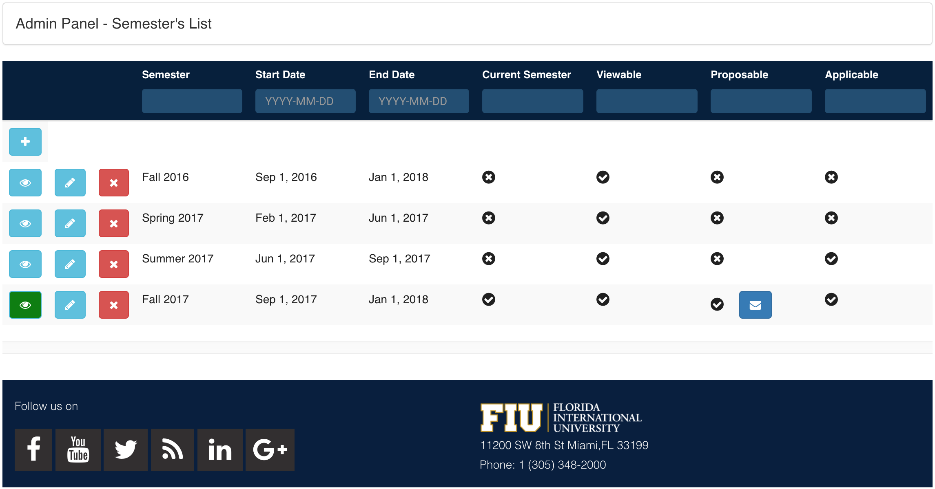
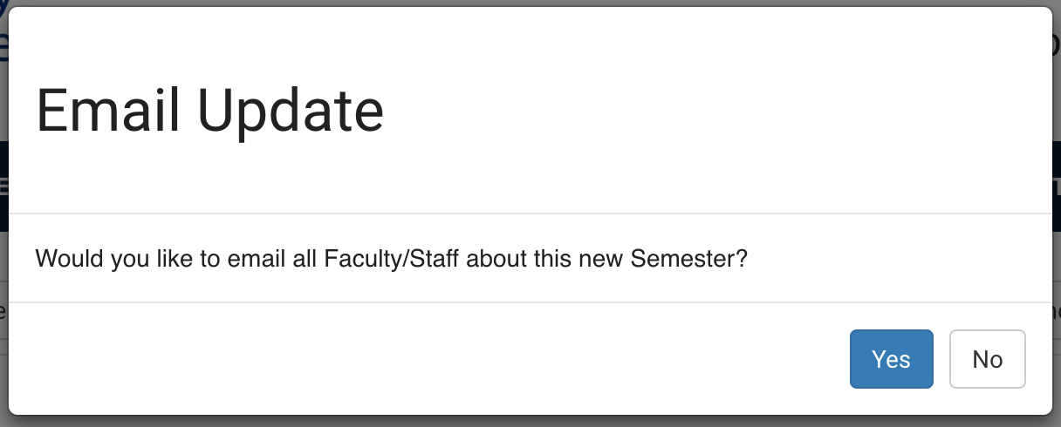
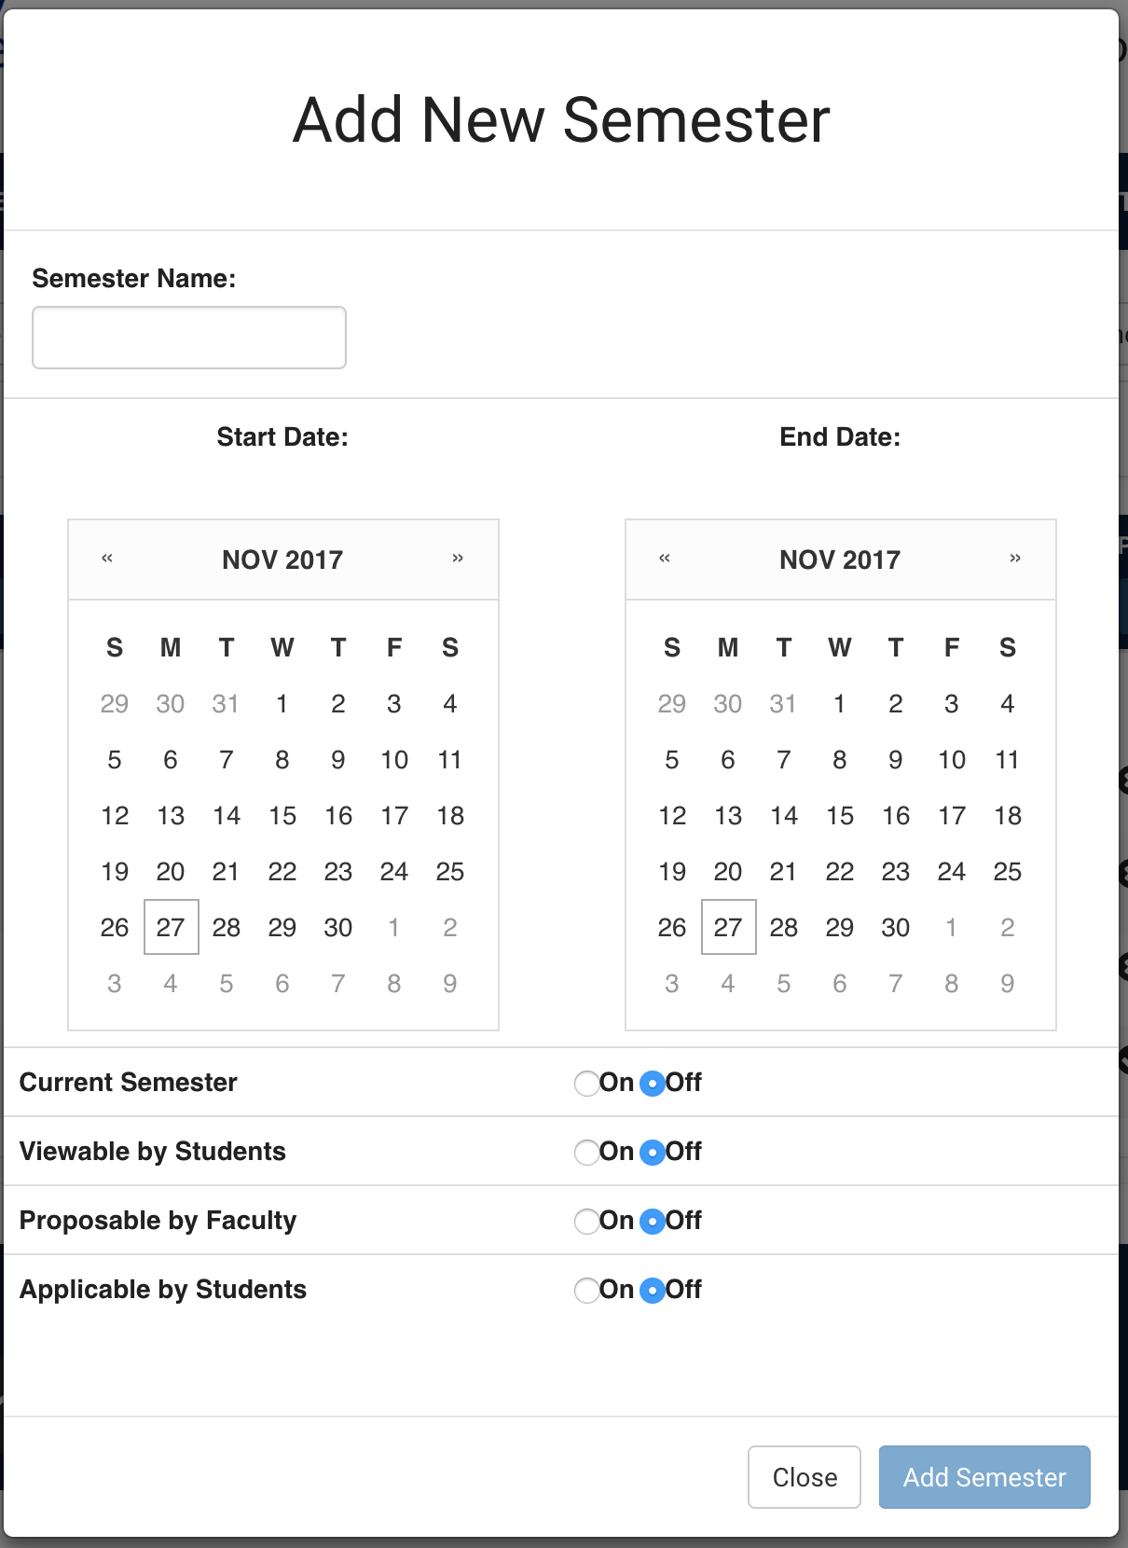
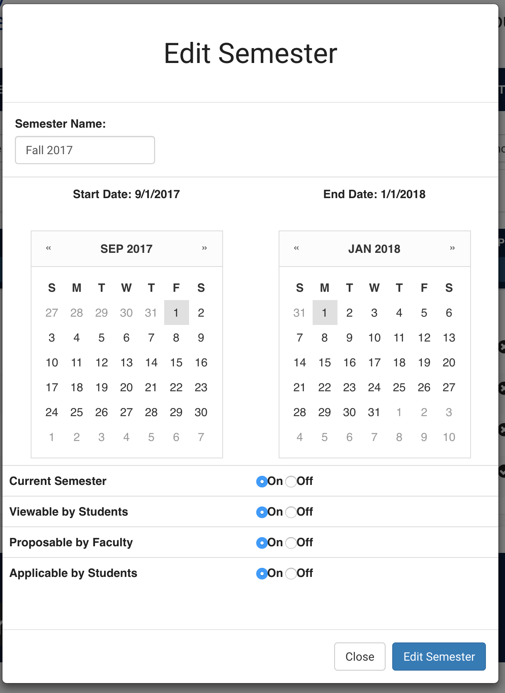
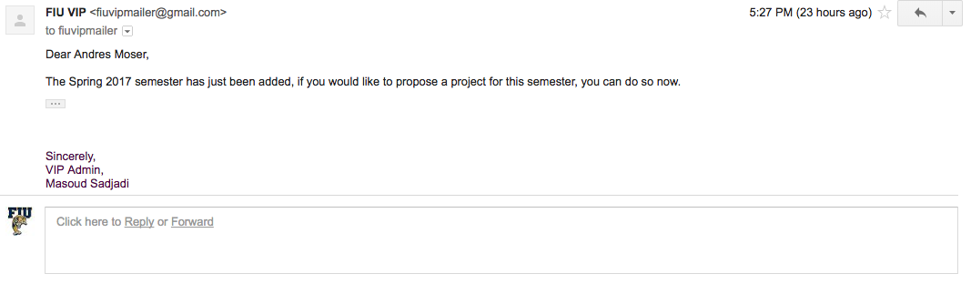

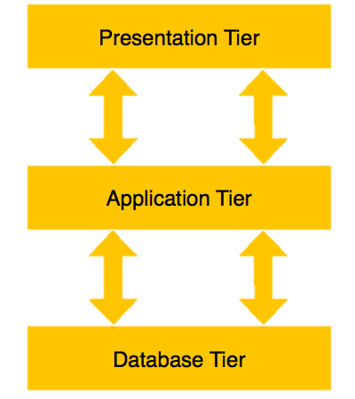



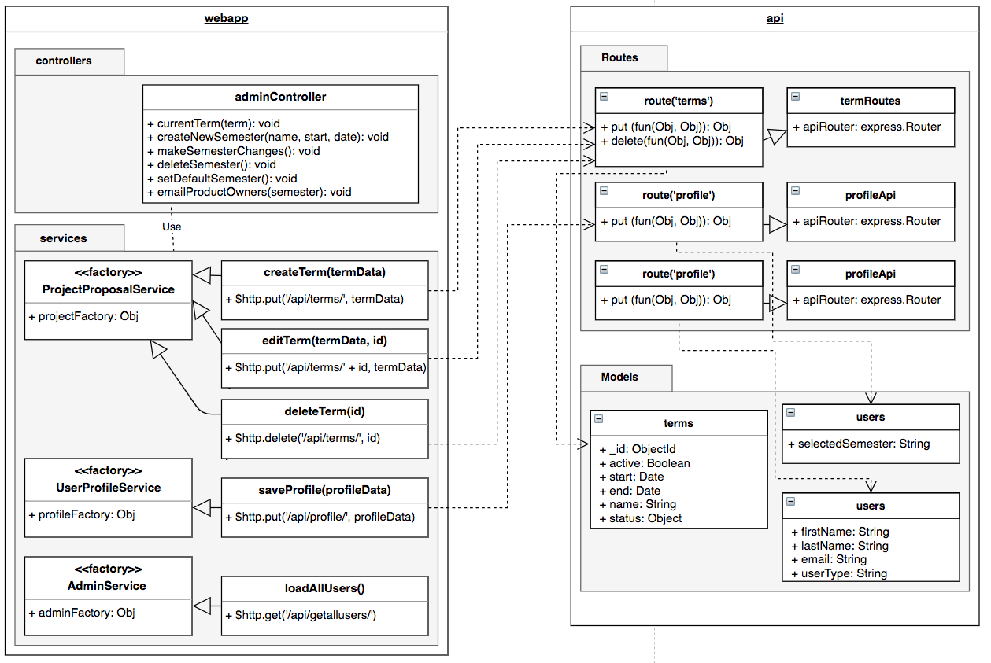
School of Computing & Information Sciences
Senior Project, 2017, Fall 2017
VIP Website 7.0
Student: Andres Moser, Florida International University
Mentor: Jose Ponce, Ultimate Software
Instructor: Masoud Sadjadi, Florida International University
Problem
Solution
Current System
Semesters were not manageable
Lack of semester effect for Admins and Faculty
Unable to announce new semesters
Semesters have a new Maintenance tab in Admin Tools
Filters based on semester properties
Email Service to Previous Product Owners
Only able to set Semester as ‘Active’ or Disabled’
No semester properties outside of ‘Active’ and ’Disabled’
No way for Admin to alert Product Owners
Figure 1: Semester Maintenance
Figure 2: Email Product Owners
about Semester
Figure 3: Add and Edit Semester
Requirements
System Design
Implementation
Admin ability to Create/Manage/Delete Semesters
Consistent UI through Admin Maintenance tabs
Default Semester for Admins
Filters based on Semester statuses
Email Product Owners about new semesters
Three-Tiered Architecture
M
NoSQL Database
Model-View-Controller
E
App Framework
Model
A
View
Controller
N
JavaScript Framework
JavaScript Runtime
Verification
Object Design
Summary
Testing done locally for each User Story with a mix of Unit and Integration Tests
User Stories merged onto a develop server as they are completed so the entire system can be tested
Semester was redefined and made manageable by Admins
Admin Panel has a consistent improved design
Admin can now notify product owners about semester information
Acknowledgement
The material presented in this poster is based upon the work supported by Dr. Masoud Sadjadi and Dr. Francisco Ortega. I am thankful to the help that I received from my group members Leon Liang, Dale Keith, Steve Hirabayashi, and Adam Levy.
,
Notes:
1

