Slide 1





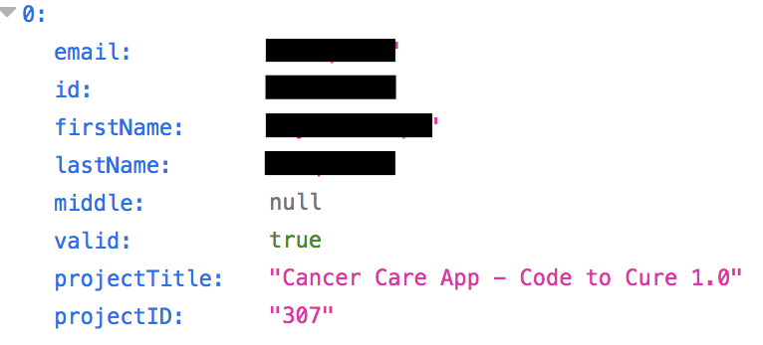
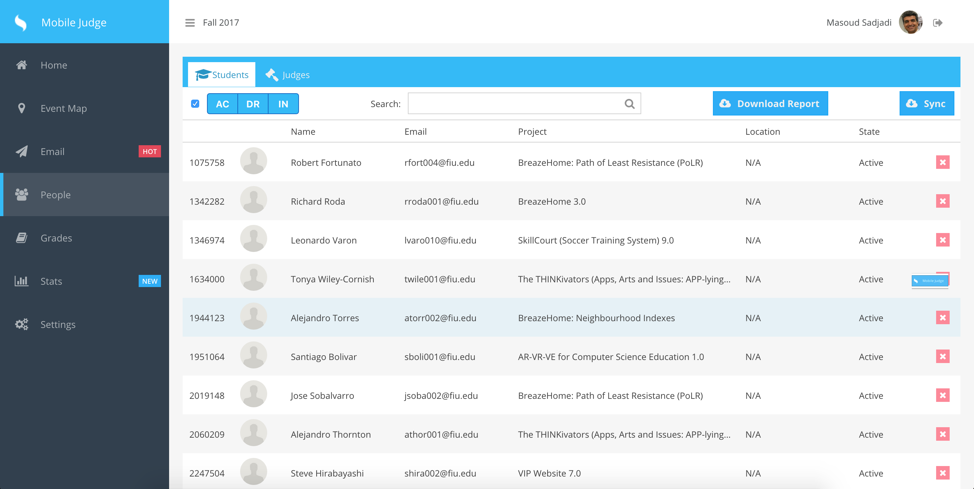
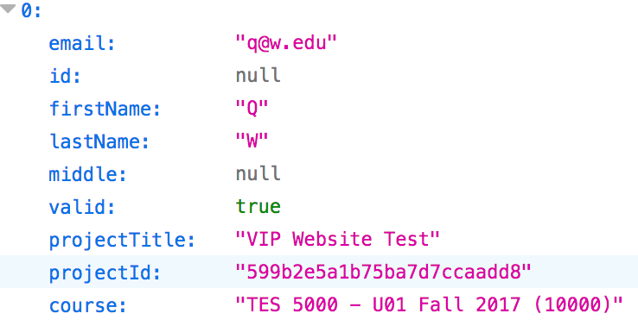
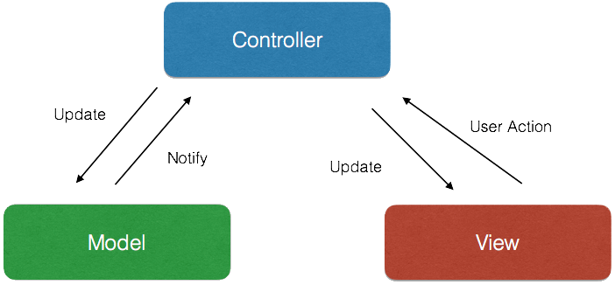

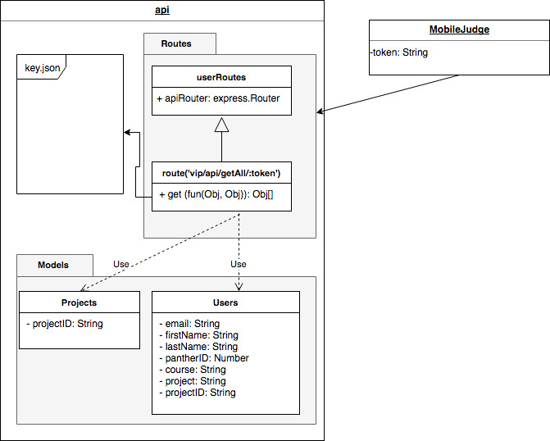
School of Computing & Information Sciences
VIP, 2017, Fall
VIP Website 7.0
Student: Adam Levy, Florida International University
Mentor: Jose Ponce, Florida International University
Professor: Masoud Sadjadi, Florida International University
Problem
Mobile Judge still sources its student data from Senior Project Website.
Senior Project Website does not provide students’ course information.
Solution
Create public RESTful API in VIP.
Create token authentication system for API endpoints.
Create data objects needed for Mobile Judge.
Add course information to student data objects.
Expose API endpoint for consumption by Mobile Judge
Current System
Mobile Judge calls Senior Project Website API and populates its own database with returned data set.
Data passed to Mobile Judge includes: Email, Name, PID, Project title, Project ID.
Screenshots
Redacted
Redacted
Fig. 1: Example Data Object from Senior Project Website API
Fig. 2: Example Data Object from VIP Website API with course information
Fig. 3: Example of API data in use in the Mobile Judge application.
Requirements
Seamlessly replace VIP Website as data source for Mobile Judge.
Mobile Judge receives students’ course data.
System Design
Implementation
The system is implemented using the mean stack:
MongoDB - Data store
ExpressJS – API/Backend
AngularJS – Front end Javascript framework
NodeJS – Javascript runtime environment
Verification
Authentication Sunny/Rainy Day local
Authentication Sunny/Rainy Day live dev server
Integration Sunny/Rainy Day local
Integration Sunny/Rainy Day live dev server
All tests received PASS
Object Design
Summary
Improved functionality of Mobile Judge by adding course information*
Improved value of VIP Website by creating important functionality.
Met owners requirements and managed expectations.
*Stated assumption: Mobile Judge team has implemented new functionality.
Acknowledgement
The material presented in this poster is based upon the work supported by Dr. Francisco Ortega and Dr. Masoud Sadjadi. I am thankful to the help that I received from my group members, Andres Moser, Dale Keith, Steve Hirabayashi, and Leon Liang.
Notes:
1

