Slide 1



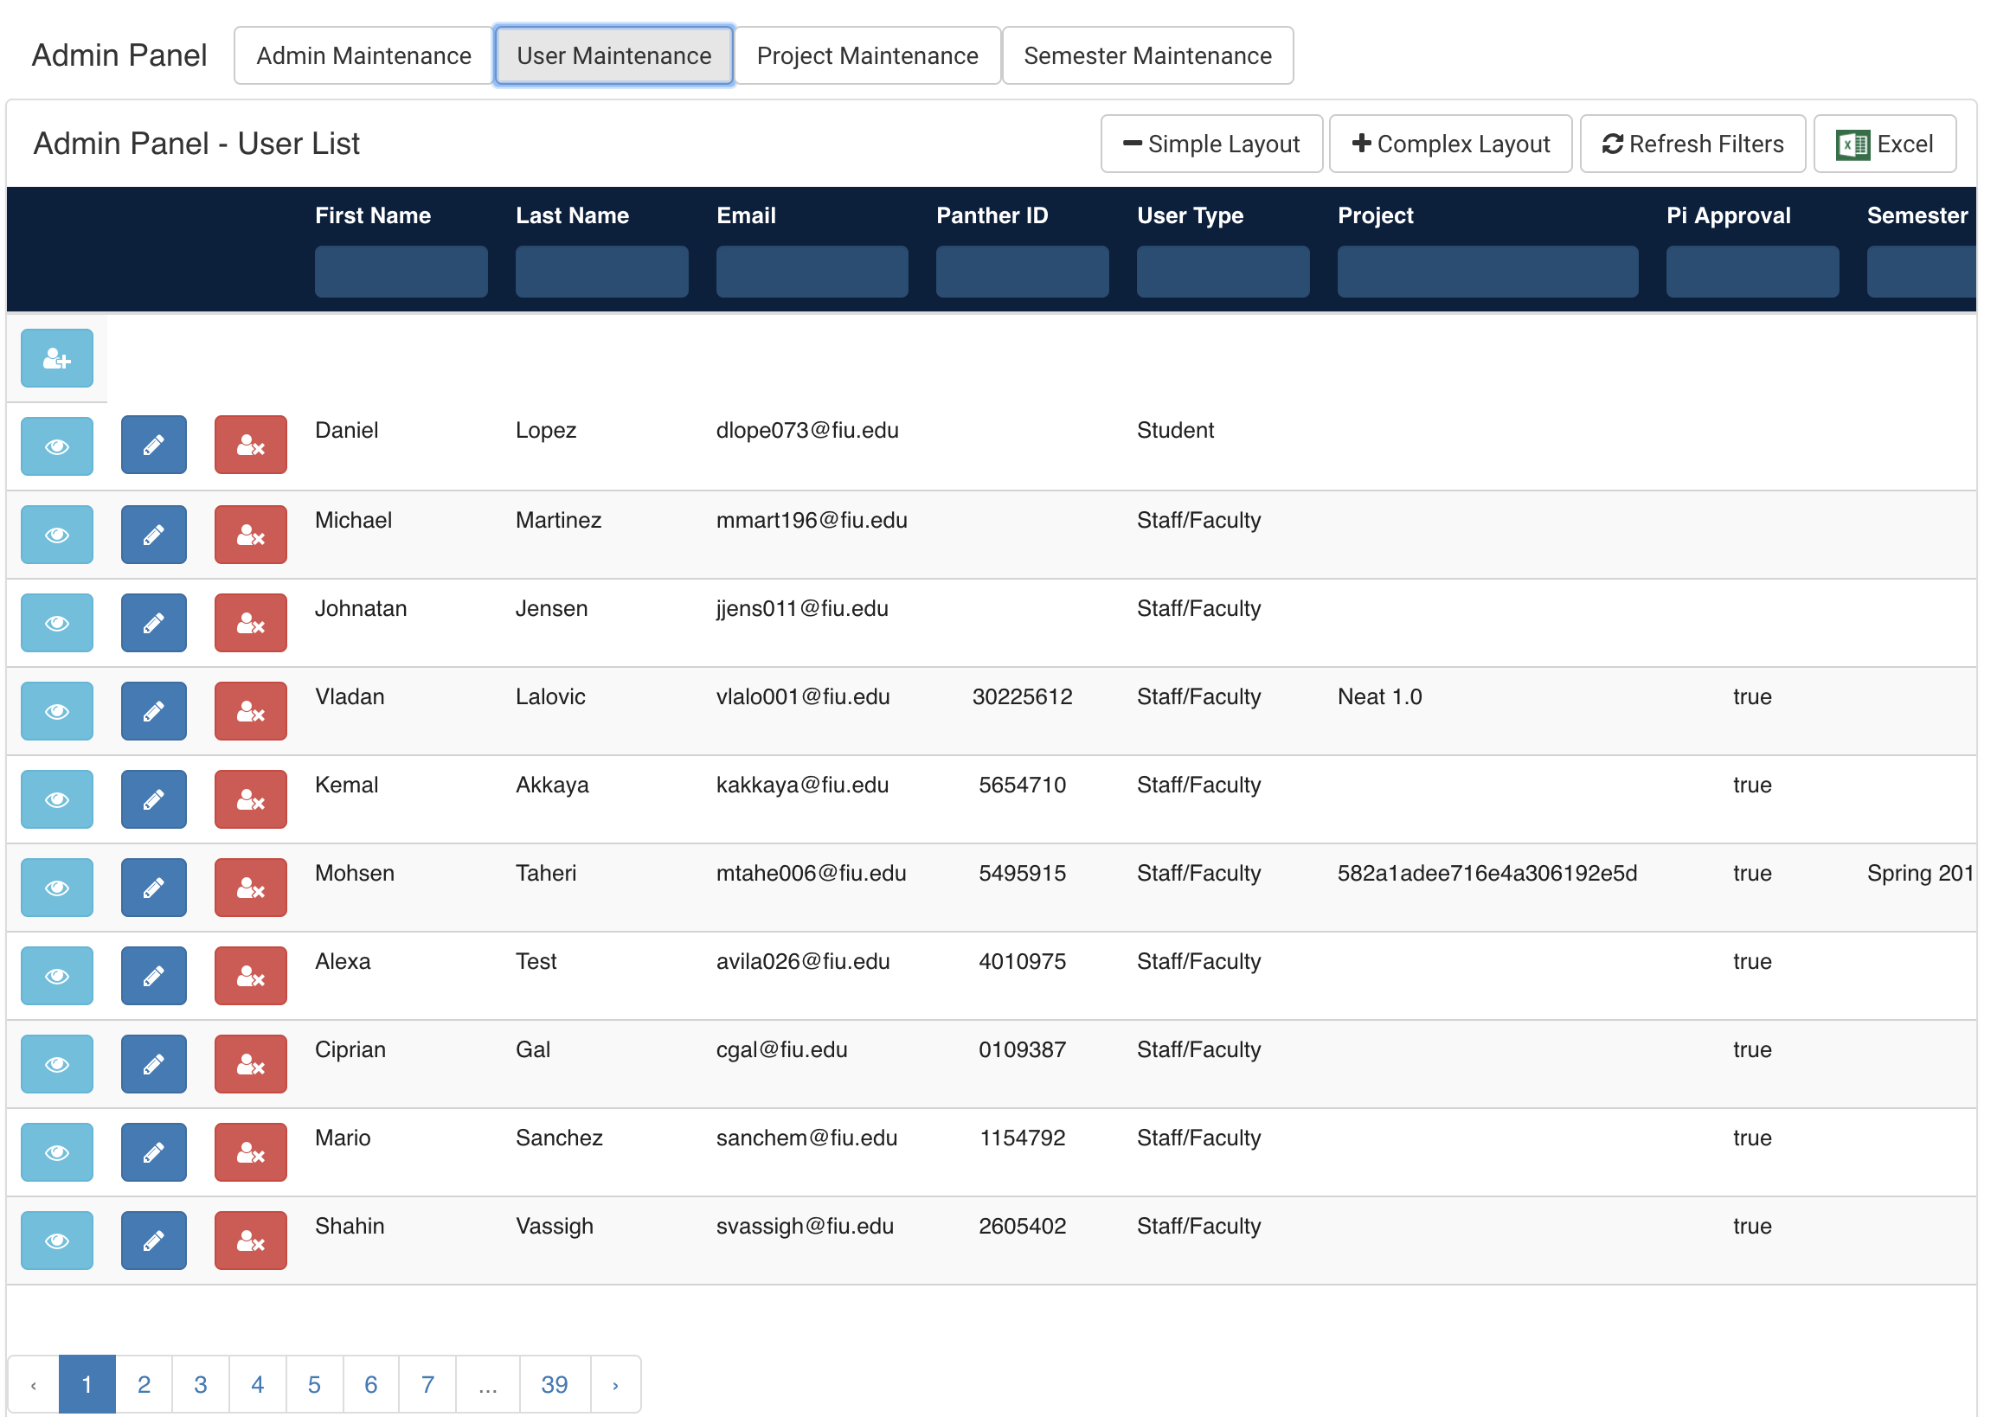
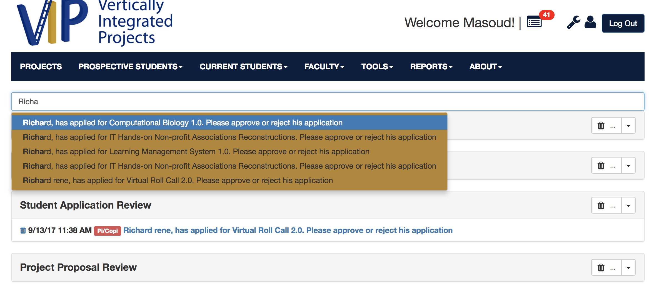
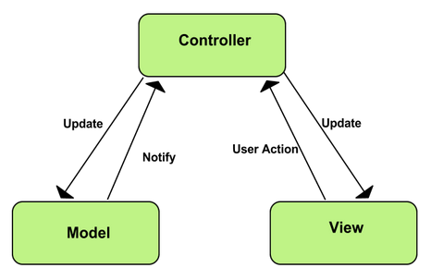
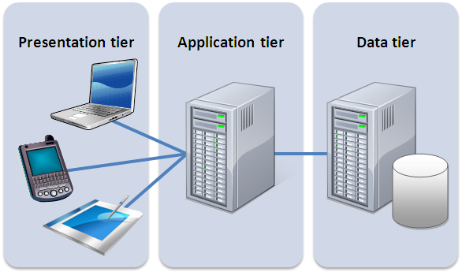
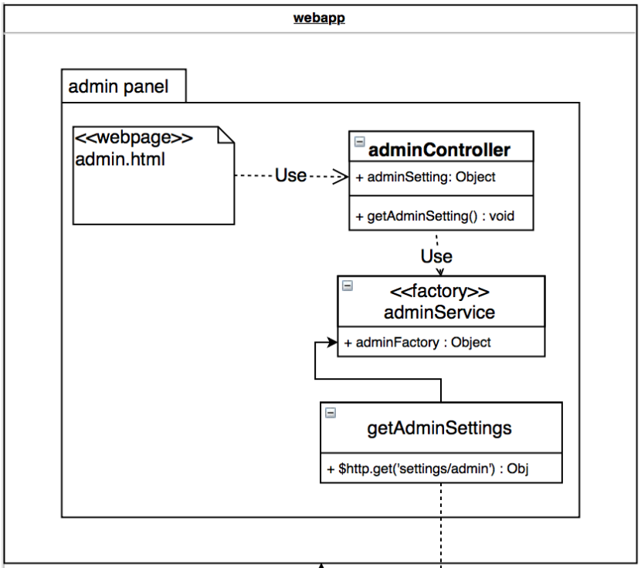
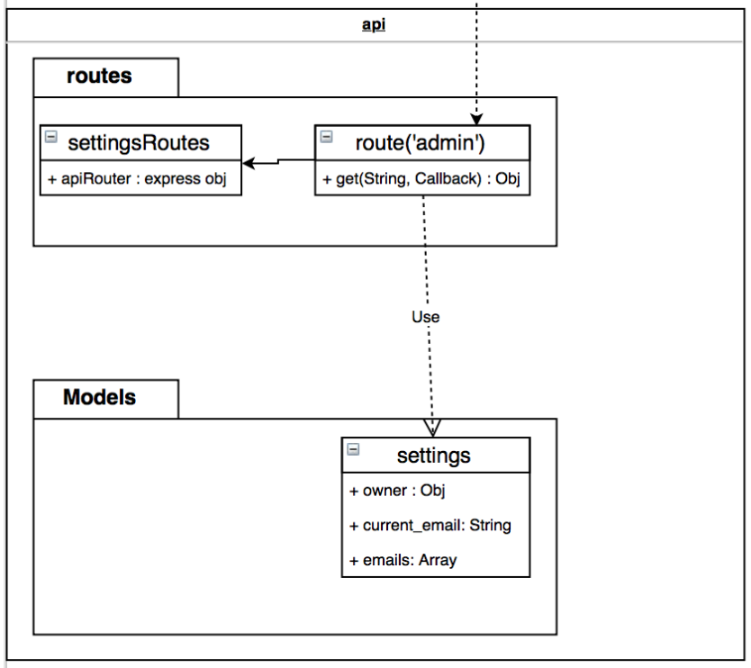
School of Computing & Information Sciences
CIS 4911, 2017, Fall 2017
V.I.P. Website 7.0
Student: Leon Liang, Florida International University
Mentor: Jose Ponce, Ultimate Software
Professor: Masoud Sadjadi, Florida International University
Problem
Fragmented system for administration controls
Bottlenecks in loading time for tables with large amount of data
Lack of search capabilities
Solution
Fragmented system solved by removing duplicated components, centralizing most capabilities to the administrative panel
Data filtering on database calls to reduce load time
Search bar capabilities for all pages
Current System
All admin capabilities were split between review pages and admin panel
Loading the data would load entire database table
No search capabilities for inbox messages
Screenshots
Requirements
Administrative components are clearly defined and compartmentalized
Tables should contain pagination to reduce heavy data loads
Inbox messages are now searchable through keywords
System Design
Implementation
The whole application is built on basic MEAN stack, MongoDB, ExpressJS, AngularJS, NodeJS
Service layer is done through RESTful api service
Pagination was done through front-end enhancements as well as back-end query optimizations
Verification
Test ID: VIP - 1322 - U1
Description:
Enter user maintenance tab, navigate between pages using pagination tool on bottom of
table.
Expected Result:
No more than 10 result per page
Status: Passed
Object Design
Summary
Improvement to user experience through front-end modifications
Enhanced load time due to new pagination components
Optimized query operations for decreasing bottle neck delays
Acknowledgement
The material presented in this poster is based upon the work supported by Professor Ortega and Professor Sadjadi. I am thankful to the help that I received from my group members, Andres Moser, Steve Hirabayashi, Dale Keith, and Adam Levy.
Notes:
‹#›

