Slide 1






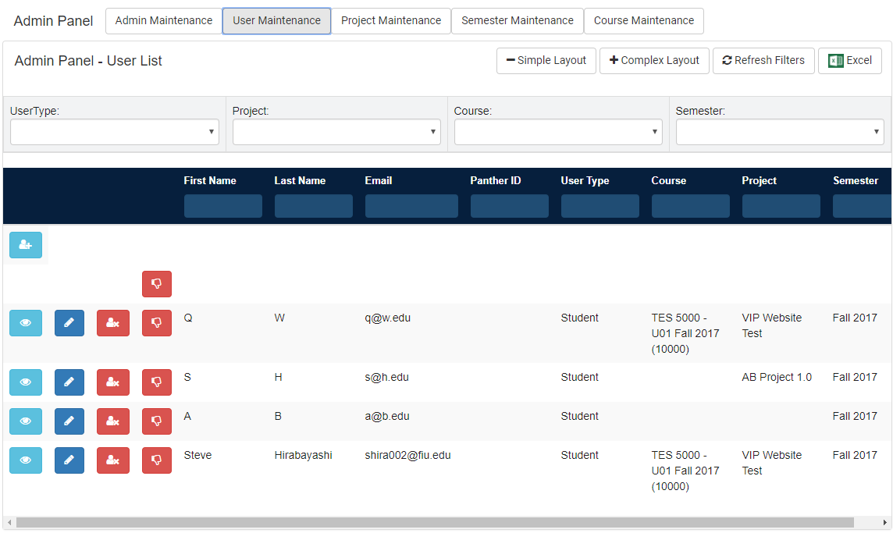
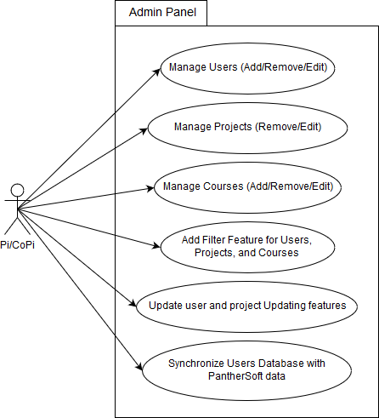
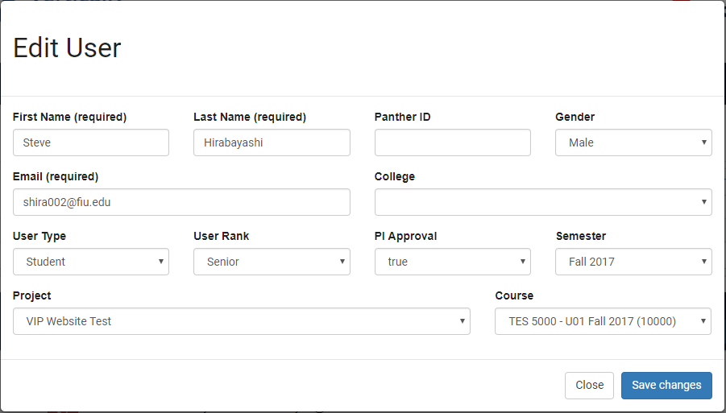
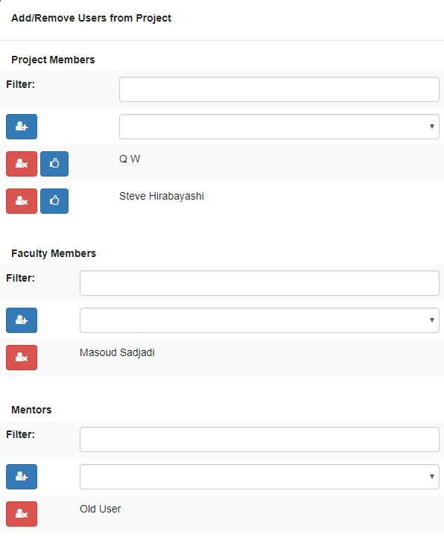
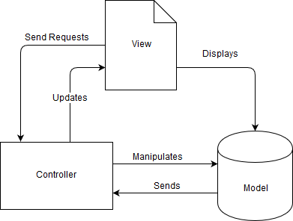
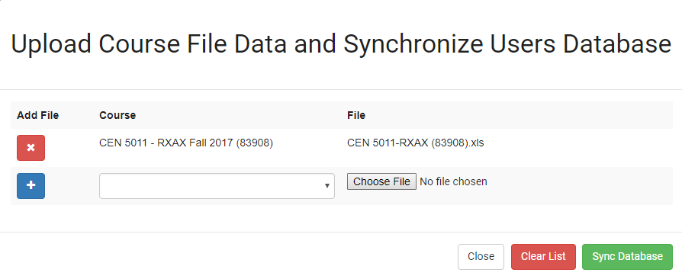
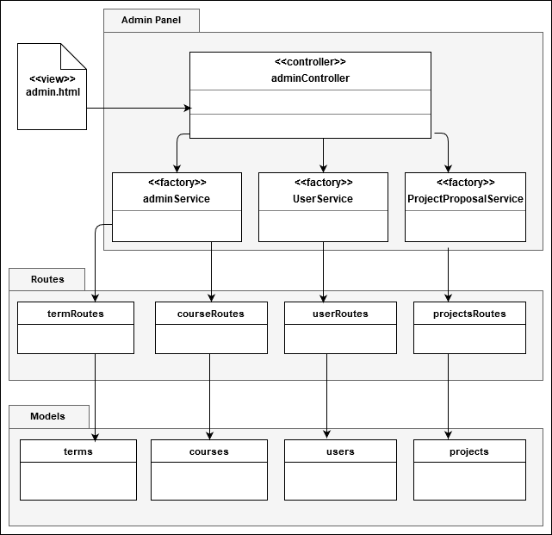
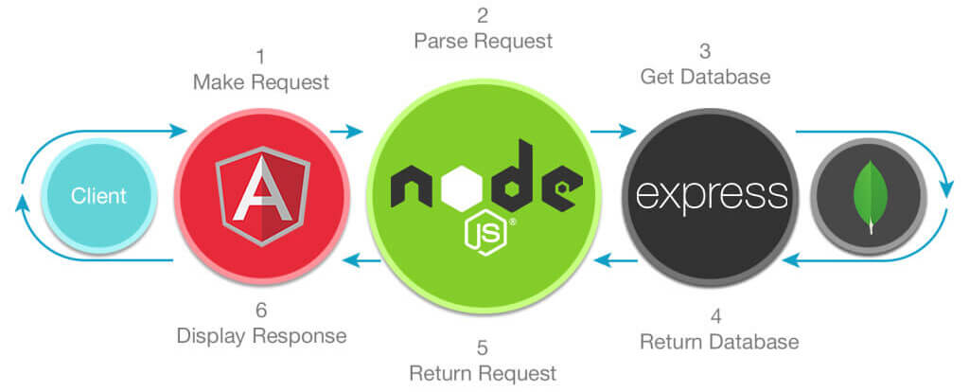
School of Computing & Information Sciences
Senior Project, 2017, Fall
VIP Website 7.0
Student: Steve Hirabayashi, Florida International University
Mentor: Jose Ponce
Professor: Masoud Sadjadi, Florida International University
Problem
Screenshots
Requirements
No ability to view and search for Projects and Courses
No accessible interface available for modifying the VIP Databases
No means to automatically update VIP Databases using external data
Admin Panel
The requirements of our system depicted with use cases:
Solution
Edit User
Administrator Panel Allows PI to:
Add/Remove and Modify Users, Projects, and Courses
Filtering Feature for easy access
Synchronize Users Database using Panthersoft Data
System Design
Add/Remove Users from Project
The sole actor, the Principal Investigator (and Co-Pi) has access to the Administrator Panel
The system employs the Model-View-Controller architecture, as shown below:
Verification
A combination of manual testing and testing done using Selenium was employed
Test Case ID: | VIP-1300-U1
Purpose | Admin adds a new user (Sunny Day Scenario)
Pre-Conditions | User with Pi/CoPi privileges has logged into the VIP website User is at the admin panel page - user maintenance tab
Test Data | First Name: testF Last Name: testL Email: test@testing.edu Password: Password#123
Expected Output | User will be added to the database Users panel table will be updated with user at the bottom Tester will be notified of success
Synchronize Users by Course
Class Design
Test Case ID: | VIP-1300-U2
Purpose | Admin adds a new user (Rainy Day Scenario)
Pre-Conditions | User with Pi/CoPi privileges has logged into the VIP website User is at the admin panel page - user maintenance tab
Test Data | First Name: testF Last Name: testL Email: test Password: pass
Expected Output | User will not be added to database Users panel table will not be updated with user at the bottom Tester will be notified of error
Condensed Class Diagram showing the relationships between the Models, Controllers, and View
Implementation
Summary
The MEAN stack was used for the development of this website
Problem: No interface available for fully managing VIP Databases
Solution: Expand the Administrator Panel to allow PI to view and modify VIP Databases
Improvements: Modifications to API to ensure database integrity
Acknowledgement
The material presented in this poster is based upon the work supported by Jose Ponce. I am thankful to the help that I received from my group members Dale Keith, Leon Liang, Andres Moser, and Adam Levy. I am also thankful for the guidance offered by professors Masoud Sadjadi and Francisco Ortega.
Notes:
1

