Slide 1






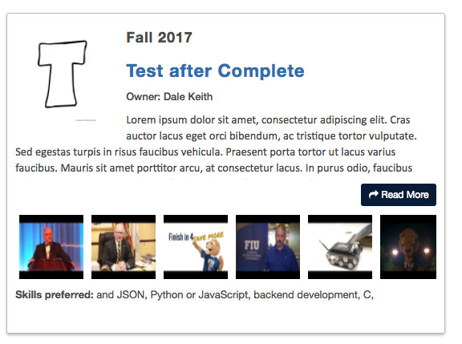
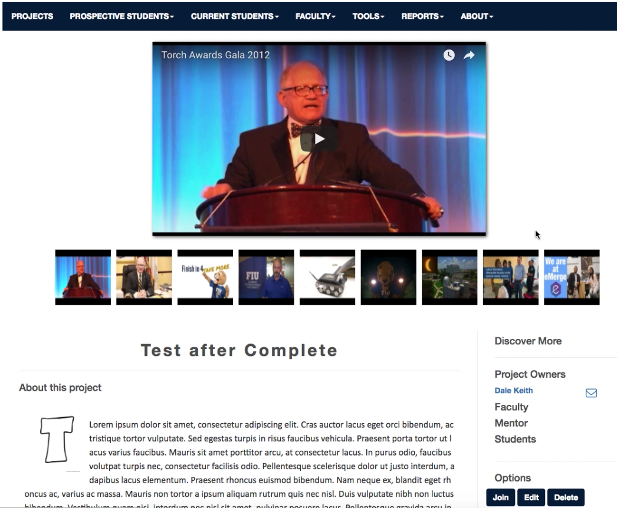
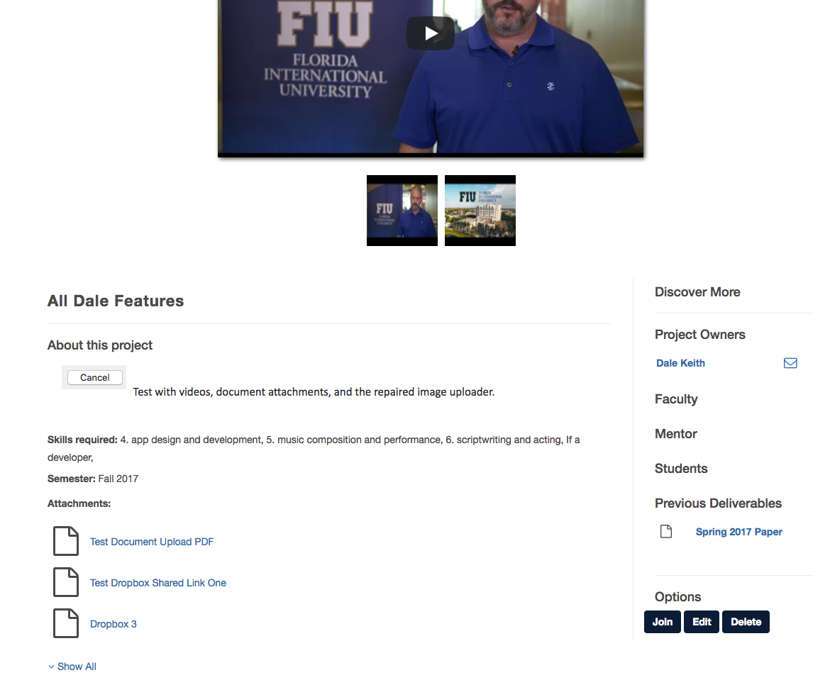
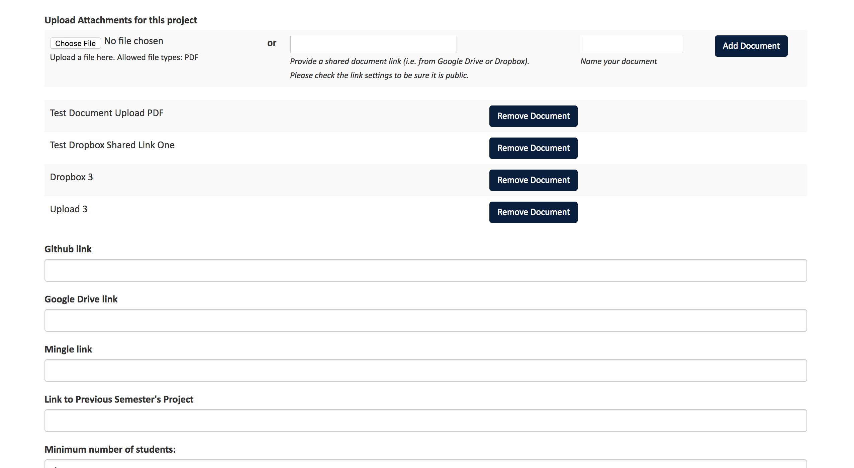


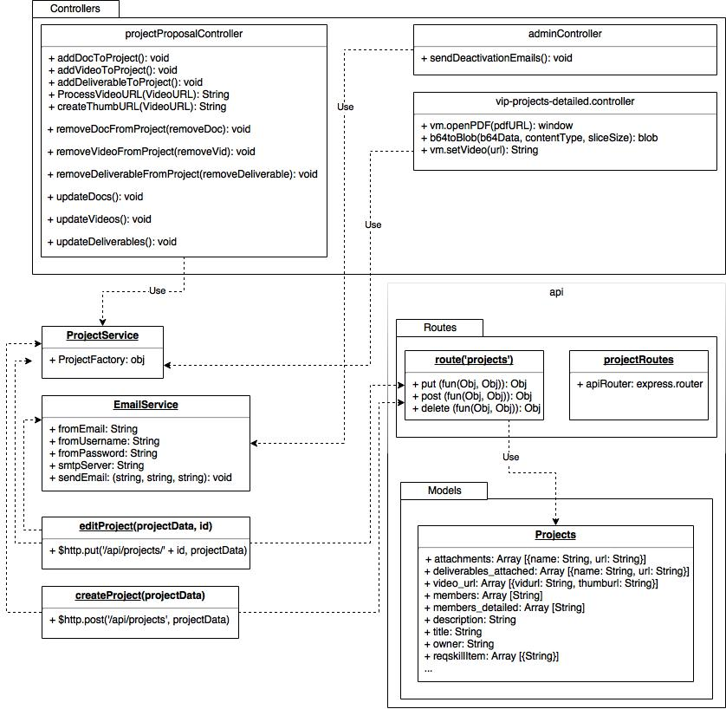
School of Computing & Information Sciences
VIP Senior, 2017, Fall
VIP Website 7.0
Student: Dale Keith, Florida International University
Mentor: Jose Ponce, Ultimate Software
Professor: Masoud Sadjadi, Florida International University
Problem
Projects do not show enough information to students.
No sense of “history” with previous projects.
Projects lacking visual appeal.
Solution
Show more project information to students at-a-glance.
Use videos and media in more areas.
Introduce functionality to add documents and attachments to projects.
Cleaner, more appealing projects.
Current System
Very plain-looking projects.
Restricted to single video.
Cannot showcase previous deliverables or documents.
Too many clicks to view details.
User Interface
Figure 1: New Project Card
Figure 2: New Project Details Page
Figure 3: Attachments and Deliverables
Figure 4: Easy Admin Interface
Requirements
Notify members if a project is deactivated.
Add an unlimited number of YouTube videos to a project.
Add General Attachments to Projects.
Redesign Project Cards to show more information.
Add Deliverable Uploads to Project Details.
System Design
Implementation
Three-tiered architecture
Model-View-Controller
MongoDB – NoSQL Database
Express – App Framework
AngularJS – Front-end framework
NodeJS – JavaScript Runtime
Client Tier
Model
Controller
View
Business Logic/Application Tier
Database Tier
Bootstrap framework for user interface elements.
Verification
Local testing done manually using unit tests.
Tested with other areas/features with manual local integration tests.
Final testing done using static development server.
Object Design
Summary
Problem: Projects needed more appealing information.
Added additional media.
Cleaner project cards.
Easier for students to choose project at-a-glance.
Minimal API changes.
Fully implemented with JavaScript.
Acknowledgement
The material presented in this poster is based upon the work supported by Dr. Masoud Sadjadi and Dr. Francisco Ortega. I am thankful to the help that I received from my group members: Steve Hirabayashi, Leon Liang, Andres Moser, and Adam Levy. Special thanks to Dr. Ortega for coordinating my VIP paper and Adam Levy for co-authoring the paper.
Notes:
1

