Slide 1











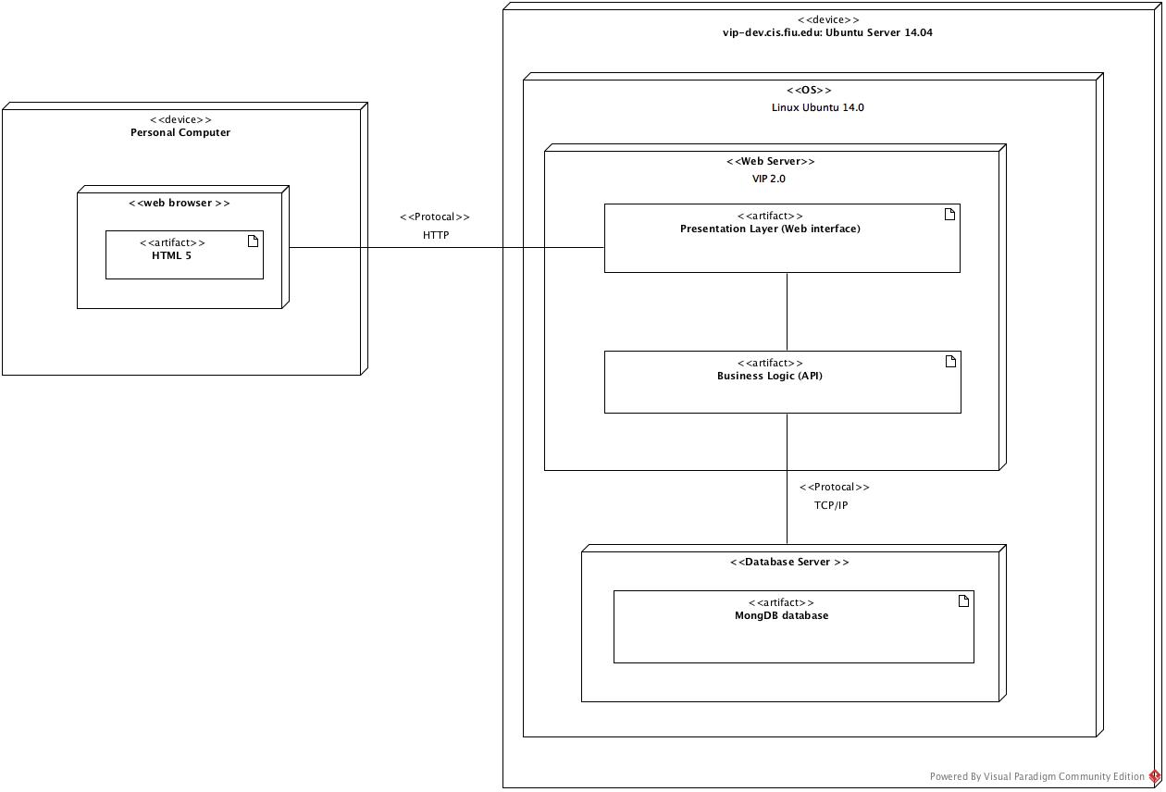
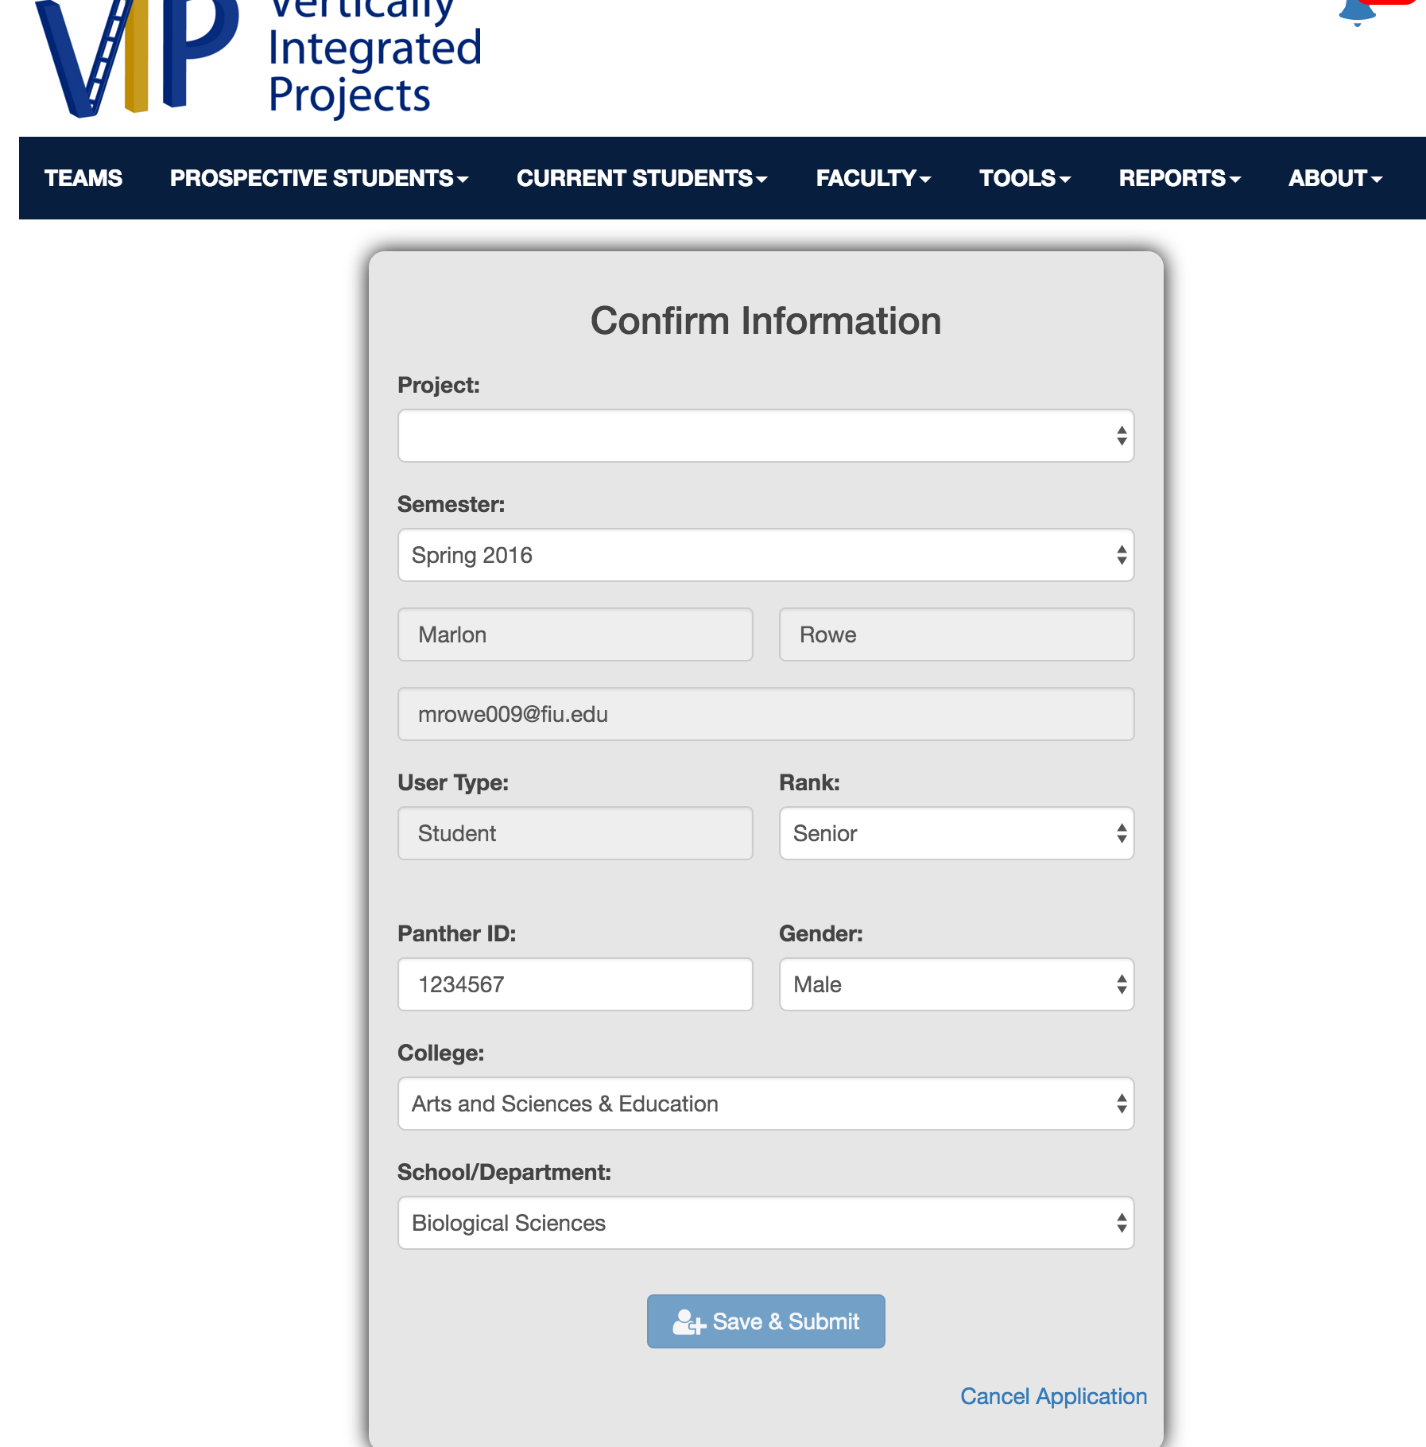
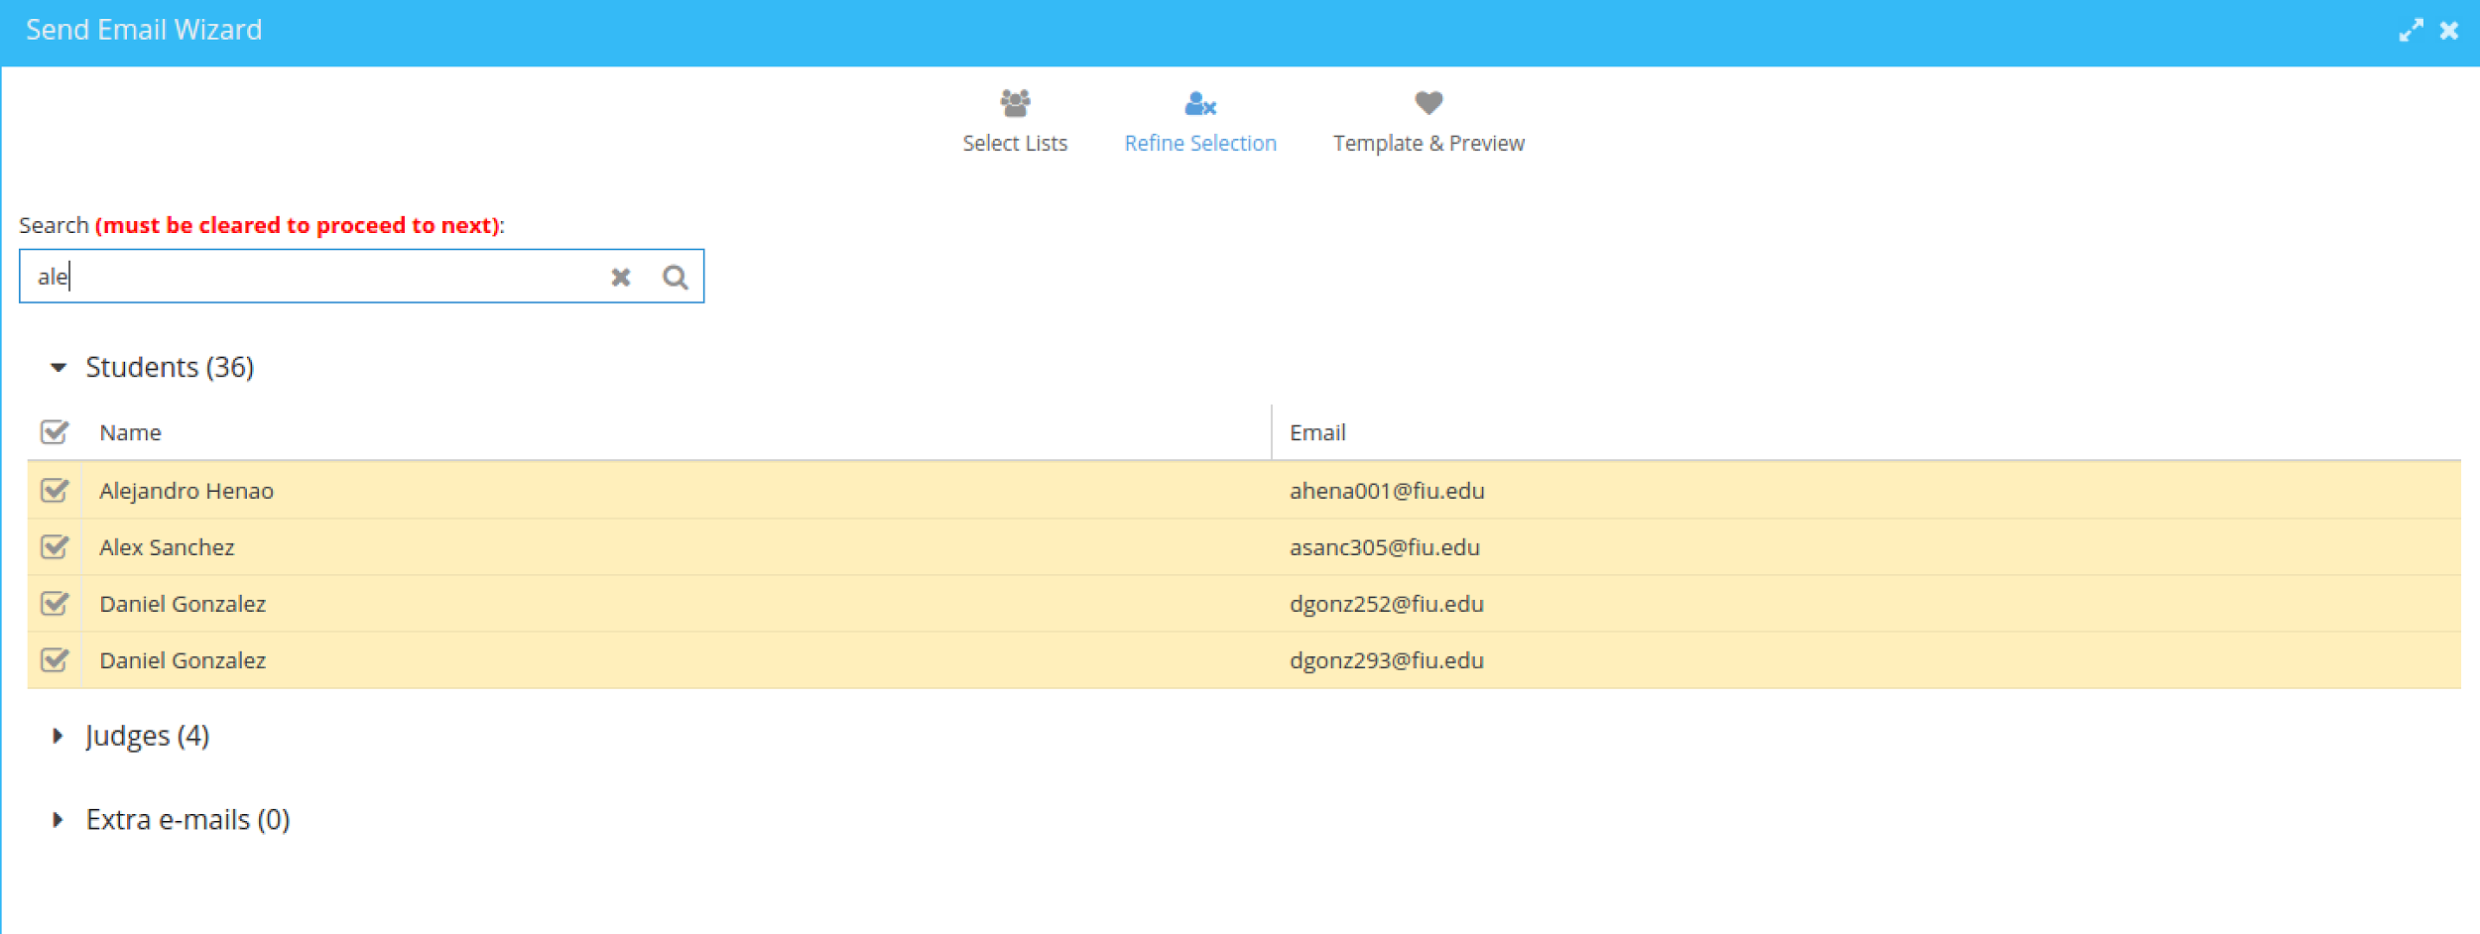
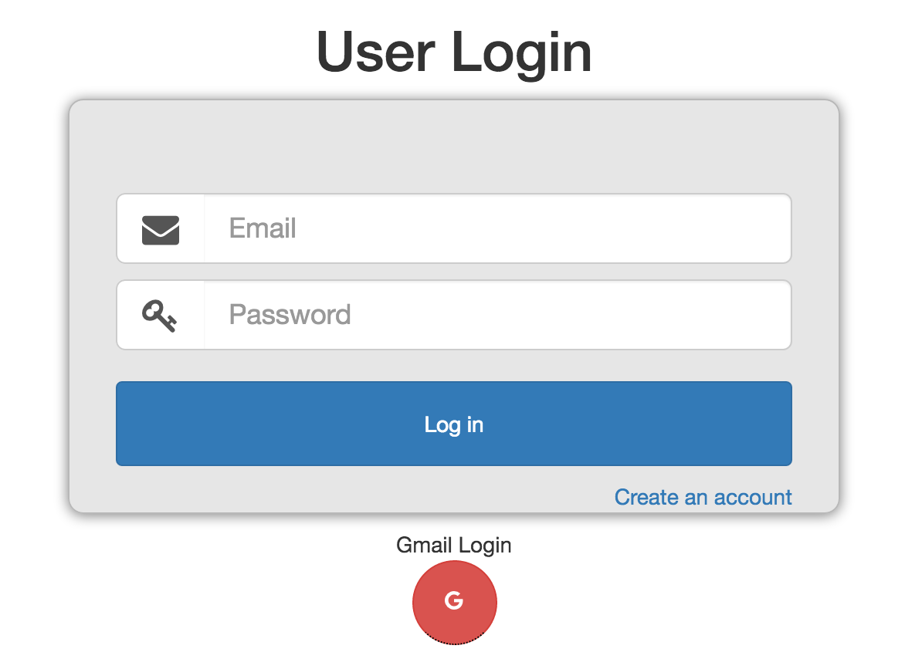
School of Computing & Information Sciences
Senior Project, 2016, Spring
VIP 2.0
Student: Miguel Conde, Florida International University
Mentor: Francisco Ortega, Florida International University
Instructor: Masoud Sadjadi, Florida International University
Problem
Current System
Requirements
The Vertically Integrated Projects (VIP) program aims to involve everyone on campus in innovation. VIP unites undergraduate education and faculty research in a team-based context. Undergraduate VIP students earn academic credits, while faculty and graduate students benefit from the design/discovery efforts of their teams.
The current system allows students and faculty to register, login, manage their profile, view projects, schedules. Faculty users can also propose new projects for students to work on. Users are able to view information about current real world problems and see which one sparks their interests. Students of all ranks are able to select and join a project where they will then be able to work side by side with industry leaders and assist with real world research problems.
The system shall allow for users, depending which role the user has, to be able to
Register
Login
Logout
Apply for projects
Edit your own projects
View currently active projects
Accept/Reject project proposals
Edit user profile
View task that needs to be completed
Solution
My Role
The solution is to provide students and faculty, a way to communicate and coordinate their projects. This will allow students to find cross-disciplinary projects and assist faculty in research.
Implement Student Application to project
Create search filter for email contact lists
Implement infrastructure for production site
Assisted in implementing managing system for students and judges
Implemented login for students using google API
System Design
Object Design
Implementation
The system employs a 3 tier client-server architecture. A user will connect to our server using a HTTP protocol and will be served the index.html file located in the presentation layer. All logic is located in the business logic area and it communicates with a mongo database located on the same server using a TCP/IP protocol.
HTML5/CSS3 was used for designing the UI components.
AngularJS allowed us for rendering pages dynamically using javascript.
MongoDB and MariaDB was used for our database to hold our consistent data
Sencha was used for mobile support as well as cross browser support
NGINX was used as our server where we were able to run all of our API.
Verification
Screenshots
Summary
Test Cases
Purpose
Ensure Student can apply to a VIP project
Precondition
Student has reached the VIP site and reached project application form
Input
Student inputs data into form
Student clicks submit
Expected Result
Student project application is created
Actual Result
Student project applicationis created
Test Cases
Purpose
Ensure project application must contain valid data for all required fields
Precondition
Student has reached the VIP site and reached project application form
Input
Student leaves a required field blank or inputs invalid data
Expected Result
Submit button becomes disabled
Actual Result
Submit button becomes disabled
This project is the second version of a system that will be in the works for years to come. This version allows students to start the process of getting involved in a unique team outside of their curriculum classes. It has been very beneficial to apply software engineering methodology to such a unique system Developing this project began with a feasibility study which lead to requirements elicitation and documentation and finally system design. This was followed by an iterative cycle of object design, implementation, and verification which finally resulted in an unique system which allows students to join Vertically Integrated Projects
Acknowledgement
The material presented in this poster is based upon the work supported by Miguel Conde. I am thankful to the help that I received from my group members, Tiago Moore, Victoriano Vega, Jorge Perez, Steven Rowe, Andres Villa, and Rodolfo Viant
Notes:
‹#›

