Slide 1
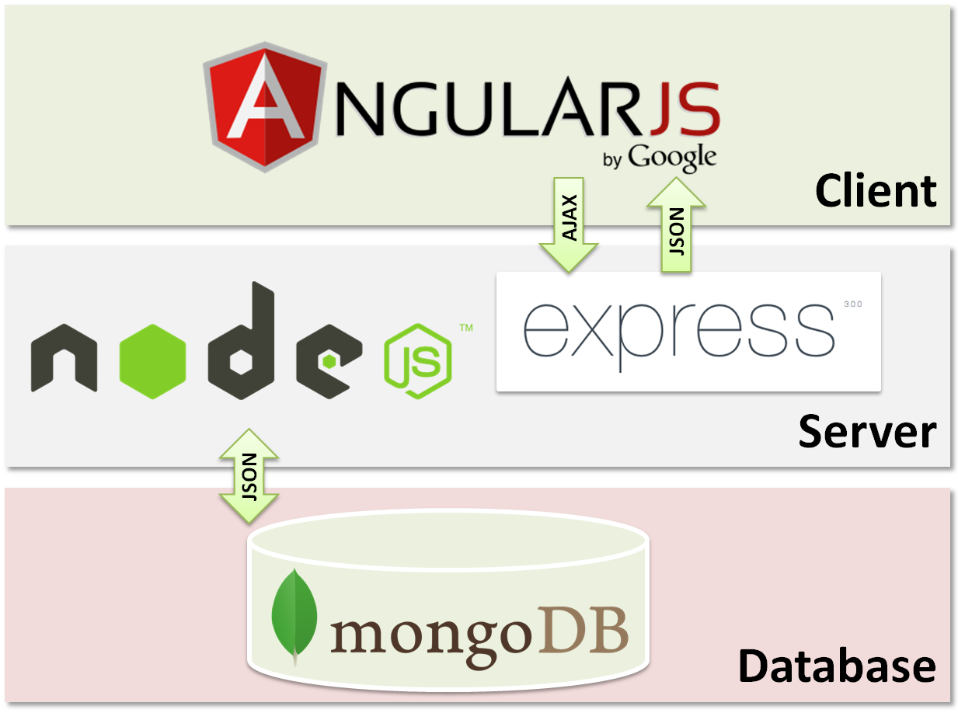


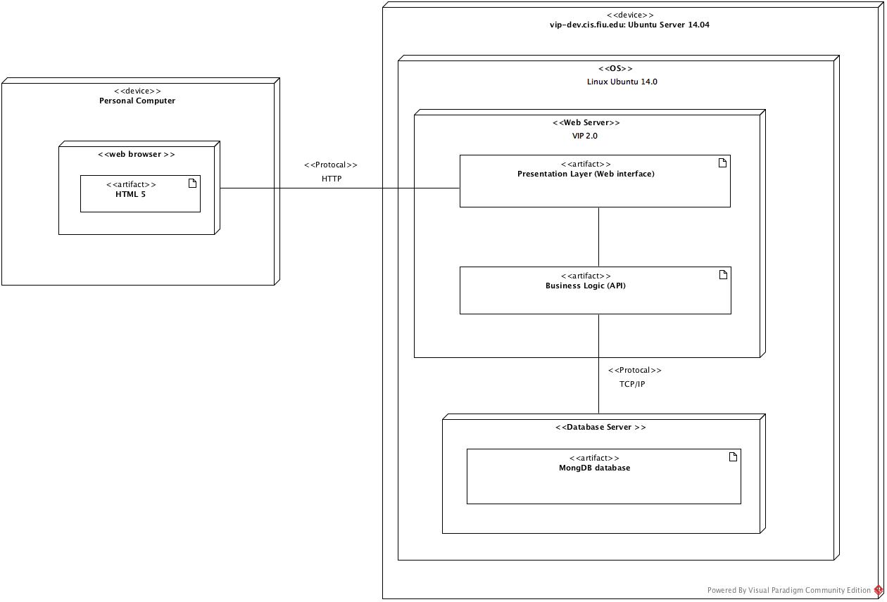
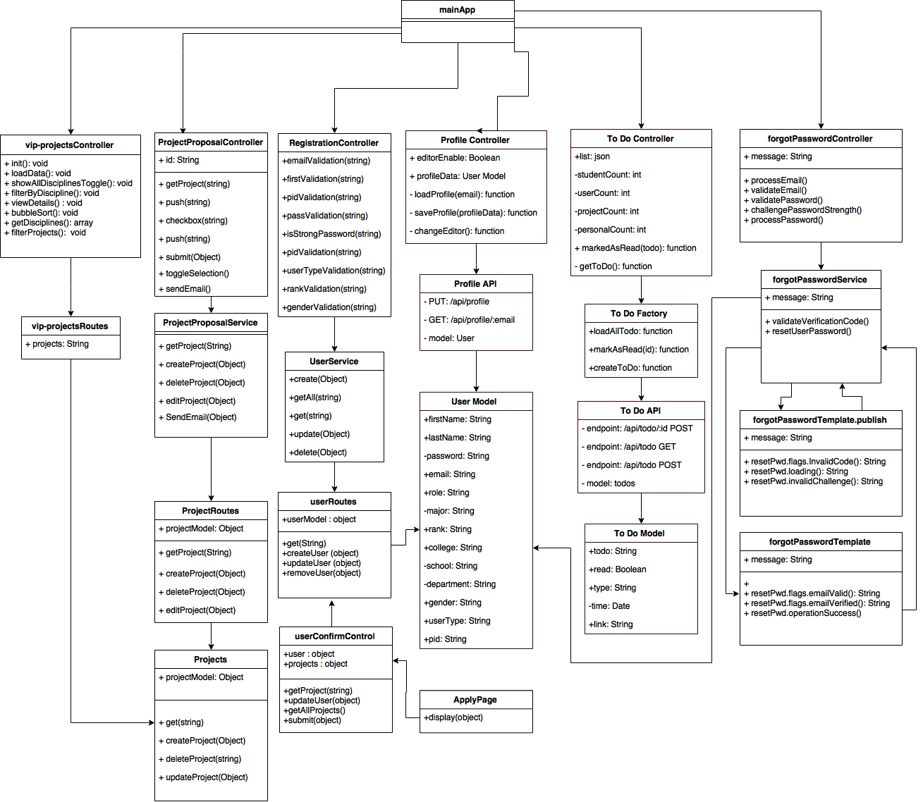
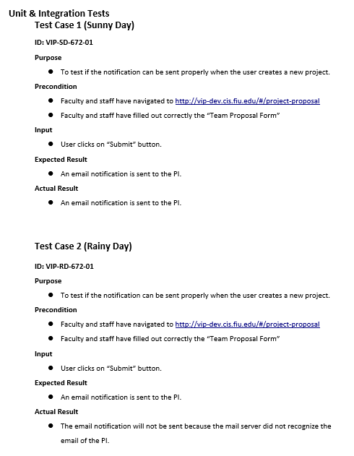
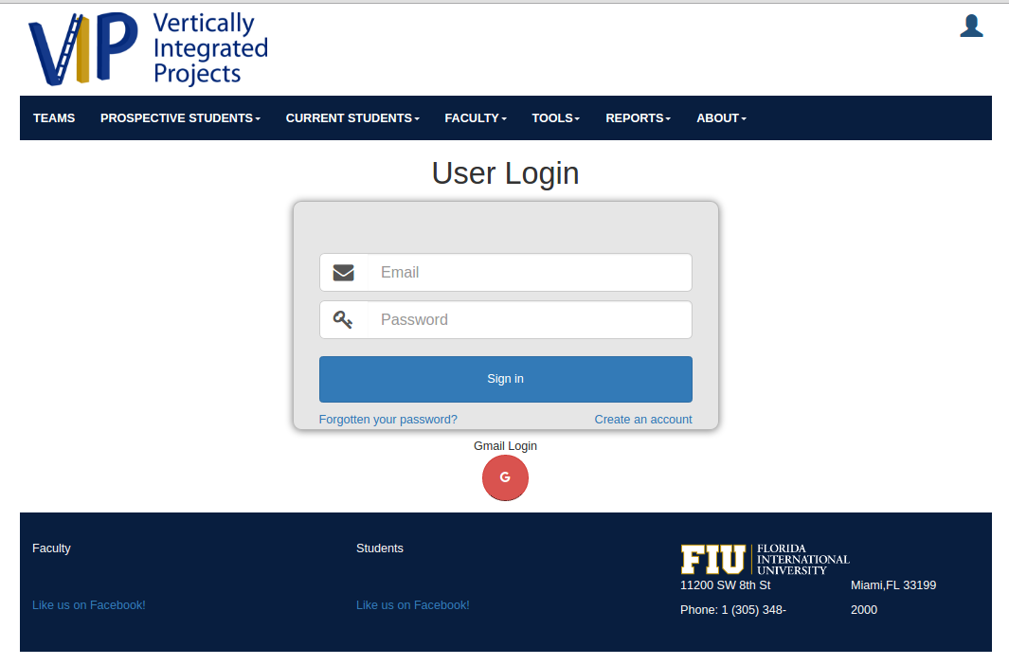
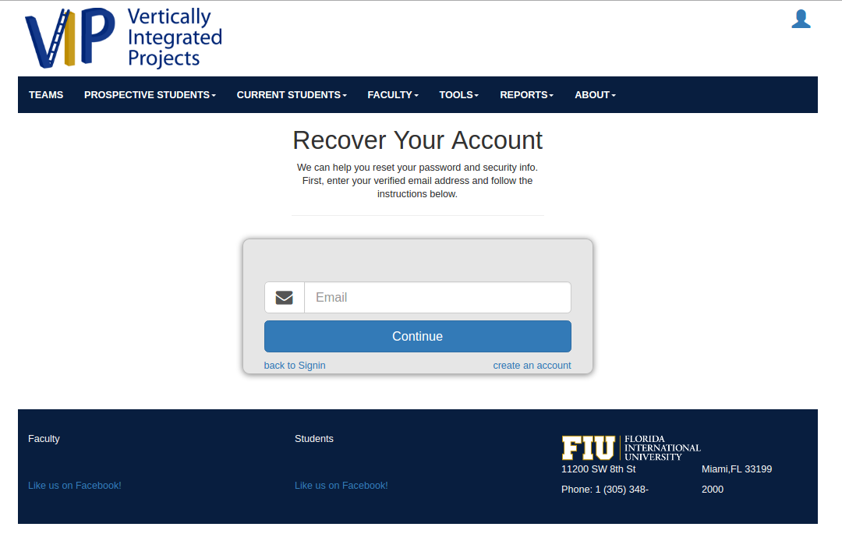
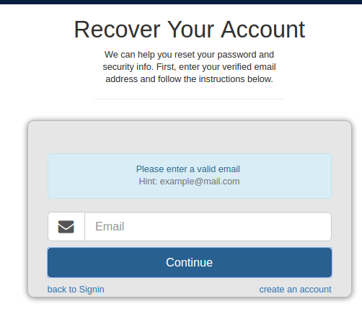
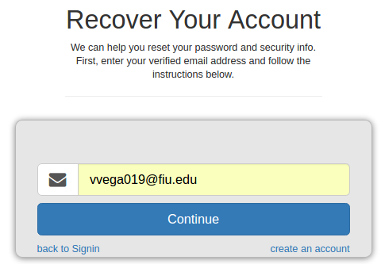
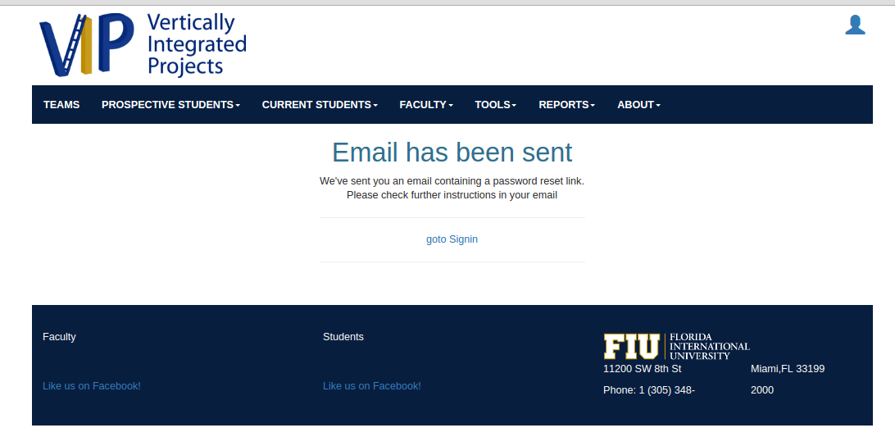
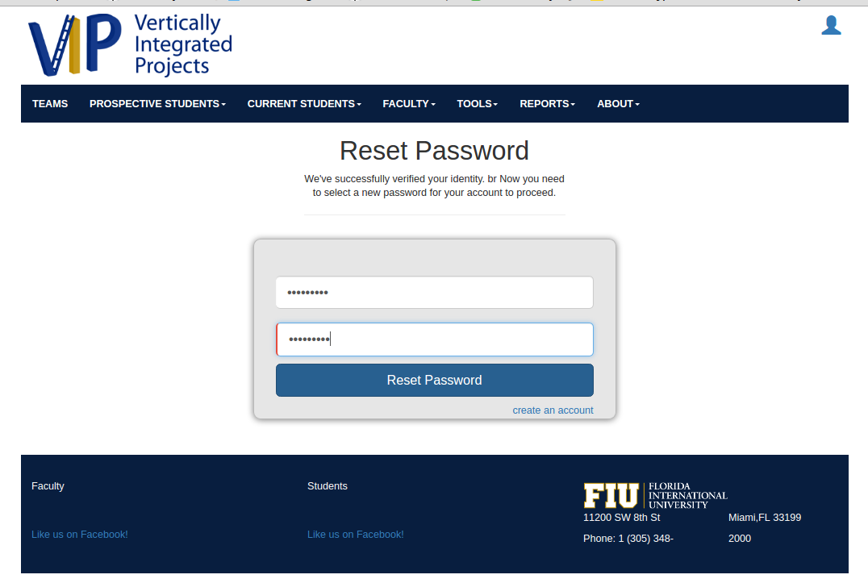
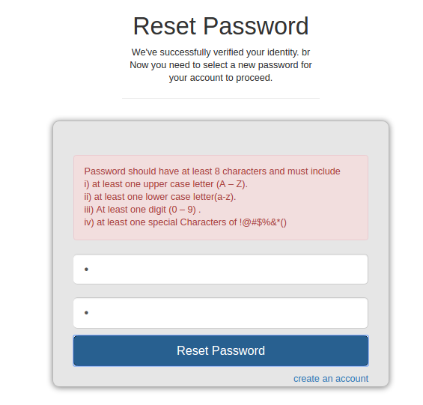
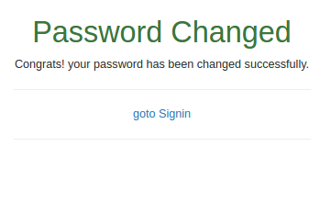
Other Related Logos
School of Computing & Information Sciences
Senior Project, 2016, Spring
<Vertically Integrated Projects 2.0>
Student: Victoriano Vega, Florida International University
Mentor: Masoud Sadjadi, Ph.D. Florida International University
Instructor: Masoud Sadjadi, Florida International University
Problem
Using cross-functional teams to break down silos improves the chances of success when building highly complicated systems. When information can be accessed instantly from almost anywhere, without wasting resources on data extraction and tying data from different sources together, system developers are better informed and can make more accurate, faster decisions.
Current System
The current system allows students and faculty to:
Register
Log in
Manage their profile
view projects and
View schedules and To Do List.
Faculty users can also propose new projects for students to work on.
Users are able to view information about current real world problems.
Students of all ranks are involved
They will then be able to work side by side with industry
Assist with real world research problems.
Requirements
The system shall allow for users, depending which role the user has, to be able to:
Register
Login
Apply for projects
Edit your own projects
View currently active projects
Accept/Reject project proposals
Edit user profile
View task that needs to be completed
Receive Project Proposal Notification
Change Forgotten Password
Solution
The Vertically-Integrated Projects (VIP) Program is an engineering education program that operates in a research and development context.
Multidisciplinary teams
mix of sophomores through PhD students each term
students at all levels can learn about a research
can generate new research ideas
System Design
Object Design
Implementation
Performance
Support from community and industry leader
Written in JavaScript
All contents are open Source
Supports MVC architecture
Node.js simplifies the server layer
Big companies are moving to Node.js: Walmart, PayPal
Developed and maintained by Google developers
MongoDB is understood by JavaScript
Runs on almost any platform
f2
My Role
Export Grades
Testing Mobile Judge 8.0
View About VIP Page
View VIP Syllabi Information
Receive Project Proposal Notification
Change Forgotten Password
Verification
Screenshots
Summary
Improved version VIP 2.0
Allow students to start the process of getting involved in a team
Beneficial to apply Software Engineering
Agile software development
Complete feasibility study
Lead to requirements elicitation
Software Requirement Specification
Software Requirement Validation
VIP 2.0 release
Thanks
Acknowledgement
The material presented in this poster is based upon the work supported by Tiago Moore, Andres Villa, Steven Rowe, Victoriano Vega, Rodolfo Viant, and Jorge Perez. I am thankful to the help that I received from my group members, … .
Notes:
1

