Slide 1












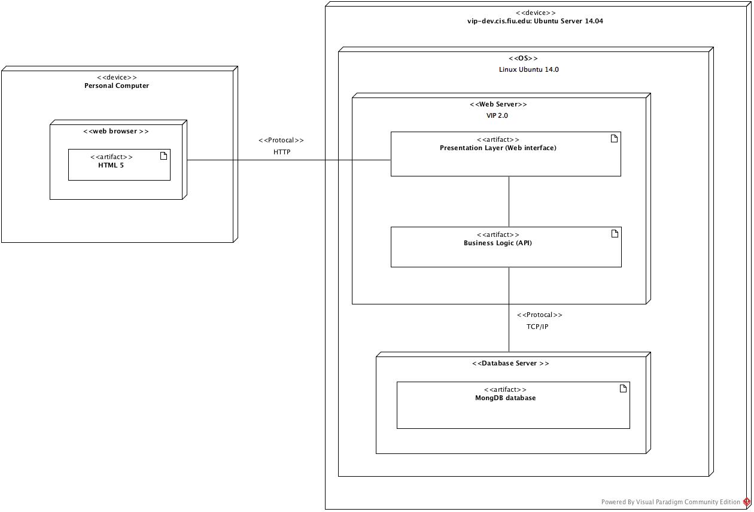
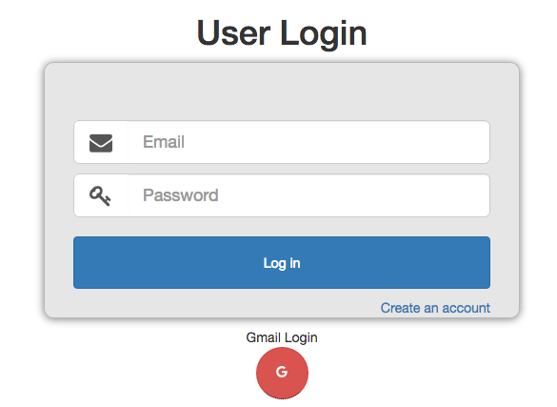
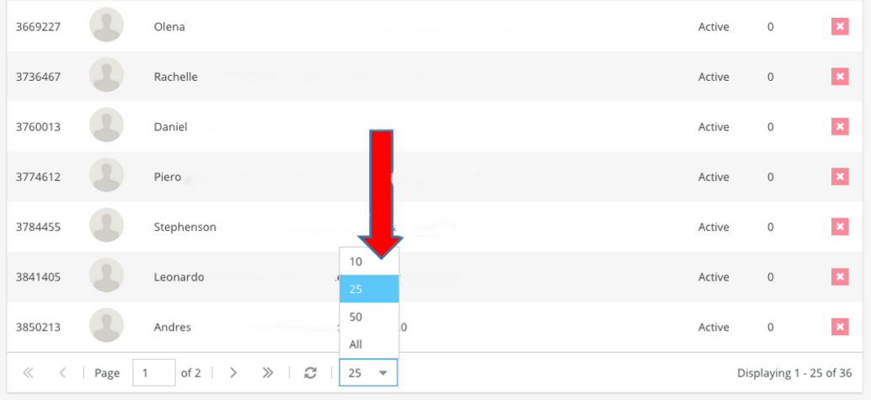
School of Computing & Information Sciences
Senior Project, 2016, Spring
VIP 2.0
Student: Jorge Perez, Florida International University
Mentor: Masoud Sadjadi, Ph.D, Florida International University
Instructor: Masoud Sadjadi, Ph.D, Florida International University
Problem
Current System
Requirements
There is a disconnect between the undergraduate student body and the faculty research that goes on in universities across the country. The problem is therefore twofold – students don’t know of the opportunity to use the skills acquired while pursuing a degree, while faculty research could directly benefit from having access to the undergraduates that can aid in real world research.
The current system allows students and faculty to register, login, manage their profile, view projects, schedules. Faculty users can also propose new projects for students to work on. Users are able to view information about current real world problems and see which one sparks their interests. Students of all ranks are able to select and join a project where they will then be able to work side by side with industry leaders and assist with real world research problems.
The system shall allow for users, depending which role the user has, to be able to
Register
Login
Logout
Apply for projects
Edit your own projects
View currently active projects
Accept/Reject project proposals
Edit user profile
View task that needs to be completed
Solution
My Role
Vertically Integrated Projects (VIP) aims to unite undergraduate education with faculty research. This allows for the undergraduate population to use their acquired skills to aid the real world research that is going on within the university itself. VIP also gives faculty a way to communicate and coordinate their projects directly to their own student population.
Scrum Master
Setup database and schema
Provide access matrix
Manage List Sizes
Setup Server Monitoring
System Design
Object Design
Implementation
The system employs a 3 tier client-server architecture. A user will connect to our server using a HTTP protocol and will be served the index.html file located in the presentation layer. All logic is located in the business logic area and it communicates with a mongo database located on the same server using a TCP/IP protocol.
HTML5/CSS3 was used for designing the layout and UI components.
AngularJS allowed us for rendering pages dynamically using Javascript.
MongoDB and MariaDB was used for our database to hold our consistent data
Sencha was used for mobile support as well as cross browser support
NGINX and NodeJS was used as our server where we were able to run all of our API.
Passportjs and Oauth2 was used to handle the login/logout of the system with different website credentials
Verification
Screenshots
Summary
Test Cases
Purpose
Ensure that the list size button changes the size of the list displayed
Precondition
User has logged in and gone to People Page
Input
User clicks List Size Button
Expected Result
List size changes to desired result
Actual Result
List Size changes to desired result
Test Cases
Purpose
Ensure that user is notified when login credentials don’t match
Precondition
User has reached the VIP login page
Input
User inputs something other than password
Expected Result
Form notifies user that username and password don’t match system
Actual Result
Form notifies user that username and password don’t match system
This project is the second version of a system that will be in the works for years to come. This version allows students to start the process of getting involved in a unique team outside of their curriculum classes. It has been very beneficial to apply software engineering methodology to such a unique system Developing this project began with a feasibility study which lead to requirements elicitation and documentation and finally system design. This was followed by an iterative cycle of object design, implementation, and verification which finally resulted in an unique system which allows students to join Vertically Integrated Projects
Acknowledgement
The material presented in this poster is based upon the work supported by Jorge Perez. I am thankful for the wonderful team I worked with all semester (Tiago Moore, Victoriano Vega, Steven Rowe, Miguel Conde, Andres Villa, and Rodolfo Viant).
Notes:
1

