Slide 1
VIP 2.0
Team Members:
Tiago Moore, Victoriano Vega, Steven Rowe,
Jorge Perez, Andres Villa, Miguel Conde, Rodolfo Viant Product Owner:
Masoud Sadjadi Instructor:
Masoud Sadjadi
School of Computing and Information Sciences Florida International University
Senior Project Final Presentation Spring 2016
4/25/2016
Notes:
Greet your audience, thank them for attending your presentation, introduce yourself, introduce your project, introduce your team members, and quickly indicate what each of you did in a high-level manner, and put more emphasis on your part/contribution.

Slide 2
Problem Definition
Our Project
Mobile Judge is a web application that is built more for mobile devices to be the primary use. Mobile Judge is the application that judges will be using to score students during the senior project showcase.
Current Problems
My Part
Lacked the ability to accept/reject grades
View/update user profile page
Ability for admin to filter email selections
Social media account linking
Pagination on all grids
Export grades/judges
Import Students
Manage Student/Judges information
Implement Docker CI
Filter emails and maintain states
Linking/Unlinking logins
Notes:
Introduce the problem that the whole project tackles and stay focused on the parts that you have been working. Indicate if there is an existing previous system, enumerate its problems/limitations, etc.

Slide 3
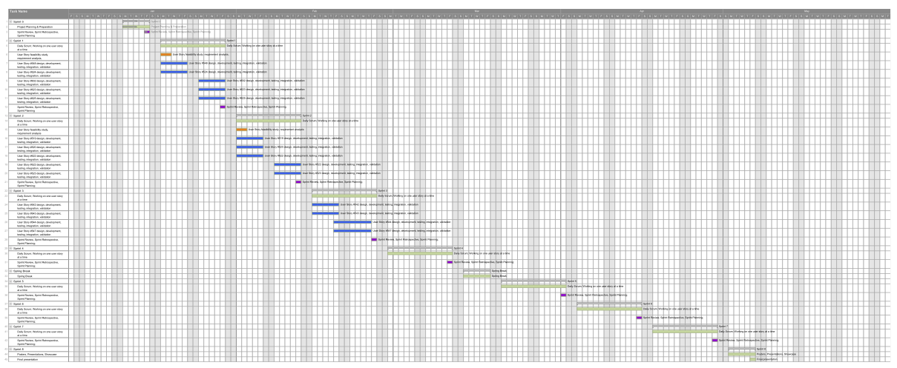
Full Gantt chart

Slide 4
System Design: Architecture
3-tier architecture and Client-Server
Security/Privacy
Oauthd authentication
Hashing and salting of passwords
Sanitizing user input
Token based authentication (bcrypt)
Notes:
5. System design:
5.1. System decomposition; identify the architecture patterns used (one slide).
5.2. System deployment – h/w and s/w requirements (one slide).
5.3. Persistent data design (one slide).
5.4. Security/Privacy (one slide).

Slide 5
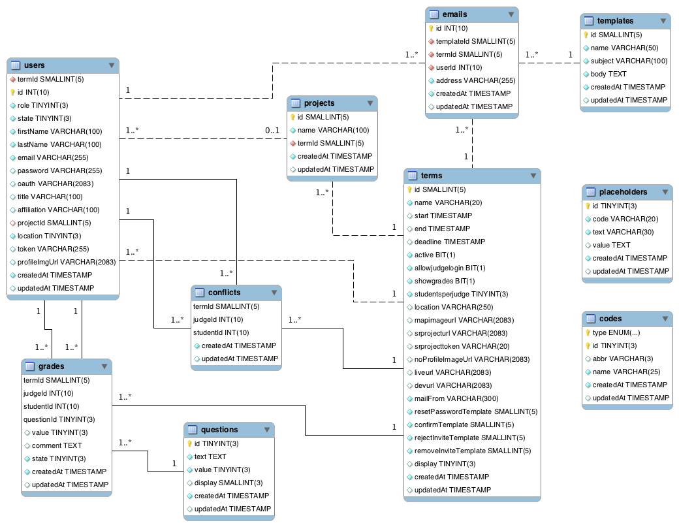
System Design: Persistent data design
Notes:
5. System design:
5.1. System decomposition; identify the architecture patterns used (one slide).
5.2. System deployment – h/w and s/w requirements (one slide).
5.3. Persistent data design (one slide).
5.4. Security/Privacy (one slide).

Slide 6
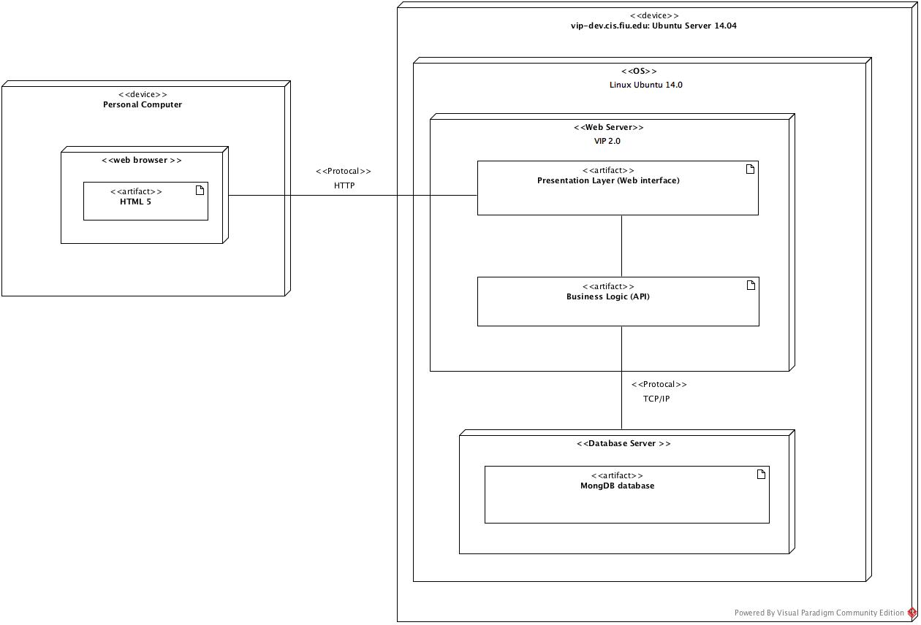
System Design: Deployment
Notes:
5. System design:
5.1. System decomposition; identify the architecture patterns used (one slide).
5.2. System deployment – h/w and s/w requirements (one slide).
5.3. Persistent data design (one slide).
5.4. Security/Privacy (one slide).

Slide 7
Requirements: User Stories
#547-Implement Docker CI
#523-Add Search Feature to Email Wizard
#519-Link Login Accounts
#622-Unlink Accounts
#623-Visualize Linked/ Unlinked Accounts
Notes:
4. Requirements:
4.1. User stories implemented (one or more slides).
4.2. UML use cases and the use case diagram for the implemented use cases (one or more slides).
4.3. UML sequence diagrams for the implemented use cases.

Slide 8
Requirements: Use Cases
Notes:
4. Requirements:
4.1. User stories implemented (one or more slides).
4.2. UML use cases and the use case diagram for the implemented use cases (one or more slides).
4.3. UML sequence diagrams for the implemented use cases.

Slide 9
Minimal Class Diagram
Notes:
6. Detailed design:
6.1. Minimal class diagram. Identify the design patterns used (one or more slides).
6.2. State machine for the main control object or the most important object of the implemented uses cases (one or more slides).
6.3. Main algorithm used related to an implemented use case described above (one or more slides).

Slide 10

Requirements: Use Cases
#622-Unlink Accounts
Details:
Actor: User
Pre-conditions:
User has successfully logged onto the system.
User is using the Profile feature.
An account has to be previously unlinked.
A checkbox will display a linked account.
Description:
Use case begins when the admin clicks his name or picture.
The system shall indicate which accounts are currently linked.
The User shall click the icon for the account he would like to unlink.
The system will prompt with a confirmation alert.
Post-conditions:
The account will be unlinked until it is relinked.
Alternate:
The database access will manually remove linked accounts.
Notes:
4. Requirements:
4.1. User stories implemented (one or more slides).
4.2. UML use cases and the use case diagram for the implemented use cases (one or more slides).
4.3. UML sequence diagrams for the implemented use cases.

Slide 11
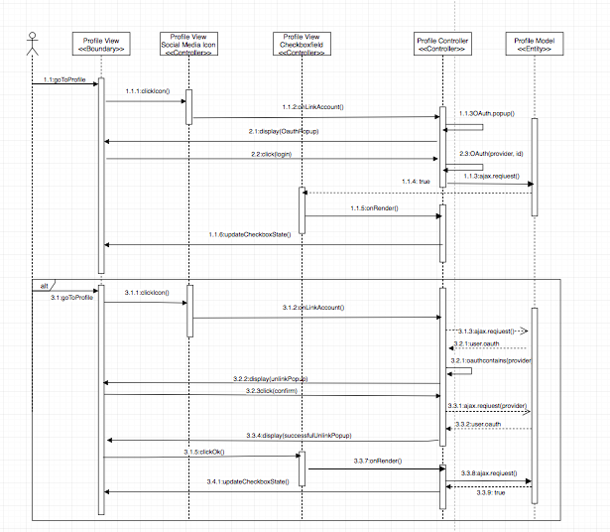
Requirements: Sequence Diagrams
#622-Unlink User Accounts
Notes:
4. Requirements:
4.1. User stories implemented (one or more slides).
4.2. UML use cases and the use case diagram for the implemented use cases (one or more slides).
4.3. UML sequence diagrams for the implemented use cases.

Slide 12
Interesting Algorithm
oauthList = Get current.user oauth value
for(oauthKey in oauthList)
if(oauthKey === provider)
userOauth = Get value at oauthKey
if(userOauth!=='')
Alert “Warning, <provider> account already linked. Would you like to unlink it?”
if(user clicks yes)
Delete provider key from oauthList;
Store current.user.oauth(oauthList)
success(resp)
Alert "Success! <provider> account has been unlinked”
var checkbox = Get provider’s respective checkbox
deselect checkbox
Notes:
7. Test Suites and Test Cases (one sunny day and one rainy day) for the use case represented in part (5) above (2 slides).
7.1 One sunny day and one rainy day for the implemented use cases (one or more slides).
7.2 Automated test scripts for the implemented use cases (one or more slides).

Slide 13
Test Cases - #622 Unlink Login
Sunny Day
Purpose
Test if account is properly unlinked.
Precondition
User has previously linked accounts.
Input
User clicks on social media icon.
Expected Result
A pop up window comes up for confirmation
The social media account is unlinked.
Actual Result
A pop up window comes up for confirmation
The social media account is unlinked.
Notes:
7. Test Suites and Test Cases (one sunny day and one rainy day) for the use case represented in part (5) above (2 slides).
7.1 One sunny day and one rainy day for the implemented use cases (one or more slides).
7.2 Automated test scripts for the implemented use cases (one or more slides).

Slide 14
Test Cases - #622 Unlink Login
Rainy Day
Purpose
Account unlink fails
Precondition
User has successfully logged onto the system.
User is using the Profile feature.
The user clicks no on unlink confirmation prompt
Input
User clicks on social media icon
User clicks no on confirmation prompt
Expected Result
A pop up window comes for confirmation.
The user account does not get unlinked to the social media account.
Actual Result
A pop up window comes for confirmation.
The user account does not get unlinked to the social media account.
Notes:
7. Test Suites and Test Cases (one sunny day and one rainy day) for the use case represented in part (5) above (2 slides).
7.1 One sunny day and one rainy day for the implemented use cases (one or more slides).
7.2 Automated test scripts for the implemented use cases (one or more slides).

Slide 15
Thank you!
Contact information:
Andres Villa email: Avill152@fiu.edu
Notes:
Summarize your contribution
Include your contact information
Ask if anyone has any questions for you.
Thank your audience

